Slide 1
Mars:
A Magnetic History
Sabine Stanley
Johns Hopkins University

Slide 2
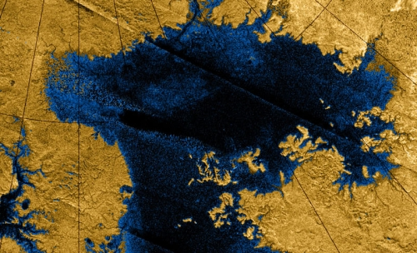
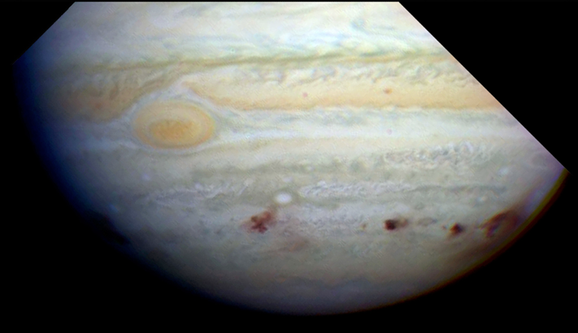
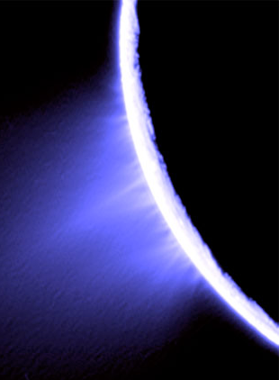
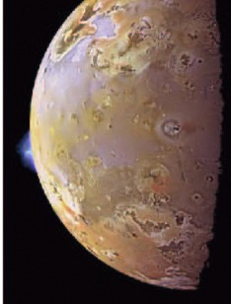
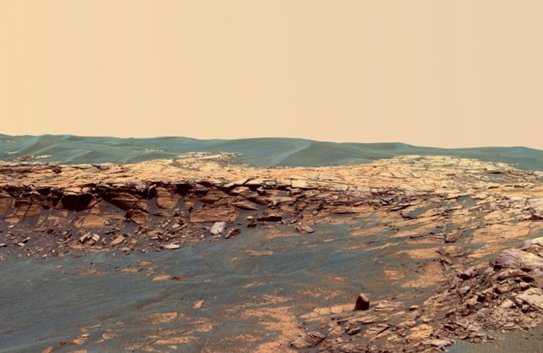
Planetary Science
over the past few decades, spacecraft missions have provided
stunning observations and information about planets
Titan’s ethane
lakes
Enceladus
geyser
Shoemaker-Levy 9 impacting Jupiter
geysers
on
Enceladus
water on Mars
volcanoes
on Io

Slide 3
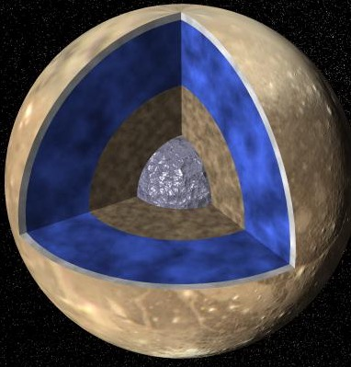
Planetary Science
most of the information is about features & physical processes near
the surface
the deeper inside the planet, the less we know
its HARDER to get info on the
deep interior, because we need
processes in the interiors to
produce observables at the
surface
one process that occurs in the
deepest regions of some planets
and is observable is:
magnetic field generation
Titan ethane lakes
volcanoes
on Io

Slide 4
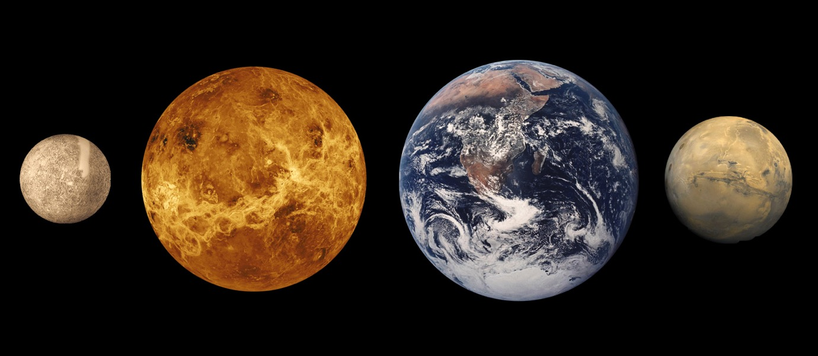
Terrestrial planet comparison
about half the size of Earth
Mars has a core, mantle and crust like other terrestrial planets
and although its small…

Slide 5
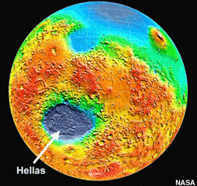
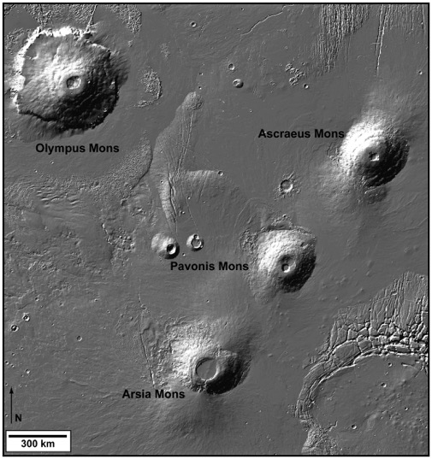
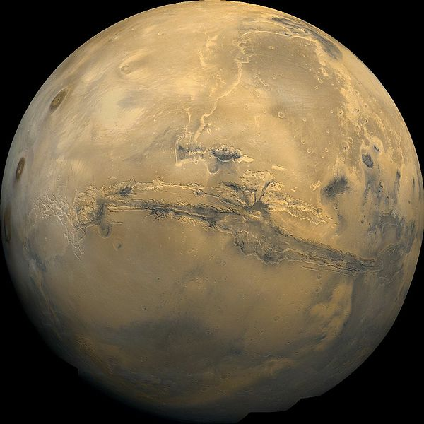
XL surface features
large impact craters: Hellas & Argyre
Tharsis volcanic province
Valles Marineris

Slide 6
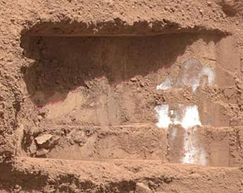
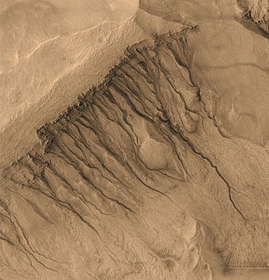
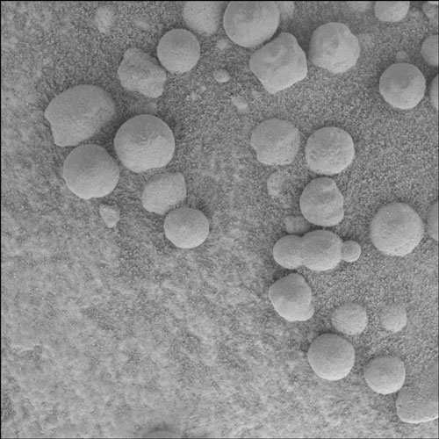
Lots of new data
recent missions: MGS, Mars Express, rovers, MAVEN, …
mapping of topography, gravity, surface composition, magnetic fields
local in-situ analysis of rocks, ice
Mars today:
no surface liquid
water, thin atmosphere
Mars in early history:
surface liquid water,
thick atmosphere

Slide 7
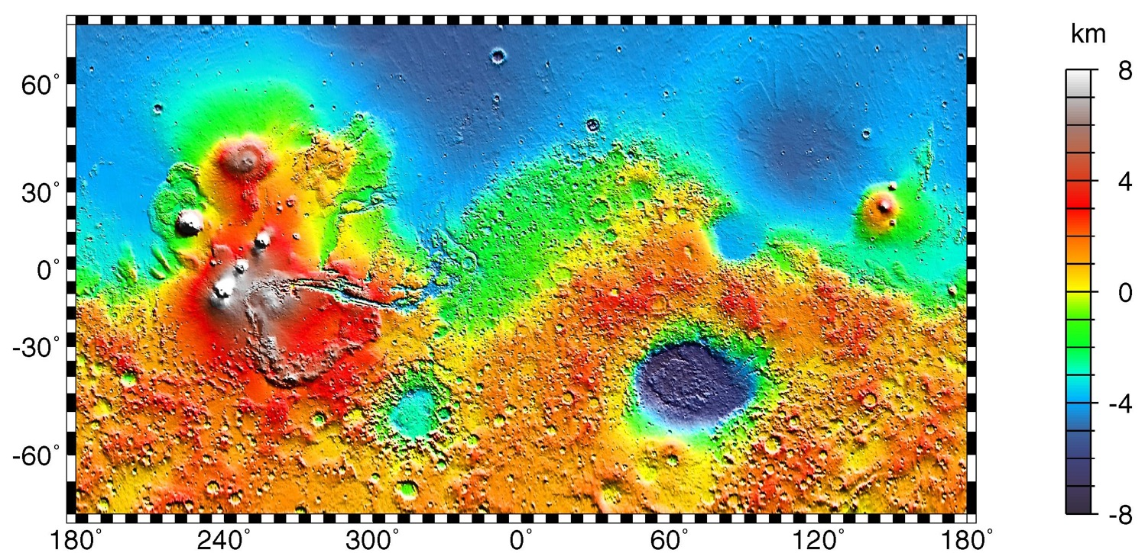
Mars topography
hemispheric crustal dichotomy: north: low
south: high
can also see Tharsis, Valles Marineris, large impact craters

Slide 8
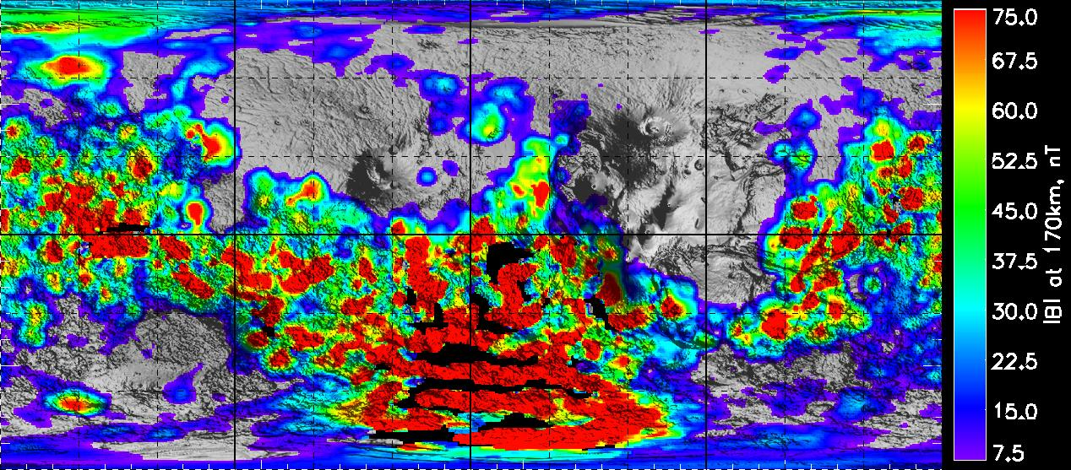
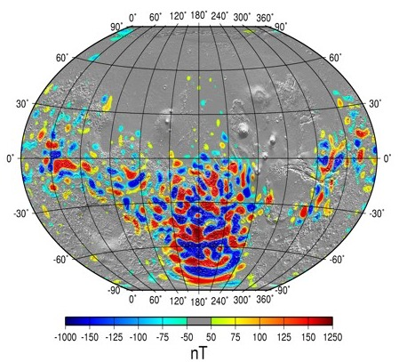
Mars magnetic field
extremely strong localized
crustal magnetism

Slide 9
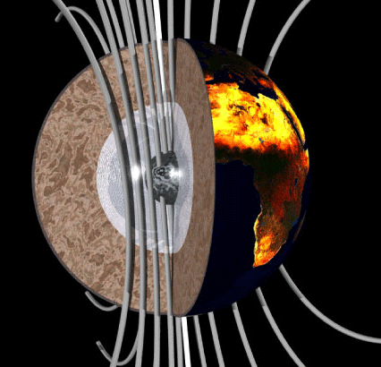
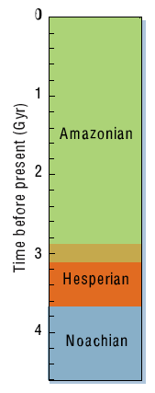
Mars: A Magnetic History
magnetic fields especially useful because:
(1) source is deep, but can be observed with spacecraft
→ can probe deep interior
(2) rocks can record past magnetic fields
→ can probe history
magnetic fields
observed here
magnetic fields
generated here

Slide 10
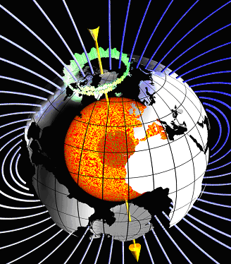
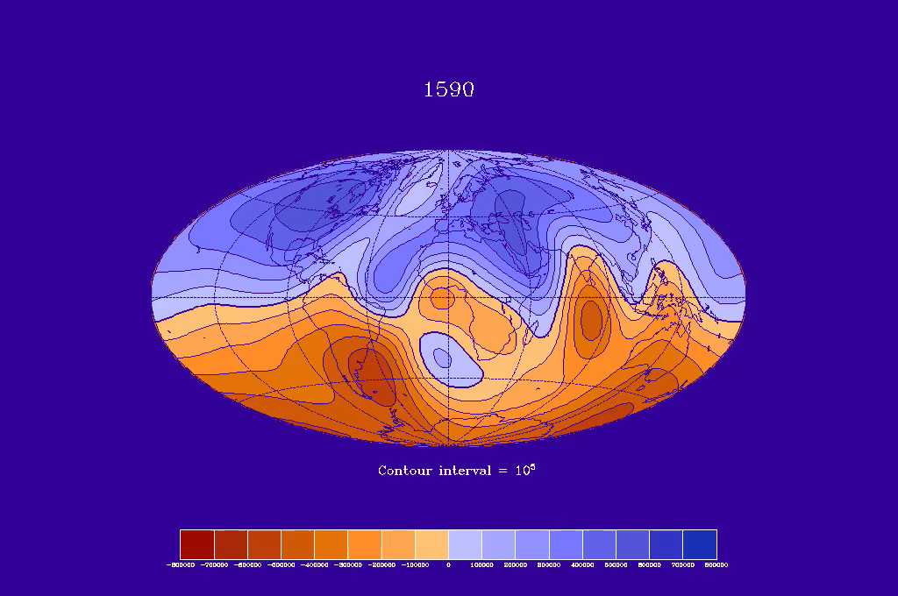
Earth magnetism
axial dipole dominated
reversals
variable in time

Slide 11

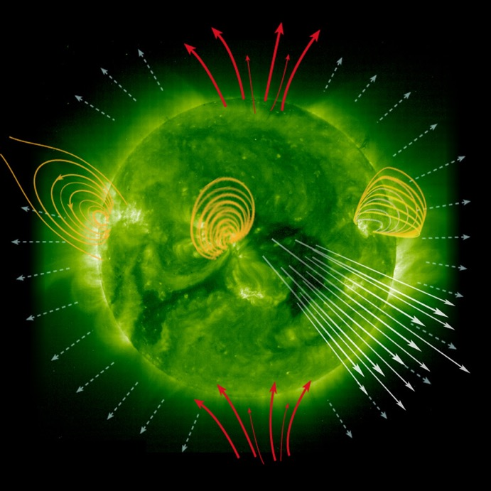
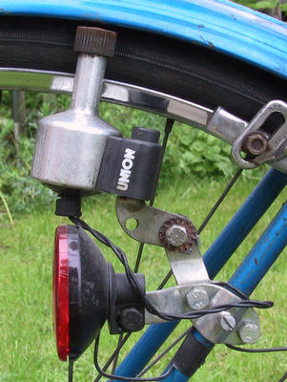
Dynamo generation
conversion of mechanical energy (motion) into electromagnetic energy
occurs in some planets, stars, galaxies, generators, bicycles…

Slide 12
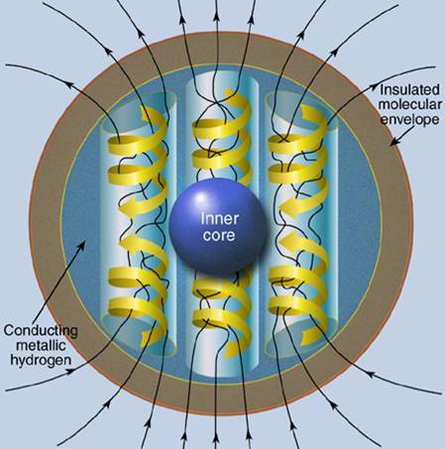
Planetary Dynamo Ingredients
complex
motions
+
electrically
conducting
fluid
+
presence
of a
magnetic field
maintain
field against
Ohmic decay
(image courtesy
NASA Goddard)

Slide 13
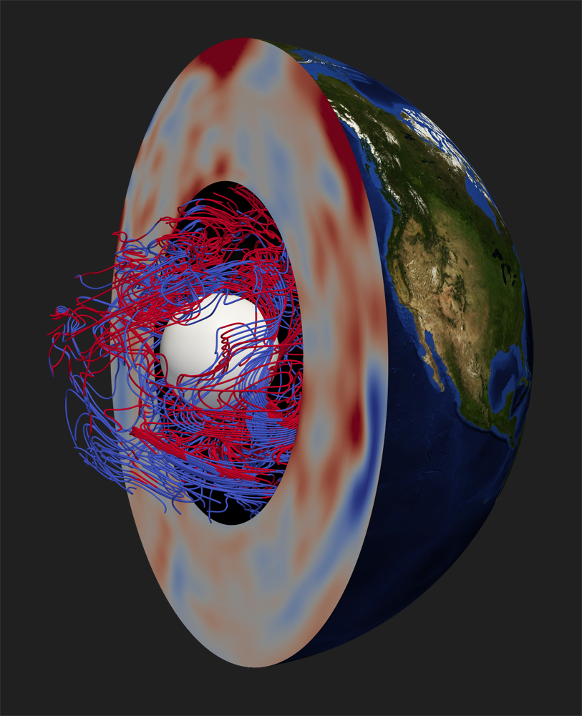
Dynamo generation
(1) electrically conducting fluid
liquid iron (terrestrial planets)
metallic hydrogen (gas giants)
ionized water (ice giants)
(2) fluid must have complex motions
lots of twisting, helical
rotation not required, but helpful in producing large-scale field
(3) motions must be vigorous enough
Velocity * Size * Conductivity
must be big enough

Slide 14
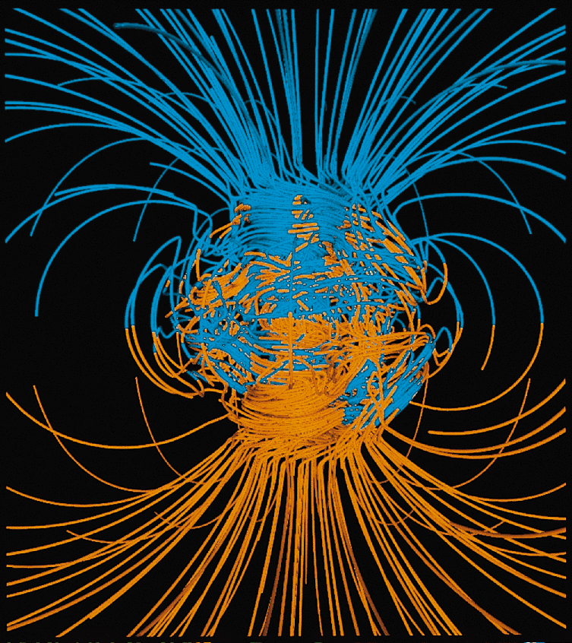
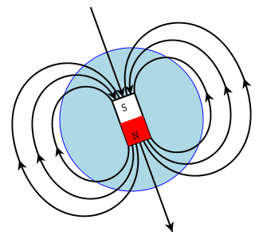
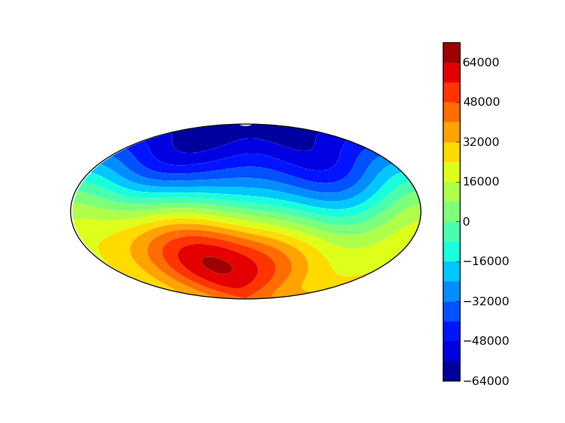
Earth’s Magnetic Field
We can only observe the field outside the surface.
We try to infer what goes on in the dynamo source region
http://www.es.ucsc.edu/~glatz/index.html
field in the source region likely very complicated
observed field at the surface very dipolar

Slide 15
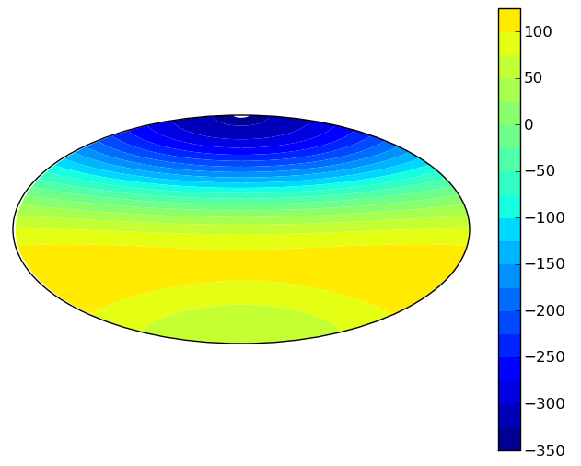
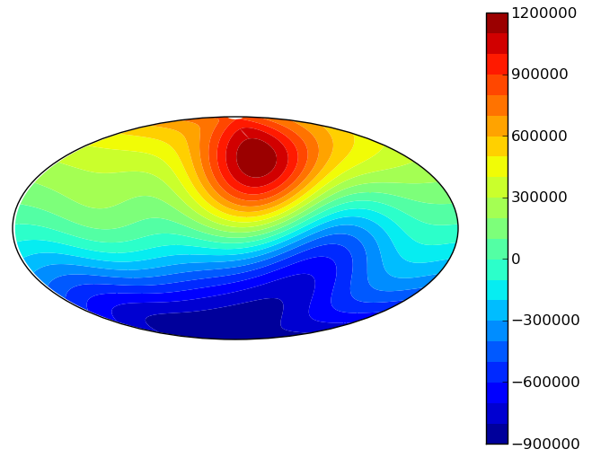
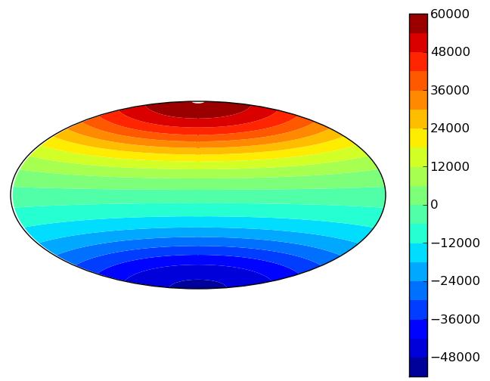
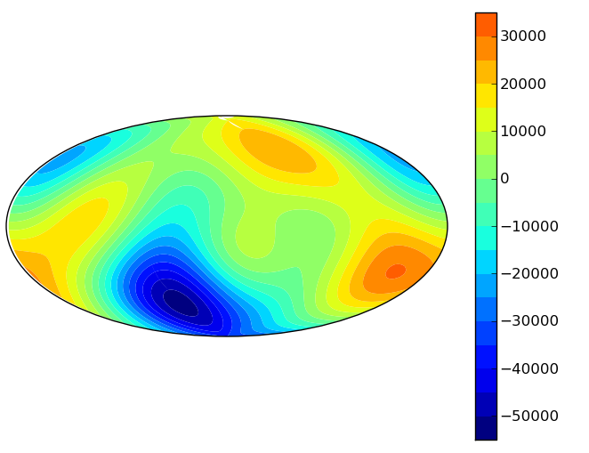
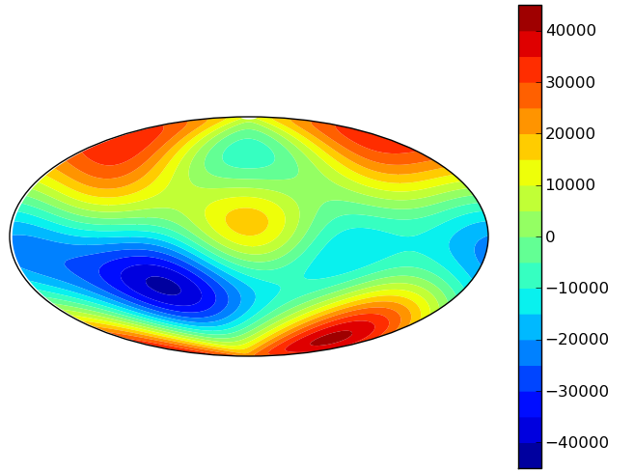
Magnetic Field Diversity
Mercury
nT
Mercury
Earth
Jupiter
Saturn
Uranus
Neptune
& Ganymede (not enough info for a figure)
there are similarities & differences which are linked to interior properties

Slide 16
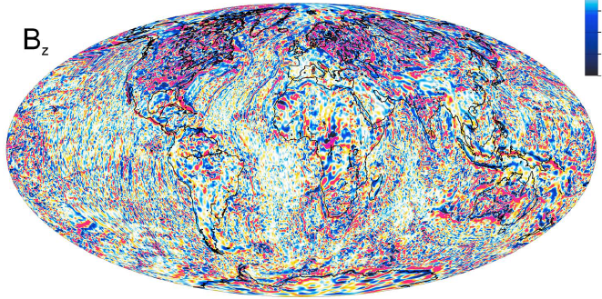
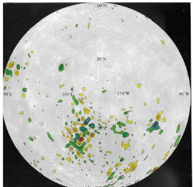
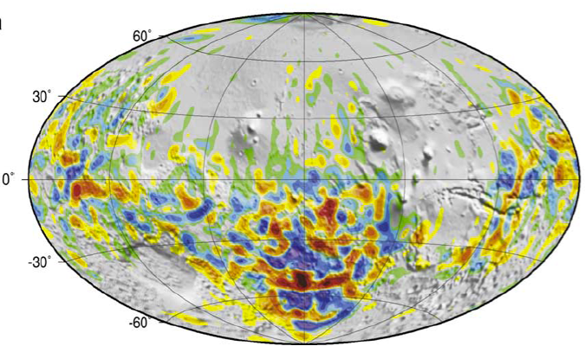
Evidence of Past Dynamos
Earth @ surface
Mercury
Johnson et al. (2015)
Maus (2010)
Planetesimals & Asteroids
Mars @ 200km
Langlais et al. (2004)
Moon @ 30km
Weiss et al. (2008)
Richmond & Hood (2008)

Slide 17
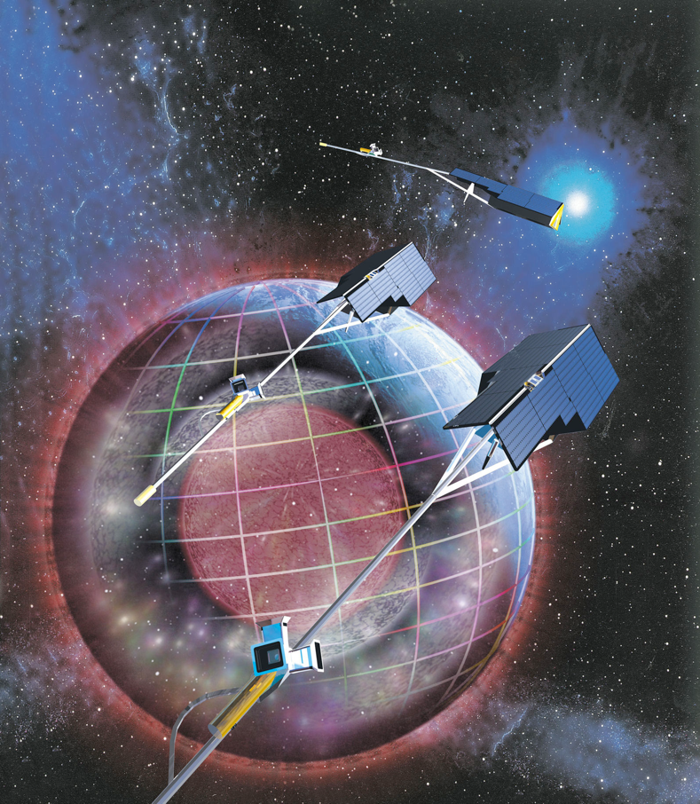
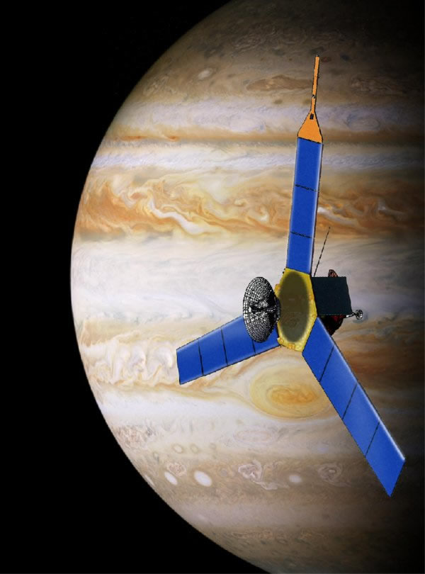
Studying Planetary Magnetic Fields
observations from spacecraft
SWARM
JUNO

Slide 18
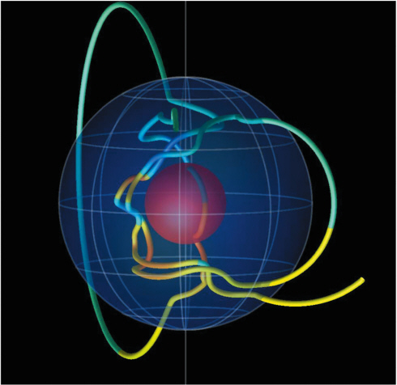
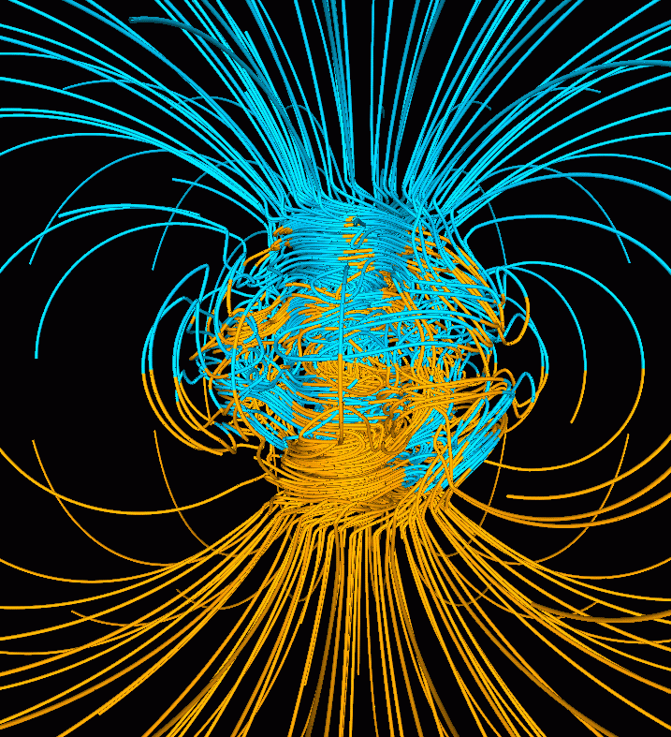
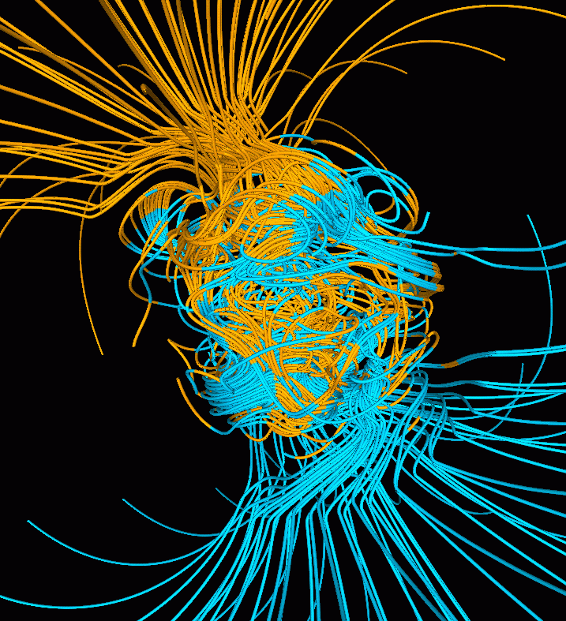
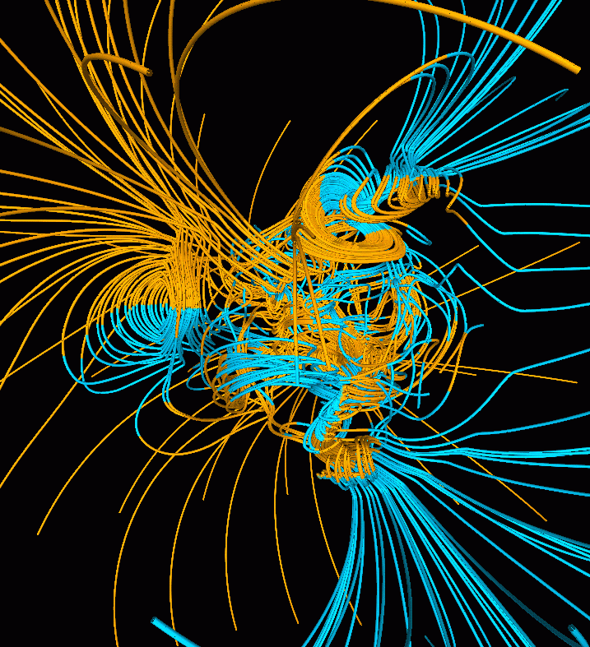
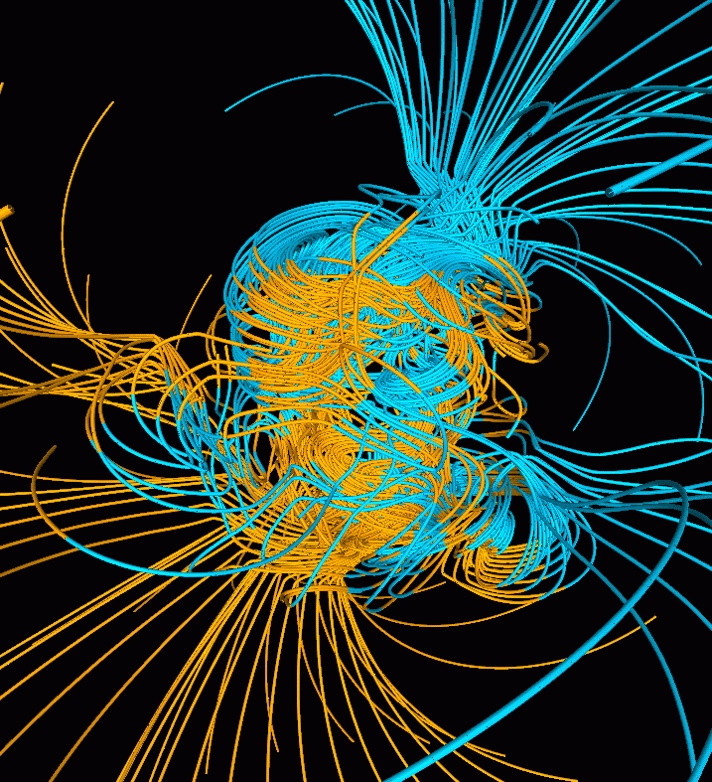
Studying Planetary Magnetic Fields
Computer simulations of dynamo generation

Slide 19
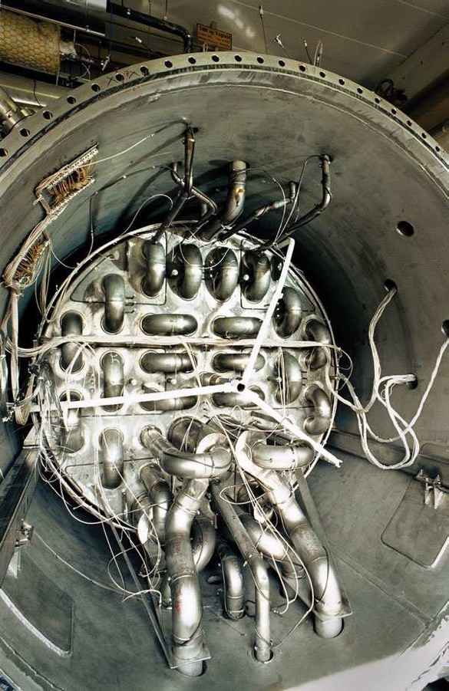
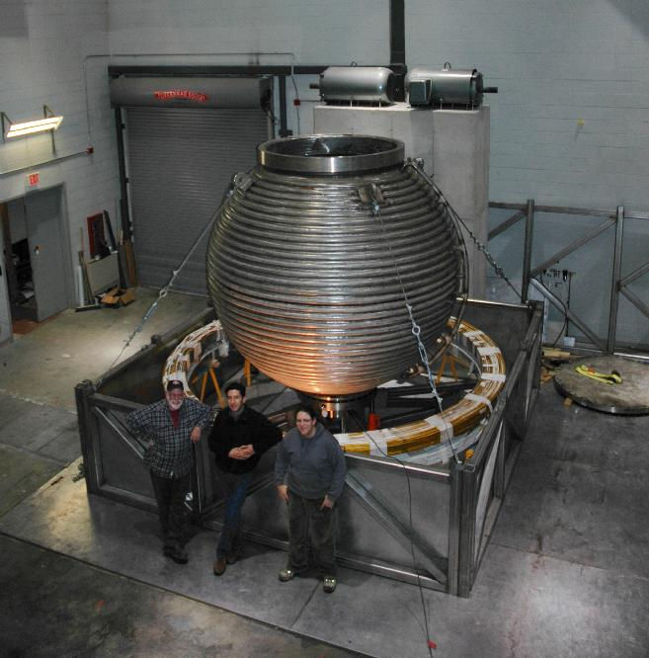
Studying Planetary Magnetic Fields
Dynamo Experiments:
Karlsruhe dynamo
Dan Lathrop’s planetary dynamo @
University of Maryland College Park

Slide 20
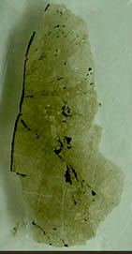
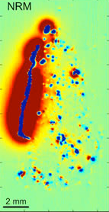
Studying Planetary Magnetic Fields
Paleomagnetism: investigating magnetic fields frozen into rocks
Martian meteorite ALH84001 sample
SQUID microscope scan of magnetic field in sample
Weiss et al. (2008)

Slide 21
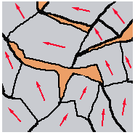
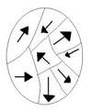
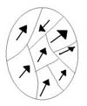
Rock Magnetization
rocks are made up of different minerals
broken up into grains
some are magnetic
if there is no dynamo-generated field,
magnetic fields will be random and
cancel on average over the rock
if there is a dynamo-generated field,
magnetic fields will preferentially
align with background field and we
observe a crustal remanent field
when rocks cool from lava, they align
their grains’ dipoles with the
field present at that time
B₀

Slide 22
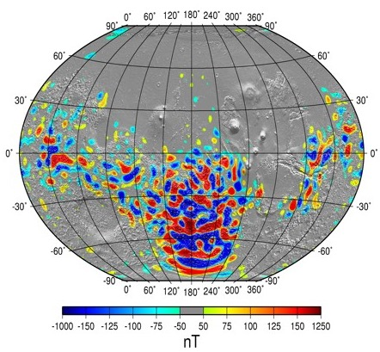
Mars’ crustal magnetic field
magnetic fields frozen into rocks as they cooled in presence of a dynamo
fields missing in large impact craters and on Tharsis → dynamo was ‘off’ by 3.9Ga
crustal fields are ancient, strong and concentrated in southern hemisphere

Slide 23

Mars’ crustal dichotomy
northern hemisphere: low, crust is thin, covered in sediments
southern hemisphere: high, crust is thick, devoid of sediment cover

Slide 24

Magnetism/Dichotomy correlation
crustal magnetic field appears to correlate with the dichotomy boundary
We asked the question: can the formation mechanism for the crustal dichotomy explain the magnetic field?

Slide 25

Mars dichotomy formation
2 possibilities:
(1) hemispheric
convection
DLR/NASA/JPL
(only upwelling shown)

Slide 26


Mars dichotomy formation
(2) Giant Impact
Topography today
removing effects of Tharsis

Slide 27

Implications for interior temperature
Why does the dynamo care?

Slide 28
‘Normal’ planetary dynamos
Normal dynamos produce dipolar fields aligned with rotation axis
field intensity ~equal but opposite direction in each hemisphere
B_{r} at Surface

Slide 29

Mars dynamo model
Asked: what effect would a hemispheric outer boundary thermal condition have on the dynamo?
Why do we think this might have effect?
Convective motions in core driven by temperature differences

Slide 30
Results: magnetic field
Mars dynamo
normal dynamo

Slide 31


Implications:
If Mars’ ancient dynamo produced a magnetic field with this morphology:
are there implications for Mars’ ancient atmosphere/water/life?
How did Mars go from to

Slide 32

Atmosphere and Water
currently, low atmospheric pressure → liquid water not stable at surface
signs of ancient flowing surface water require a higher atmospheric
pressure (a ‘thicker’ atmosphere) in past
the atmosphere must have
eroded away to produce the
current thin atmosphere
atmospheric erosion processes:
  solar wind erosion
  impact erosion

Slide 33

Magnetic Fields & Erosion
when dynamo active, magnetic field shields atmosphere and reduces solar wind erosion
it may not be a coincidence that Mars had a dynamo when it had a thick atmosphere

Slide 34

When the dynamo died
when dynamo died, atmosphere began to erode
BUT
models suggest you can’t remove enough
atmosphere from 4 Ga to now
very young Sun was more active → easier
to erode atmosphere earlier in Mars history
atmospheric people want no magnetic field
shielding on early Mars so that young Sun
(more active) could more efficiently erode
atmosphere
BUT
planetary magnetists want strong magnetic field on early Mars to
create strong crustal fields

Slide 35
How our model helps
in our model, the magnetic field is only strong
in the southern hemisphere
SO
can have efficient early atmospheric removal
(in the northern hemisphere)
AND
strong magnetic fields for the rocks to
magnetize (in the southern hemisphere)
we need to model this atmospheric loss process
to do that, we need data on Mars’ atmosphere …

Slide 36

Mars MAVEN Mission
“Mars Atmosphere and Volatile EvolutioN”
launched Nov 18, 2013
arrived Sep 22, 2014

Slide 37

MAVEN objectives:
Determine the current state of Mars’ atmosphere
Determine atmosphere escape rates today
Determine total loss of atmosphere to space over time
How did Mars go from wet/warm to dry/cold?

Slide 38

MAVEN Spacecraft

Slide 39
Cool Maven Results
Solar wind & radiation responsible for most of the atmospheric loss on Mars
Depletion was enough to transform Martian climate
https://www.nasa.gov/press-release/nasas-maven-reveals-most-of-mars-atmosphere-was-lost-to-space

Slide 40
Mars InSight
INterior exploration using Seismic Investigations, Geodesy and Heat Transport
Science Goals:
Determine size, composition, physical state of Martian core
Determine thickness and structure of Martian crust
Determine thermal state of Mars’ interior
...
https://insight.jpl.nasa.gov/home.cfm

Slide 41
Mars InSight
INterior exploration using Seismic Investigations, Geodesy and Heat Transport
Science Goals:
Determine size, composition, physical state of Martian core
Determine thickness and structure of Martian crust
Determine thermal state of Mars’ interior
...
Launch:
May 5 2018
(was originally planned for Mar 2016, but scrapped)
Landing:
Nov 26 2018
https://insight.jpl.nasa.gov/home.cfm

Slide 42
Conclusions
want to understand how Mars got its wacky magnetism and what it tells us about Mars’ past
Mars’ dichotomy formation mechanisms can result in a single hemisphere dynamo
this can explain why crustal rocks are most strongly magnetized in the southern hemisphere
implications for the atmosphere are interesting and need to be studied further
Thank you

