Slide 1
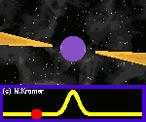
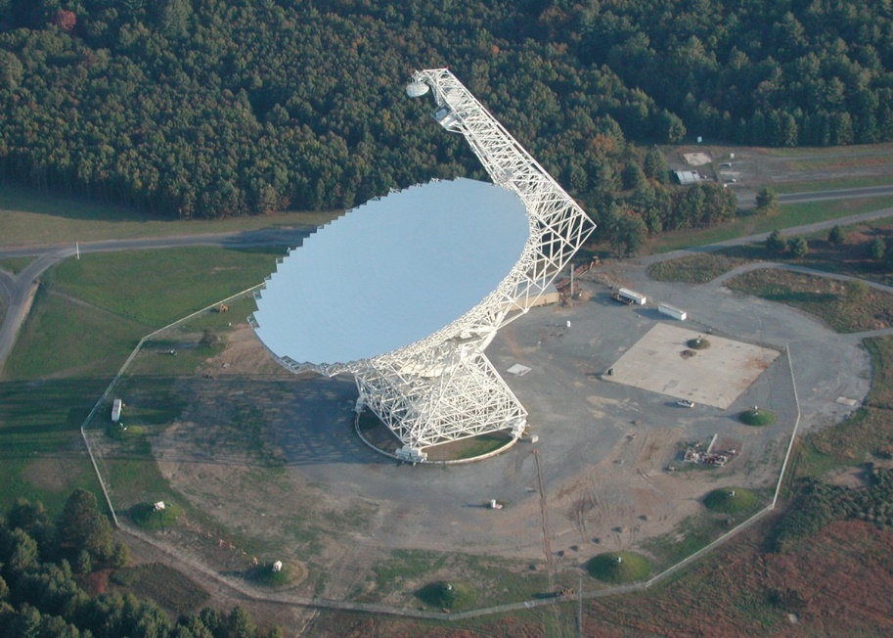
Searching for pulsars
Radio astronomy at Green Bank

Slide 2
Background
Pulsars are rapidly spinning neutron stars
They are slightly more massive than our sun (1.4 Mo), but much smaller (10 to 20 km in diameter)
Their discovery came as a surprise to astronomers in the 1960s
The fast rotation of pulsars means we observe them as a flickering signal, which is emitted with great precision

Slide 3
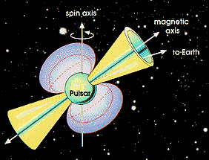

Slide 4
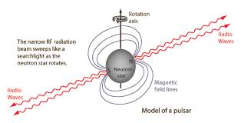

Slide 5
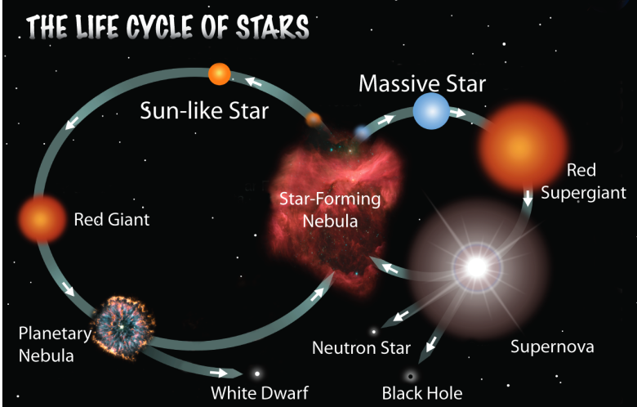

Slide 6
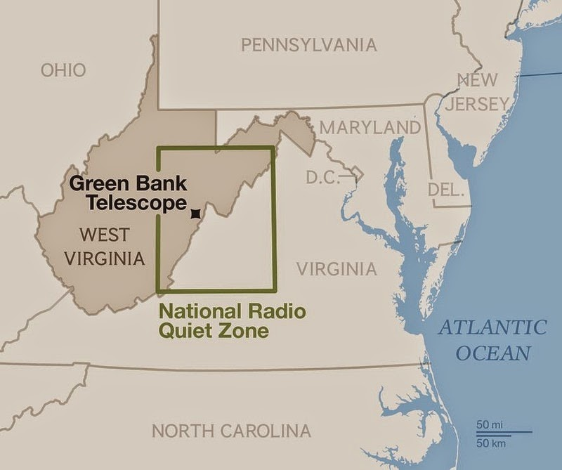
You are now entering the quiet zone…
The location for a radio quiet zone was well chosen.
BEFORE all of our mobile devices become ubiquitous, the NRAO (National Radio Astronomical Observatory) was built in a remote part of West Virginia, far from interference.
It is so remote, and surrounded by state forests, that it is still “radio quiet”.

Slide 7
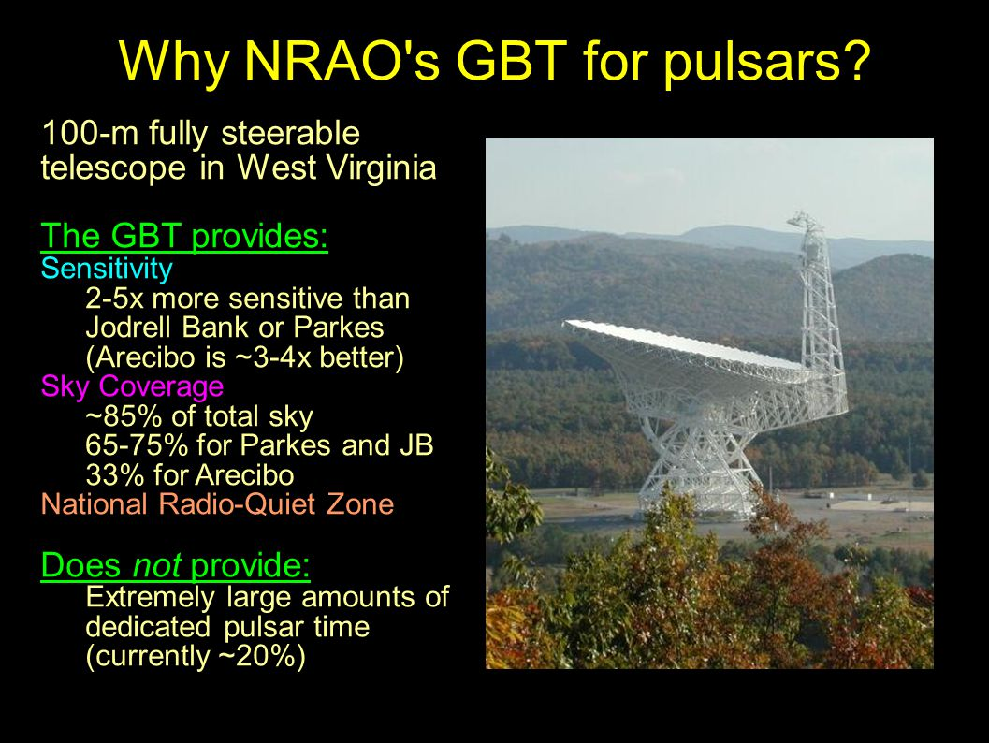

Slide 8
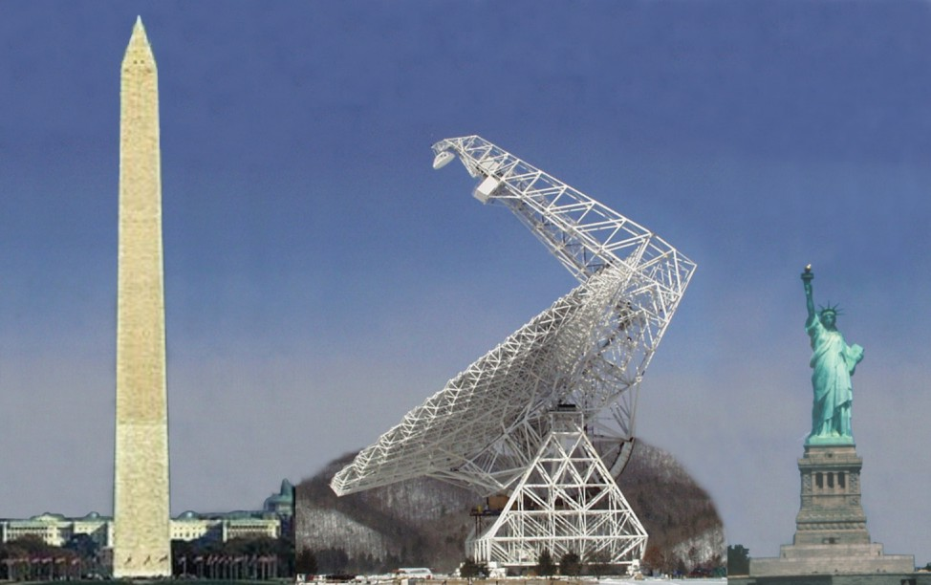

Slide 9
What do students do with it?
They can join the PSC (Pulsar Search Collaboratory).
This program began when the GBT was under repair and immobile, but not useless
Students and teachers can attend a 1 week summer session/crash course in astronomy and pulsars
They learn about the physics of pulsars and how to use the database to evaluate pulsar candidates
Their model is similar to that of Galaxy Zoo, but with more training
About 20 new pulsars have been found by students since 2007!

Slide 10
