Slide 1
LIGO and Gravitational Waves
Laser Interferometer Gravitational Wave Observatory
Recommend GOOGLE at your leisure.
Sept. 14, 2015 event for first observation of gravitational waves as predicted by Albert Einstein’s theory of General Relativity for 2 black holes annihilating.
A second event, which occurred on 12/25/15 Baltimore time, was reported in June.
I’ll do quick “review” of special relativity and general relativity as previously confirmed by experiment.

Slide 2
Special Relativity:
Behavior of Space and Time as measured in inertial coordinate systems moving at constant velocity with respect to each other.
Maxwell Equations for Electromagnetic Waves (1865) had a velocity related to constants of nature and independent of coordinate system.
“Aether” was proposed as the ``medium” which ``waved”.
Michelson-Morley experiment did not detect this ``aether”.

Slide 3
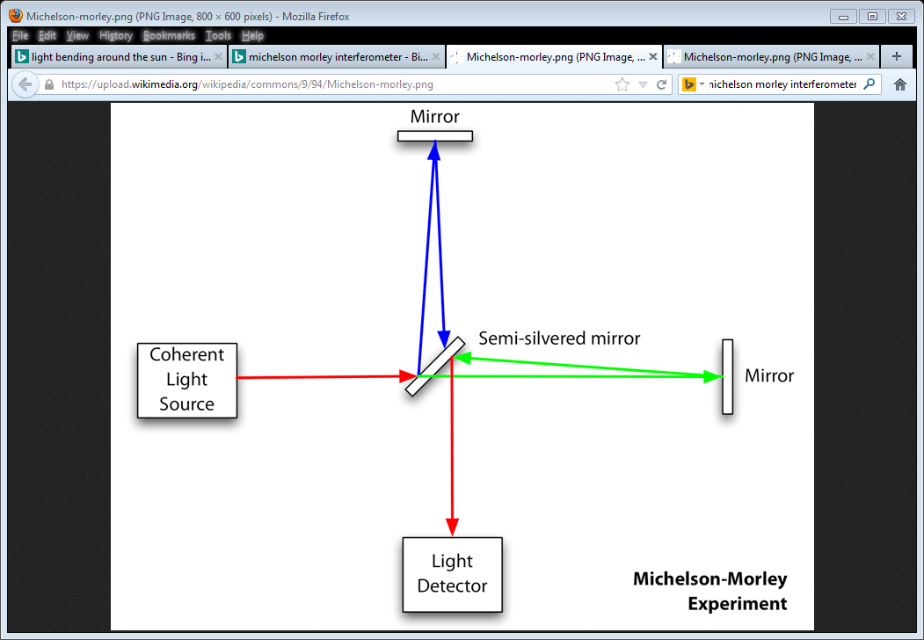
Michelson Morley Experiment to detect the aether.
Interference pattern should change as earth goes around the sun and as earth rotates on its axis each day. No change in the interference pattern was observed, i.e. no evidence of the aether was found.

Slide 4
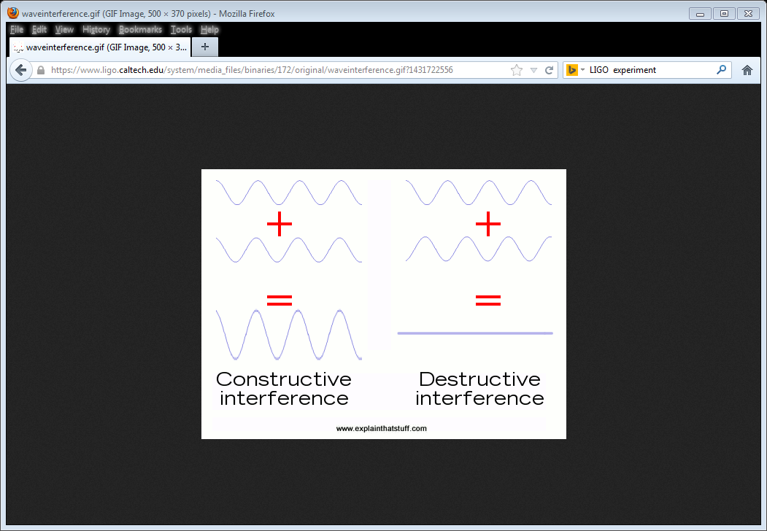

Slide 5
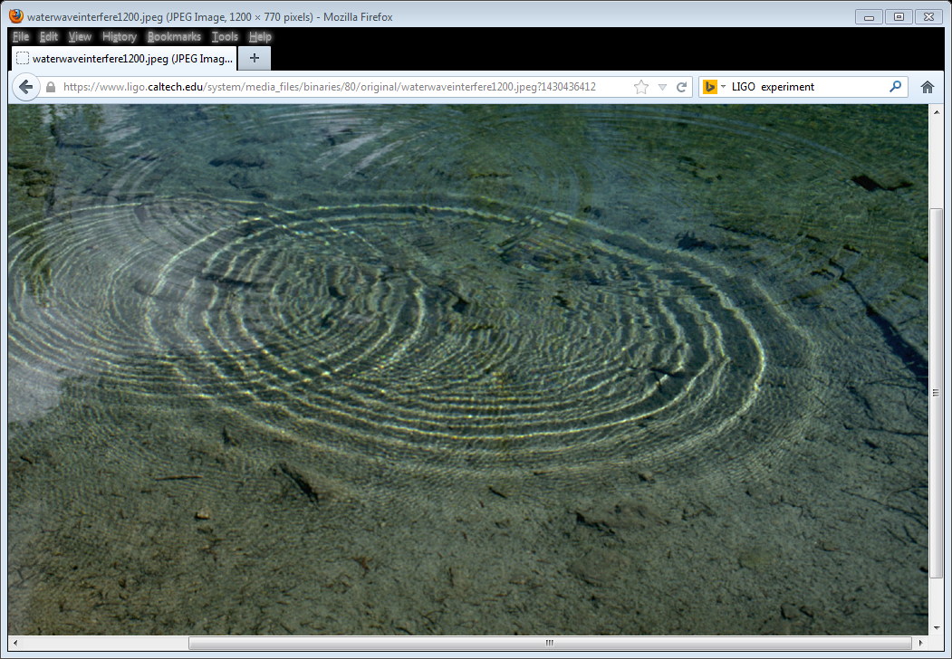
Interference pattern for water waves.

Slide 6
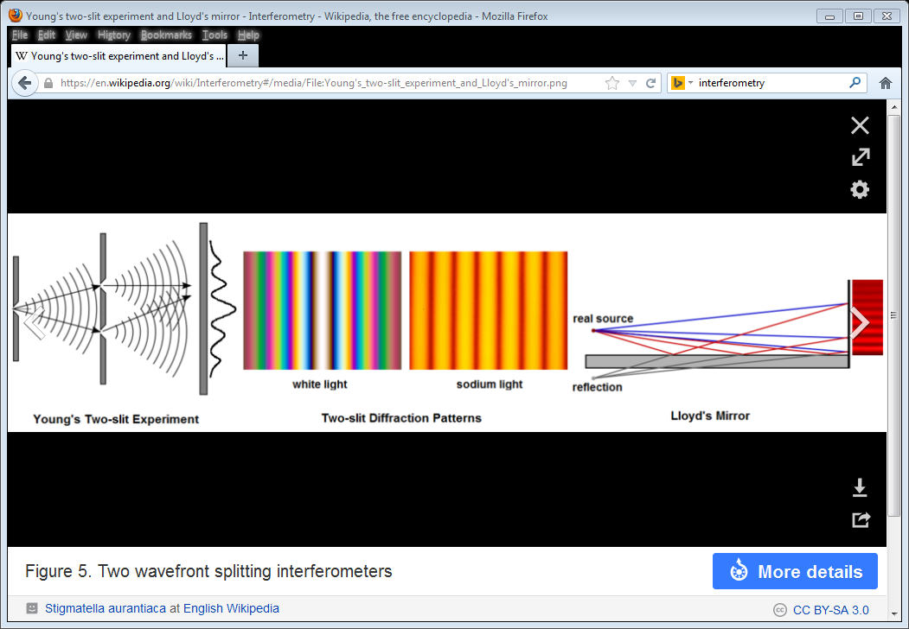

Slide 7
Michelson Morley Experiment to detect the aether.
Interference pattern should change as earth goes around the sun and as earth rotates on its axis each day. No change in the interference pattern was observed, i.e. no evidence of the aether was found.

Slide 8
Special Relativity:
1905 Einstein produced his theory of Special Relativity.
1) “Physics” is the same in all inertial coordinate frames.
2) Speed of light is constant regardless of speed of source or detector.
Predicted several strange effects.

Slide 9
Time Dilation: Clocks in a moving coordinate system are measured to run slower than those in a stationary coordinate system.
Length Contraction: The length of an object in a moving coordinate system is measured to be shorter than when it is measured in its own, stationary, coordinate system.
Events which are simultaneous in one coordinate system will not be measured to be simultaneous in another moving coordinate system.
No physical object can move with a speed equal to or greater than the speed of light in vacuum.
E = mc Mass is a form of energy.
2

Slide 10
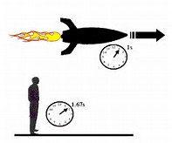
The time interval between two events which occur at the same place in a coordinate system is less than the time difference between the two events when they are measured to occur at two different places in a coordinate system.
Time
Dilation.

Slide 11
Time Dilation: Clocks in a moving coordinate system are measured to run slower than those in a stationary coordinate system.
Length Contraction: The length of an object in a moving coordinate system is measured to be shorter than when it is measured in its own, stationary, coordinate system.
Events which are simultaneous in one coordinate system will not be measured to be simultaneous in another moving coordinate system.
No physical object can move with a speed equal to or greater than the speed of light in vacuum.
E = mc Mass is a form of energy.
2

Slide 12
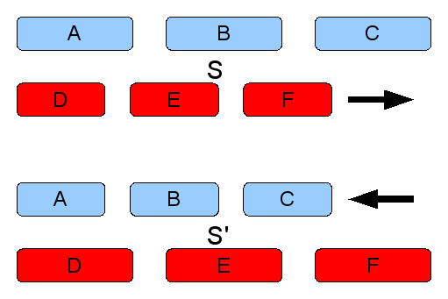
Length Contraction. The length of an object is measured to be shorter in a coordinate system where it is moving than in a coordinate system where it is stationary.
Length is the distance between the end points when measured simultaneously.

Slide 13
Time Dilation: Clocks in a moving coordinate system are measured to run slower than those in a stationary coordinate system.
Length Contraction: The length of an object in a moving coordinate system is measured to be shorter than when it is measured in its own, stationary, coordinate system.
Events which are simultaneous in one coordinate system will not be measured to be simultaneous in another moving coordinate system.
No physical object can move with a speed equal to or greater than the speed of light in vacuum.
E = mc Mass is a form of energy.
2

Slide 14
Special Relativity did not handle accelerations or the presence of gravity.
Introduce General Relativity
Einstein said you could not distinguish between an acceleration and the presence of a gravitational force. Imagine yourself in an elevator on earth and in outer space.
The inertial mass in F=ma is the same mass as in the gravitational force equations.
The presence of a mass ``warps” space via gravity.
This causes many effects. Observations all agree with General Relativity.

Slide 15
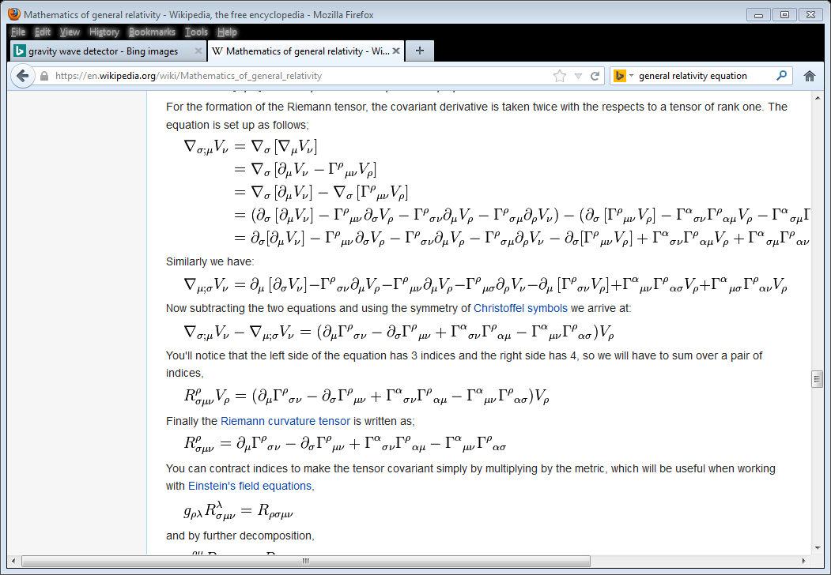

Slide 16
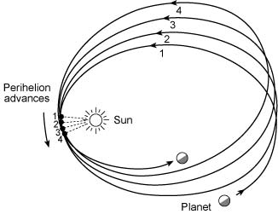
Precession of perihelion of Mercury.
About half of the effect is due to the other planets and half to General Relativity.

Slide 17
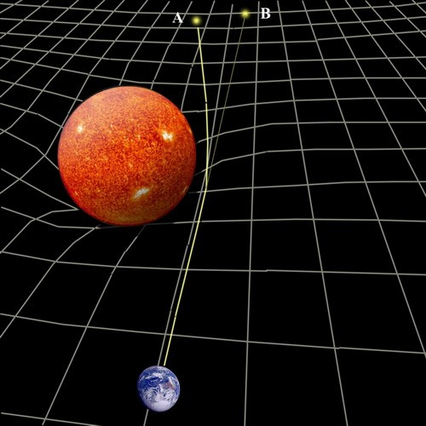
Bending of the path followed by light traversing through a region with a gravitational field.
Detected by Eddington in 1919 during a solar eclipse of the sun.

Slide 18
Gravitational “red shift” of light.
The wave length of light increases, and its frequency decreases, as it moves away from a gravitating mass.
The wave length of light decreases, and its frequency increases, as it moves towards a gravitation mass.
Confirmed by Pound & Rebka at Harvard around 1960.
A light beam with “wave length” 1.0 in the basement had a “wavelength” of 1.000000000000002455 at the building roof.
Therefore, a clock in a gravitational field will be measured to run slower than that same clock away from the gravitational field.
You “live longer” because you are in the gravitational fields of the sun and earth.

Slide 19
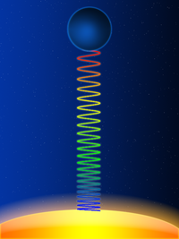
Gravitational Redshift
Wavelength increases as light moves away from large mass.
Blue light becomes more red.

Slide 20
Black Holes:
A large mass can “warp” space so much that an object close to it, inside its “Schwarzschild Radius”, can never escape. True even for light. The ultimate limit of gravitational red shifting.
Same result from thinking about “escape velocity”.
Evidence exists indicating that there are massive black holes at the center of most galaxies, including our Milky Way, which has 4.1 million solar masses.
Although no matter can escape a black hole they may radiate energy via ``Hawking Radiation”. Insignificant effect for large black holes, but micro black holes can “evaporate”.
Schwarzschild radius for the earth is about 1 cm.

Slide 21
Gravitational Waves:
So far we have only discussed stationary gravitating masses.
Accelerating electric charges emit E-M waves. Microwaves, gamma rays, X-rays, radio waves, microwaves, infrared radiation, ultraviolet radiation, visible light.
Similarly, accelerating mass emits, according to Einstein, gravitational waves.
Electromagnetic waves are planar whereas gravitational waves oscillate (squeeze-stretch) in both transverse directions.
LIGO discovered Gravitational Waves. Today’s real subject.

Slide 22
Evidence for gravitational waves already existed.
1974: Hulse-Taylor Pulsar (1993 Nobel Prize):
Binary Pulsar (2 neutron stars) system emits gravitational waves and slowly looses energy due to rotation of two objects. Pulsar is neutron star emitting energy along its magnetic field axis which differs from its rotational axis.
Orbital period slowly decreases as energy is lost.
Excellent agreement with General Relativity expectations.

Slide 23
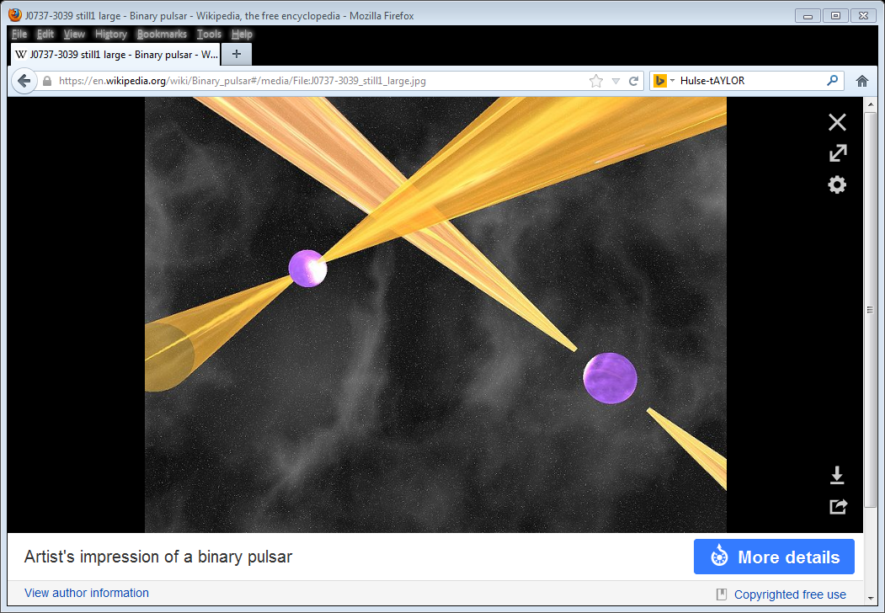

Slide 24
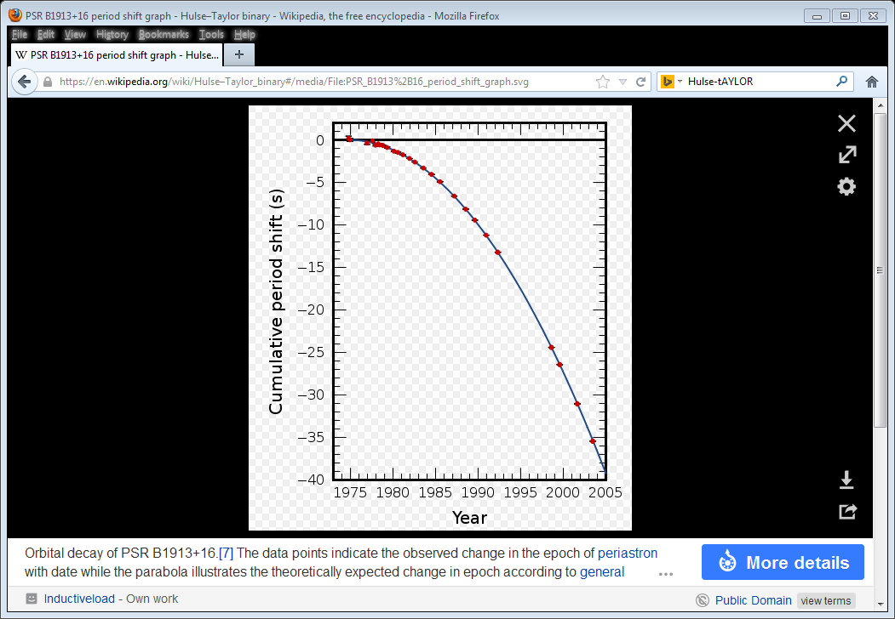
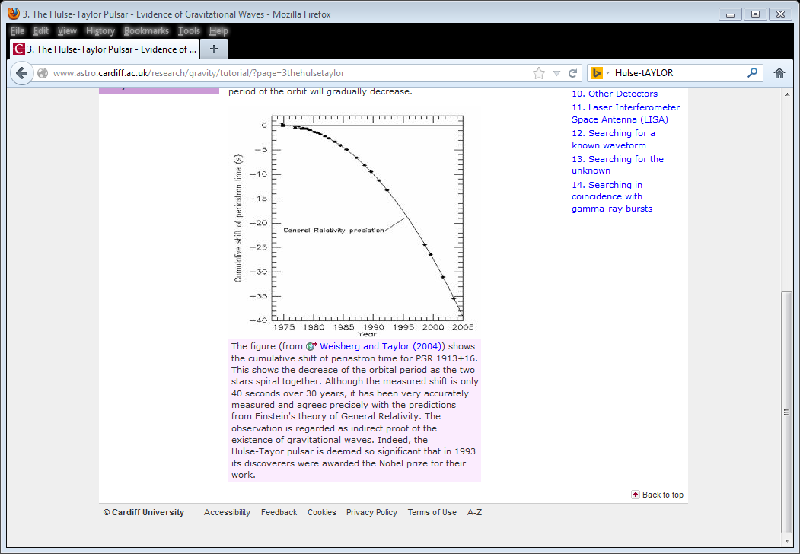

Slide 25
LIGO experiment is first detection of Gravitational Waves.
L: Laser
I: Interferometer
G: Gravitational Wave
O: Observatory
Two facilities: Hanford, Washington & Livingston, Louisiana.
Detector arms are 4 km long and can detect a distance change of 1/10,000 the width of a proton!!! Equivalent to measuring the distance to our nearest neighboring star to the width of one human hair.
Laser beam is split into the 2 arms, bounces back and forth 280 times, and is eventually superimposed for interference to check for changes in the length of the arms. Effective arm length is 1120 km.
Like Michelson-Morley.

Slide 26
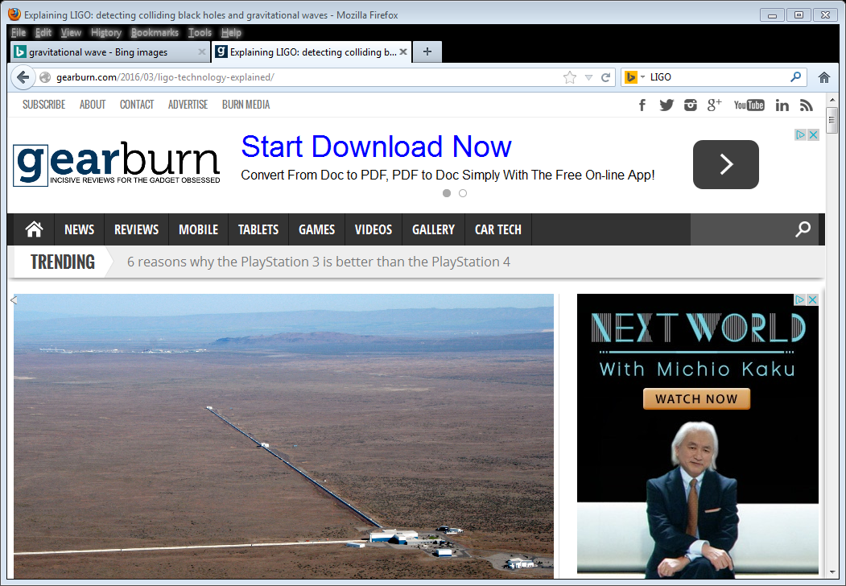

Slide 27
LIGO conversations started in 1970.
Inspired by 1960 Joe Weber (false) result at U. Maryland.
Completed in 1999.
First “search” started in 2002,
Upgrade started in 2010. Factor 10 in sensitivity. Factor 1000 in volume of space available for search.
Search resumed in Sept 2015 in debugging mode.

Slide 28
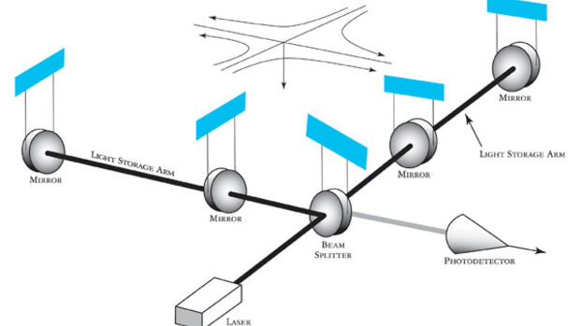

Slide 29
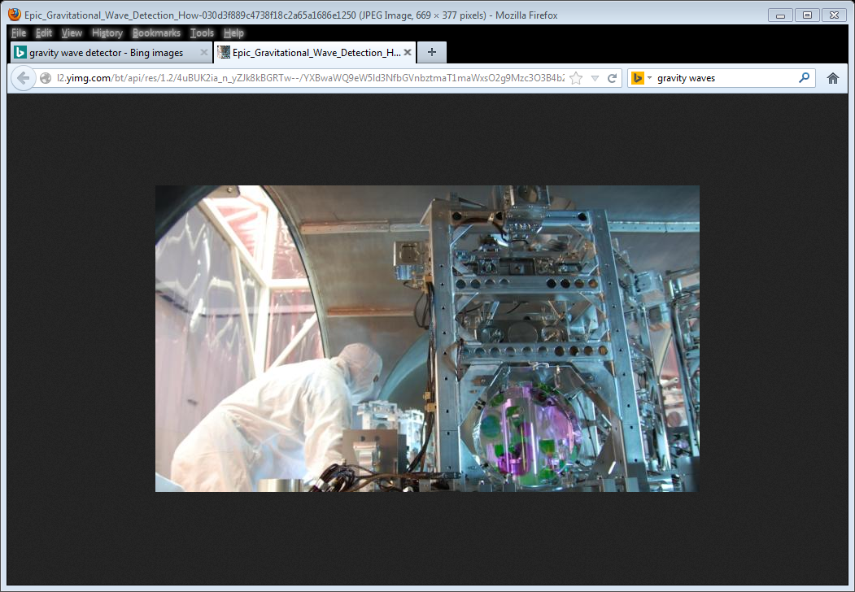
LIGO Detector

Slide 30
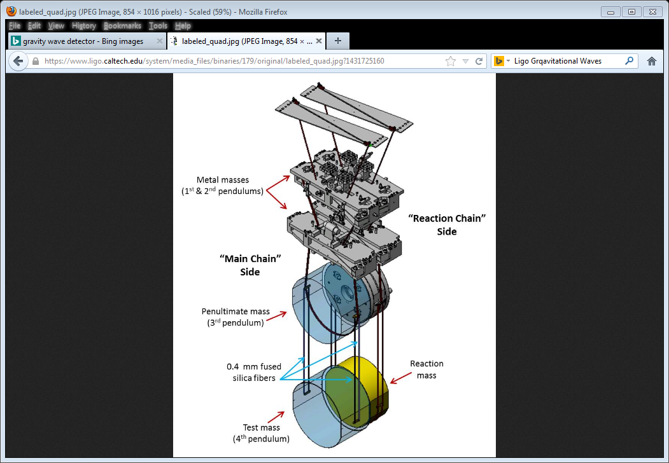
LIGO 4 vibration damping masses

Slide 31
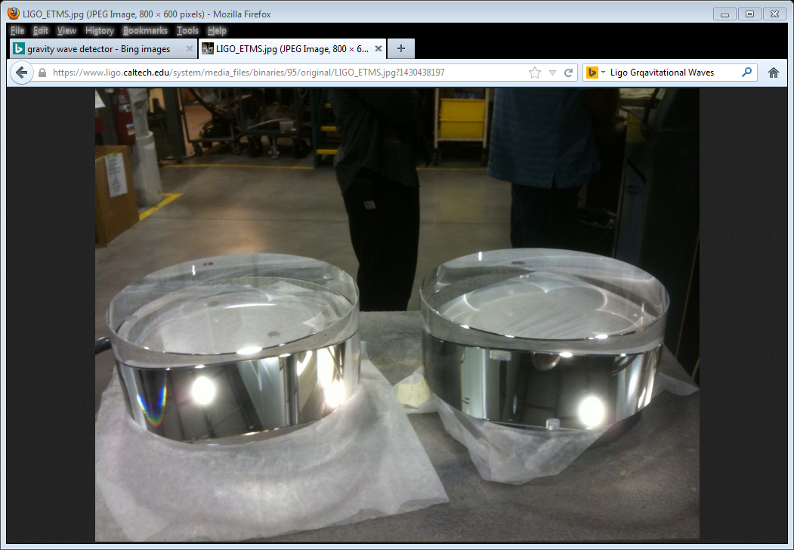
LIGO 88 Pound mirrors

Slide 32
LIGO Characteristics:
1) Seismic Isolation:
Active and Passive isolation
2) Vacuum:
Only “Large Hadron Collider” has larger volume vacuum.
Air pressure is 1 trillionth atmospheric pressure.
3) Optics:
LASER: 200 watts, 1064 nanometer wavelength.
800 times the power of a laser pointer.
4) Computers:
200 terabytes of data per day.
Would need 3000 laptops constantly running for analysis.
144,000 times bigger than Michelson-Morley Apparatus

Slide 33
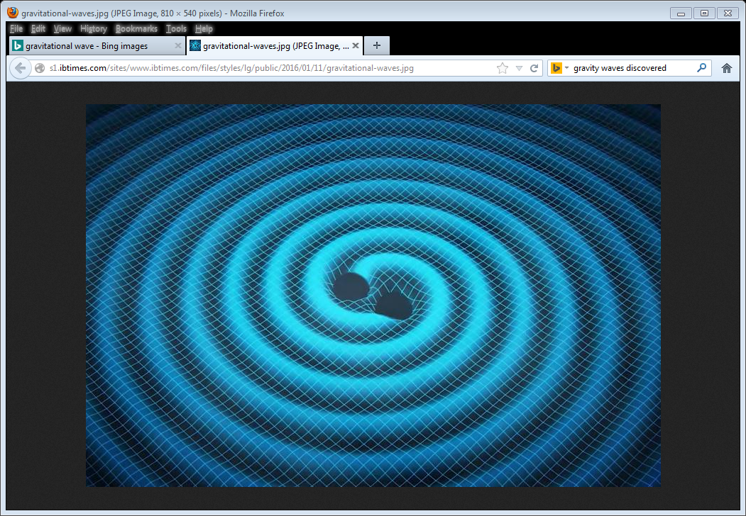
2 orbiting black holes

Slide 34
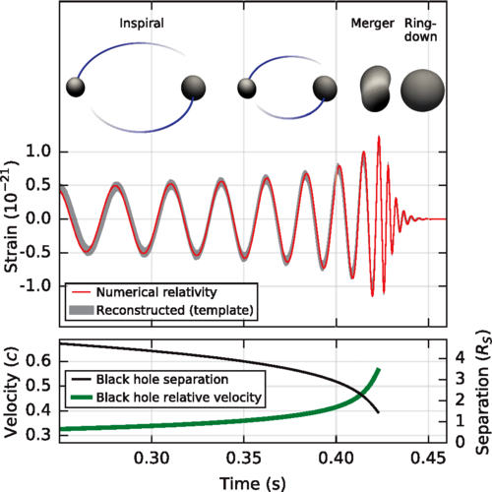

Slide 35
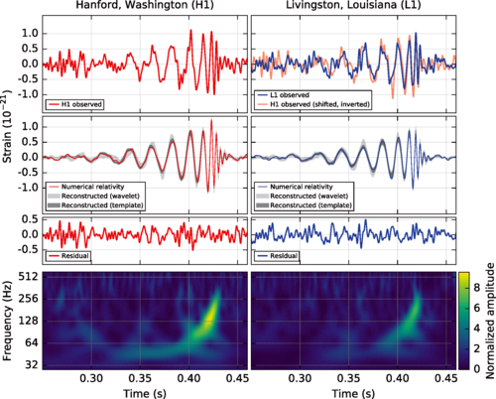

Slide 36
Signal first in Louisiana and 6.9 msec later in Washington.
Overlap the two signals for excellent agreement.
Frequency region 35 to 250 cycles per second (Hertz).
Extremely careful super computer simulations with varying black hole masses, speeds, distances, etc., required to best match the two waveforms seen in the data.
In 0.2 seconds the signal increases in frequency and amplitude in 8 cycles from 35 to 250 Hertz.
This is first direct detection of gravitational waves and also the first direct observation of a binary black hole system merging into one black hole.
+0.5
-0.4

Slide 37
Primary Black Hole Mass 36 M(sun)
Secondary Black Hole Mass 29 M(sun)
Final Black Hole Mass 62 M(sun)
Gravitational Waves Total Energy 3.0 M(sun)
Peak Gravitation Wave Power 200 M(sun)/sec
Distance from us 1.3 Billion Light Years
Mass of “graviton” < 10 electron mass
No evidence of any disagreement with Einstein’s Theory of General Relativity.
+5
-4
+4
-4
+4
-4
+0.5
-0.5
+30
-20
+.4
-.4
-16

Slide 38
SECOND EVENT 12/26/15
03:38:53 GREENWICH TIME
SIGNALS IN 2 DETECTORS CLOSER IN TIME. MEANS EVENT WAS MORE CENTRAL TO EARTH’S PLANE. NOT IN SAME LOCATION AS FIRST EVENT.
SMALLER BLACK HOLES: 14 & 8 M(SUN)
EVENT WAS ABOUT 1.4 BILLION LIGHT YEARS AWAY. SIMILAR DISTANCE TO EVENT 1.
EVENT SIGNAL WAS SMALLER IN AMPLITUDE BUT LONGER IN TIME DURATION MAKING DETECTION POSSIBLE.
ABOUT 27 ORBITS OVER ONE SECOND.
DETAILED ANALYSIS CONSISTENT WITH EINSTEIN’S GEBERAL THEORY.

Slide 39
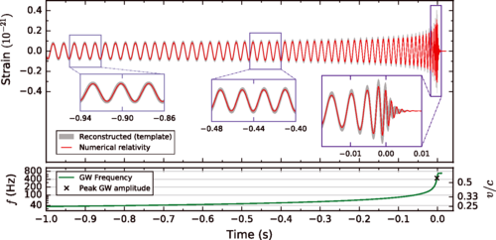

Slide 40
Examples of future research with gravitational waves:
1) What are the properties of gravitational waves?
2) Is General Relativity the full explanation?
3) Is General Relativity valid under strong gravity conditions?
4) Are nature’s black holes General Relativity’s black holes?
5) How does matter behave under extreme pressure & density?
6) What happens when a massive star collapses?
7) How do compact binary stars form and evolve?

Slide 42
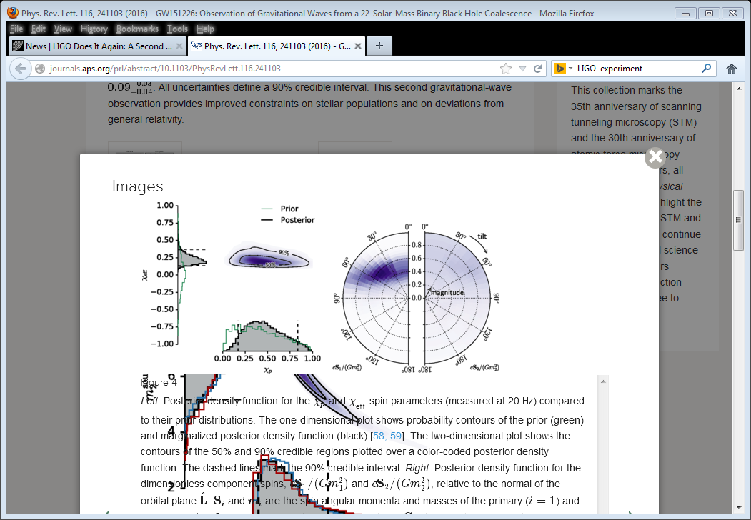

Slide 43
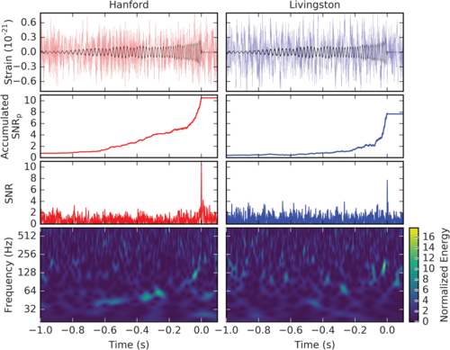

Slide 46
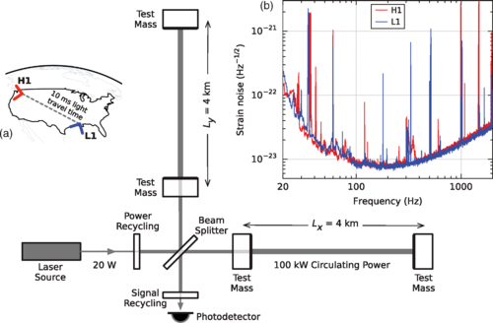

Slide 47
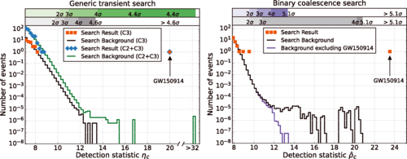

Slide 48
