Slide 1

The Extensive Young Supernova Remnant Population in the Face-on Spiral Galaxy M83
Bill Blair
Research Professor
Department of Physics & Astronomy
Johns Hopkins University
Baltimore, MD USA
Quarknet, July 29, 2016

Slide 2
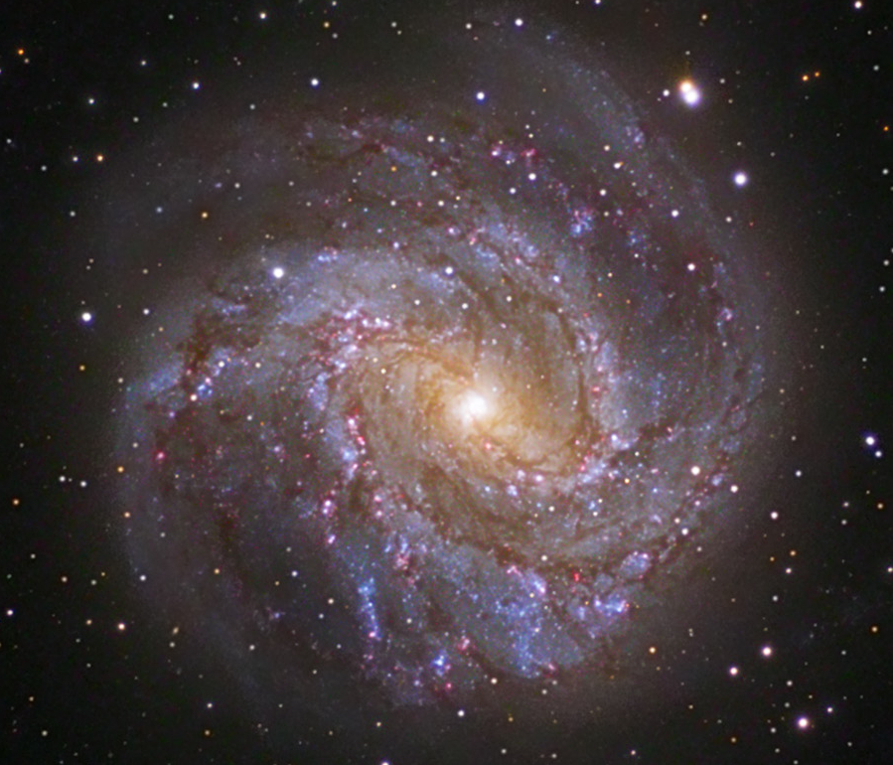
M83 Basics
Dist = 14.9 Mly (4.6 Mpc)
1” = 72 ly (22 pc)
Barred spiral galaxy with a starburst nucleus
(a.k.a. NGC 5236)
Supernova Factory:
6 (7?) SNe since 1923!
Many core collapse (from massive stars)
~200 SNRs less than 3000 years?
0.25 degree FOV
(note: full moon is 0.5 degree across)
Ground-based image
(photo: Rob Gendler)

Slide 3
The Context
To observe star formation and star death in the local universe to determine how star formation is triggered, how it is regulated through feedback, and the degree to which the physical processes involved are universal.
The galaxy M83 is a prime testing ground for this work.
Finding and studying Supernova Remnants (SNRs) is one part of this much bigger picture of understanding the energetics and physical conditions in the interstellar medium of galaxies.

Slide 4
M83 Data Sets
Magellan 6.5 m IMACS ground-based images
  Blair et al. 2012, ApJS, 203, 8 (>225 optical SNR candidates)
Chandra X-ray Observatory (730 ks)
  Long et al. 2014, ApJS, 212, 21 (>440 pt X-ray sources)
HST WFC3 Cy19 Imaging of 5 (+2 ERS) fields
  Blair et al. 2014, ApJ, 788, 55 (63 SNRs <11 pc in size)
Gemini South/GMOS Spectroscopy (7 masks; ~100 objects); (line ratios and kinematics)
  Winkler et al. (2016, in preparation)
EVLA and ATCA radio surveys
  ATCA (2011) reported in Long et al. 2014, ApJS, 212, 21
  New ATCA(2015) and EVLA data still being processed

Slide 5
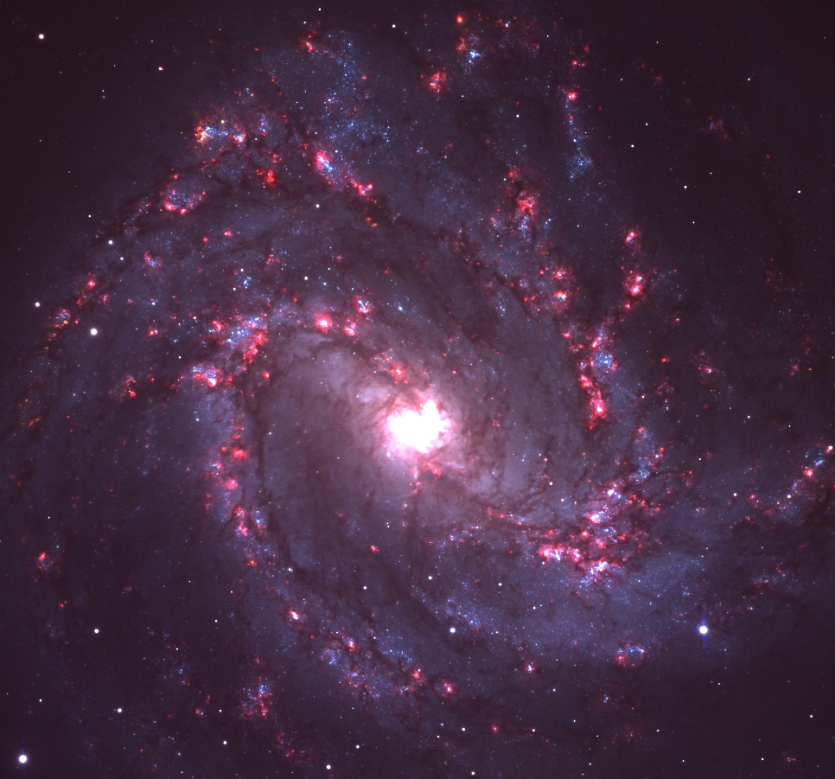
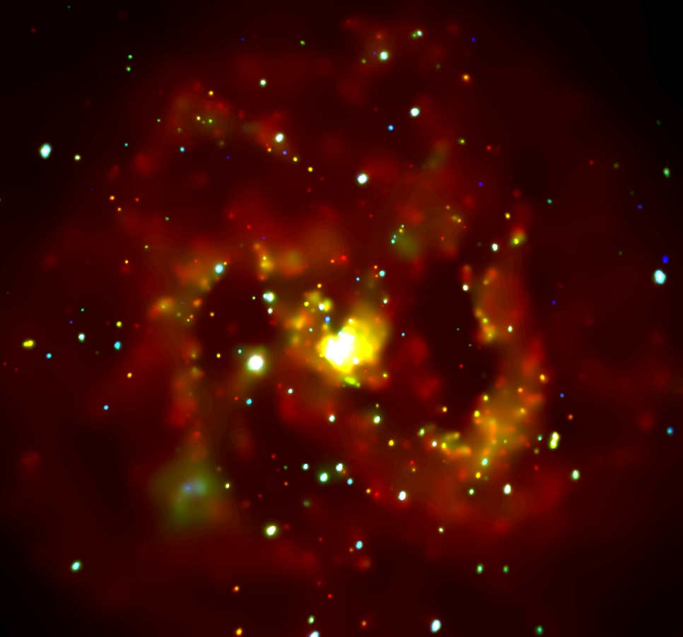
Multi-wavelength Overviews of M83
Magellan 6.5m Imagery
D=4.6 Mpc (1” = 22 pc)
Six SNe observed since 1923 →
~70 SNRs < 1000 years old!
(Many core collapse SNe expected due to all the star formation)
Chandra X-ray Observatory
Red: Hα (w/stars)
Green: V-band
Blue: B-band
Also [S II] and [O III]
729 ks, ACIS-S
Red: 0.5 – 1.1 keV (soft)
Green: 1.1 – 2.4 keV (med)
Blue: 2.4 – 8 keV (hard)

Slide 6
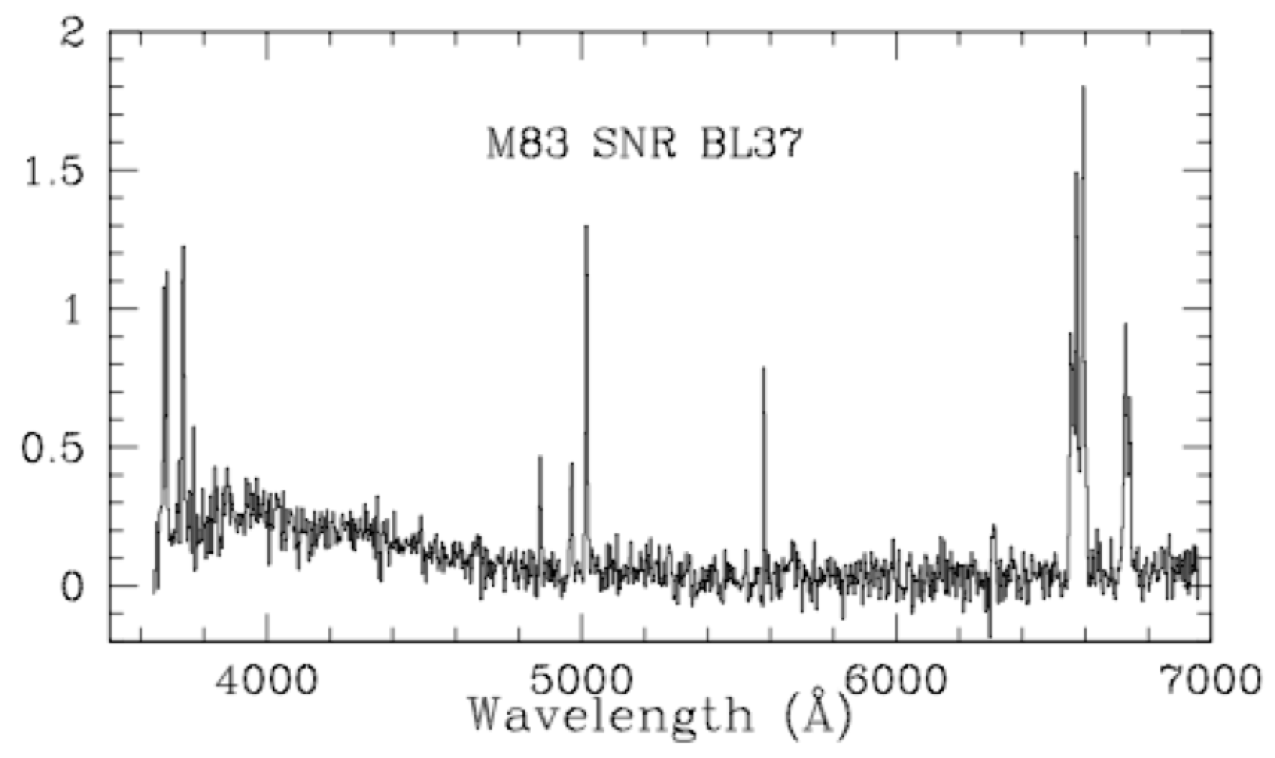
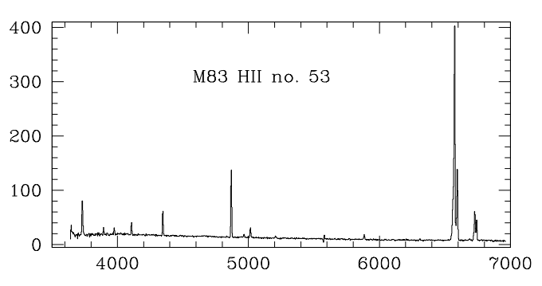
Finding Normal SN Remnants
Example spectra
Supernova Remnants are heated by explosions (shock waves).
Other emission nebulas are heated by starlight (photoionized).
Different heating mechanisms cause different line ratios.
We can use these differences to find SNRs, by taking “narrow band” images and comparing them carefully.
(From Blair & Long 2004, ApJS, 155, 101)

Slide 7
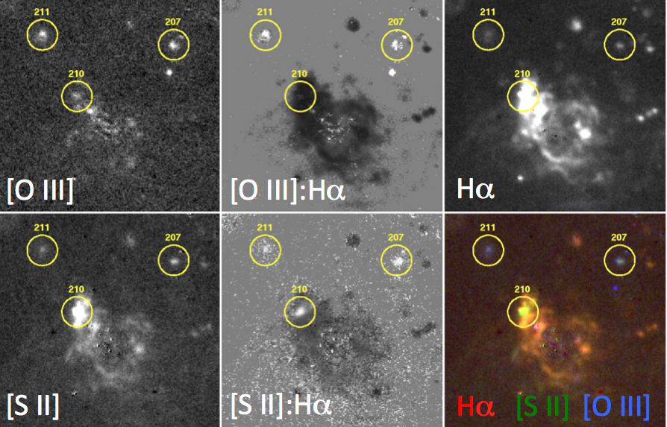
Magellan Data Example
(27’’ FoV)
^
PN

Slide 8
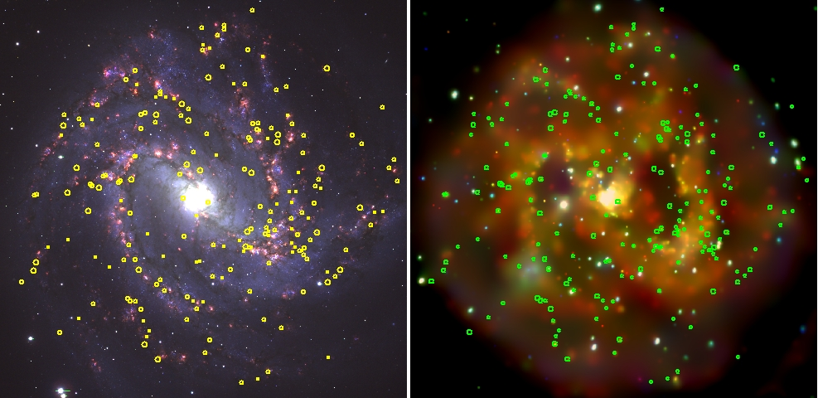
Magellan/IMACS SNR Survey*
* Blair et al. 2012, ApJS, 203, 8
>225 ISM-dominated SNRs identified! (87 with Chandra counterparts)
46 relatively strong [O III] emitters (possible ejecta-dominated SNRs) have NOT panned out. (More later…)

Slide 9
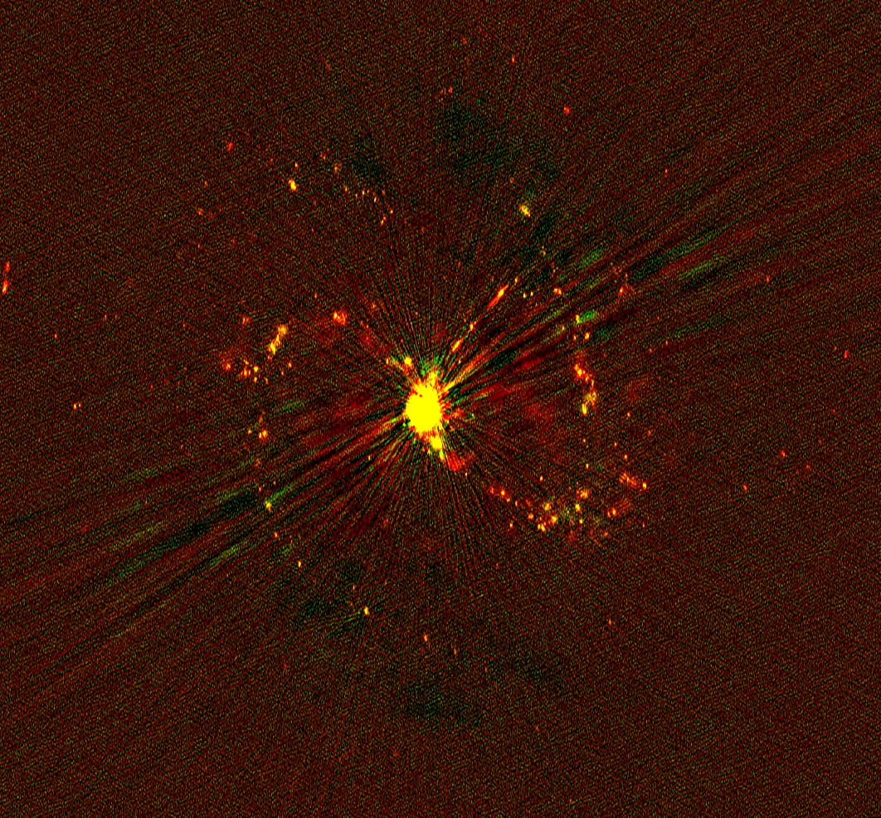
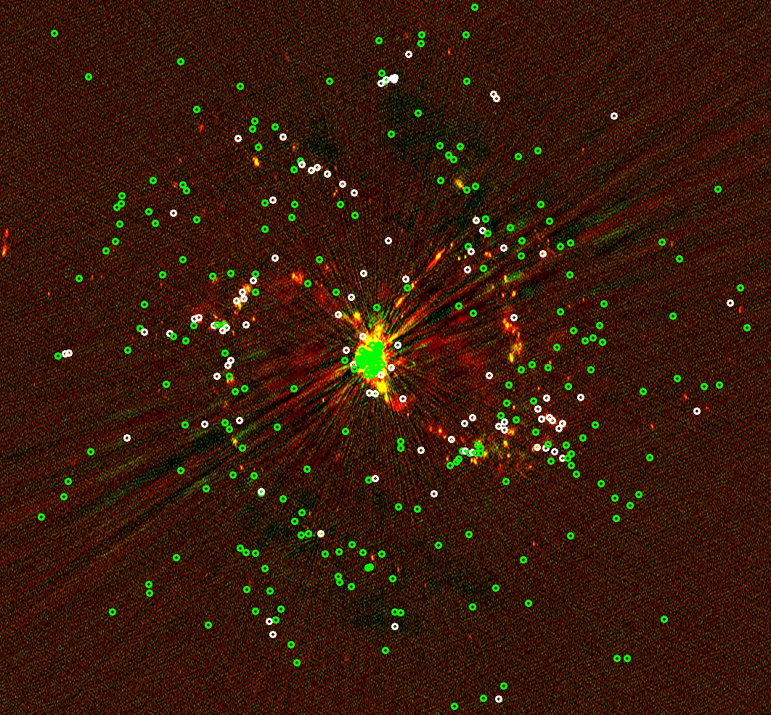
ATCA 2015 maps
Red: 5 GHz Green: 9 GHz
>180 sources not incl. nucleus
Optical SNRs (85 in white have obvious radio)

Slide 10
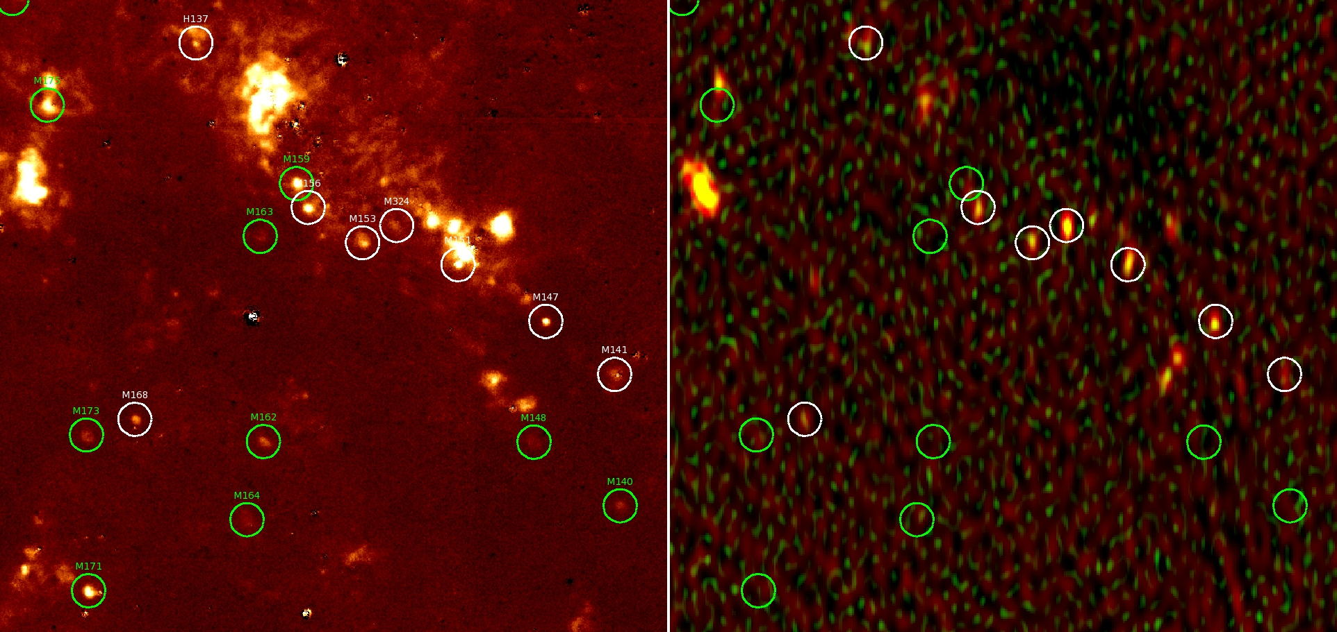
Magellan-ATCA 2015 Comparison
SN1957D
SN1957D
Magellan [S II] continuum subtracted
Optical SNRs (white have radio)
(75 arcsec region of northern spiral arm is shown)

Slide 11
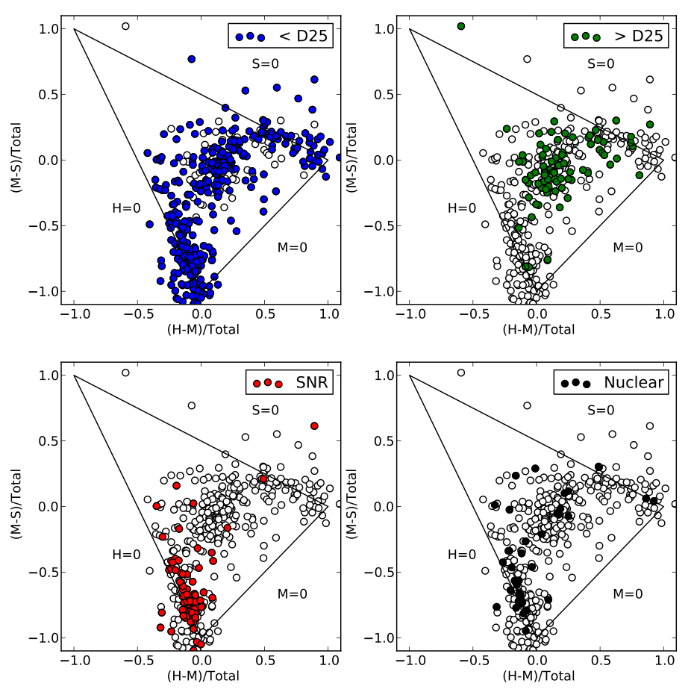
M83 Chandra Summary
Long et al. 2014, ApJS, 212, 21 >450 point sources plus strong diffuse X-ray gas.
Points to hot, high pressure ISM, especially in arms.
At least 87 X-ray sources align with optical SNRs.

Slide 12
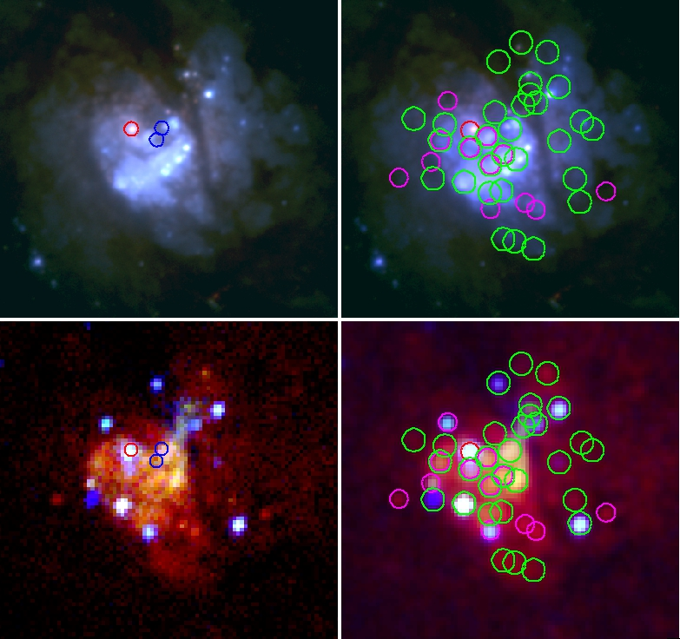
M83 Complex Nuclear Region
Top: Magellan continuum
Bottom: Chandra RGB
Green circles: XRBs
Magenta circles: HST SNRs
Circles in left panels are the optical nucleus and two different assessments of the dynamical center.

Slide 13
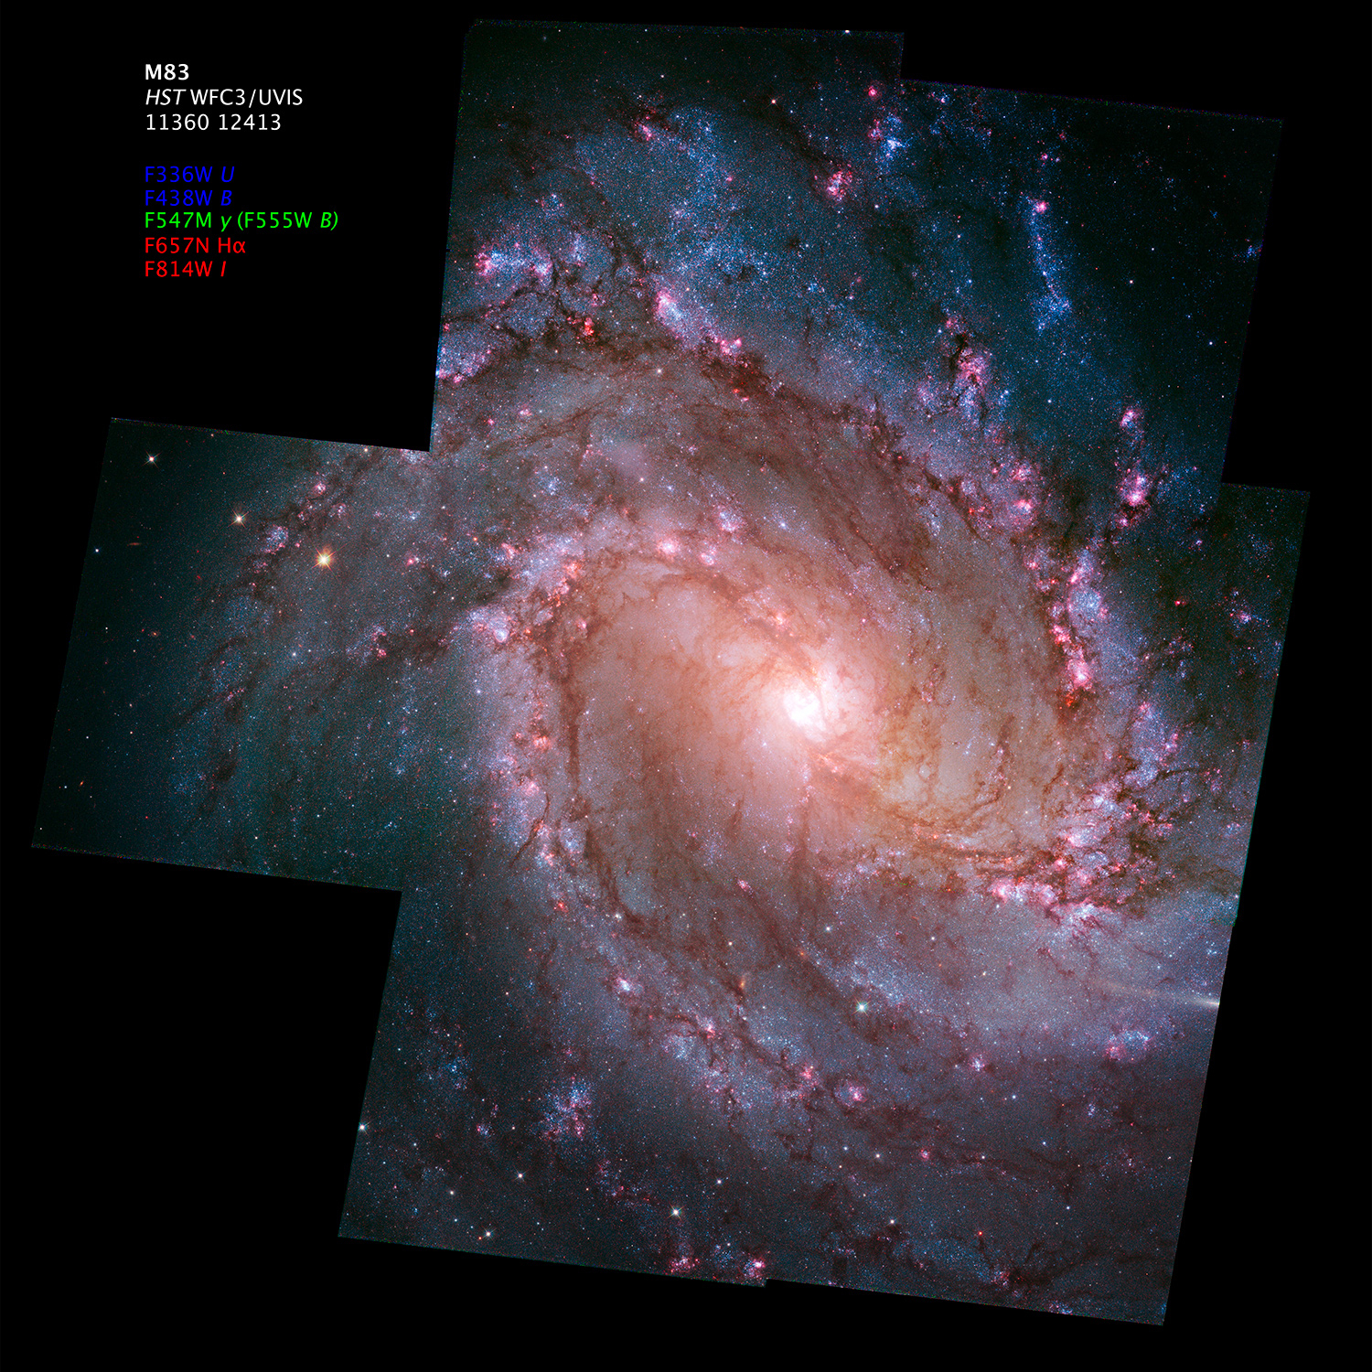
All Seven WFC3 Fields
Alignment and astrodrizzle of individual fields thanks to Derek Hammer and Jennifer Mack, STScI
Seven field mosaic thanks to Zolt Levay, STScI.
U, B, V, I, (H and K)
Hα, [S II], [O III], ([Fe II] 1.644 μm)
46 additional SNRs found, plus
accurate diameters for nearly all of the Magellan SNRs.
(1 WFC3 pixel = 1 pc)
Full aligned mosaics available at MAST: https://archive.stsci.edu/prepds/m83mos/

Slide 14
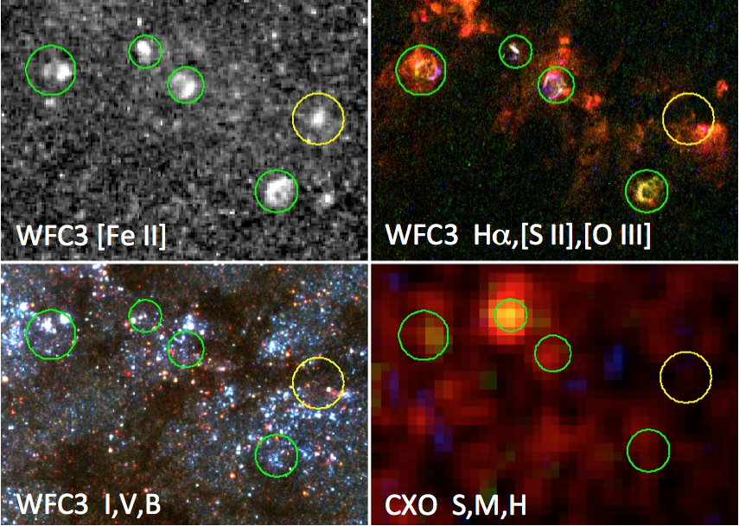
Five SNRs in One 15’’x20’’ FoV
Notes:
Note: H II regions simply do not show [Fe II] emission, making the [Fe II] a very nice diagnostic for SNRs, even if substantial extinction is present (see yellow circle).

Slide 15
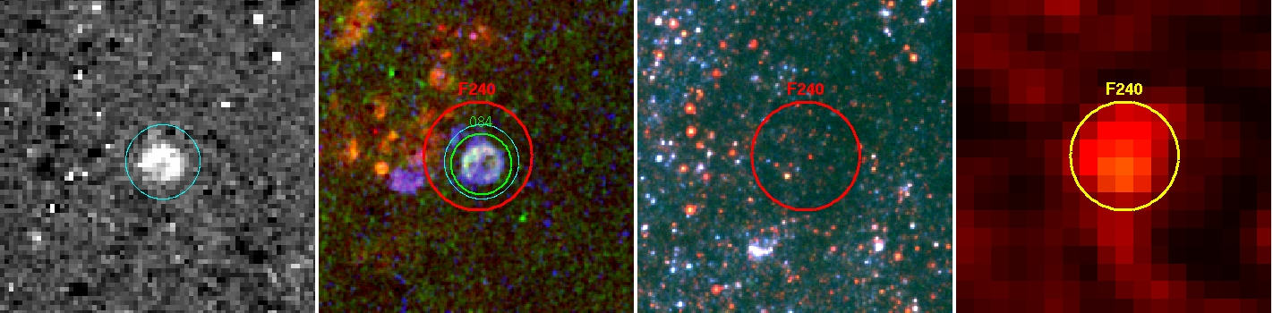
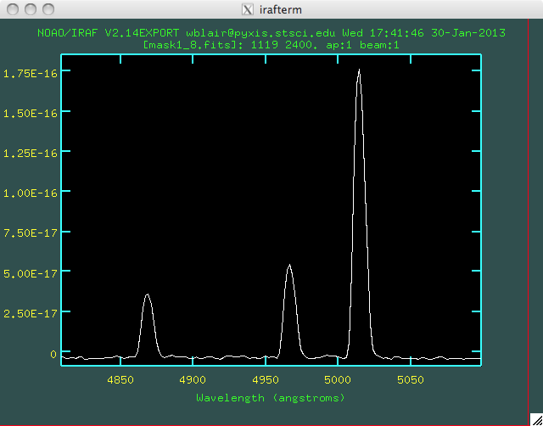
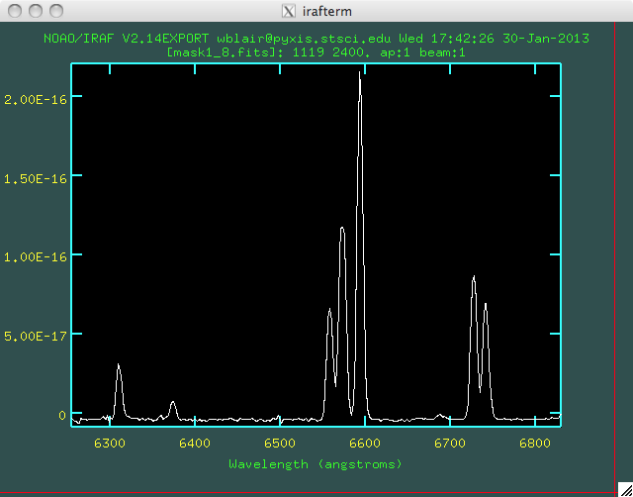
A “Cygnus Loop” in M83
(B12-84, similar in size to the Cygnus Loop)
[Fe II]
Hα,[SII],[OIII]
B,V,I
CXO
(Large circle is 3”)
Gemini-S GMOS Spectra
[N II]
[O III]
Hα
[S II]
Hβ
[O I]

Slide 16
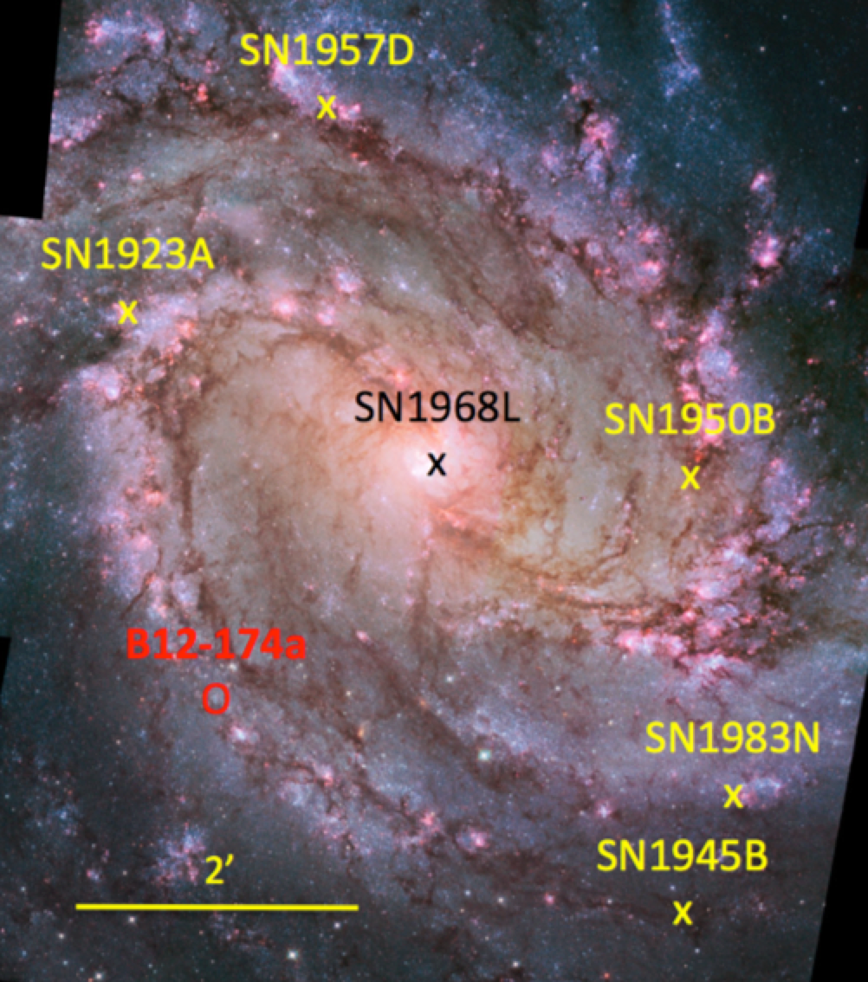
6 (7?) Historical SNe in M83
SN ID | Type
SN1923A | II P:
SN1945B | ?
SN1950B | ?
SN1957D | II
SN1968L | II P
SN1983N | Ic
B12-174a | (C-C)
(Types from Asiago catalog)
With this many SNe in last century, expect 60-70 SNRs <1000 years post-explosion.

Slide 17
6 (7?) Historical SNe in M83
SN ID | Type
SN1923A | II P:
SN1945B | ?
SN1950B | ?
SN1957D | II
SN1968L | II P
SN1983N | Ic
B12-174a | (C-C)
(Types from Asiago catalog)
With this many SNe in last century, expect 60-70 SNRs <1000 years post-explosion.

Slide 18
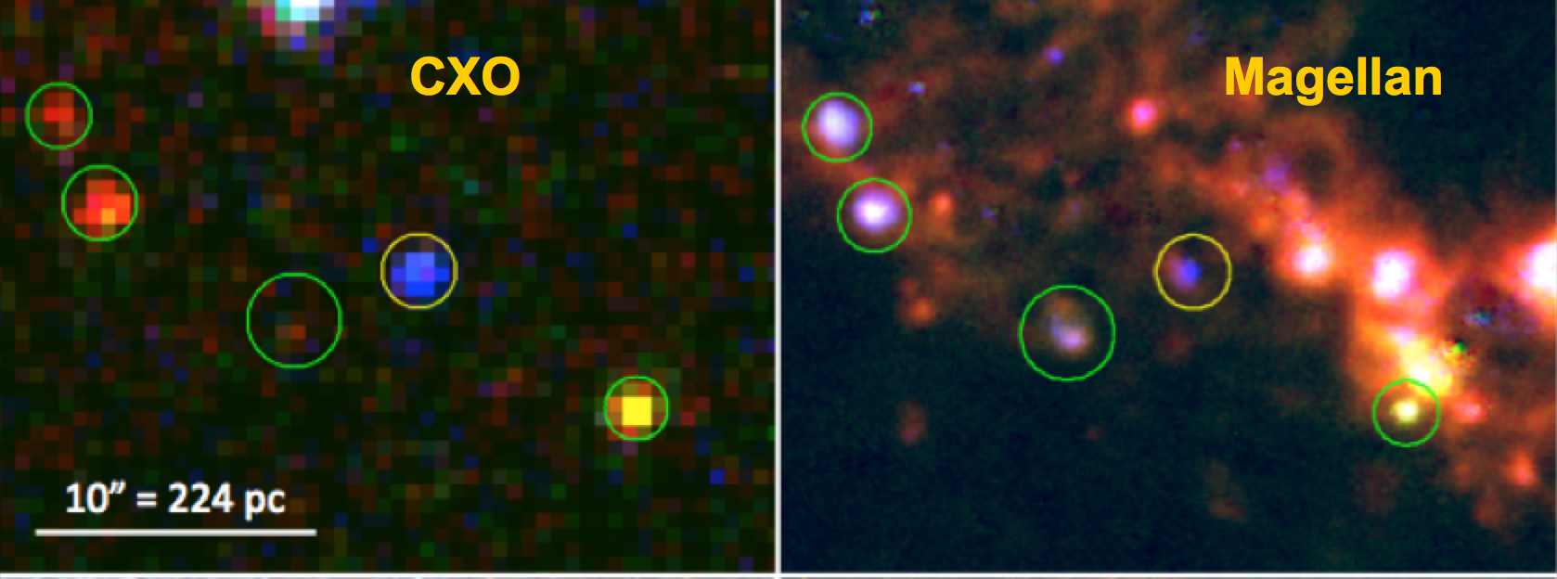
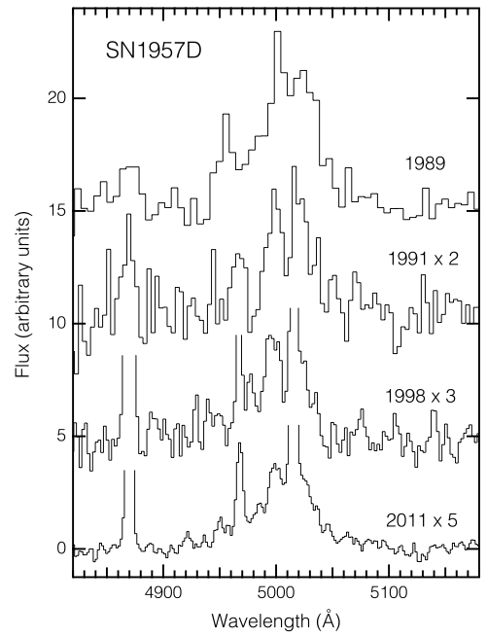
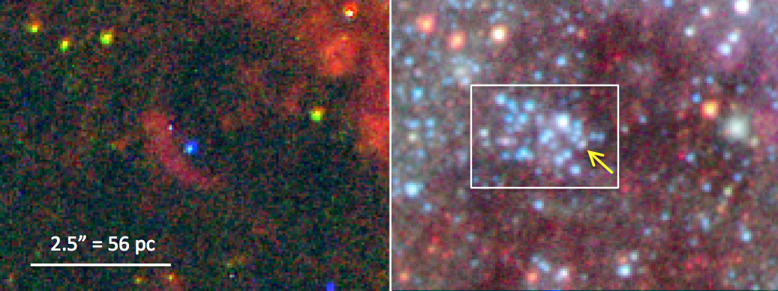
X-ray & Optical Counterpart of SN 1957D
(A very young ejecta-dominated SNR)
WFC3
Broad ejecta lines, but decreasing in intensity rapidly over time…
(A clue?)
Blue=dominated by [O III]
CMD fitting: age <10 Myr and MS turnoff >17 M_{o}
Long et al. 2012, ApJ, 756, 18

Slide 19
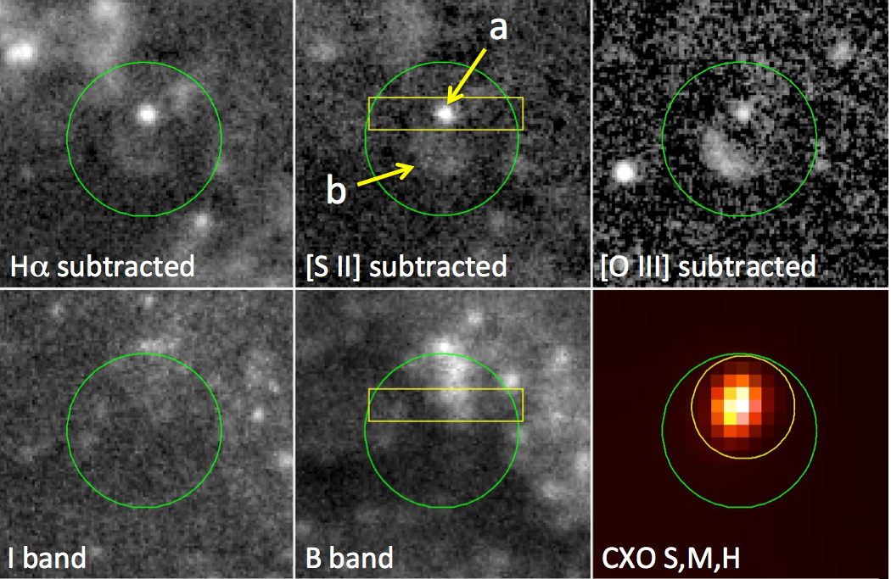
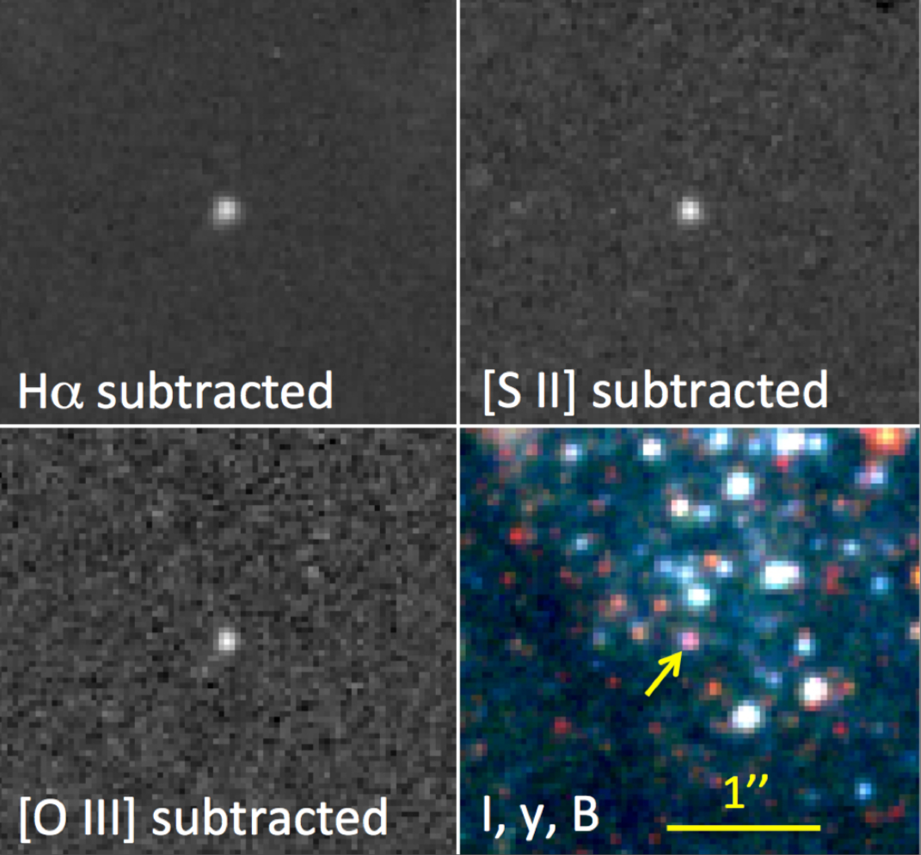
Magellan images, 10” FoV
HST WFC3 images, 3” FoV
B12-174a: A newly recognized very young SNR in M83

Slide 20
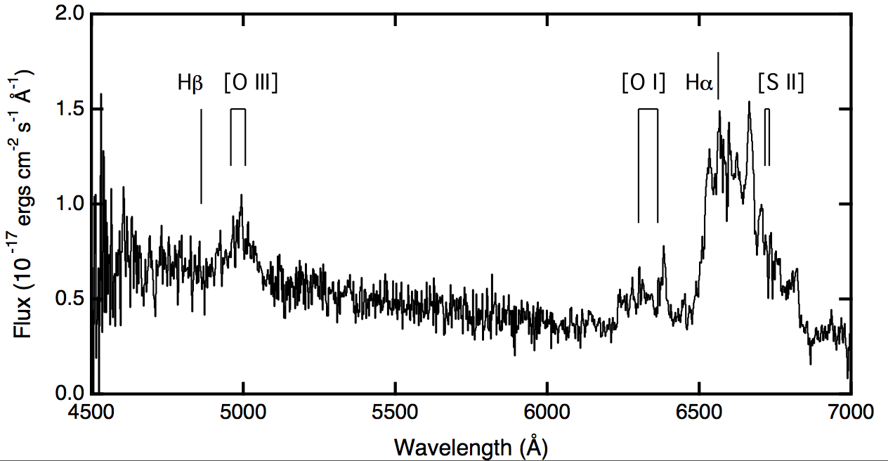
Magellan images, 10” FoV
HST WFC3 images, 3” FoV
B12-174a: A newly recognized very young SNR in M83
<100 years old, but the SN was not observed!
Blair et al. (2015)
Gemini-S GMOS

Slide 21
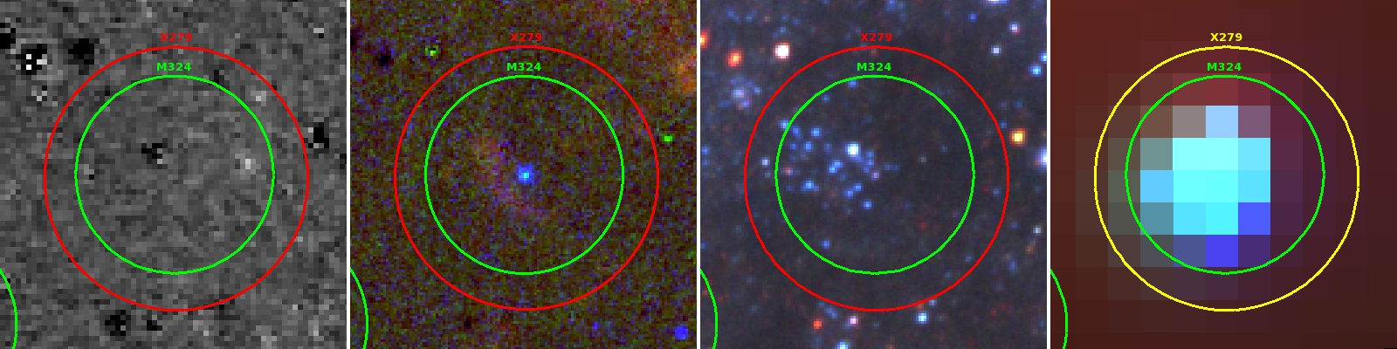
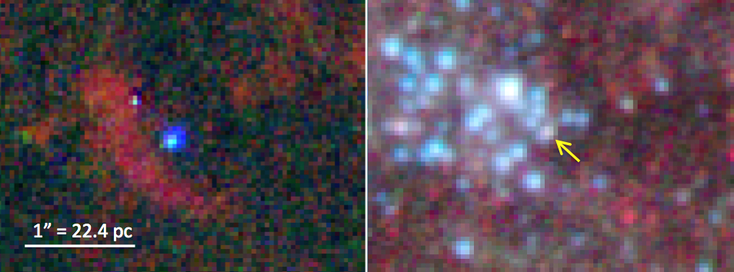
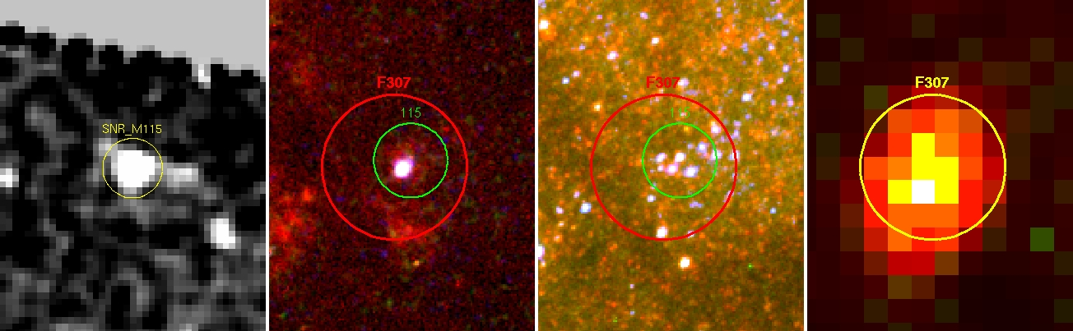
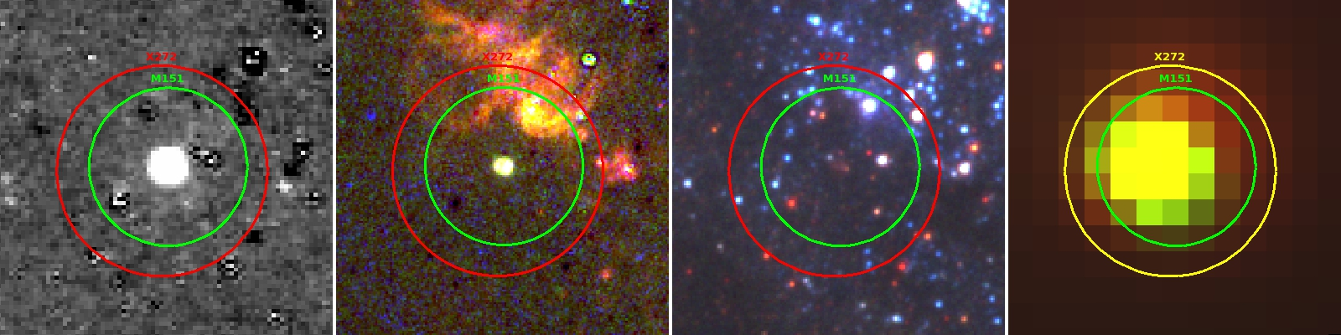
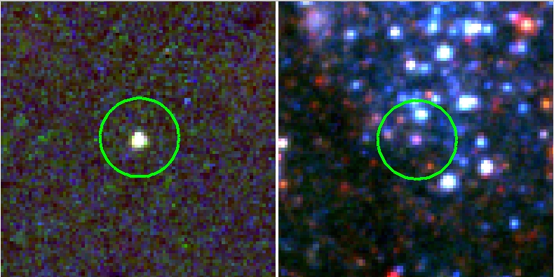
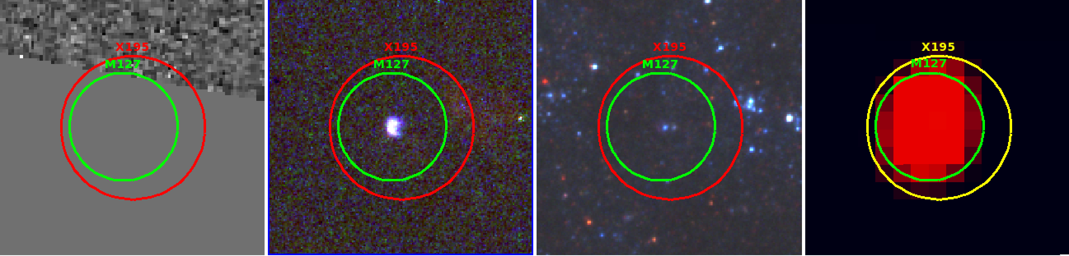
The Binary Progenitor Issue —
Possible Post-explosion Companions?
SN 1957D
B12-115
These are some of the best examples, but there are numerous other possible cases to investigate.
B12-151
B12-127
B12-174a

Slide 22
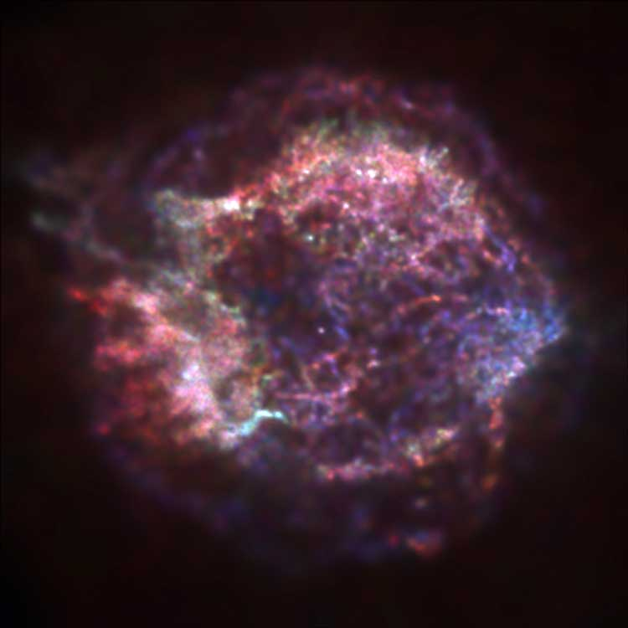
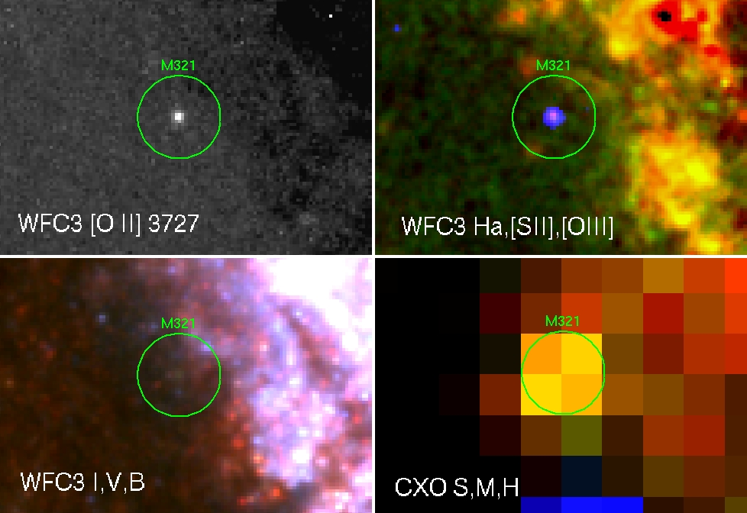
Where are all the “Cas A’s”?
Cas A -- 340 years
If such objects stay visible for ~1-2000 years (like E0102), one might have expected ~50-100 such objects in the M83 WFC3 fields.
So far, we found THREE examples: SN 1957D, B12-174a, and the object shown here, and even they are “different” from Cas A in significant ways!
(1’’ circles)
Expected signature: a small diameter optical nebula dominated by
[O III] (and possibly [S II] emission), coincident with a soft X-ray source.
Notes:
It may be that we have the wrong perspective from the small sample of objects in this class. Perhaps the typical young SNR evolves beyond the O-rich stage much more quickly than we have thought (at least in M83). Note, green circle is 1” in diameter

Slide 23
Young (Small) SNR Summary
63 SNR candidates with diameters below 0.5” (or 11 pc).
  37/63 were previously known SNR candidates but there small sizes were unknown prior to HST.
  26/63 were newly discovered with HST.
32 have Chandra X-ray counterparts.
But only three objects look to be ~similar to our expectations of the “ejecta-dominated” paradigm.

Slide 24
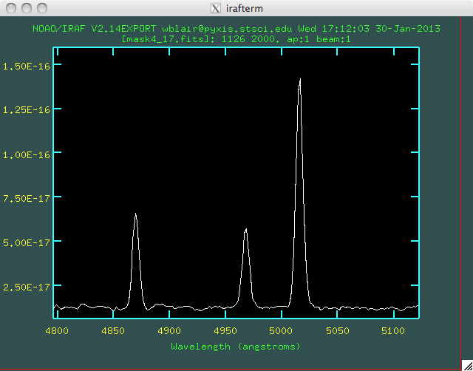
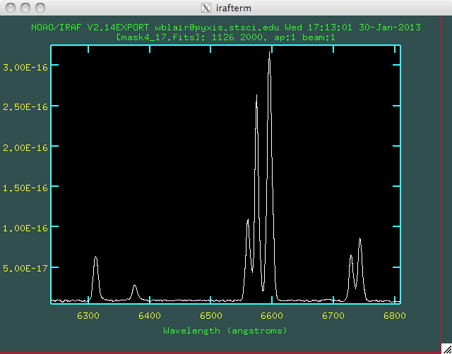
A “typical” young M83 SNR
(B12-115; diameter=5.3 pc)
[Fe II]
Hα,[SII],[OIII]
B,V,I
CXO
(Large circle is 3” or ~65 pc)
Gemini-S GMOS Spectra
Hα
[N II]
[O III]
Hβ
[O I]
[S II]
Looks like the Cygnus Loop, except small Diam and high [S II] density…
Notes:
Note: No obvious high velocity emission, and note the high [S II] density.

Slide 25
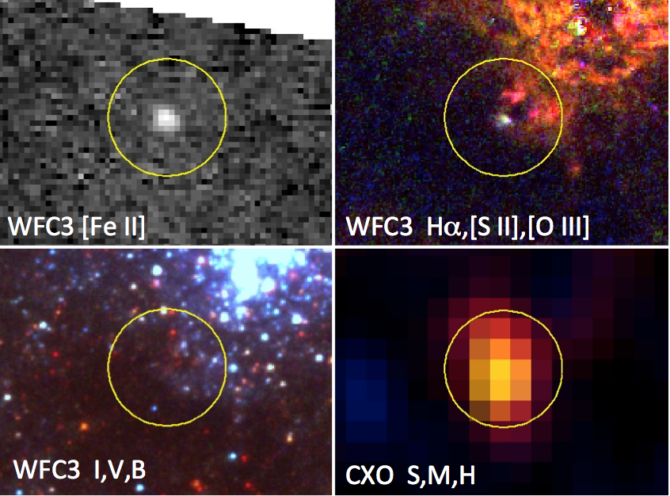
A Newly Discovered SNR from HST/WFC3
(Circle is 3’’)
White means strong in all three bands,
=
Radiative shock emission!
Notes:
Note how the H II region just “goes away” in [Fe II].

Slide 26
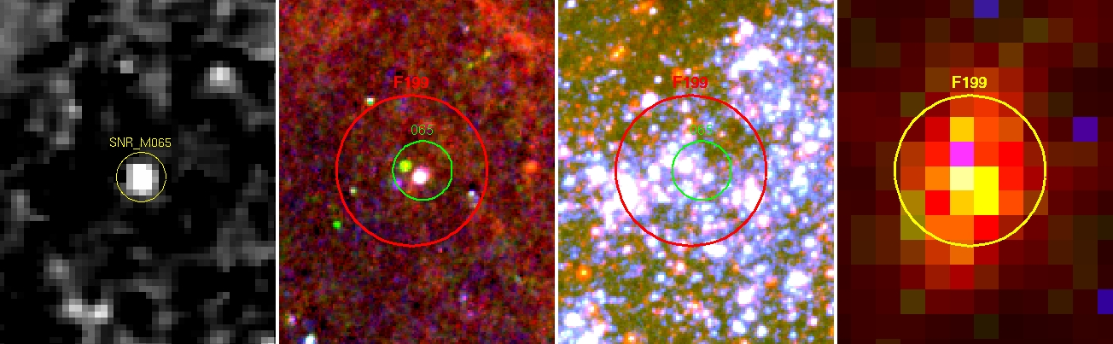
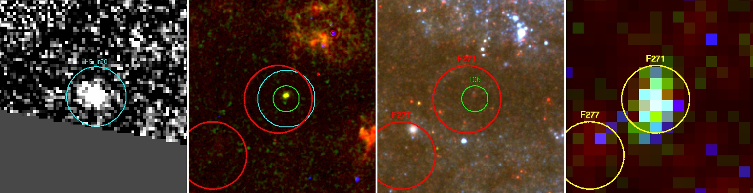
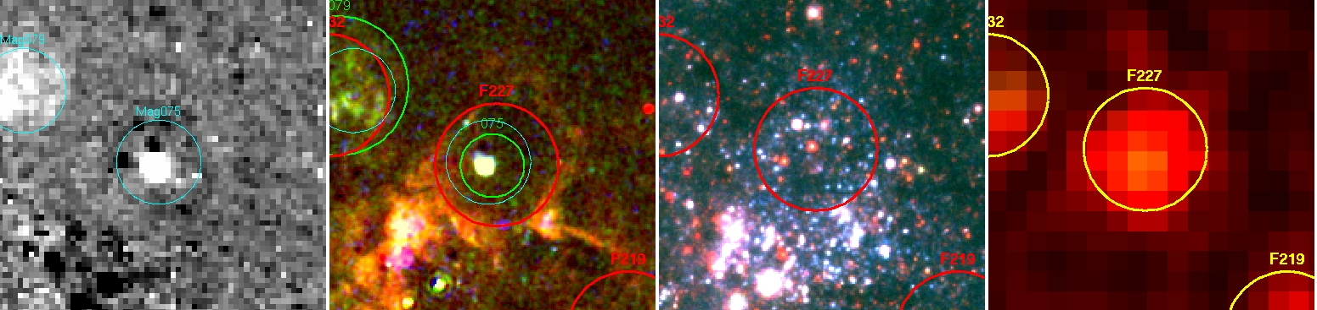
Many other young SNRs are basically similar…
(Believe, me, I could bore you with many more…)

Slide 27
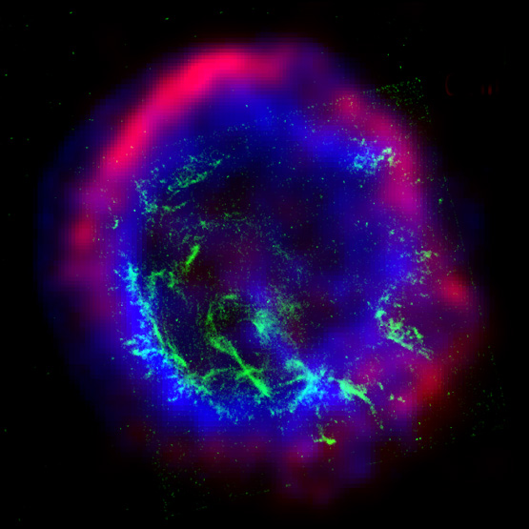
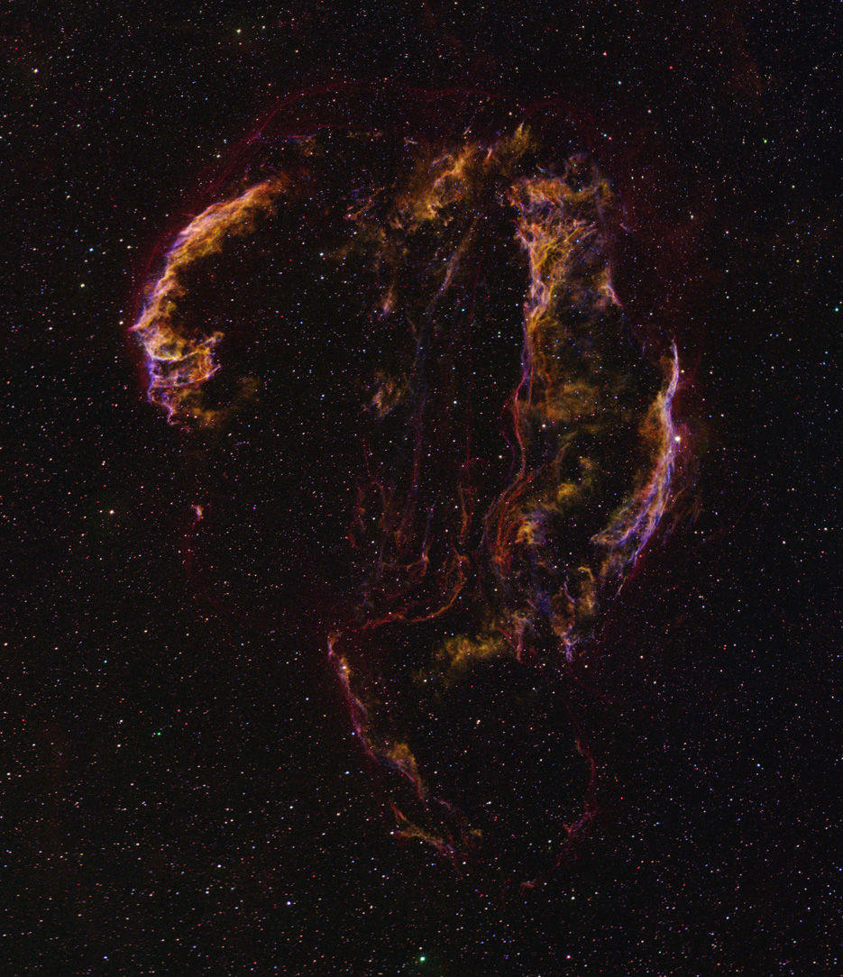
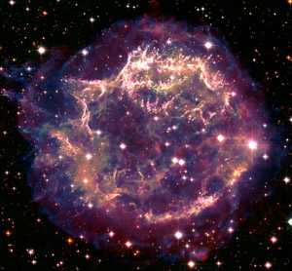
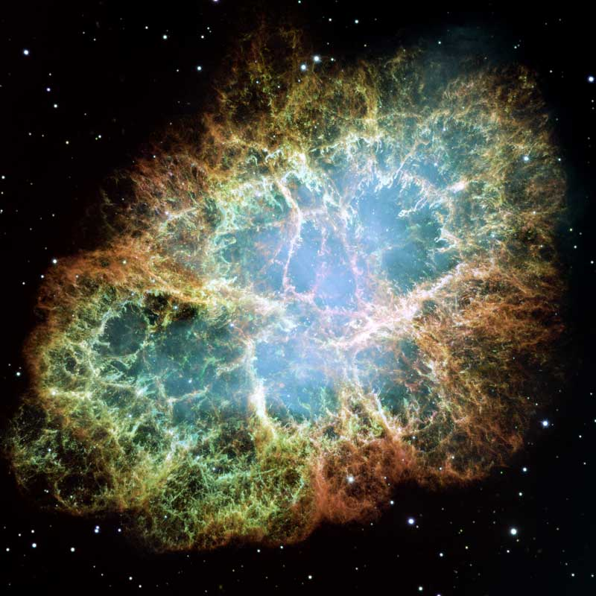
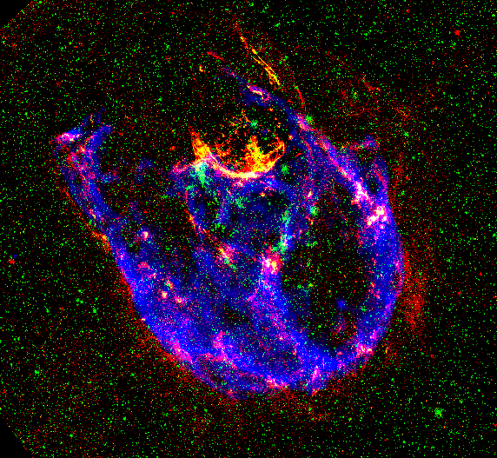
The Core Collapse-SNR Paradigm
(Approximate relative sizes shown)
Cas A
5.6 pc
Crab
5x7 pc
E0102
~13 pc
N132D
~25 pc
Cygnus Loop
28-30 pc
(Note: CC-SN that
Exploded in a cavity.)

Slide 28
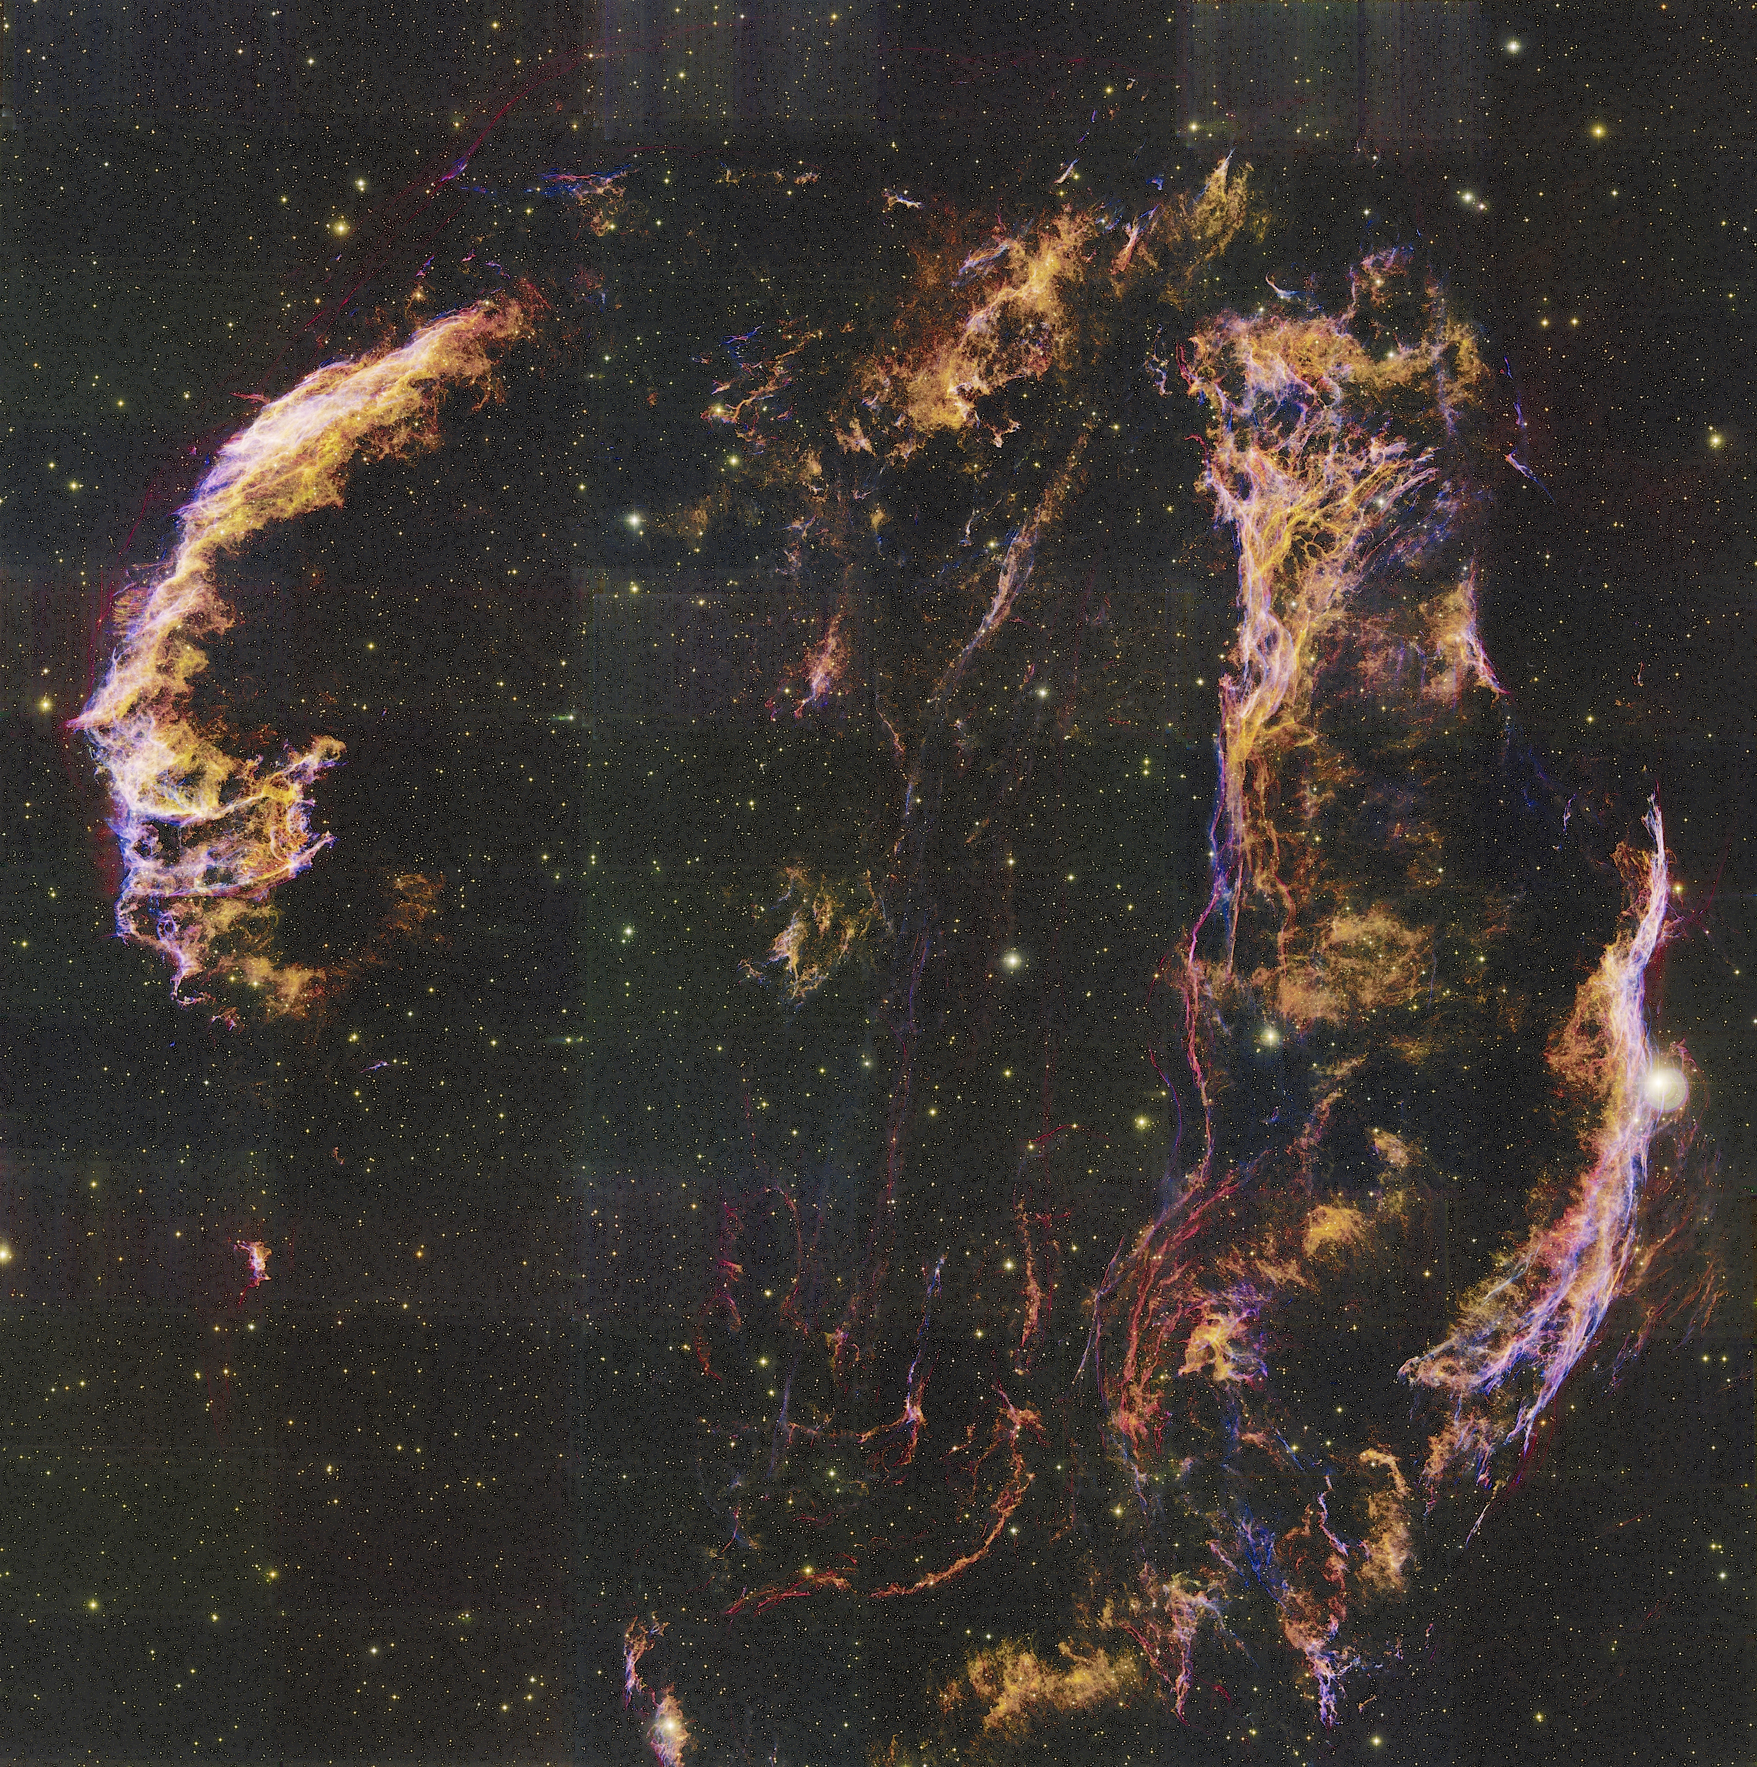
M83 SNRs are “different”
Cas A
5.6 pc
Crab
5x7 pc
E0102
~13 pc pc
Bright, radiative “Cygnus Loops”
At diameters < 10 pc!
M83 SNRs are evolving very quickly into the radiative phase

Slide 29
So what’s going on??
(Possibilities…)
M83 has unusually high ISM pressures and densities.
High abundances in M83 allow significantly higher stellar winds/mass loss from SN progenitors; high density CSM around progenitors causes young SNRs to evolve quickly beyond the ejecta-dominated stage.
Some combination of 1. and 2.

Slide 30
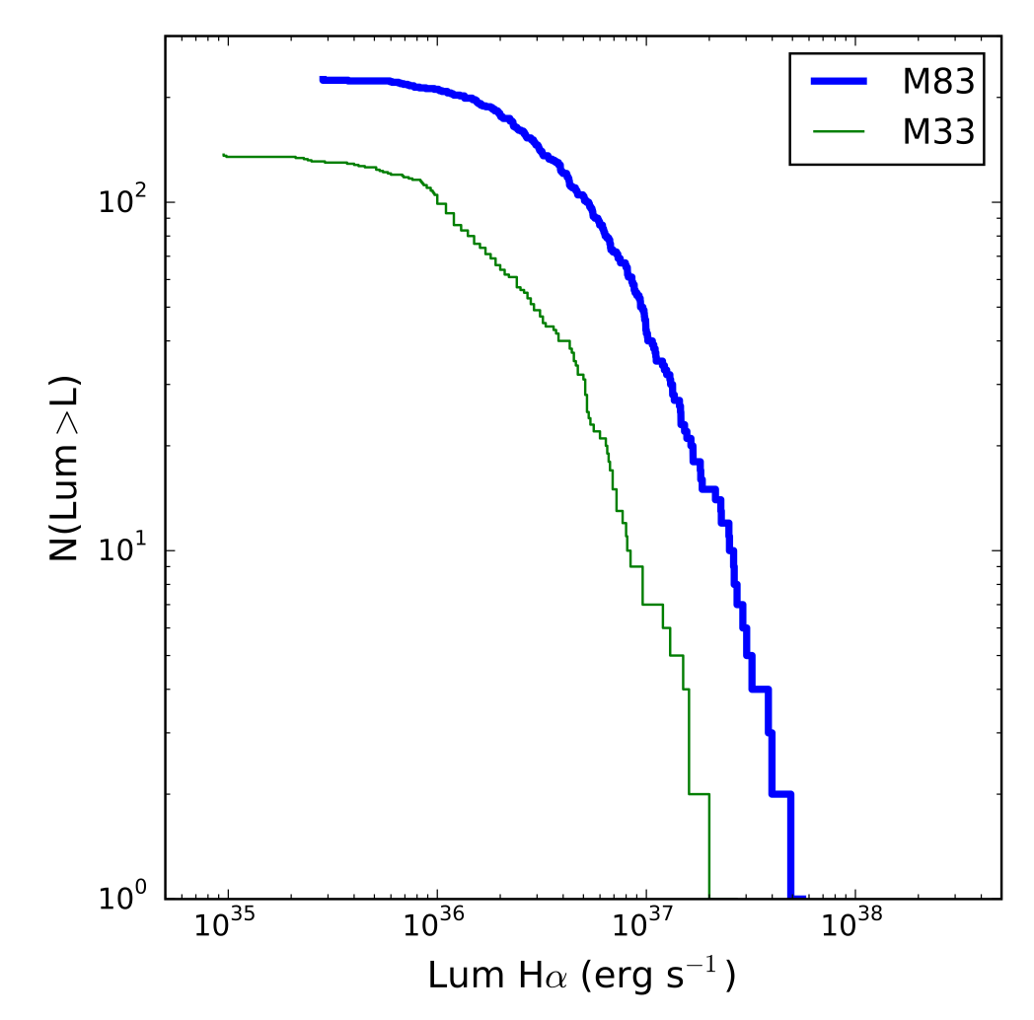
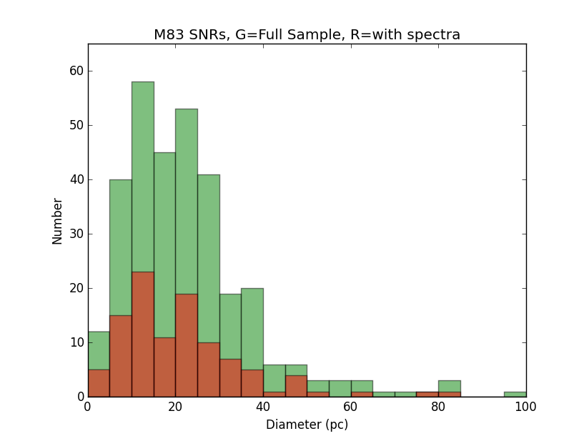
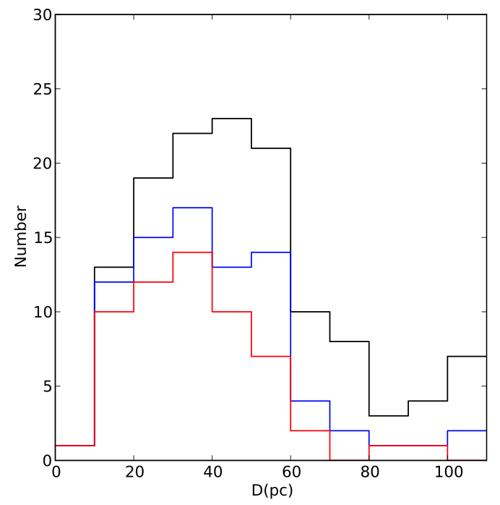
M83 – M33 Comparison
M83
M33: Long+10
M83 SNRs are skewed toward smaller Diameters and higher Luminosities

Slide 31
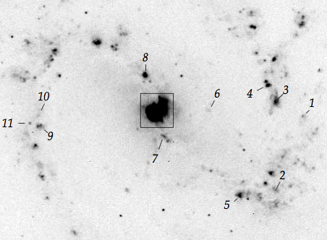
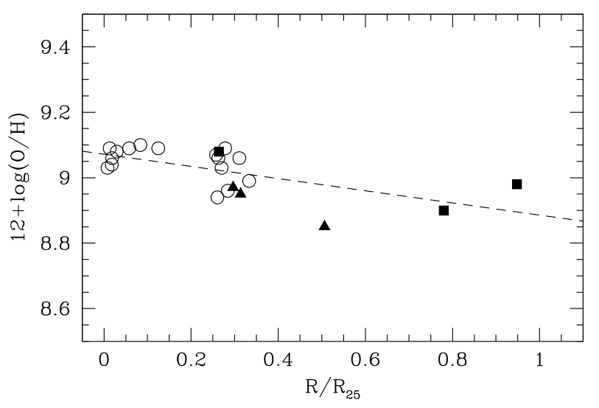
M83 Abundances and Gradients
(solar)
H II region spectral analyses show a modest abundance gradient, but very high (super-solar) abundances over the entire bright optical disk.
(Bresolin & Kennicutt 2002, ApJ, 572, 838; Note: R₂₅ = 6.74’)

Slide 32
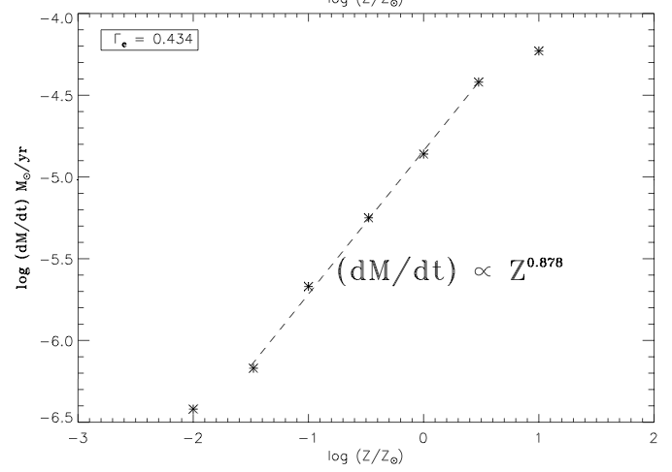

Mass Loss and Metallicity: Models
Vink, de Koter, & Lamers 2001, A&A, 369, 574. T=50,000 K, and constant V_{inf}/V_{esc} for these models.
Kudritzki 2002, ApJ, 577, 389. Models go from early O (top) to late O (bottom) and only up to solar abundance.
Higher metallicity → higher stellar wind mass loss
Notes:
Gamma_e is the ratio between the gravitational and radiative acceleration due to electron scattering.

Slide 33

Summary
As expected from observed SN rate, there are LOTS of SNRs in M83!
HST/WFC3 and Chandra have allowed us to uncover the young SNR population in M83, but...
Very few appear to be obviously in the ejecta-dominated state.
Possible reasons include:
  Rapid evolution due to higher density/pressure in the general ISM?
  High CSM densities due to enhanced mass loss from progenitors?
Some additional young SNRs may remain to be discovered via additional spectroscopy.

Slide 34
Extra Slides

Slide 35



Does [N II]:Hα provide a clue?
M83 SNRs – GMOS spectra
Other Galaxies (from Lee+2015)
[N II]/Hα is primarily an N/H abundance indicator
Even in galaxies where an abundance gradient is indicated, there is large scatter
Is the huge variation at a given GCD indicative of strong and variable pre-SN mass loss?

Slide 36

Does [N II]:Hα provide a clue?
M83 SNRs – GMOS spectra
[N II]/Hα is primarily an N/H abundance indicator
Even in galaxies where an abundance gradient is indicated, there is large scatter
Is the huge variation at a given GCD indicative of strong and variable pre-SN mass loss?
Is the stronger [N II]:Hα for small diameters indicative of local enrichment?
Is there a connection to binarity here?

Slide 37

SN 1957D Optical Spectrum
(From Gemini-S GMOS)

Slide 38


Slide 39


Two Populations of SNRs
This product should be ~ constant.
(Width indicative of range in E_{o} and n_{o}.)
Density:Radiative Age Relationship.
(Slope of -1 expected, but not a bifurcation.)

Slide 40

Spatial Correlation
Yellow:
High Density
Blue:
Low Density
Green:
Undetermined

Slide 41

New Ultraluminous X-ray Source with an HST Counterpart
Soria et al. 2012, ApJ, 750, 152

Slide 42


M83 B12-174a Photometry
Observed photometry for cluster near B12-174a.
Reddening-corrected stars cluster on the youngest isochrones, indicating a population age of <10 Myr and a MS turnoff >17 M_{o}
(Note: SN1957D region is essentially identical to this.)
(See Blair et al. 2015, ApJ, 800, 118)

Slide 43
More young SNRs — with Possible Companion stars?
SN 1957D
B12-115
These are some of the best examples, but there are numerous other possible cases to investigate.
B12-151
B12-127
B12-174a

Slide 44


M83 – M33 Comparison-II
[S II] electron densities
M33: Long+10
M83 GMOS: Winkler+16
M83 has larger fraction at lower ratios
(=higher densities)

