Slide 1
LHC, Neutrinos, and Beyond
Masterclass Update
Neutrino Masterclasses:
  MINERvA (current)
    worked well in 2019 and in 2020 until COVID intervention; adapt to online for 2021.
    Experiment no longer taking data; sunset in future?
  Over-the-horizon development
    MicroBooNE – with Sowjanya Gollapinni (LANL)
    DUNE – with group headed by David Martinez (SDSMT) and David DeMuth (VCSU)

Slide 2
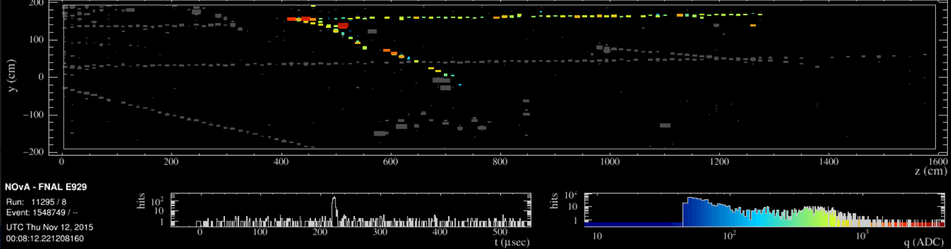
LHC, Neutrinos, and Beyond
Masterclass Update
NOvA – Neutrino Oscillations:
Working with UMN mentor Greg Pawloski
Successful activity prototype at UMN center
Working to expand collaboration with Fermilab

Slide 3
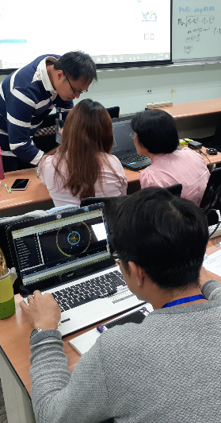
LHC, Neutrinos, and Beyond
Masterclass Update
CMS Masterclass:
Improvements and new developments
  New data: ~270 events with 4-lepton,
  including ZZ, H, background
  CIMA, iSpy enable 2- & 4-lepton events with
  mass plots
  CIMA, iSpy new data allocation scheme
  CIMA fixes to speed database connections
  CIMA plan to improve flexibility &
  maintainability

Slide 4
LHC, Neutrinos, and Beyond
Additional Work
BAMC and BAMA Further Details:
CMS April (QuarkNet) and May (International)
ATLAS July (LBNL)
Enthusiastic responses, nearly 800 students
LHC and Neutrino Fellows:
Monthly → weekly meetings (Mar.–Aug.); now biweekly
Assisted, gave feedback, participated.

Slide 5
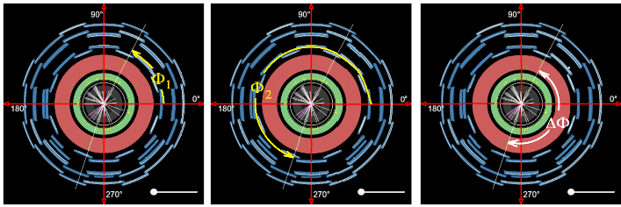
LHC, Neutrinos, and Beyond
Additional Work
World Wide Data Day (W2D2)
Completed November 12
  New measurement – Φ and ΔΦ (previously Φ and θ)
  Adapted for remote learning

