Slide 1
Boston QuarkNet
Quantum Tunneling Workshop
Astrophysics, Applications
August 13-14, 2026
Dr. Rick Dower
Charles T. Bauer Professor, Emeritus
The Roxbury Latin School

Slide 2
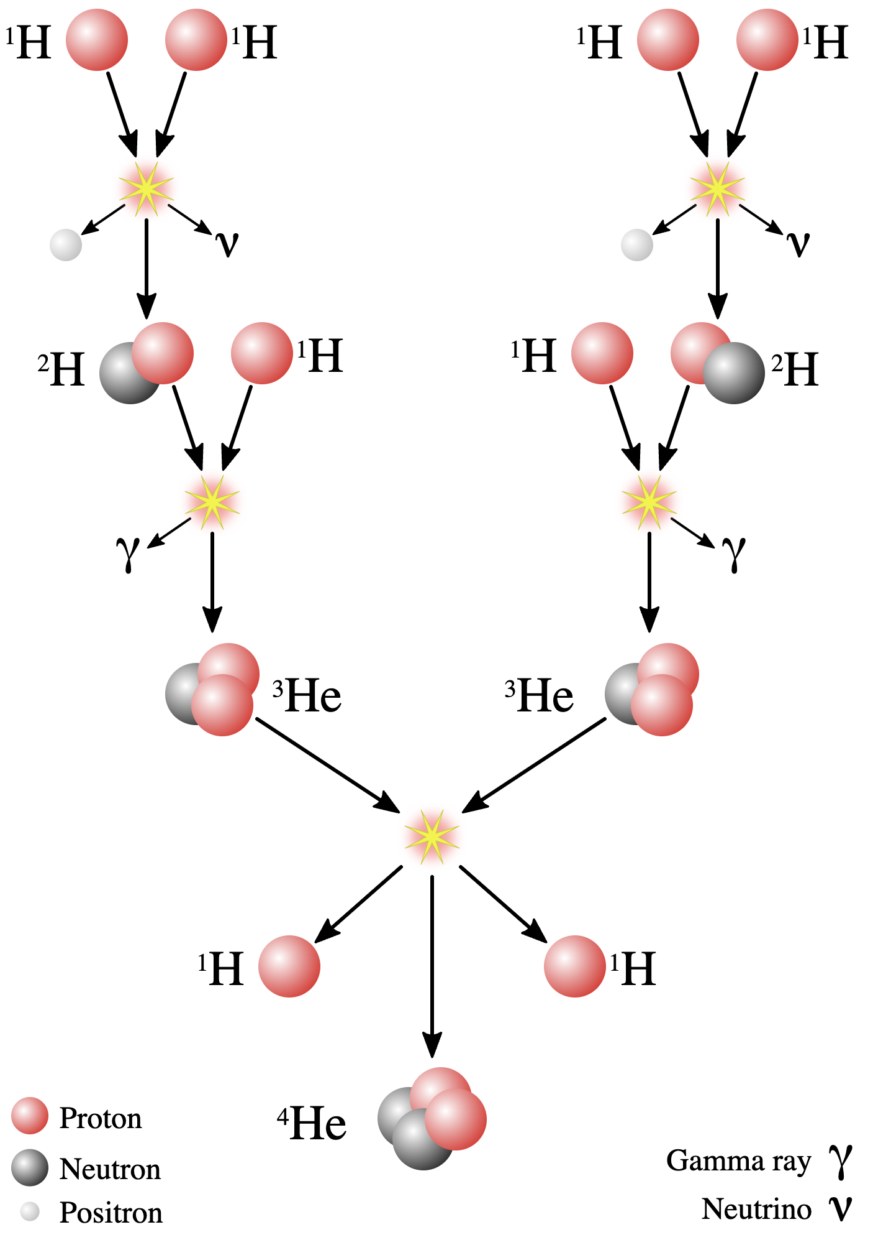
Quantum Tunneling in Astrophysics - 1
Standard Solar Model (SSM) attributes 83% of Sun’s energy production to the pp fusion chain illustrated here.

Slide 3
Activity 11 pp Solar Fusion - 1
Calculate KE₁ (J and keV) required for each of two protons to achieve a separation of 2.4 fm to allow strong force interaction during a head-on collision (proton radius = 1.2 fm).
Calculate the speed of a proton with the KE₁ .

Slide 4
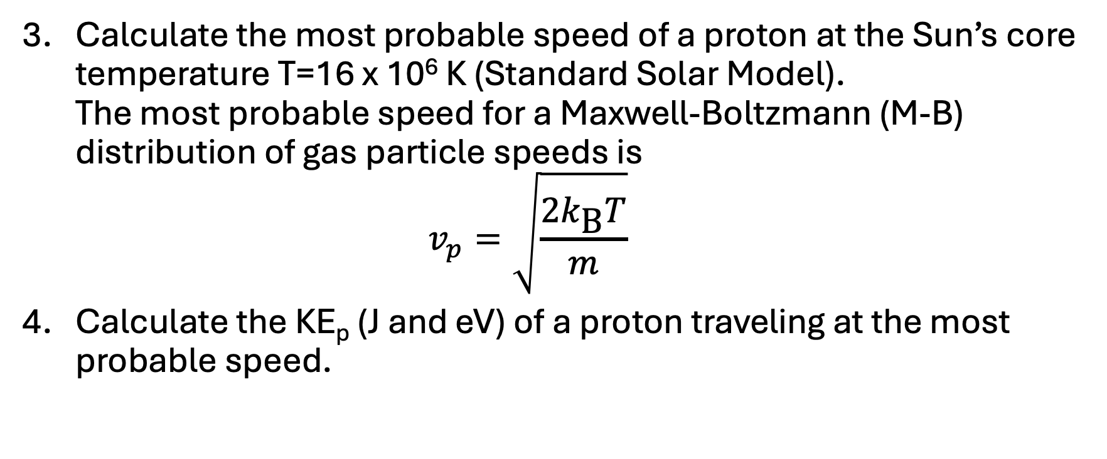
Activity 11 pp Solar Fusion - 2
Calculate the most probable speed of a proton at the Sun’s core temperature T=16 x 10⁶ K (Standard Solar Model).
The most probable speed for a Maxwell-Boltzmann (M-B) distribution of gas particle speeds is
$v_{p}=\sqrt{\frac{2k_{\text{B}}T}{m}}$
Calculate the KE_{p} (J and eV) of a proton traveling at the most probable speed.

Slide 5
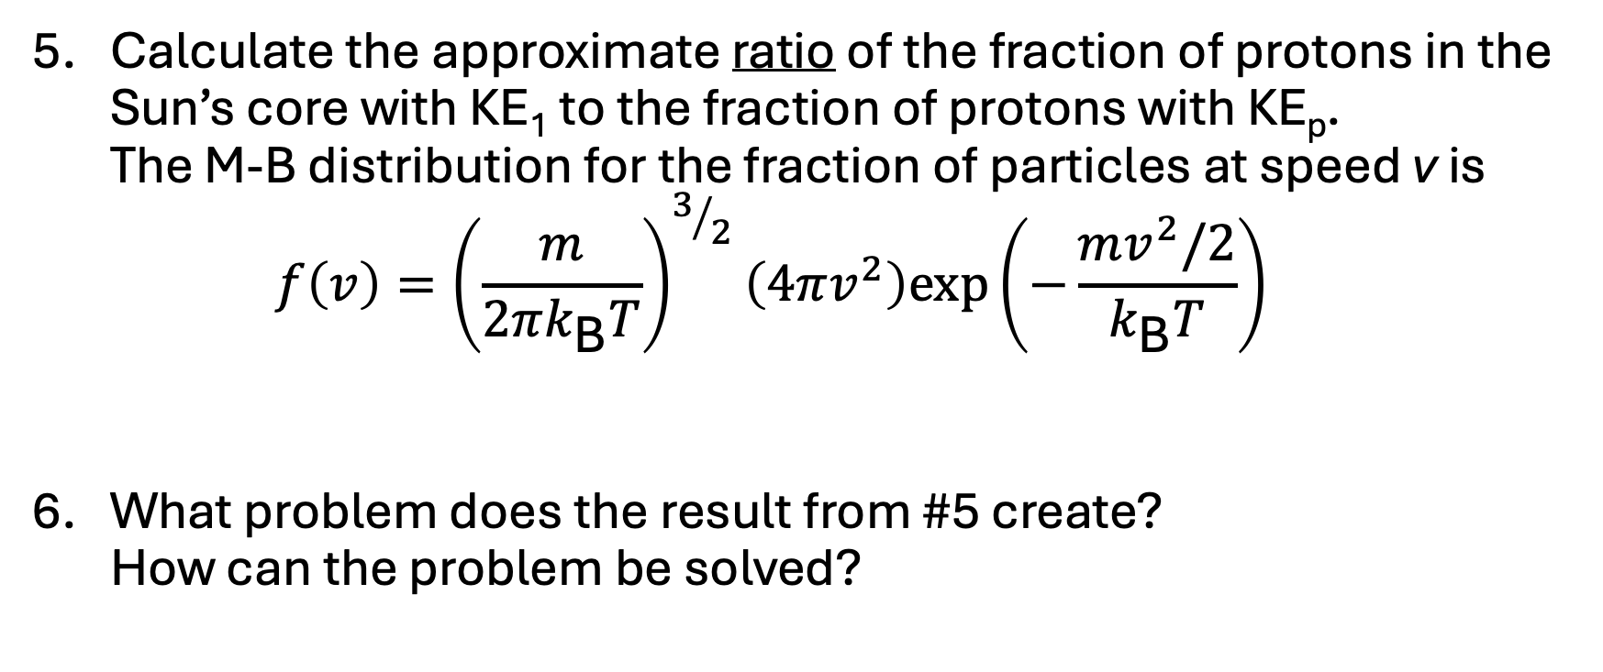
Activity 11 pp Solar Fusion - 3
Calculate the approximate ratio of the fraction of protons in the Sun’s core with KE₁ to the fraction of protons with KE_{p}.
The M-B distribution for the fraction of particles at speed v is
$f\left(v\right)={\left(\frac{m}{2πk_{\text{B}}T}\right)}^{3/2}\left(4πv^{2}\right)exp\left(−\frac{mv^{2}/2}{k_{\text{B}}T}\right)$
What problem does the result from #5 create?
How can the problem be solved?

Slide 6
Quantum Tunneling in Astrophysics - 2
George Gamow realized that quantum tunneling is not restricted to
α-decay. It is fundamental to fusion energy production in stellar cores.
For fusion, particles tunnel into a strong force potential well rather than out of such a well.
But first, how do we know the SSM is correct?
Photons may take 10⁵ years from travel from core to surface of Sun due to the random walk electromagnetic scattering of photons from ions.
How can we measure the core temperature of the Sun now?

Slide 7
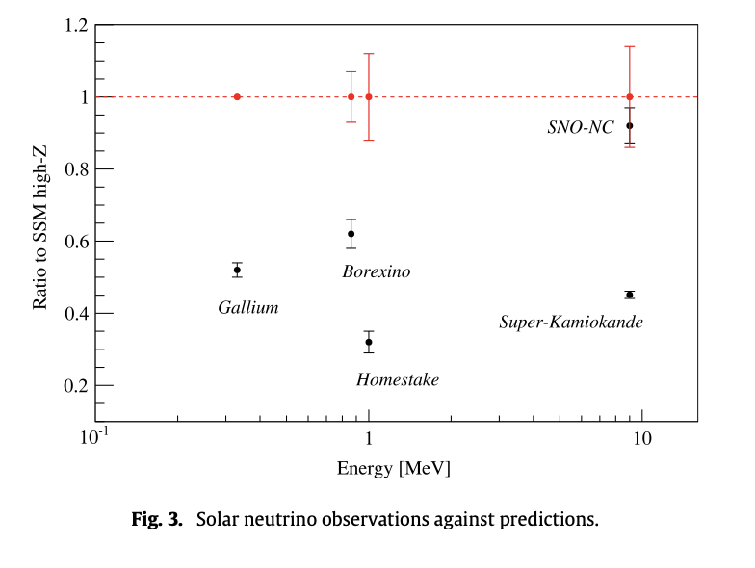
Quantum Tunneling in Astrophysics - 3
Solar Neutrinos!
In a plot from a 2014 review article “Solar neutrinos and the solar model,” Aldo Ianni showed the correspondence between SSM calculations and neutrinos measured by several different experiments sensitive to a variety of neutrino energy values.

Slide 8
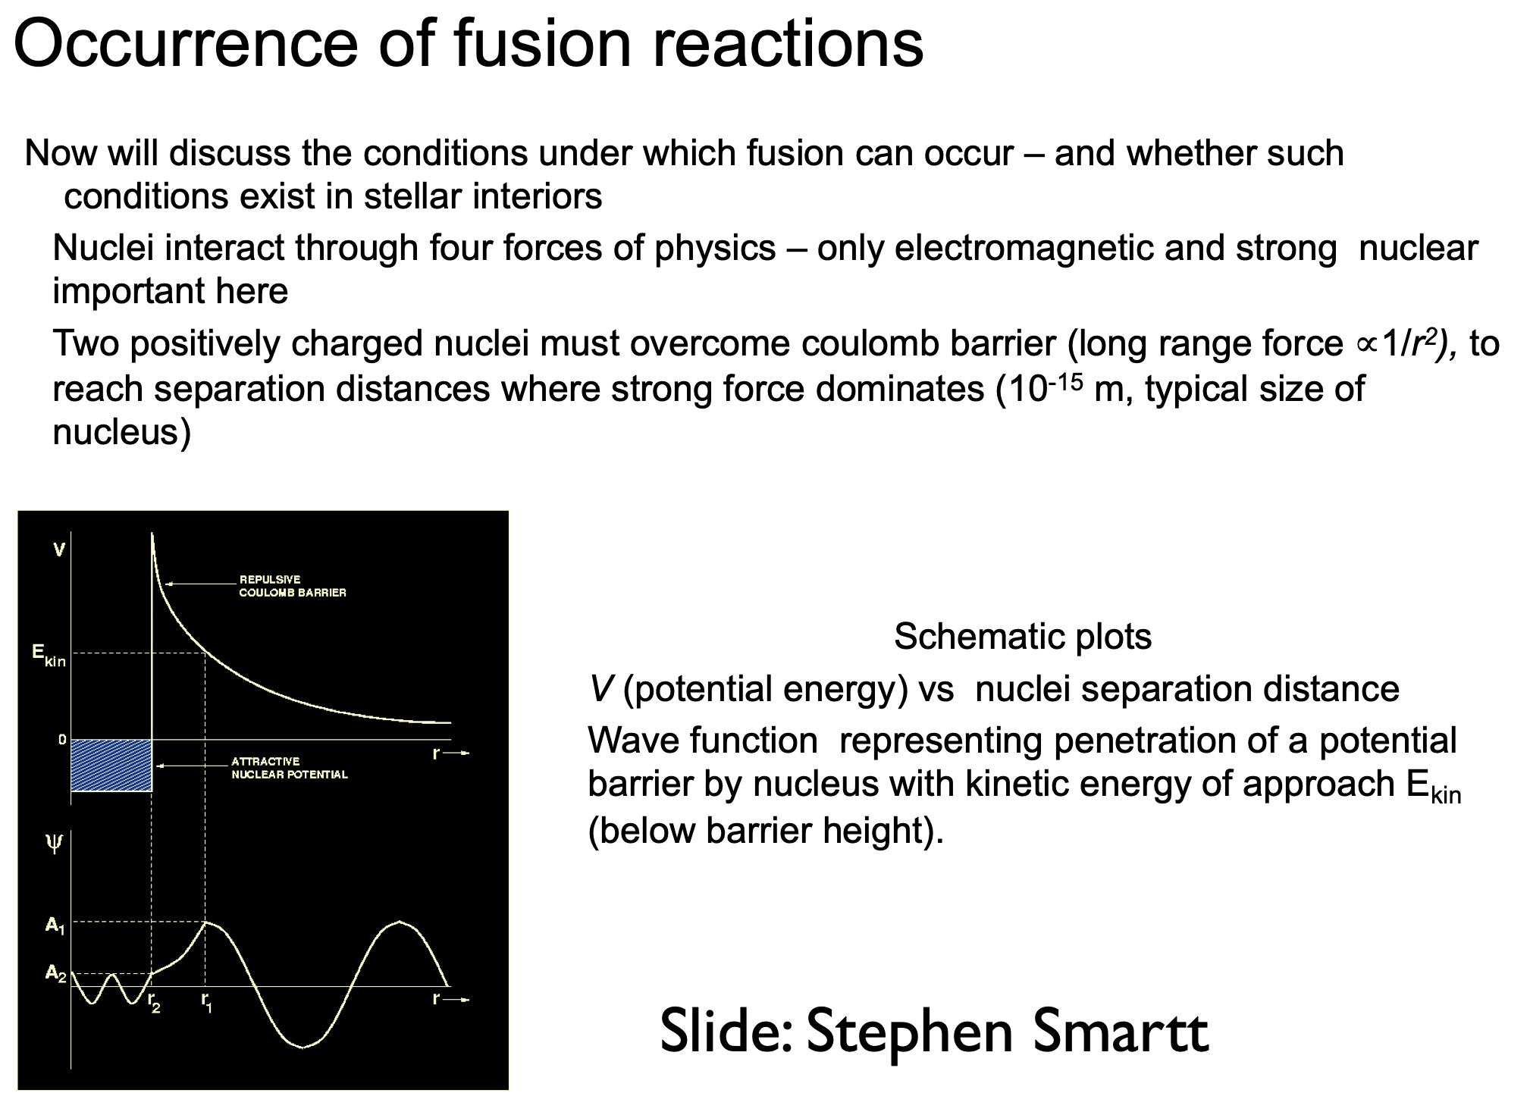
Quantum Tunneling in Astrophysics - 4
Prof. of Astrophysics at Oxford

Slide 9
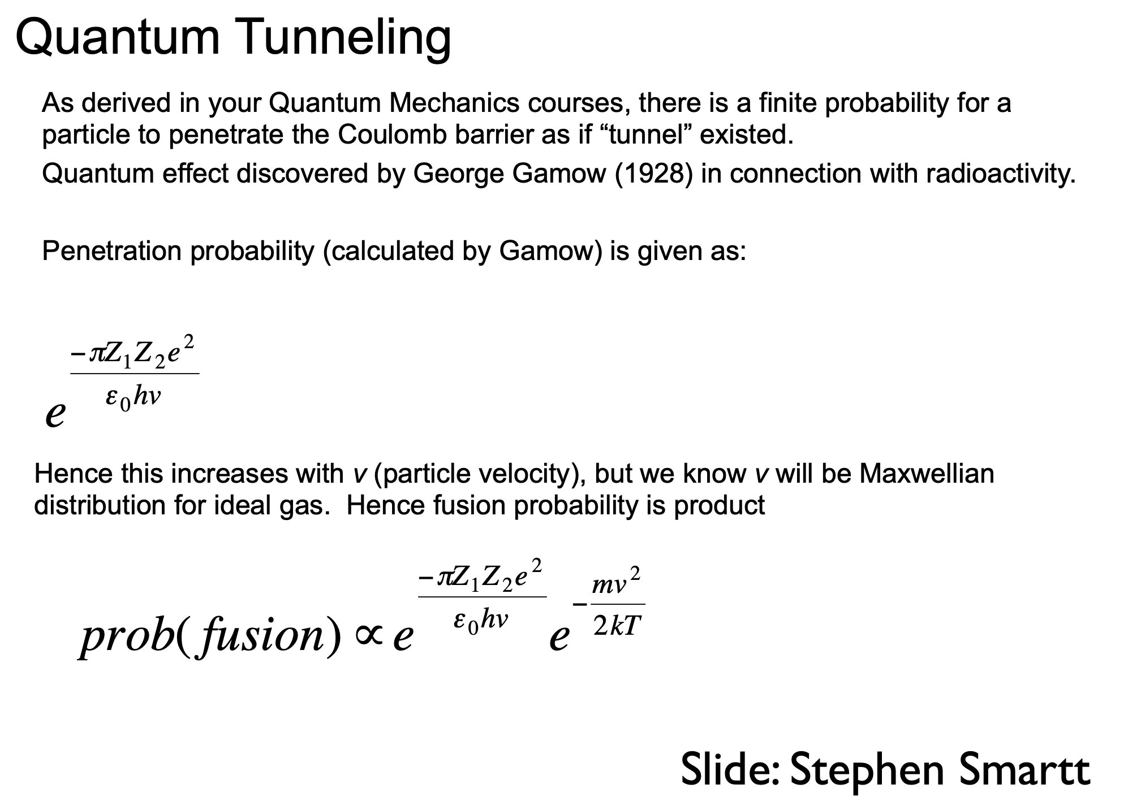
Quantum Tunneling in Astrophysics - 5

Slide 10
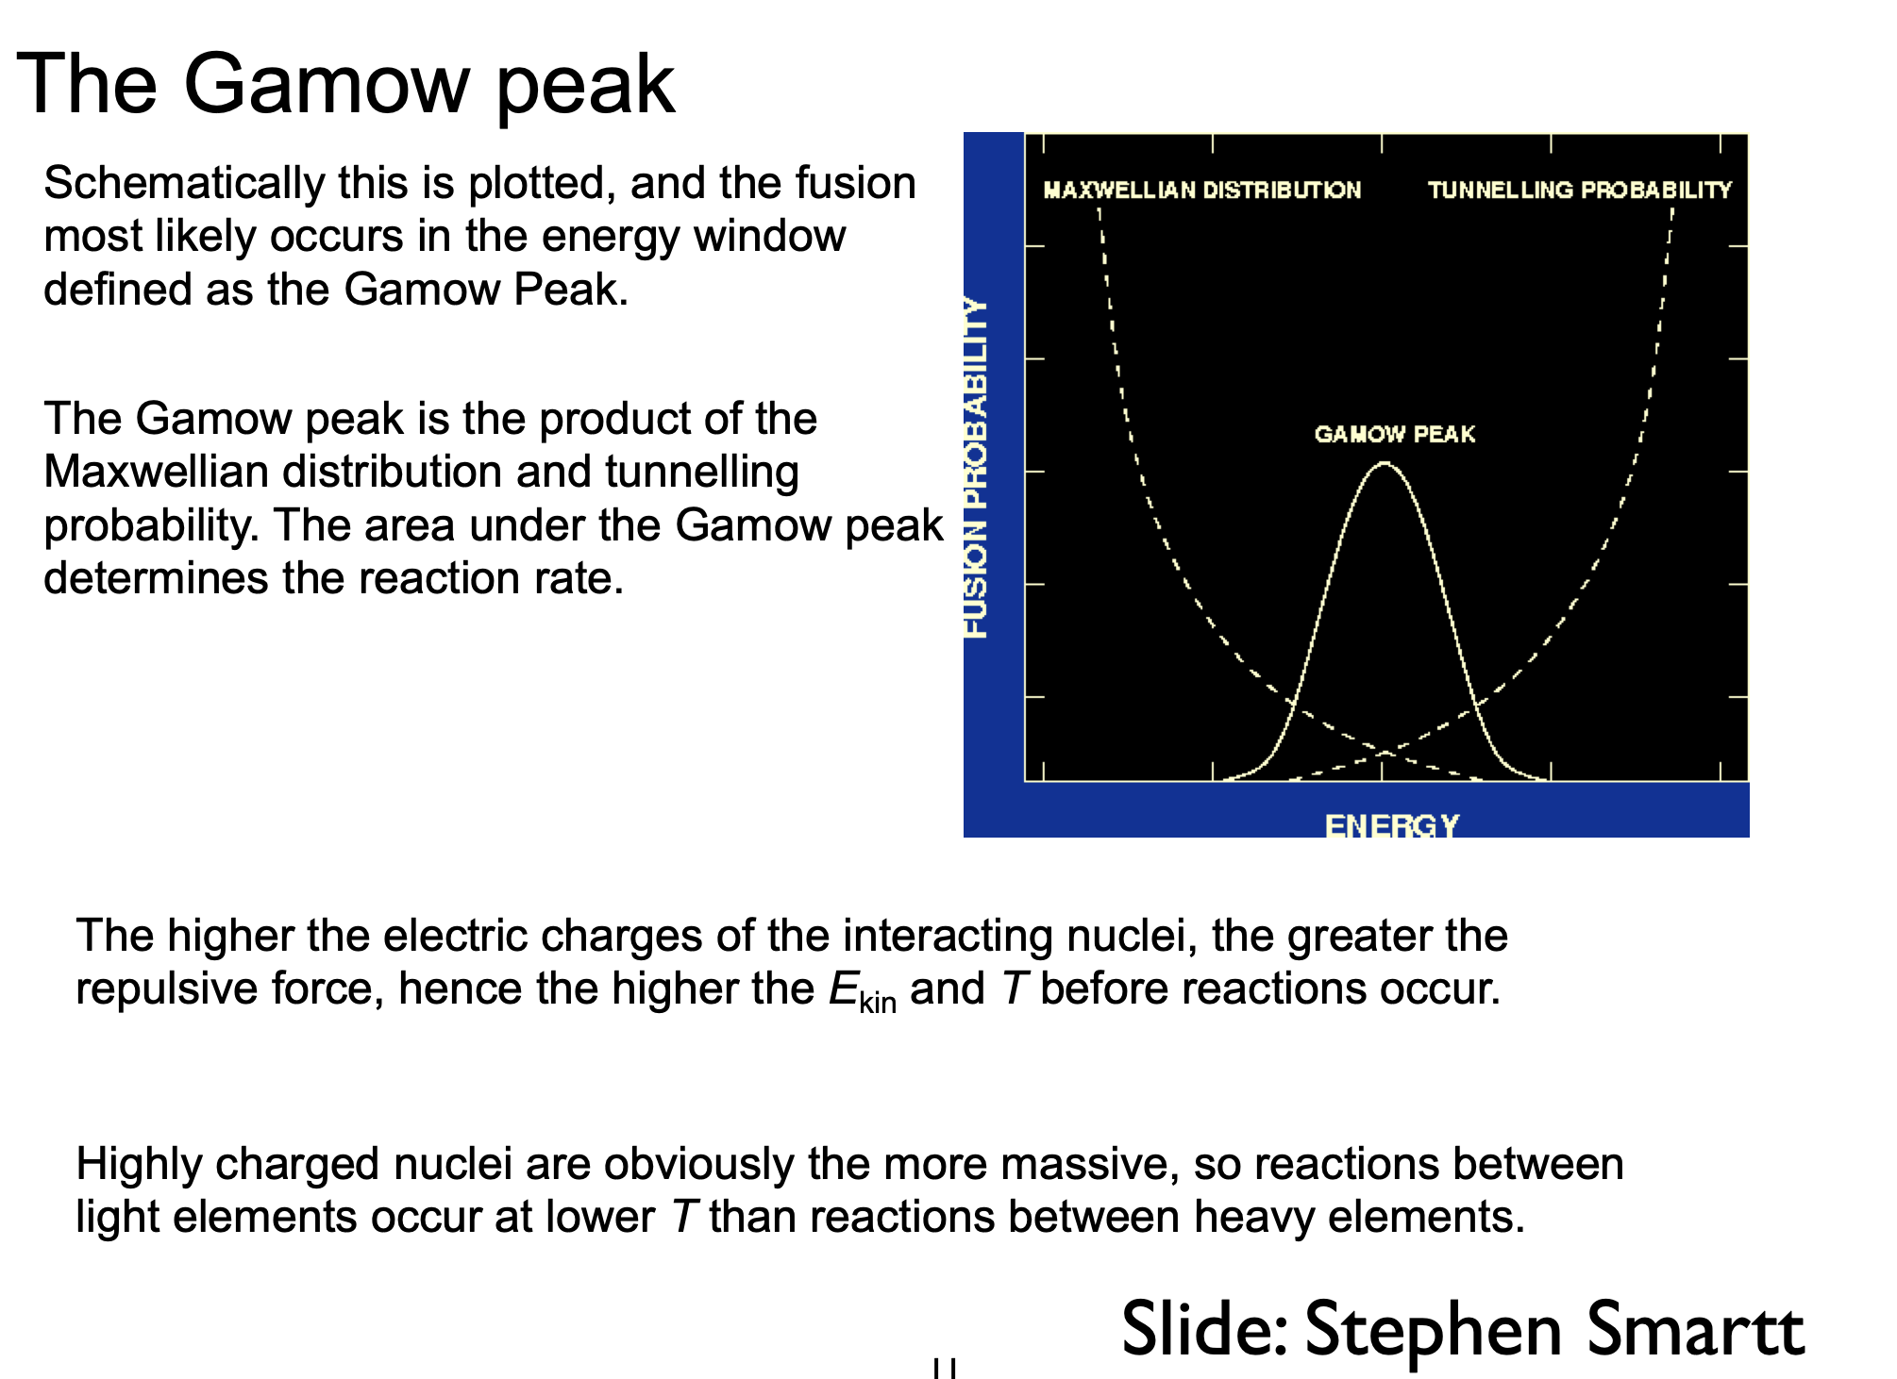
Quantum Tunneling in Astrophysics - 6

Slide 11
Quantum Tunneling in Astrophysics - 7
1938 – Hans Bethe, emphasizing quantum tunneling, showed that nuclear fusion powers the stars.
1948 April 1 –Ralph Alpher and George Gamow, published “The Origin of Chemical Elements,” a foundational paper in Big Bang nucleosynthesis. Gamow invited his friend Hans Bethe to contribute his name to make it the “alphabet” paper – Alpher, Bethe, Gamow.
1967 – Hans Bethe awarded Nobel Prize in Physics “for his contribution to the theory of nuclear reactions especially his discoveries concerning the energy production in stars.”

Slide 12
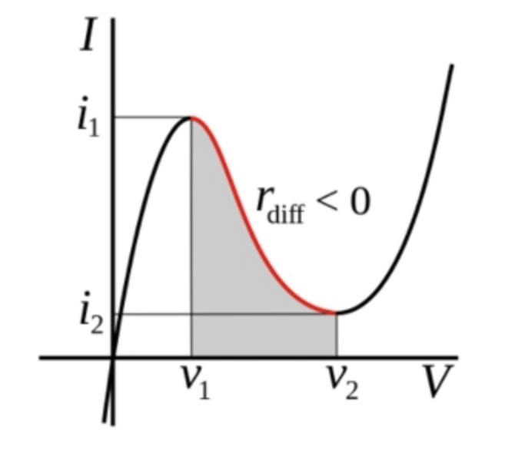
Quantum Tunneling in Electronics
1973 – Nobel Prize to Leo Esaki for “experimental discoveries regarding tunneling phenomena in semiconductors”.
Red line: “negative resistance.”
Tunneling current: 0<V<V₁, 0<i<i₁
Used in high frequency oscillators - negative resistance compensates for R in circuit and stabilizes oscillation frequency.

Slide 13
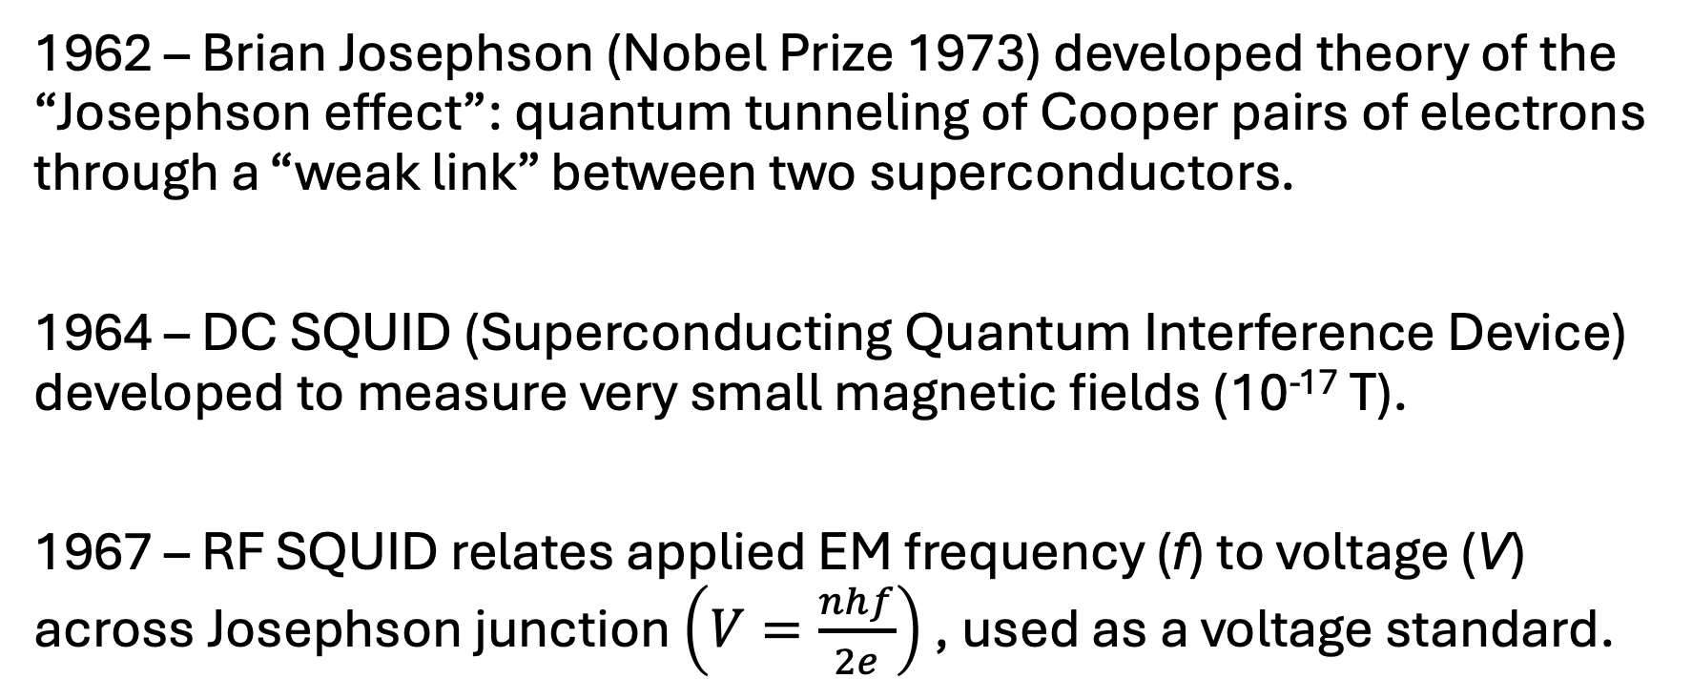
Quantum Tunneling in Superconductors - 1
1962 – Brian Josephson (Nobel Prize 1973) developed theory of the “Josephson effect”: quantum tunneling of Cooper pairs of electrons through a “weak link” between two superconductors.
1964 – DC SQUID (Superconducting Quantum Interference Device) developed to measure very small magnetic fields (10⁻¹⁷ T).
1967 – RF SQUID relates applied EM frequency (f) to voltage (V) across Josephson junction $\left(V=\frac{nhf}{2e}\right)$ , used as a voltage standard.

Slide 14
Quantum Tunneling in Superconductors - 2
John Clarke, Michel Devoret, John Martinis (Nobel Prize 2025)
“for the discovery of macroscopic quantum mechanical tunneling and energy quantisation in an electric circuit”.
SHORT:
https://www.youtube.com/shorts/d435bjxj8kE (about 2:00)
Sixty Symbols:
https://www.youtube.com/watch?v=wwJf9ZUuKi8 (13:21)

Slide 15
Quantum Tunneling in Microscopy - 1
1981 – Gerd Binnig and Heinrich Rohrer (Nobel Prize 1986) develop the scanning tunneling electron microscope that measures atomic surface features by measuring the tunneling current between a tungsten atom tip of a wire and a surface.
“Scanning Tunneling Microscopy: Seeing Atoms” (3:39)
(https://www.youtube.com/watch?v=9KMo1peo2PU )

Slide 16
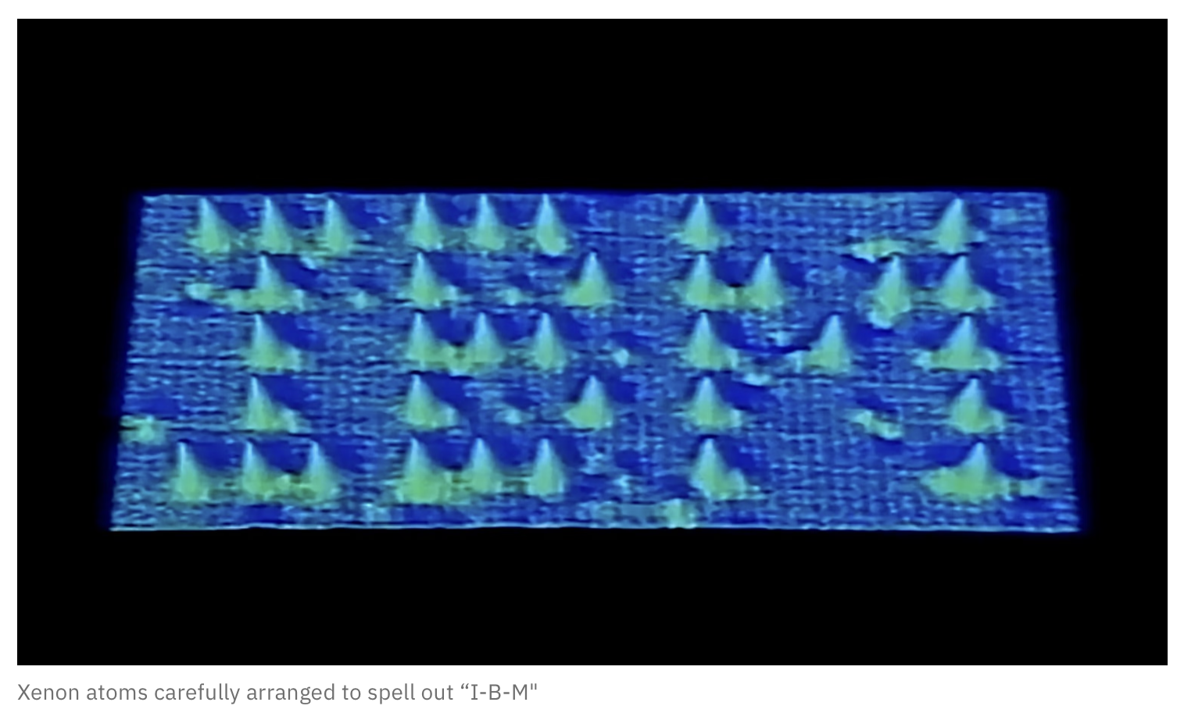
Quantum Tunneling in Microscopy - 2
1990 – Don Eigler arranges Xe atoms on a surface to spell “IBM”.
“Don Eigler at IBM explains scanning tunneling microscope” (2:44)
(https://www.youtube.com/watch?v=Kjd4FFmcHeU)

Slide 17
Quantum Tunneling in Biology
Enzymes: https://www.youtube.com/watch?v=almlINDXU5c (12:16)
Mitochondria
Electron Transport Chain
Photosynthesis?

