Slide 1
Boston QuarkNet
Quantum Tunneling Workshop
Quantum Mechanics, α-decay
August 13-14, 2026
Dr. Rick Dower
Charles T. Bauer Professor, Emeritus
The Roxbury Latin School

Slide 2
Quantum Tunneling
Quantum: In physics, a discrete (i.e. countable, not continuous) physical quantity, such as energy, momentum, angular momentum, action, or electric charge involved in an interaction.
Tunneling: The process of going through a barrier without going over it, e.g. a train traveling through a tunnel rather than going over a mountain to get to the other side.
What problem inspired quantum tunneling?

Slide 3
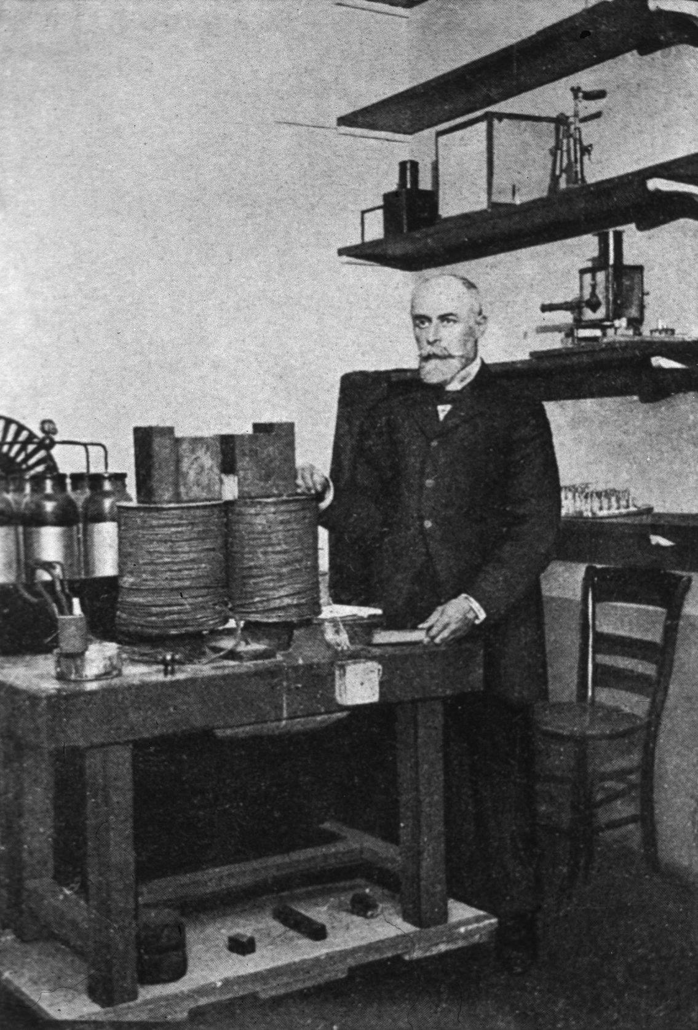
Radioactivity Discovered - 1
Henri Becquerel (1852-1908)
Timeline
20 Jan.1896 – Becquerel learned of Röntgen’s discovery of X-rays.
24 Feb. 1896 – Becquerel reported that phosphorescent materials activated by sunlight produced shadows on photo plates wrapped in black paper.
26-27 Feb, 1896 – cloudy and dark in Paris. Becquerel placed wrapped photo plates with uranium salts on top in a drawer.

Slide 4
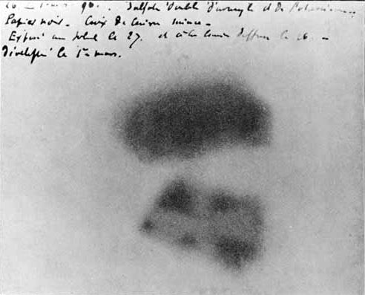
Radioactivity Discovered - 2
Becquerel Photograph
Timeline
1 March 1896 – Becquerel develops plate from drawer.
He expects very faint image.
May 1896 – Becquerel finds non-phosphorescent uranium salt yields same result.
Uranium is radioactive.
1898 – Marie Curie and
Gerhard Carl Schmidt report :
Thorium is radioactive,
but no other element tested.

Slide 5

Radioactivity Discovered - 3
Marie Curie and Pierre Curie
(1867-1934) (1859-1906)
Timeline
1898 – Pitchblende more radioactive than uranium.
Polonium similar to bismuth. Radium similar to barium.
1899 – André-Louis Debierne discovers radioactive actinium. Friedrich Giesel (1904) identifies its chemical properties and Z=89.

Slide 6

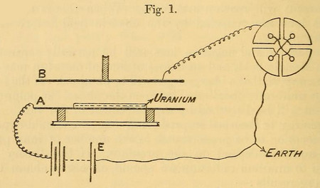
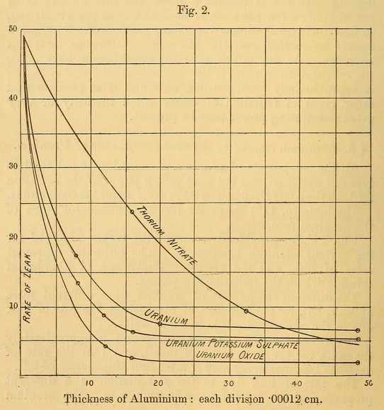
Radioactivity Discovered - 4
Ernest Rutherford (1871-1937)
Timeline
1899 – Rutherford finds two types of radiation from uranium: α, with less penetrating power,
β, with more penetrating power.

Slide 7
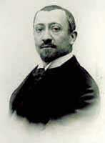
Radioactivity Discovered - 5
Paul Villard (1860-1934)
Timeline
1900 – For a beam of radium radiation, with α-particles blocked by a thin lead sheet, Villard noted rays deflected by a magnet (β-particles) and other rays not deflected by a magnet.
1903 – Rutherford named the undeflected rays γ-rays because they had more penetrating power than β-rays.

Slide 8
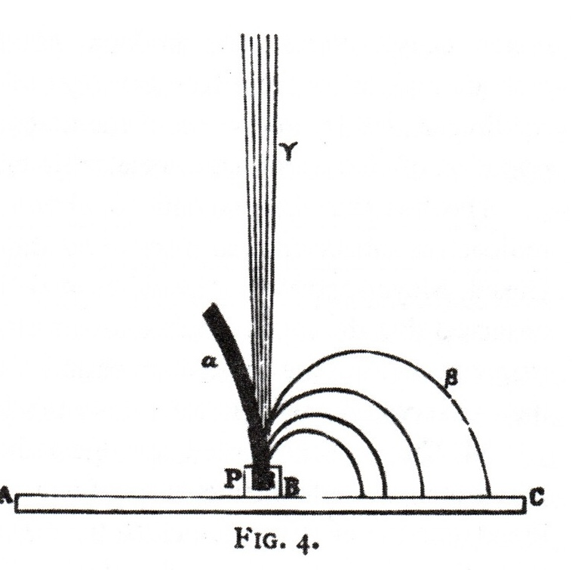
Radioactivity Discovered - 6
3 Types of Radiation (1904)
M. Curie, Radioactive Substances
Timeline
1900 – Becquerel measured
q/m β-particles = q/m electrons
β-particles are electrons.
1914 – Rutherford and Edward Andrade measured λ of γ-rays with crystal diffraction.
γ-rays are very short wavelength electromagnetic radiation.

Slide 9
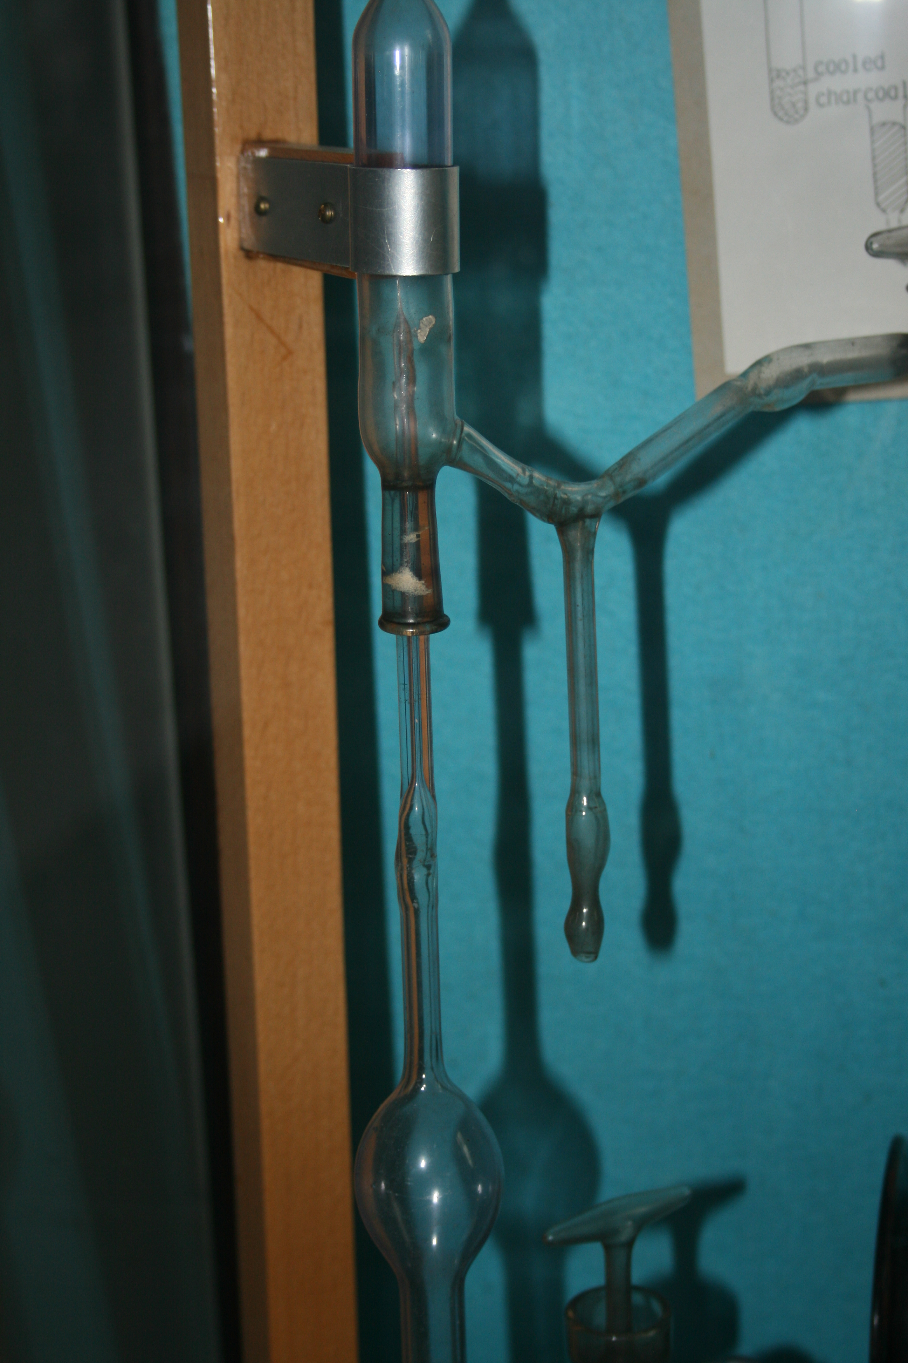
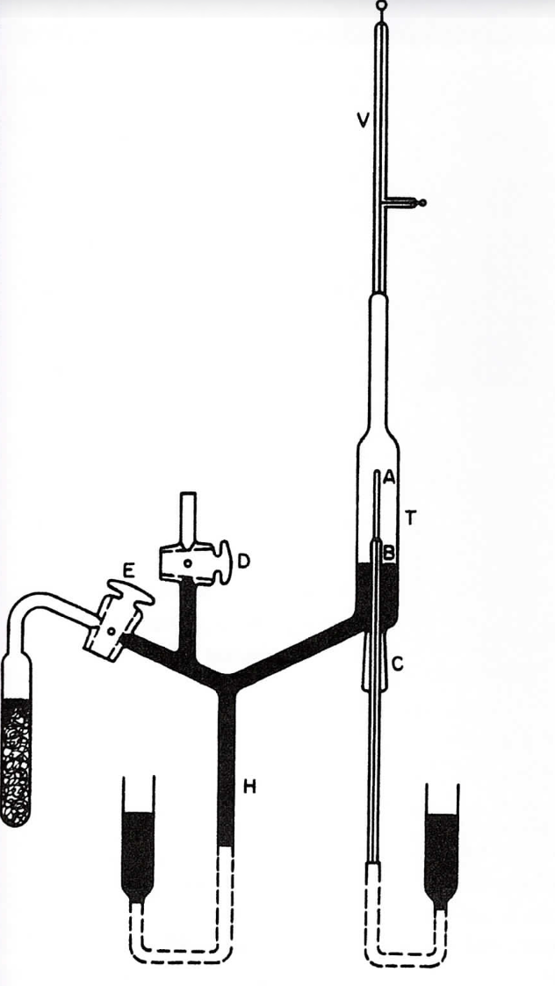
Radioactivity Discovered - 7
Rutherford and Royds Apparatus
Timeline
Cavendish Lab Diagram
Museum
1906 – Rutherford measures
α q/m = (1/2) H ion q/m
1908 – Rutherford and
Hans Geiger measure
α-particle charge = +2 q_{e}.
1909 – Rutherford and Thomas Royds demonstrated that
α-particle = He⁺⁺ ion

Slide 10
Activity 1 Radioactive Decay Series
Get a chart for one of the four natural radioactive decay series (Uranium, Actinium, Thorium, Neptunium).
Use the sequence of α and β decays to fill in the isotopes on the chart from the beginning isotope at the top right to the stable end point isotope at the bottom left of your series.
Compare your isotope sequence with those of others who had the same series and reconcile any differences.

Slide 11
How were the α, β decay sequences of the radioactive series determined?

Slide 12
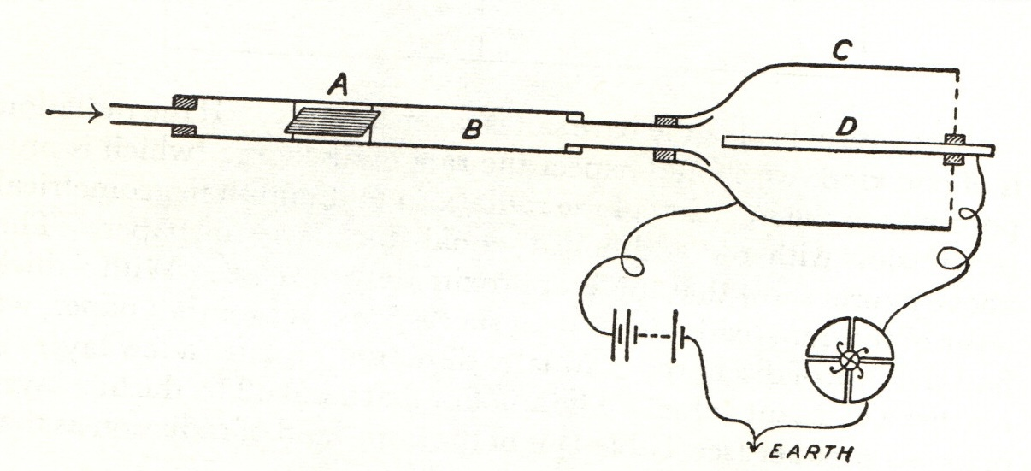
Radioactive Transformations - 1
Thorium Emanation Apparatus
1900 Rutherford at McGill
Why was thorium radioactivity altered by small drafts of air in the lab?
Air from left slowly flows past thorium oxide in paper container A through screen at right.
Ionization of air measured with 100 volts between C and D.

Slide 13
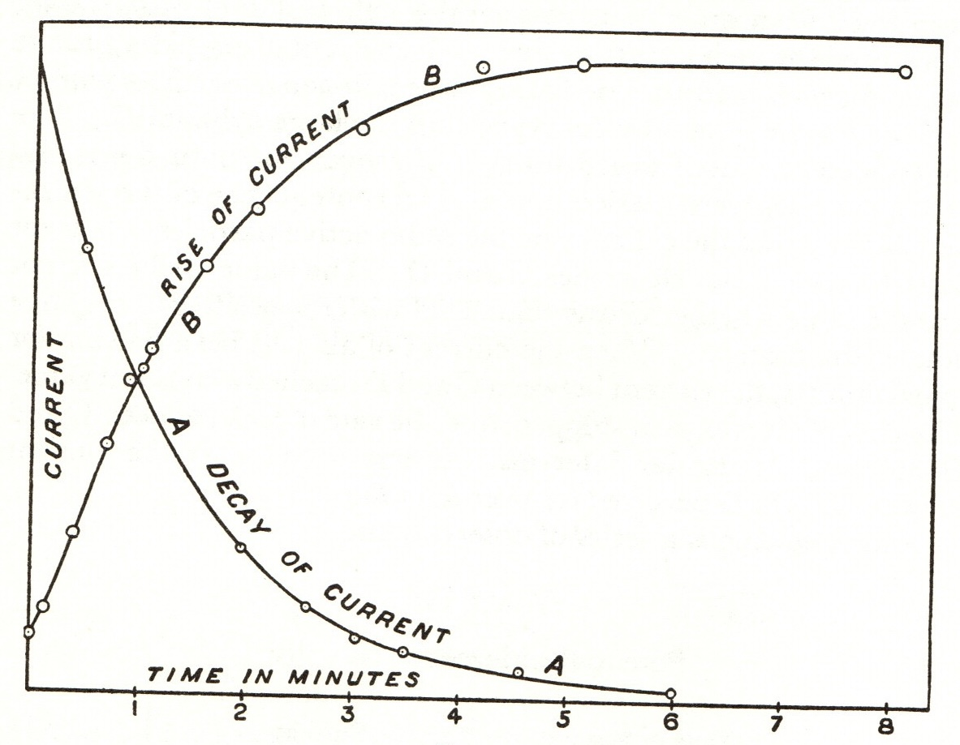
Radioactive Transformations - 2
Exponential Decay
1900 Rutherford at McGill
Curve A shows exponential decay of ionization produced by Th emanation after air flow stopped.
Curve B shows, with data from a different apparatus, recovery of radioactivity of thorium sample after airflow stopped removing the thorium emanation.
Other experiments showed that emanation is a noble gas.

Slide 14
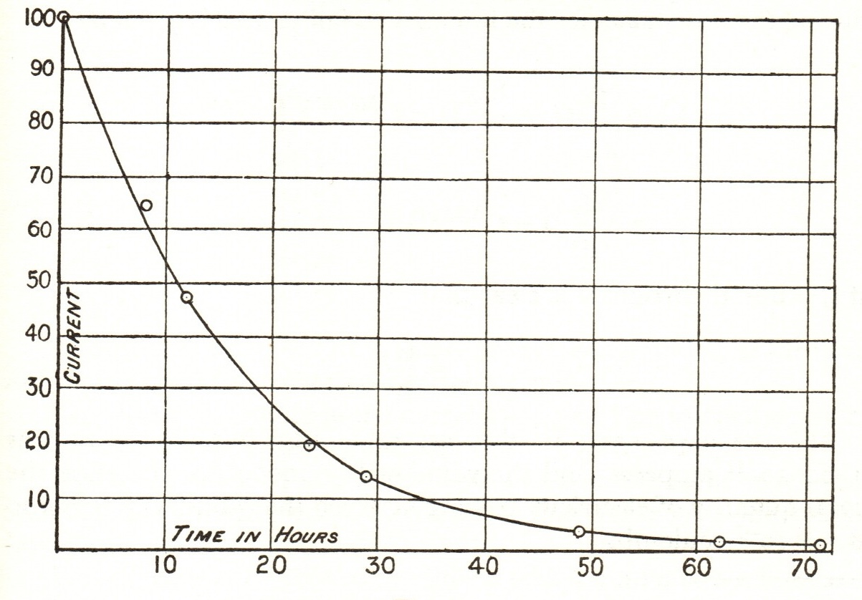
Radioactive Transformations - 3
Th Emanation Deposit Decay
1900 Rutherford at McGill
Thorium emanation, half-life about 1 minute, left behind a residue that has a radioactive half-life of about 11 hours.
Ionization of air produced by radioactivity measures quantities of substances undetectable by chemical balances.

Slide 15
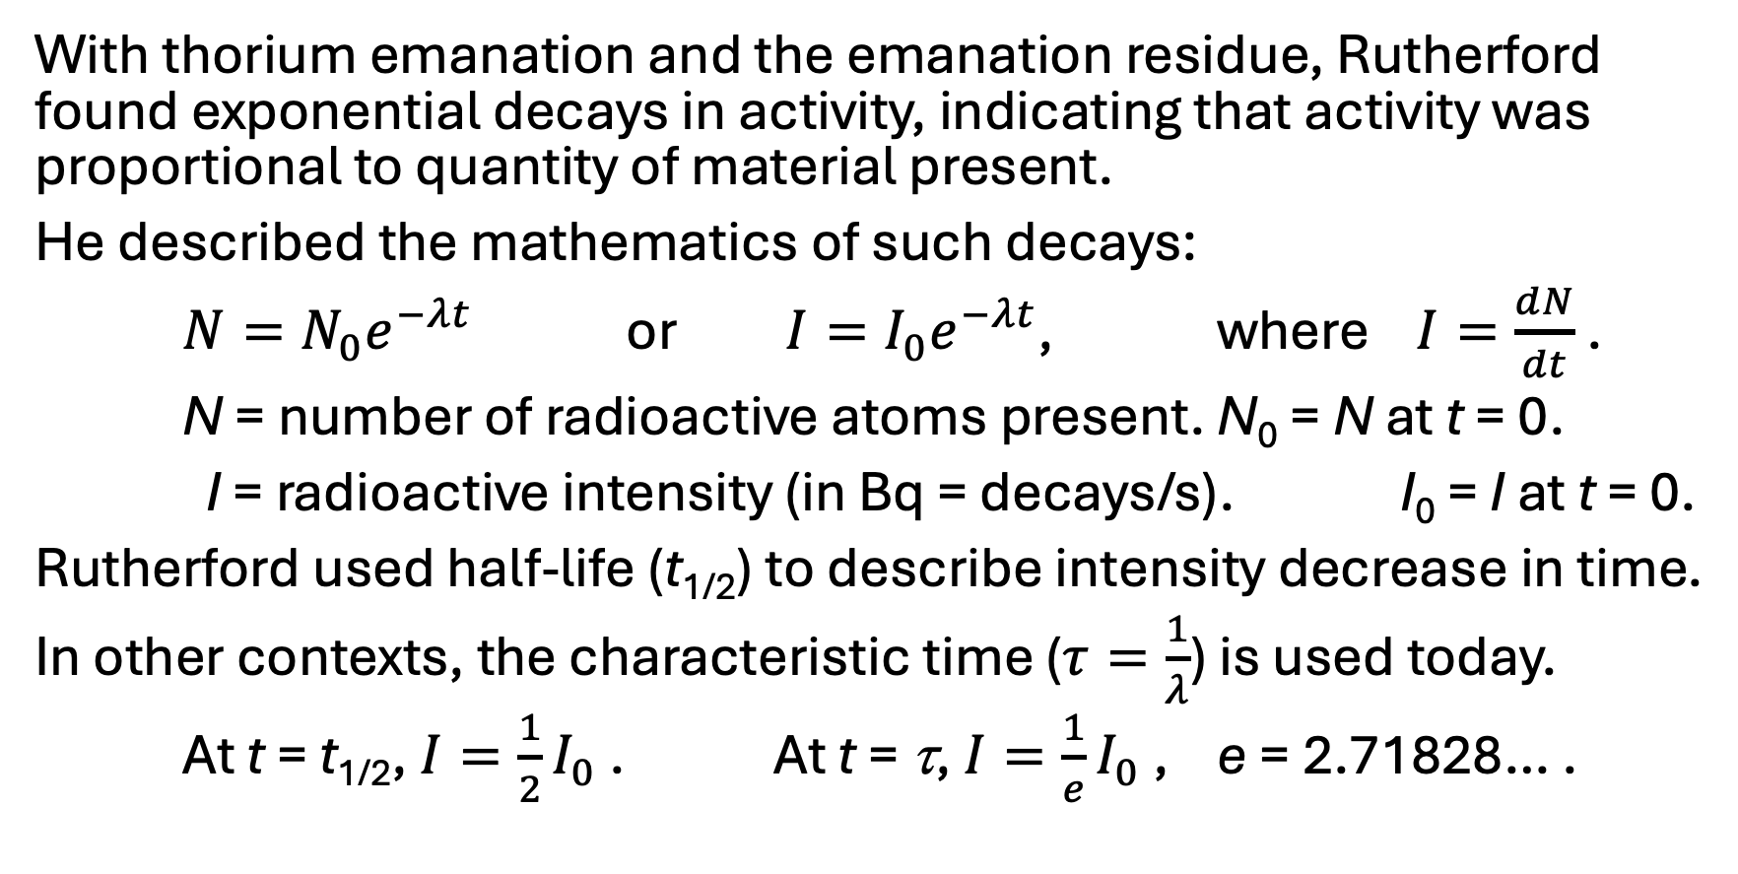
Radioactive Transformations - 4
With thorium emanation and the emanation residue, Rutherford found exponential decays in activity, indicating that activity was proportional to quantity of material present.
He described the mathematics of such decays:
$N=N_{0}e^{−λt}$ or $I=I_{0}e^{−λt}$, where $I=\frac{dN}{dt}$ .
N = number of radioactive atoms present. N₀ = N at t = 0.
I = radioactive intensity (in Bq = decays/s). I₀ = I at t = 0.
Rutherford used half-life (t_{1/2}) to describe intensity decrease in time.
In other contexts, the characteristic time ($τ=\frac{1}{λ}$) is used today.
At t = t_{1/2}, $I=\frac{1}{2}I_{0}$ . At t = τ, $I=\frac{1}{e}I_{0}$ , e = 2.71828… .

Slide 16
Activity 2 Radioactive Half-Life (t_{1/2})
Values for the average number of α decays in 1.00 s for 0.01 g of the starting isotope of each decay series are given below.
U-238: 124.4 Bq, Pu-239: 2.29 x 10⁷ Bq,
Th-232: 40.7 Bq, Np-237: 2.60 x 10⁵ Bq
Bq = becquerel = 1 decay/s = s⁻¹
Use the intensity value (I) for the starting isotope in your series to calculate the half-life (t_{1/2}) of that isotope.
Work collaboratively to devise a calculation procedure, OR
work individually then compare your procedures and results.

Slide 17
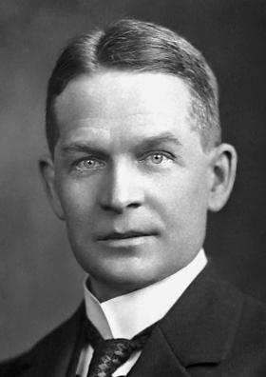
Radioactive Transformations - 5
Frederick Soddy (1877-1956)
Rutherford and Soddy at McGill (1900-1903)
Oxford trained chemist Frederick Soddy worked with Rutherford to show that radioactive decays are accompanied by chemical changes.
Radioactive atoms change from one element to another with different chemical properties.

Slide 18
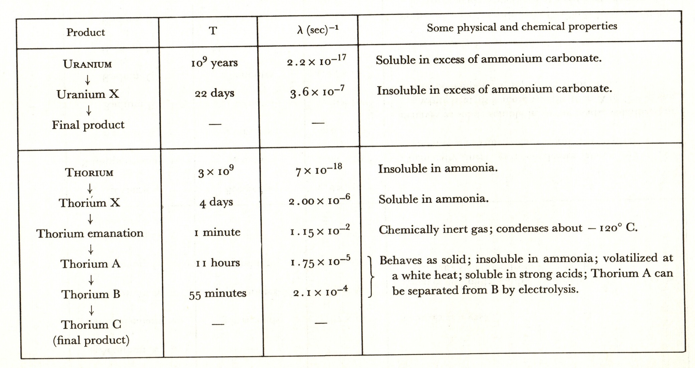
Radioactive Transformations – 6
Rutherford 1905

Slide 19
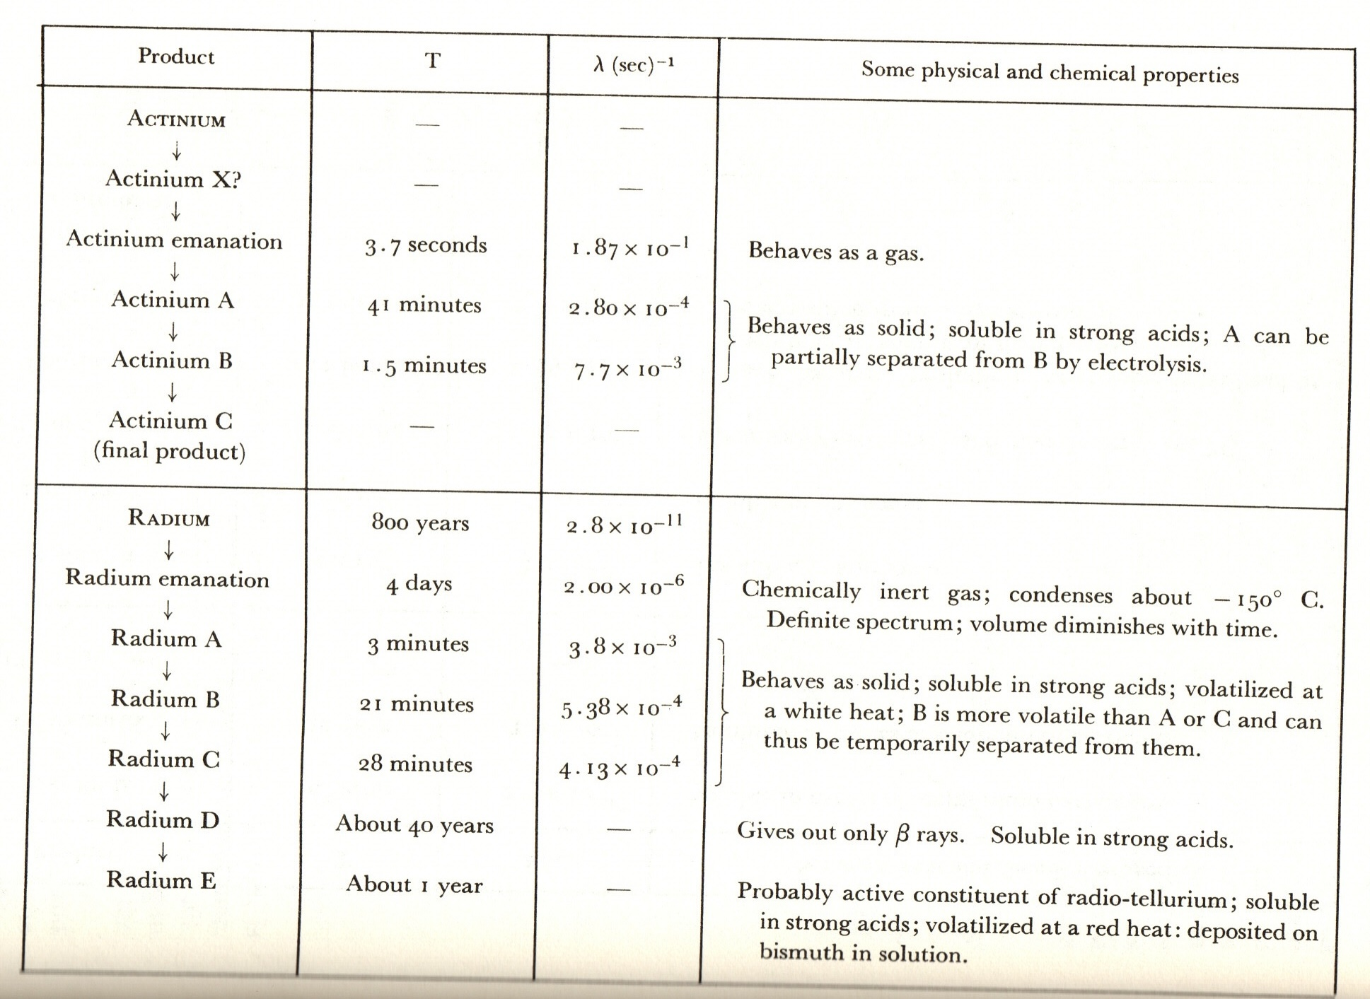
Radioactive Transformations – 7
Rutherford 1905

Slide 20
Radioactive Transformations – 8
Early 1900s – Chemists identified properties of radioactive decay products. Many displayed chemistries similar to other elements but different radioactive characteristics, e.g. half-life, decay type.
How could these radioactive products be fit into the periodic table of elements?
1911 – Rutherford announced the nuclear model of the atom based on α-particle scattering experiments of Geiger and Marsden.
1913 – Henry Moseley supported Bohr’s atomic theory with results of X-ray spectra of elements and identified atomic number (Z) as positive charge of nucleus.

Slide 21
Radioactive Transformations – 9
1913 – Kasimir Fajans and Frederick Soddy proposed that the emission of an α-particle moved the daughter atom two places lower (Z-2) on the periodic table and β-particle emission moved the daughter one place higher (Z+1).
1913 – Soddy proposed to call atoms with same atomic number (Z) but different mass “isotopes” “because they occupy the same place on the periodic table.”
1913 – J. J. Thomson announced that most neon atoms have mass 20, but a significant fraction have mass 22.
1913 – Francis Aston separated neon gas into two fractions, one denser than the other.
1919 – Aston developed the mass spectrometer and separated isotopes of many non-radioactive elements.

Slide 22
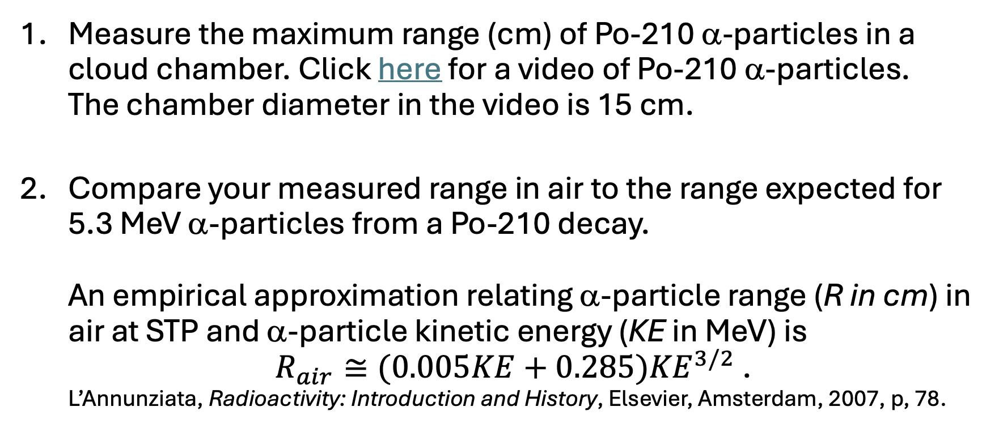
Activity 3 α-Particle Energy Measurement
Measure the maximum range (cm) of Po-210 α-particles in a cloud chamber. Click here for a video of Po-210 α-particles.
The chamber diameter in the video is 15 cm.
Compare your measured range in air to the range expected for 5.3 MeV α-particles from a Po-210 decay.
An empirical approximation relating α-particle range (R in cm) in air at STP and α-particle kinetic energy (KE in MeV) is
$R_{air}≅(0.005KE+0.285){KE}^{3/2}$ .
L’Annunziata, Radioactivity: Introduction and History, Elsevier, Amsterdam, 2007, p, 78.

Slide 23
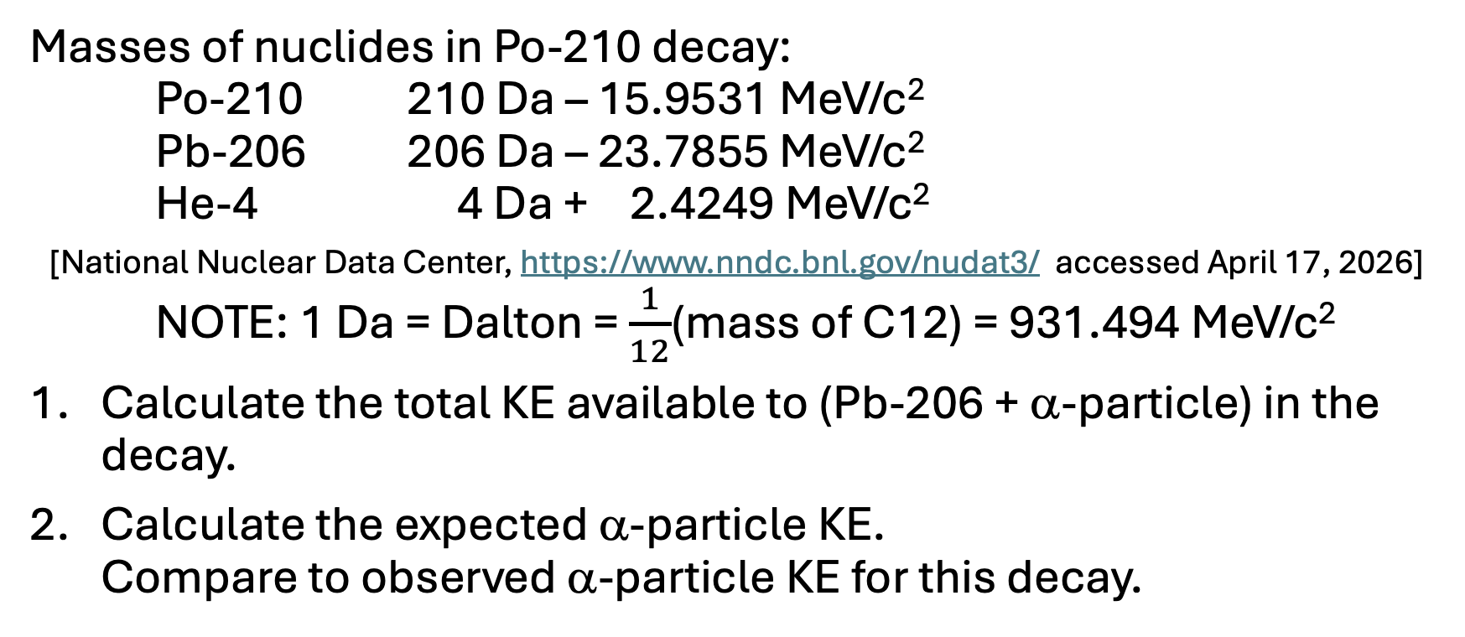
Activity 4 α-Particle Energy Calculation
Masses of nuclides in Po-210 decay:
Po-210 210 Da – 15.9531 MeV/c²
Pb-206 206 Da – 23.7855 MeV/c²
He-4 4 Da + 2.4249 MeV/c²
[National Nuclear Data Center, https://www.nndc.bnl.gov/nudat3/ accessed April 17, 2026]
NOTE: 1 Da = Dalton = $\frac{1}{12}$(mass of C12) = 931.494 MeV/c²
Calculate the total KE available to (Pb-206 + α-particle) in the decay.
Calculate the expected α-particle KE.
Compare to observed α-particle KE for this decay.

Slide 24
Why don’t heavy nuclei eject protons?

Slide 25
Activity 5 α-Particle Binding Energy
Calculate the binding energy of an α-particle, i. e. the energy needed to separate an α-particle into its constituent protons and neutrons.
Proton mass = 938.272 MeV/c² Neutron mass = 939.565 MeV/c²
α-particle mass = 3,727.379 MeV/c²
Calculate the binding energy per nucleon of an α-particle.
Why don’t heavy nuclei eject protons, rather than α-particles?

Slide 26
Binding Energy/Nucleon (Da)

Slide 27
Activity 6 α-Particle Decay Patterns
Get the Radioactive Decay Series sheets that include α and β energies and half-lives.
What pattern between α-particle kinetic energy (KE_{α}) and its starting distance from the nucleus (r_{αmin}) do you expect?
What relationship do you notice between an emitted α-particle kinetic energy (KE_{α}) and decay half-life of its parent nucleus?
How could you plot values on graphs to look for patterns in these relationships?

Slide 28
Activity 7 α-Decay Patterns (Plots)
Get the Radioactive Decay Patterns sheet for your decay series.
Collaborate with others working on the same decay series to calculate and fill in the values in the blank columns of the sheet. NOTE: Nuclear Radius = r₀A^{1/3}, r₀ = 1.2 fm = proton radius.
What model of the nucleus does the above formula reflect?
Plot the values of (KE_{α}, r_{αmin}) and (KE_{α}, log₁₀(t_{1/2})) for your series on the two graphs on the sheet.

Slide 29
Activity 8 (KE_{α}, r_{αmin}) Plot Discussion
Draw a line representing the approximate value of the nuclear radii in your decay series on your KE_{α} vs. r_{αmin} plot.
How are your r_{αmin} values related to KE_{α} values?
Explain the relationship.
How are your r_{αmin} values related to your nuclear radii values?
Why is this relationship a problem?

Slide 30
(Ke_{α} vs. r_{αmin}) Plot

Slide 31
What theory can account for the characteristics of α-decay?

Slide 32
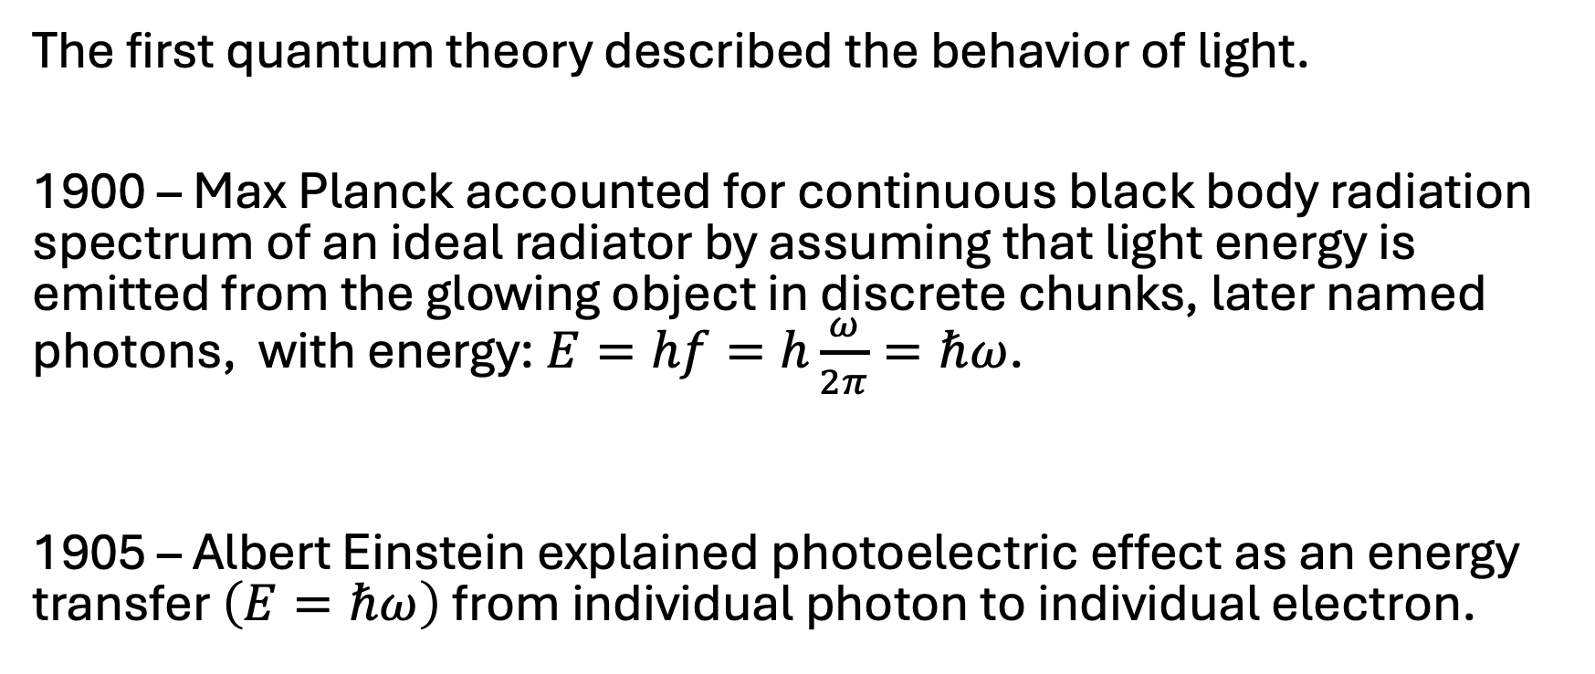
Light Quanta - 1
The first quantum theory described the behavior of light.
1900 – Max Planck accounted for continuous black body radiation spectrum of an ideal radiator by assuming that light energy is emitted from the glowing object in discrete chunks, later named photons, with energy: $E=hf=h\frac{ω}{2π}=ℏω$.
$ω=$ angular frequency = phase angle change (rad) per unit time
1905 – Albert Einstein explained photoelectric effect as an energy transfer $\left(E=ℏω\right)$ from individual photon to individual electron.

Slide 33
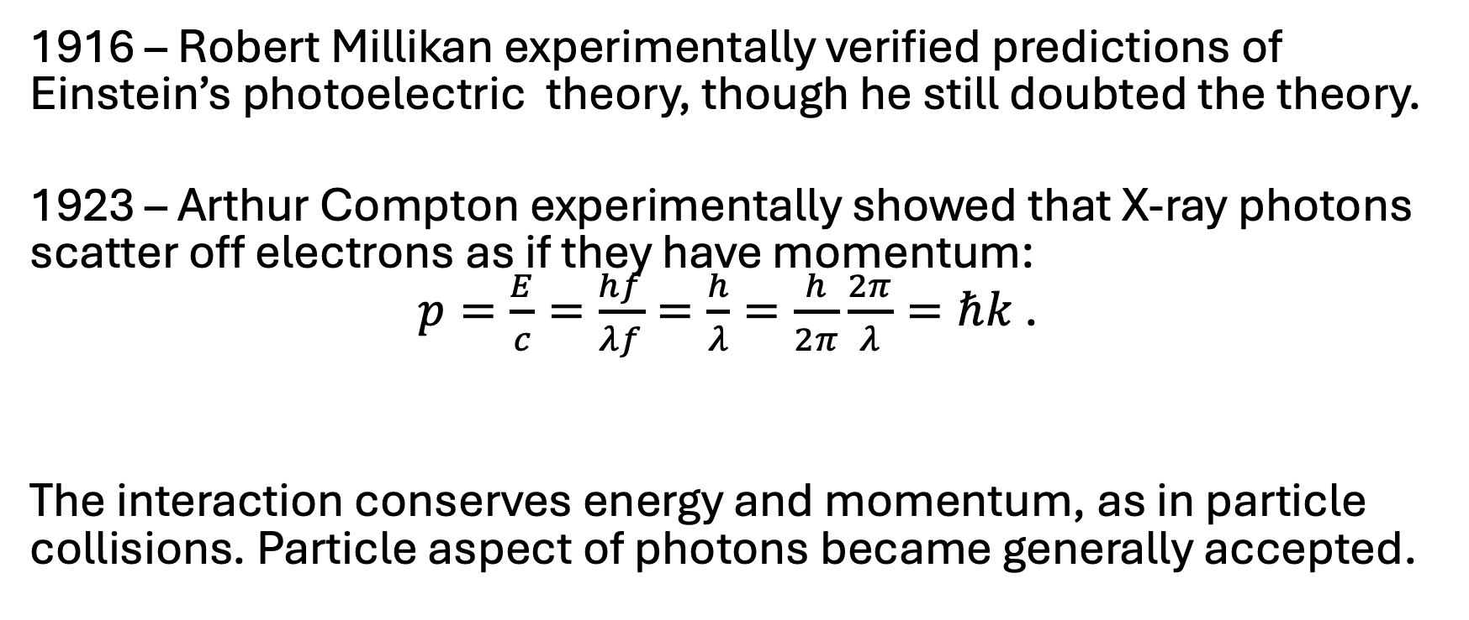
Light Quanta - 2
1916 – Robert Millikan experimentally verified predictions of Einstein’s photoelectric theory, though he still doubted the theory.
1923 – Arthur Compton experimentally showed that X-ray photons scatter off electrons as if they have momentum:
$p=\frac{E}{c}=\frac{hf}{λf}=\frac{h}{λ}=\frac{h}{2π}\frac{2π}{λ}=ℏk$ .
$k=$ spatial frequency = phase change (radians) per unit length
The interaction conserves energy and momentum, as in particle collisions. Particle aspect of photons became generally accepted.

Slide 34
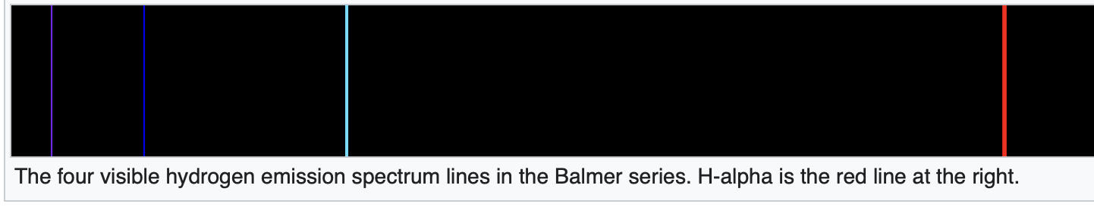
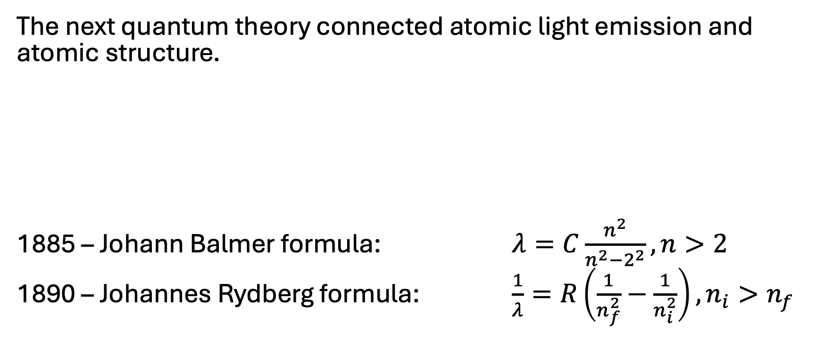
Light Quanta - 3
The next quantum theory connected atomic light emission and atomic structure.
1885 – Johann Balmer formula: $λ=C\frac{n^{2}}{n^{2}−2^{2}}, n>2$
1890 – Johannes Rydberg formula: $\frac{1}{λ}=R\left(\frac{1}{n_{f}^{2}}−\frac{1}{n_{i}^{2}}\right), n_{i}>n_{f}$

Slide 35
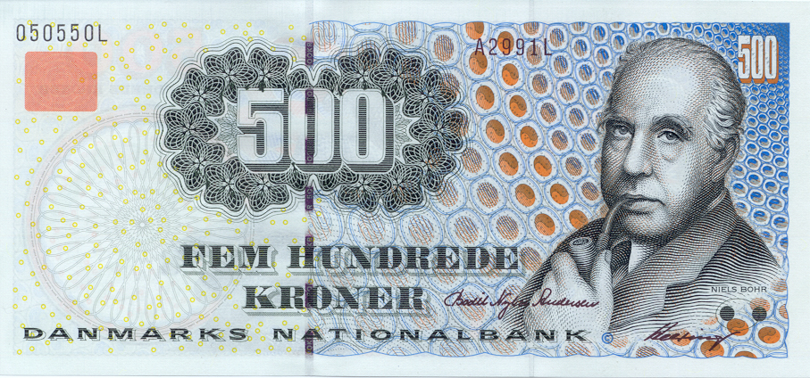
Niels Bohr (1885 – 1962)

Slide 36
Activity 9 Bohr Model for H Atom
Work with colleagues to do the calculations and algebraic derivations in the “Bohr Model of Hydrogen Atom Worksheet.”

Slide 37
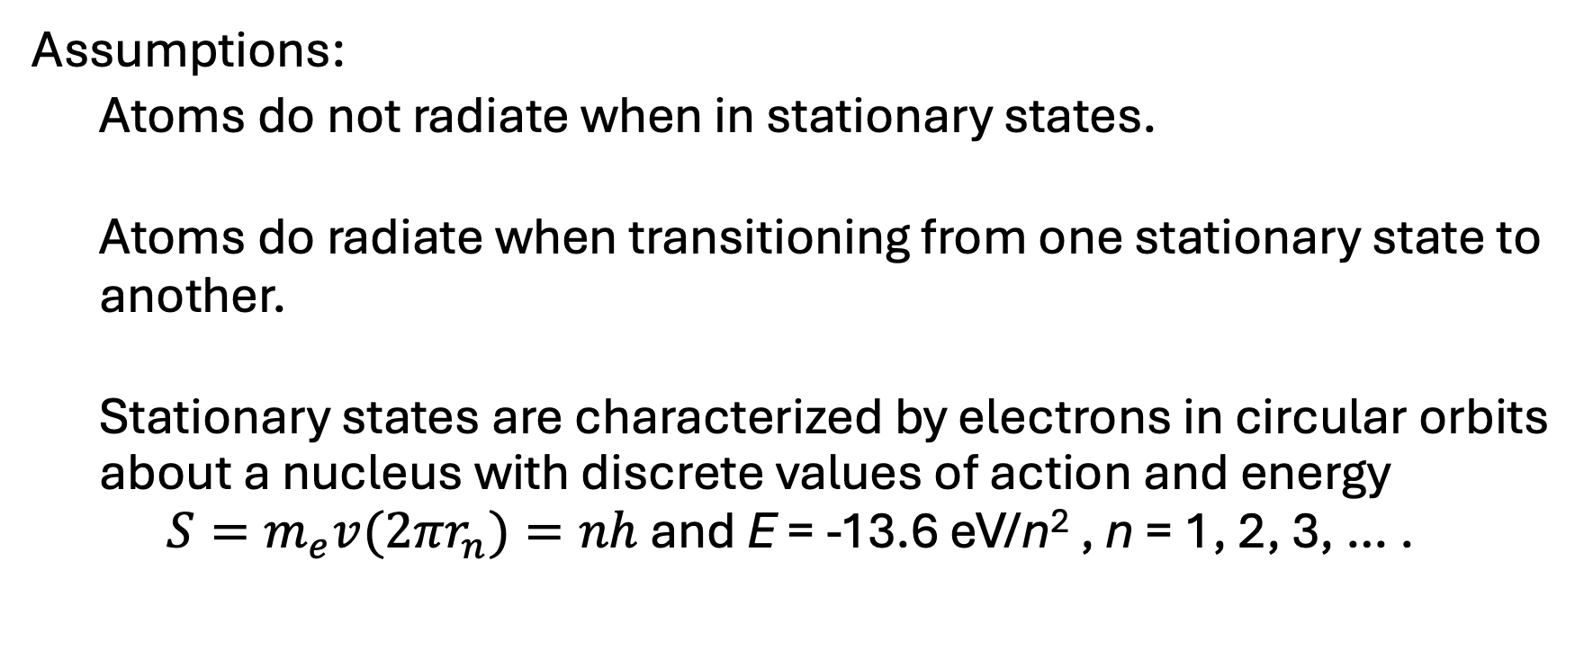
Bohr’s Quantum Theory (1913)
Assumptions:
  Atoms do not radiate when in stationary states.
  Atoms do radiate when transitioning from one stationary state to another.
  Stationary states are characterized by electrons in circular orbits about a nucleus with discrete values of action and energy
  $S=m_{e}v{(2πr}_{n})=nh$ and E = -13.6 eV/n² , n = 1, 2, 3, … .

Slide 38
Bohr’s Quantum Theory - Successes
What were some of the successes of Bohr’s theory?

Slide 39
Bohr’s Quantum Theory – Successes 1
Accounted for size of H atom (10⁻¹⁰ m) known from kinetic theory .
Accounted for ionization energy of ground state H atom (13.6 eV).
Accounted for Lyman (UV), Balmer (Visible), Paschen (IR) spectrum wavelengths and predicted Brackett and Pfund series values in IR.
Linked hydrogen spectrum to H atom electron energy levels.

Slide 40
Bohr’s Quantum Theory – Successes 2
Accounted for spectral series for He+ and other 1-electron atoms.
Accounted for K_{α} X-rays of elements (Henry Moseley - 1913) and linked atomic number (Z) with nuclear + charge units.
Accounted for Franck-Hertz ionization of Hg vapor by electrons.
Collision with 4.9 eV electrons ionized Hg atoms. Recombination of electrons with Hg ions, produced 4.9 eV photons (1914).

Slide 41
Bohr’s Quantum Theory - Limitations
What were some of the limitations of Bohr’s theory?

Slide 42
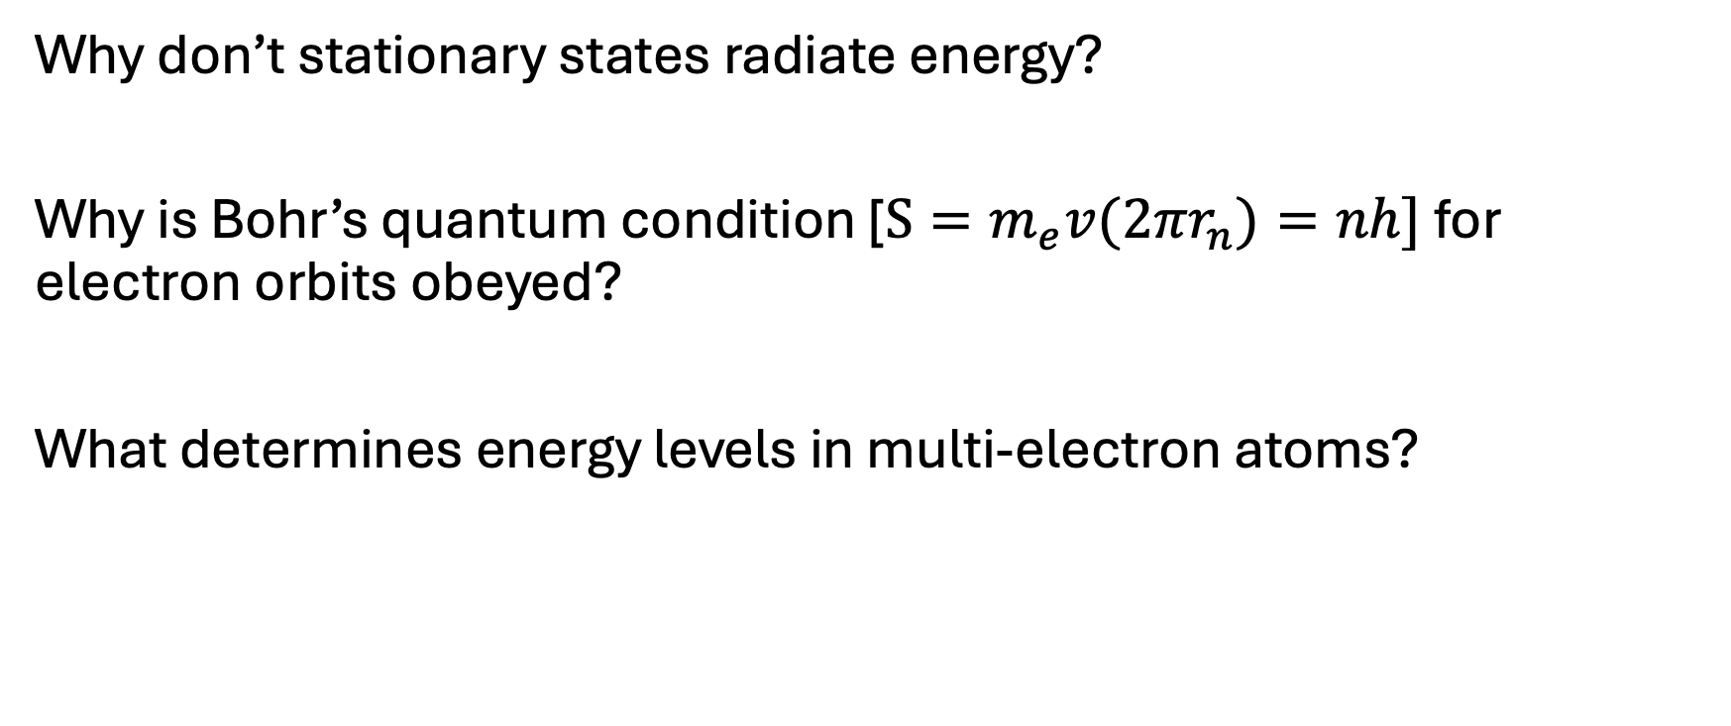
Bohr’s Quantum Theory - Limitations
Why don’t stationary states radiate energy?
Why is Bohr’s quantum condition [$S=m_{e}v{(2πr}_{n})=nh]$ for electron orbits obeyed?
What determines energy levels in multi-electron atoms?

Slide 43
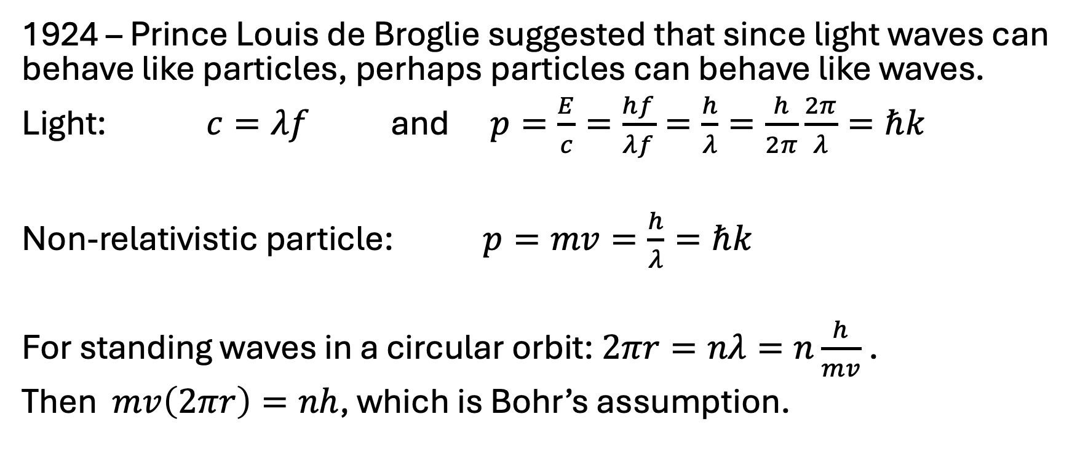
Matter Waves
1924 – Prince Louis de Broglie suggested that since light waves can behave like particles, perhaps particles can behave like waves.
Light: $c=λf$ and $p=\frac{E}{c}=\frac{hf}{λf}=\frac{h}{λ}=\frac{h}{2π}\frac{2π}{λ}=ℏk$
Non-relativistic particle: $p=mv=\frac{h}{λ}=ℏk$
For standing waves in a circular orbit: $2πr=nλ=n\frac{h}{mv}$ .
Then $mv\left(2πr\right)=nh$, which is Bohr’s assumption.

Slide 44
Modern Quantum Mechanics
1925 – Werner Heisenberg developed first modern quantum mechanics using the mathematics of matrices.
1926 – Erwin Schrödinger developed wave mechanics version of non-relativistic quantum mechanics. Schrödinger also showed the equivalence of his version and Heisenberg’s version of QM.
1928 – Paul Dirac developed a relativistic equation for quantum mechanics.

Slide 45
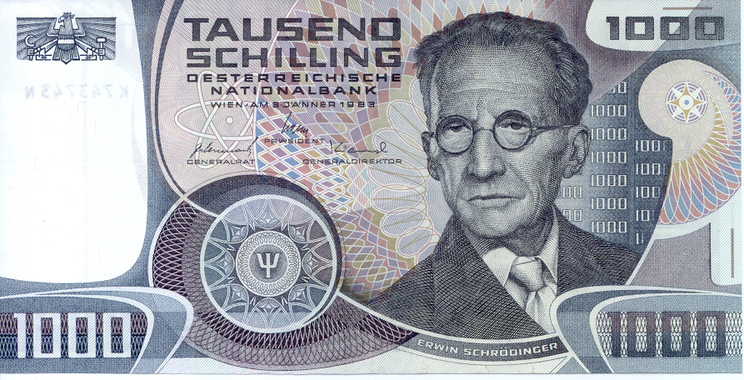
Erwin Schrödinger (1887-1961)

Slide 46
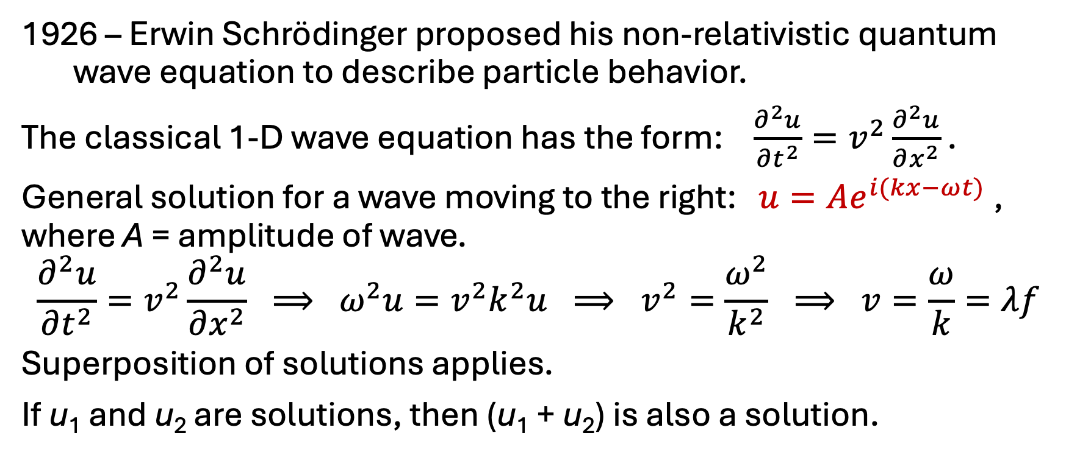
Schrödinger’s NR Quantum Wave Equation - 1
– Erwin Schrödinger proposed his non-relativistic quantum wave equation to describe particle behavior.
The classical 1-D wave equation has the form: $\frac{∂^{2}u}{∂t^{2}}=v^{2}\frac{∂^{2}u}{∂x^{2}}$ .
General solution for a wave moving to the right: $u=Ae^{i(kx−ωt)}$ ,
where A = amplitude of wave.
$$\frac{∂^{2}u}{∂t^{2}}=v^{2}\frac{∂^{2}u}{∂x^{2}} ⟹ ω^{2}u=v^{2}k^{2}u ⟹ v^{2}=\frac{ω^{2}}{k^{2}} ⟹ v=\frac{ω}{k}=λf$$
Superposition of solutions applies.
If u₁ and u₂ are solutions, then (u₁ + u₂) is also a solution.

Slide 47
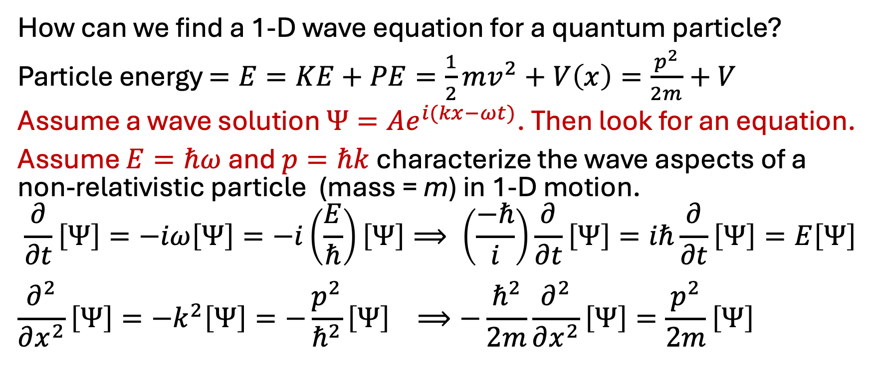
Schrödinger’s NR Quantum Wave Equation - 2
How can we find a 1-D wave equation for a quantum particle?
Particle energy $=E=KE+PE=\frac{1}{2}mv^{2}+V\left(x\right)=\frac{p^{2}}{2m}+V$
Assume a wave solution $Ψ=Ae^{i(kx−ωt)}$. Then look for an equation.
Assume $E=ℏω$ and $p=ℏk$ characterize the wave aspects of a non-relativistic particle (mass = m) in 1-D motion.
$$\frac{∂}{∂t}\left[Ψ\right]=−iω\left[Ψ\right]=−i\left(\frac{E}{ℏ}\right)\left[Ψ\right]⟹ \left(\frac{−ℏ}{i}\right)\frac{∂}{∂t}\left[Ψ\right]=iℏ\frac{∂}{∂t}\left[Ψ\right]=E\left[Ψ\right]$$
$$\frac{∂^{2}}{∂x^{2}}\left[Ψ\right]=−k^{2}\left[Ψ\right]=−\frac{p^{2}}{ℏ^{2}}\left[Ψ\right] ⟹−\frac{ℏ^{2}}{2m}\frac{∂^{2}}{∂x^{2}}\left[Ψ\right]=\frac{p^{2}}{2m}\left[Ψ\right]$$

Slide 48
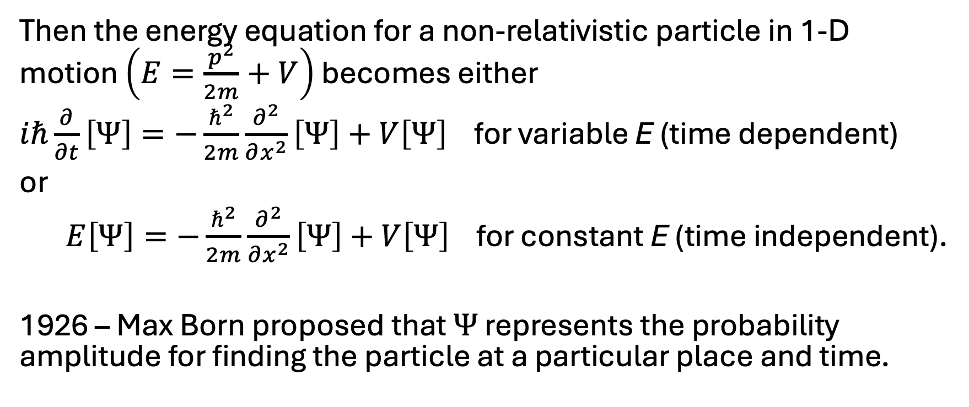
Schrödinger’s NR Quantum Wave Equation - 3
Then the energy equation for a non-relativistic particle in 1-D motion $\left(E=\frac{p^{2}}{2m}+V\right)$ becomes either
$iℏ\frac{∂}{∂t}\left[Ψ\right]=−\frac{ℏ^{2}}{2m}\frac{∂^{2}}{∂x^{2}}\left[Ψ\right]+V\left[Ψ\right]$ for variable E (time dependent)
or
$E\left[Ψ\right]=−\frac{ℏ^{2}}{2m}\frac{∂^{2}}{∂x^{2}}\left[Ψ\right]+V\left[Ψ\right]$ for constant E (time independent).
1926 – Max Born proposed that $Ψ$ represents the probability amplitude for finding the particle at a particular place and time.

Slide 49
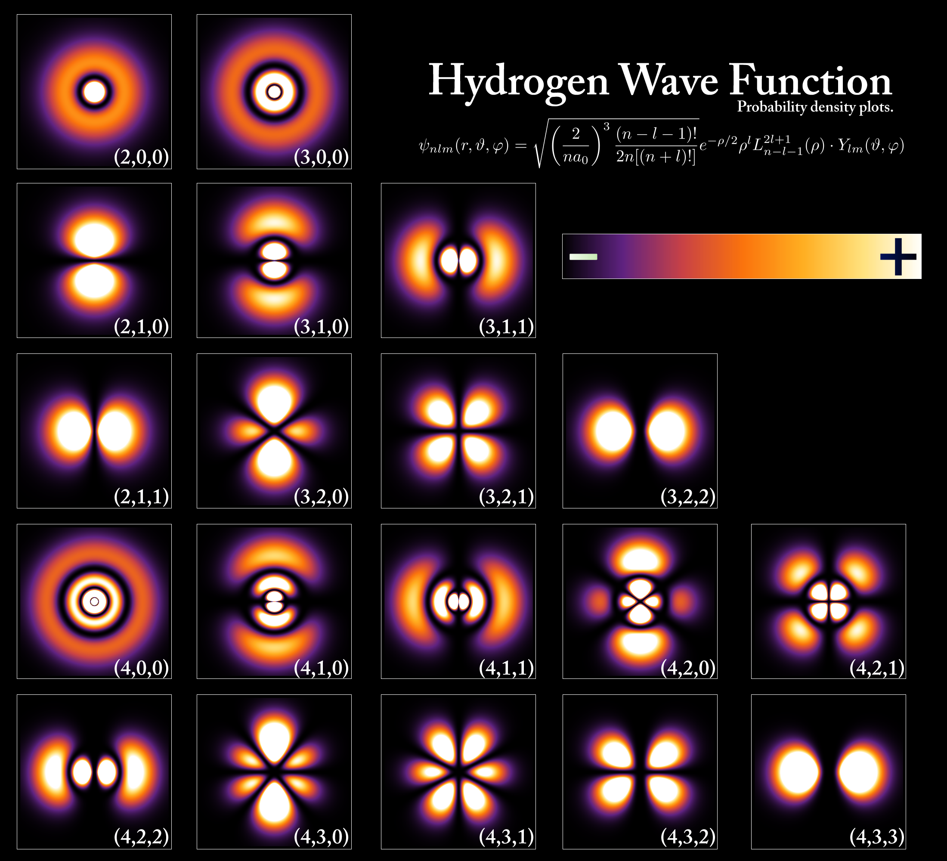
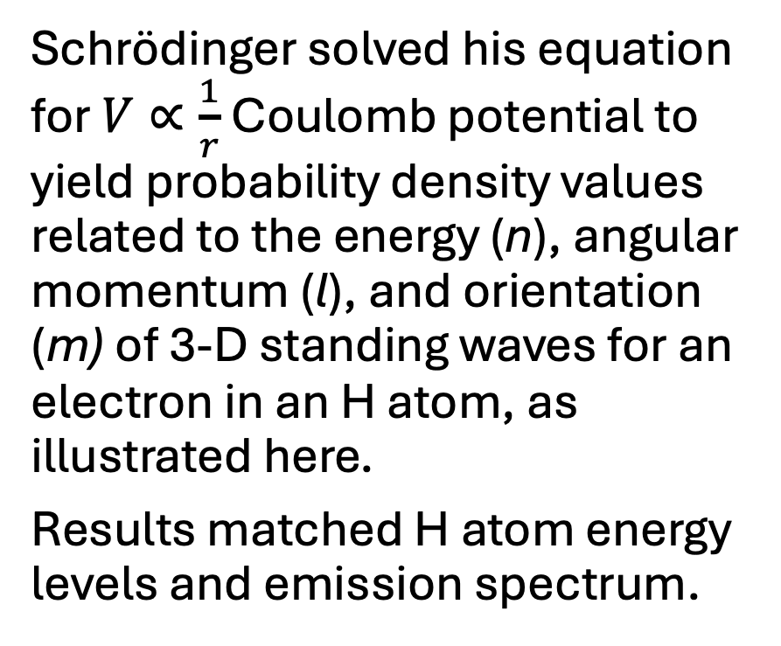
Schrödinger’s NR Quantum Wave Equation - 4
Schrödinger solved his equation for $V∝\frac{1}{r}$ Coulomb potential to yield probability density values related to the energy (n), angular momentum (l), and orientation (m) of 3-D standing waves for an electron in an H atom, as illustrated here.
Results matched H atom energy levels and emission spectrum.

Slide 50
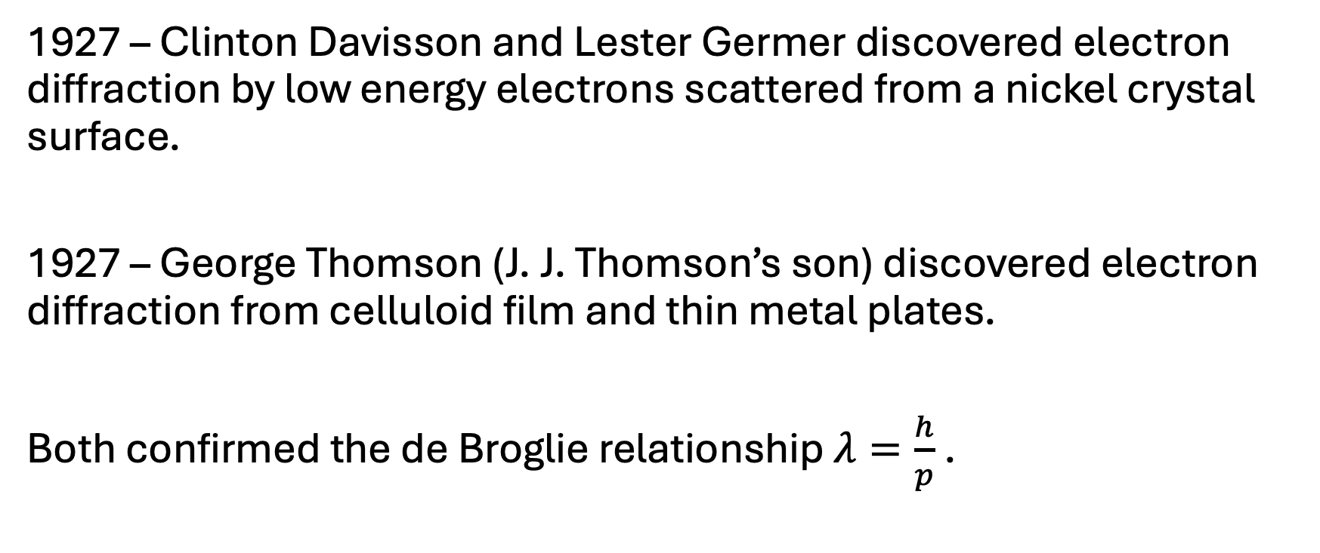
Schrödinger’s NR Quantum Wave Equation - 5
1927 – Clinton Davisson and Lester Germer discovered electron diffraction by low energy electrons scattered from a nickel crystal surface.
1927 – George Thomson (J. J. Thomson’s son) discovered electron diffraction from celluloid film and thin metal plates.
Both confirmed the de Broglie relationship $λ=\frac{h}{p}$ .

Slide 51
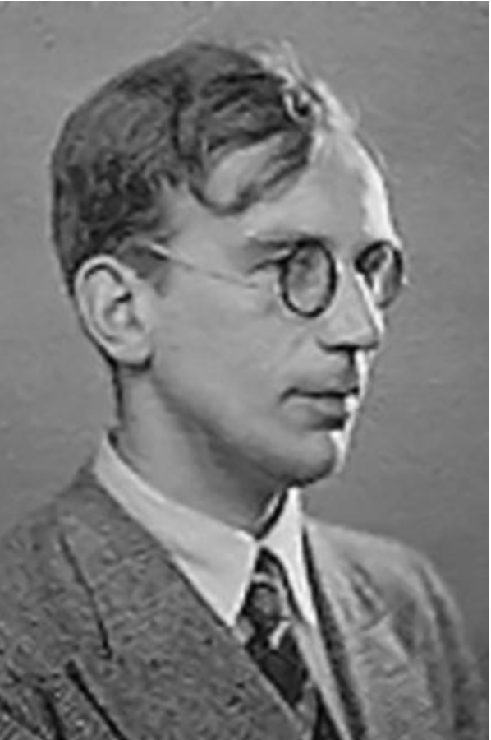
Schrödinger’s NR Quantum Wave Equation - 6
1928 – George Gamow, a 24 year-old Russian (Ukrainian) grad student at Göttingen, and, independently, Ronald Gurney and Edward Condon at Princeton applied the Schrödinger equation to the atomic nucleus for the first time. They explained radioactive
α-decay by quantum tunneling.
Gamow achieved quantitative results that solved two α-decay mysteries.

Slide 52
Gamow and α-decay - 1
1928 – Gamow read Rutherford’s 1927 paper on the scattering of Ra-C’ [Po-214] α-particles [7.7 MeV] from U-238 nuclei. The repulsive nuclear Coulomb potential applies to within 32 fm from the nuclei centers. So, the attractive nuclear potential that holds α-particles in the nucleus must have a range of less than 32 fm.
However, the 4.2 MeV α-particles emitted from U-238 seemed to emerge at 63 fm from the nuclei centers.
Rutherford proposed that the α-particles were accompanied by two electrons until they escaped the nucleus then shed the electrons.

Slide 53
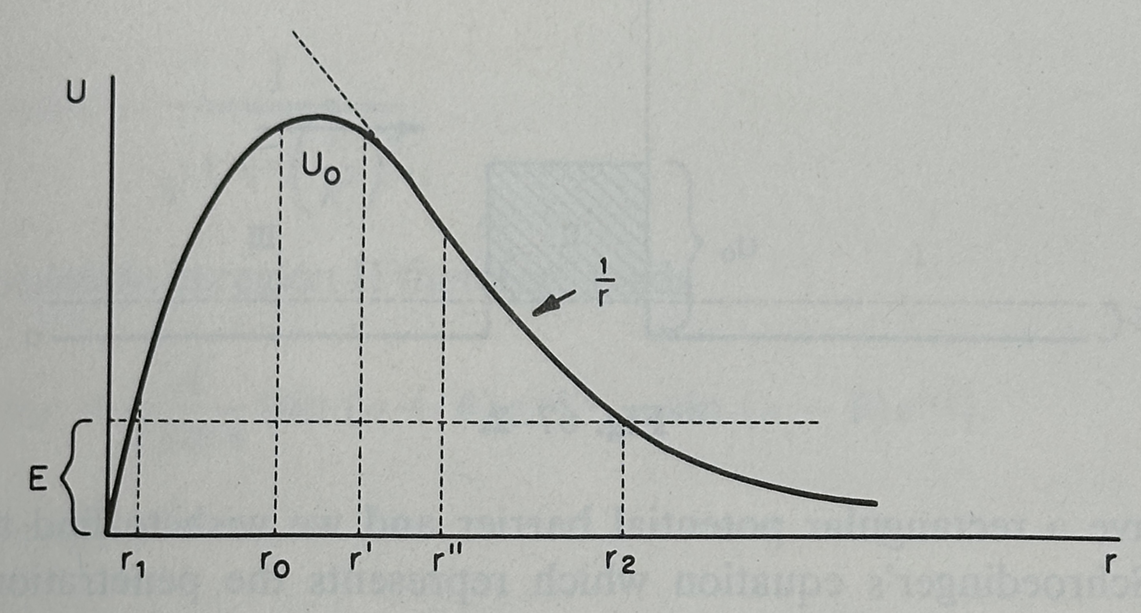
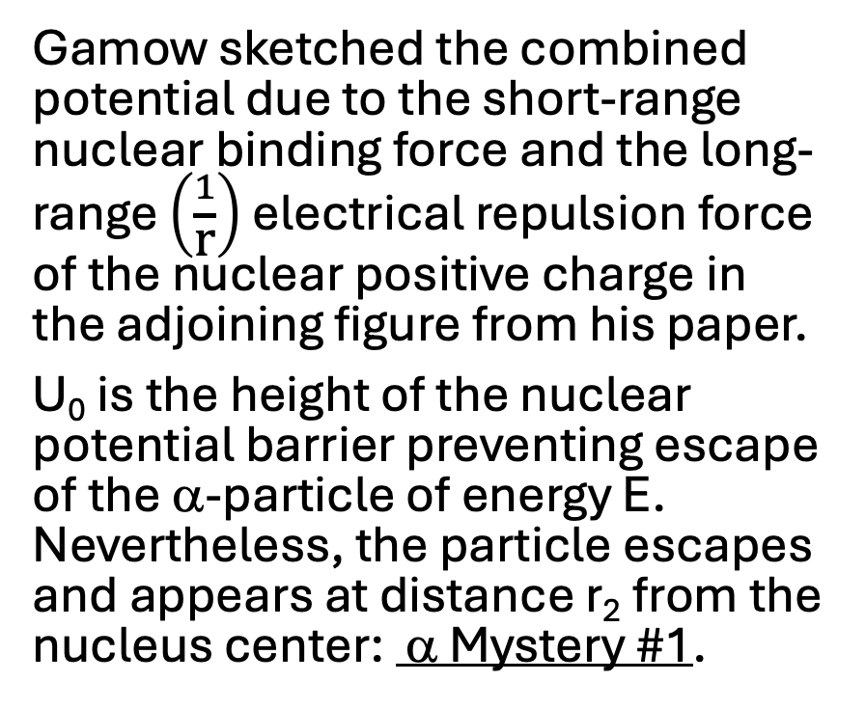
Gamow and α-decay - 2
Gamow sketched the combined potential due to the short-range nuclear binding force and the long-range $\left(\frac{1}{\text{r}}\right)$ electrical repulsion force of the nuclear positive charge in the adjoining figure from his paper.
U₀ is the height of the nuclear potential barrier preventing escape of the α-particle of energy E. Nevertheless, the particle escapes and appears at distance r₂ from the nucleus center: α Mystery #1.

Slide 54
Gamow and α-decay - 3
As a grad student at University of Leningrad, Gamow had discussed Schrödinger’s quantum mechanics with other grad students including Lev Landau. He had also worked on checking refraction of optical glass at the Soviet Optical Institute.
So, he may have been familiar with frustrated total internal reflection in which light can cross an apparently forbidden region under the right conditions.

Slide 55
Analogy: Frustrated Total Internal Reflection
Waves traveling from a slower speed medium to faster speed medium can experience total internal reflection.
However, a wave can leak through a narrow gap between two slower speed media under the right conditions, as demonstrated with
λ = 3 cm microwaves:
https://www.youtube.com/watch?v=VaDA4k_68QI (8:14).
Boundary conditions determine the transmission and reflection of waves traveling between two media, as demonstrated here:
https://www.youtube.com/watch?v=5BPC9fWqkDw (4:11).

Slide 56
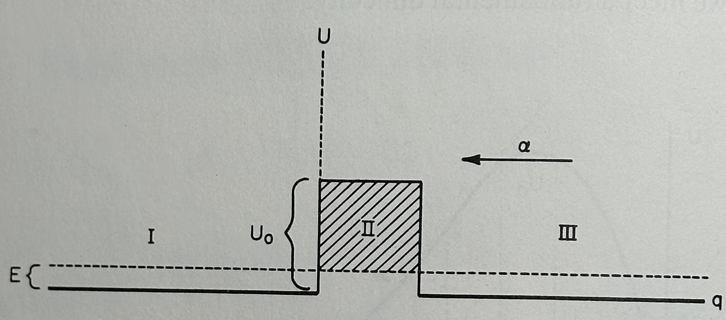
Gamow and α-decay - 4
1928 – Gamow solved the Schrödinger equation for an
α-particle with energy E traveling from right to left incident on a simple rectangular potential barrier, as indicated in the adjacent figure from his paper.

Slide 57
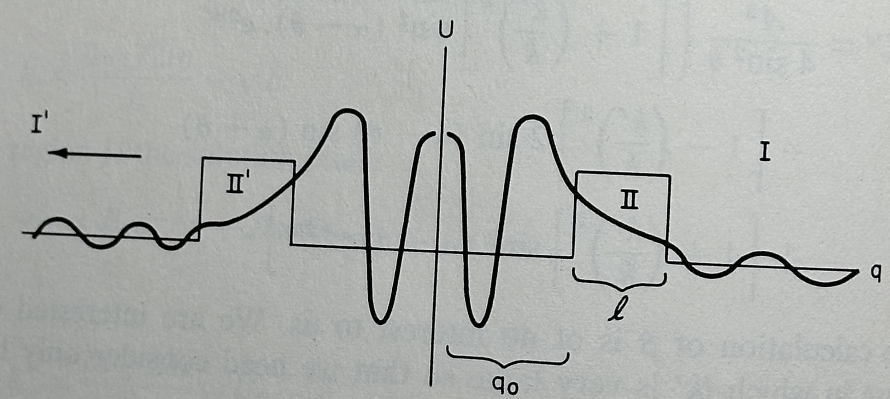
Gamow and α-decay - 5
The solution to the Schrödinger equation for symmetrical potential barriers preventing the escape of a particle trapped between them is shown in this figure from Gamow’s paper.

Slide 58
Gamow and α-decay - 6
The Schrödinger solution represents the probability density which, when squared, gives the probability of the particle location:
high between the barriers as the particle bounces back and forth within the barriers, low outside the barriers where the particle has escaped, and exponentially decreasing within the barriers in regions II and II’.
So, there is a small, but finite, probability that the particle can escape, even when it does not have enough energy to overcome the confining potential barrier. This is quantum tunneling.
α Mystery #1 solved.

Slide 59
Schrödinger with Boundary Conditions
A step-by-step solution to the Schrödinger wave equation with boundary conditions to explain α-particle decay is given in this YouTube video from Physics Explained:
https://www.youtube.com/watch?v=_f8zeEI0oys&t=379s (40:05).

Slide 60
Activity 10 (KE_{α}, log₁₀(t_{1/2})) Plot Discussion
What do you notice about your (KE_{α}, log₁₀(t_{1/2})) plot?
How can the logarithmic relation be explained?
This is α Mystery #2.

Slide 61
(KE_{α}, log₁₀(t_{1/2})) Plot

Slide 62
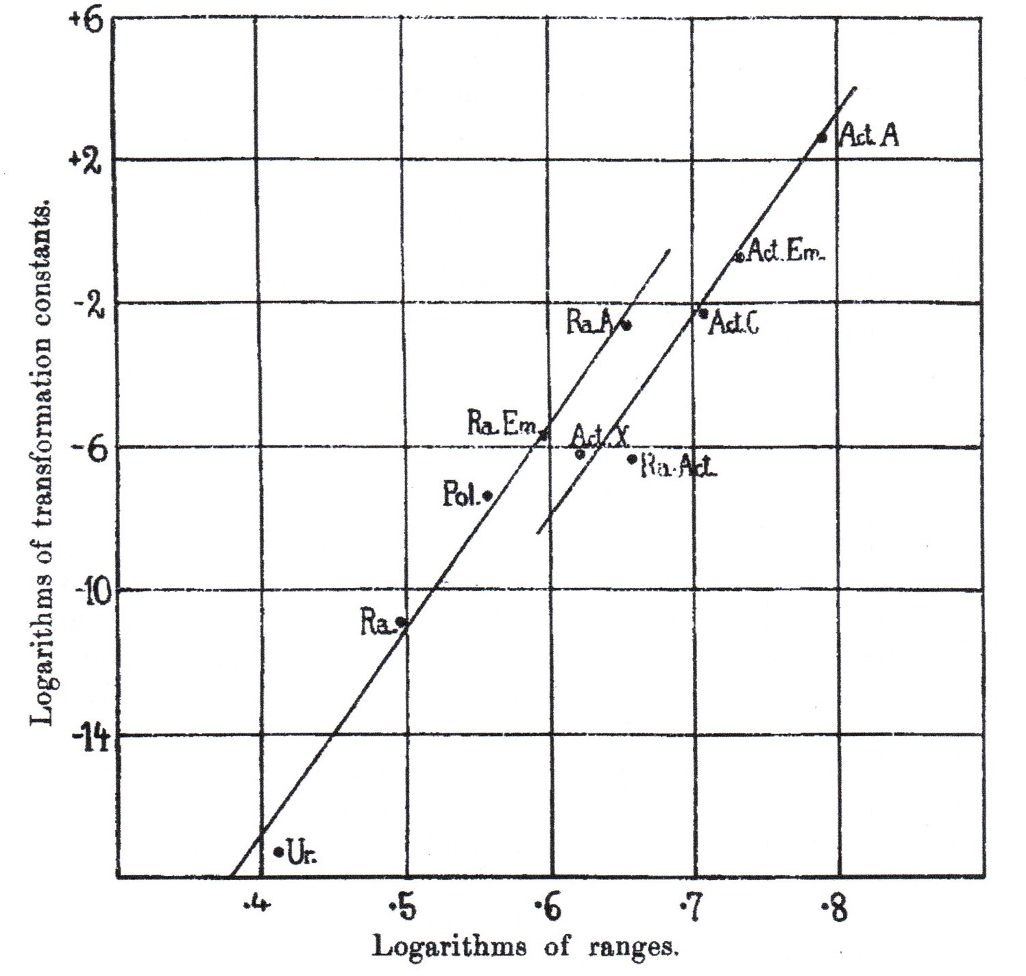
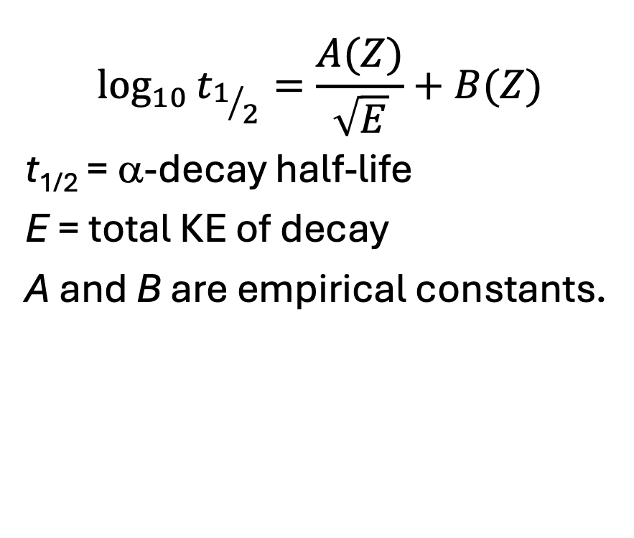
Geiger-Nuttall Law
Geiger-Nuttall Measurements 1911
Modern Geiger-Nuttall Law
$$\log_{10}{t_{1/2}=\frac{A(Z)}{\sqrt{E}}+B(Z)}$$
t_{1/2} = α-decay half-life
E = total KE of decay
A and B are empirical constants.

Slide 63
Gamow and α-decay - 7
1928 - Gamow showed that exponentially decreasing probability density in classically forbidden region of potential produces exponentially decreasing probability of α-particle escape and exponentially longer half-life as α-particle energy decreases.
After calculating approximate values and finding reasonable agreement with experimental observations, he concluded: “The order of magnitude agreement shows that the basic assumptions of our theory must be correct”.
α Mystery #2 solved.

