Slide 1
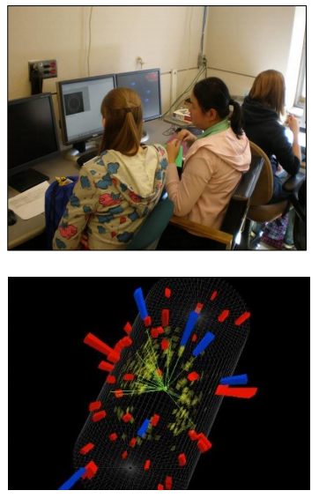
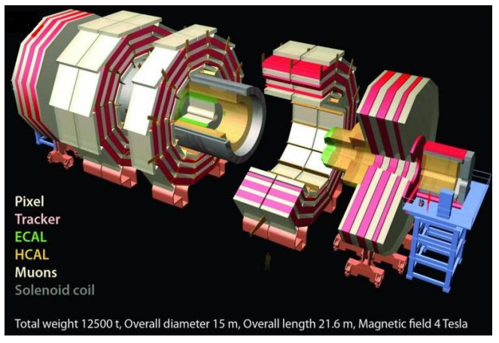



CMS WZH Masterclass

Slide 2
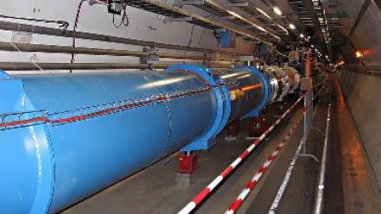
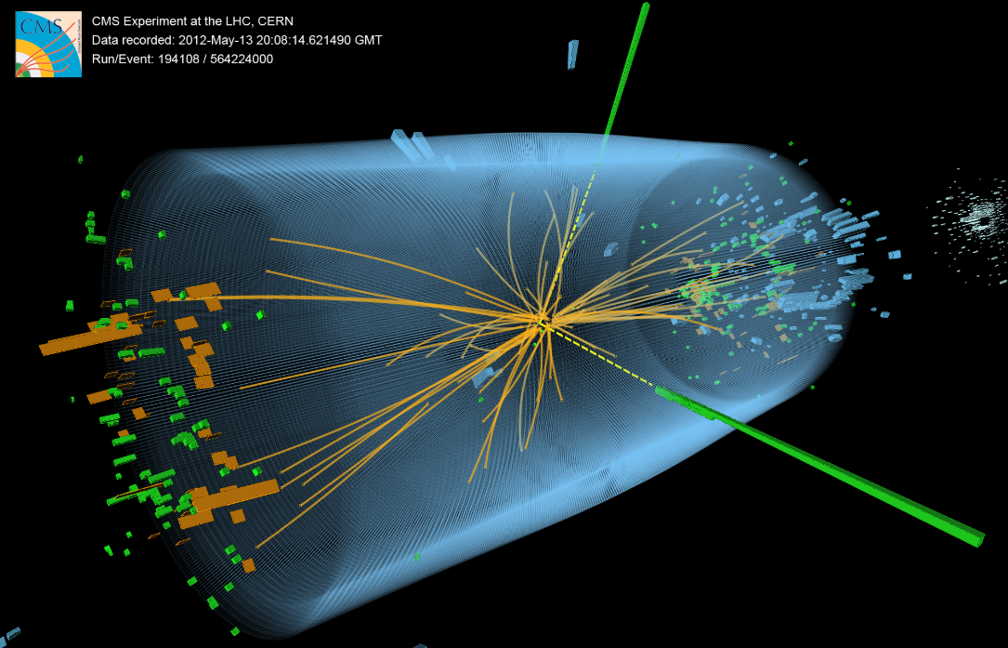
The LHC and the new physics
It is a time of exciting new discoveries in particle physics.
At CERN, the LHC has had its highest collision rates and energies yet. It is now shutting down for a major upgrade that will produce more data then ever. This will enable physicists to probe new questions even as they anchor the calibration of CMS and the LHC to the highly reliable Standard Model.
Let’s put this scientific anchor to the test…

Slide 3
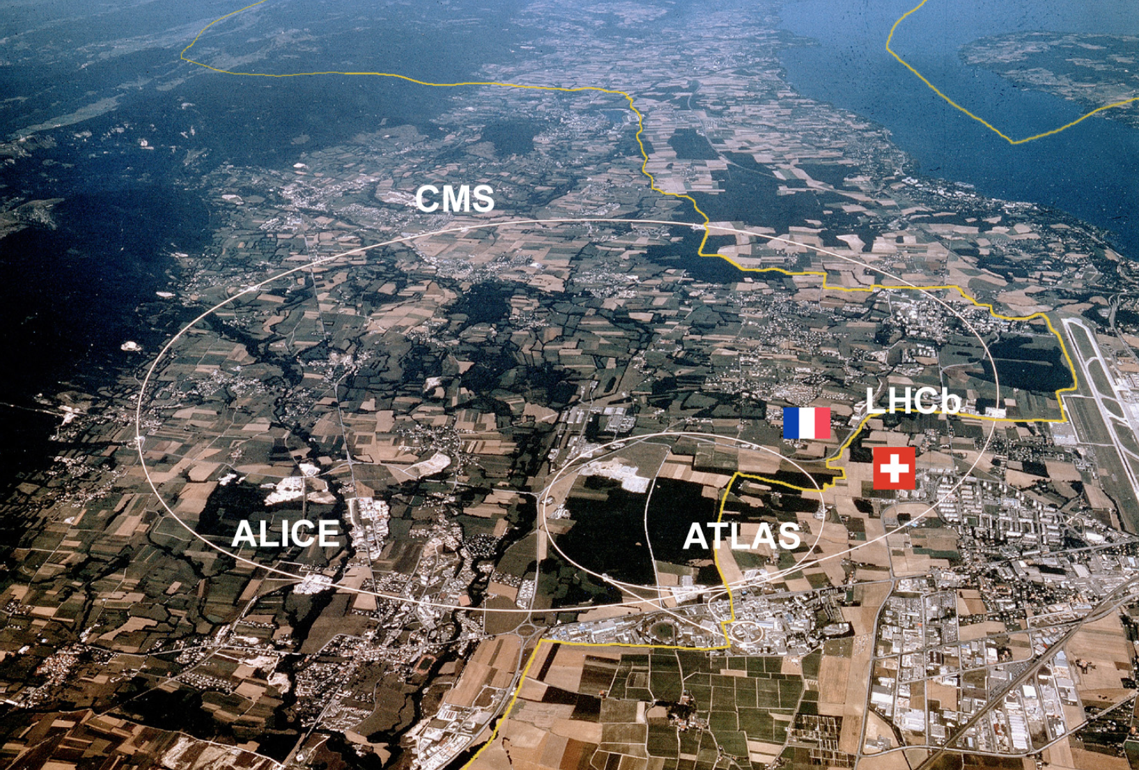
LHC@CERN
~27 km circumference
~100 m underground
Protons circulate in opposite directions
Up to 14 TeV collision energy

Slide 4
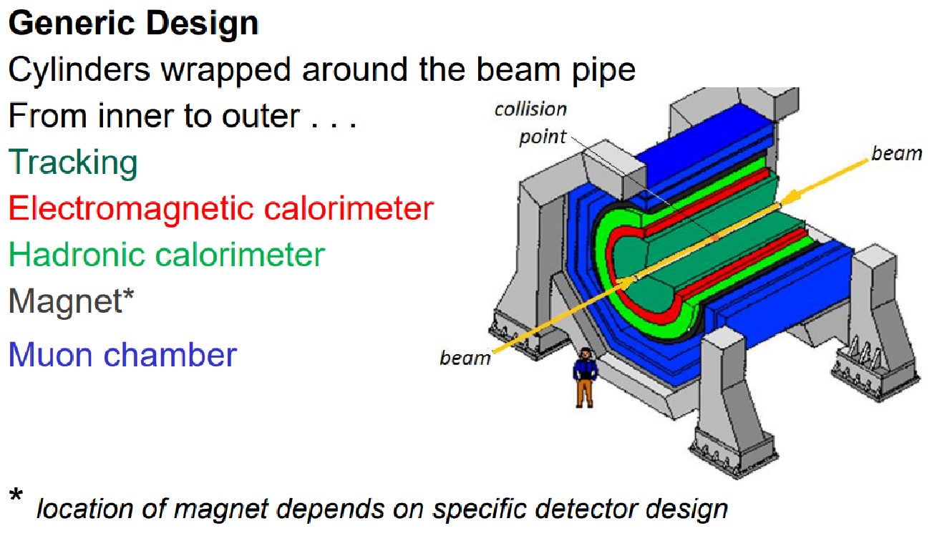
The LHC and the new physics

Slide 5
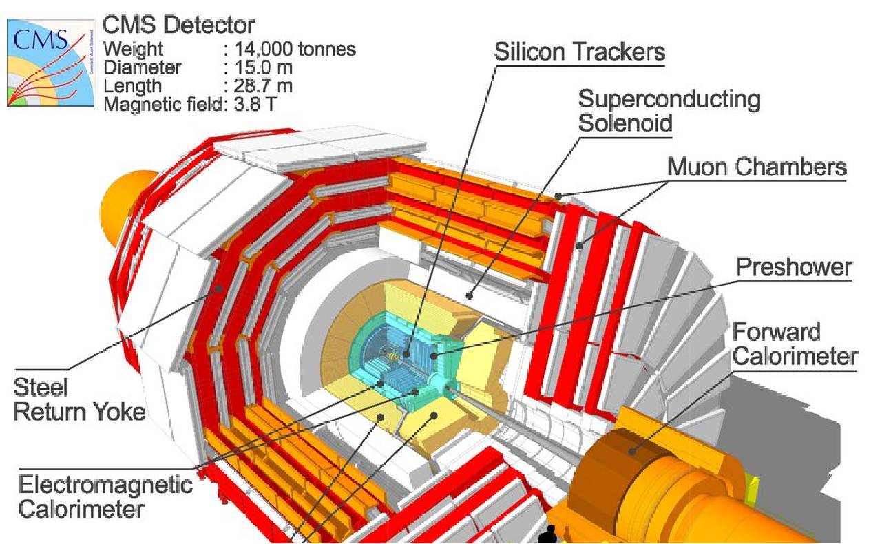
The Compact Muon Solenoid (CMS)

Slide 6
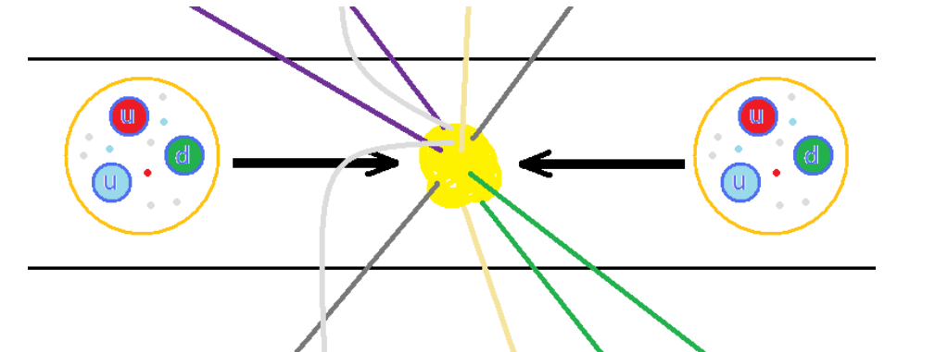
Protons collide inside CMS
The LHC accelerates protons to almost 7500 times the energy equivalent of their mass. The protons circulate in opposite directions and collide in the center of CMS.
But protons are not just particles: they are more like bags of quarks and gluons. When protons collide, all sorts of very short-lived particles can be made from all that energy.

Slide 7
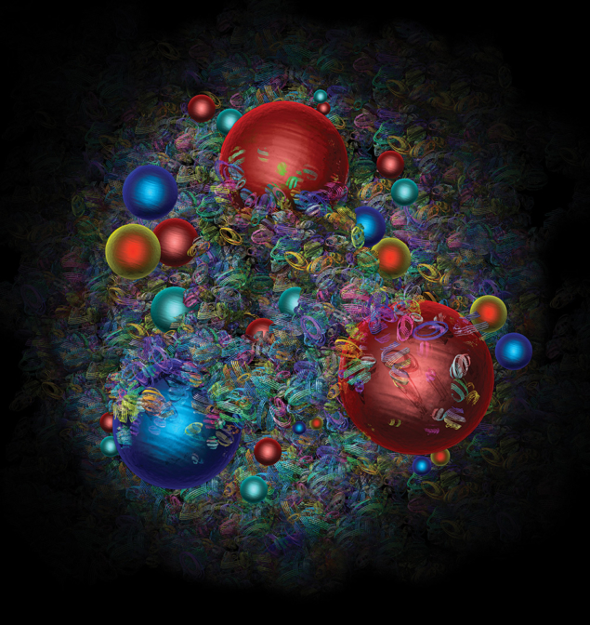
What do the protons tell us?
We learn from what proton collisions produce:
W bosons give us clues to the proton structure…and they also present a mystery.
Z bosons decay (sort of) like lighter particles but are also needed to sort out Higgs data.
Higgs bosons, well, are Higgs bosons, the new kid on the block!
Artist’s image of a proton from CERN Courier. Learn more here and even more here.

Slide 8
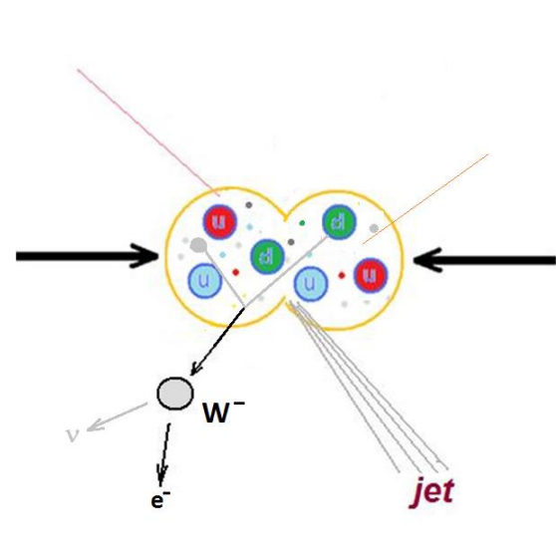




One-lepton events
The + or – charged W boson enables radioactive decay by transforming neutrons into protons.
It decays into a neutrino and another lepton. Since CMS cannot detect the neutrino directly, we can call this a one-lepton event.

Slide 9
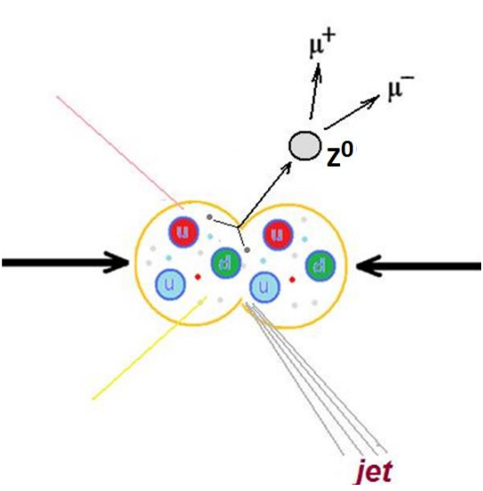


Two-lepton events
The Z boson is a neutral cousin of the W. It enables the “weak neutral current”.
It decays into two leptons of the same type but opposite charge – electron and positron or muon and antimuon. It has other decay paths but we are not looking for these.

Slide 10
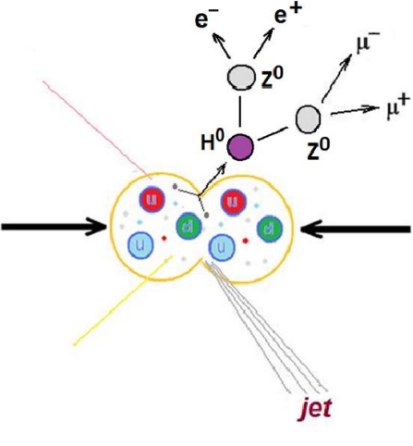
Four-lepton events
The Higgs boson is an expression of the field that gives other particles mass.
One decay mode of the Higgs is into two Z bosons, which themselves promptly decay. Thus we can get 2 muons and 2 electrons or 4 muons or 4 electrons.

Slide 11
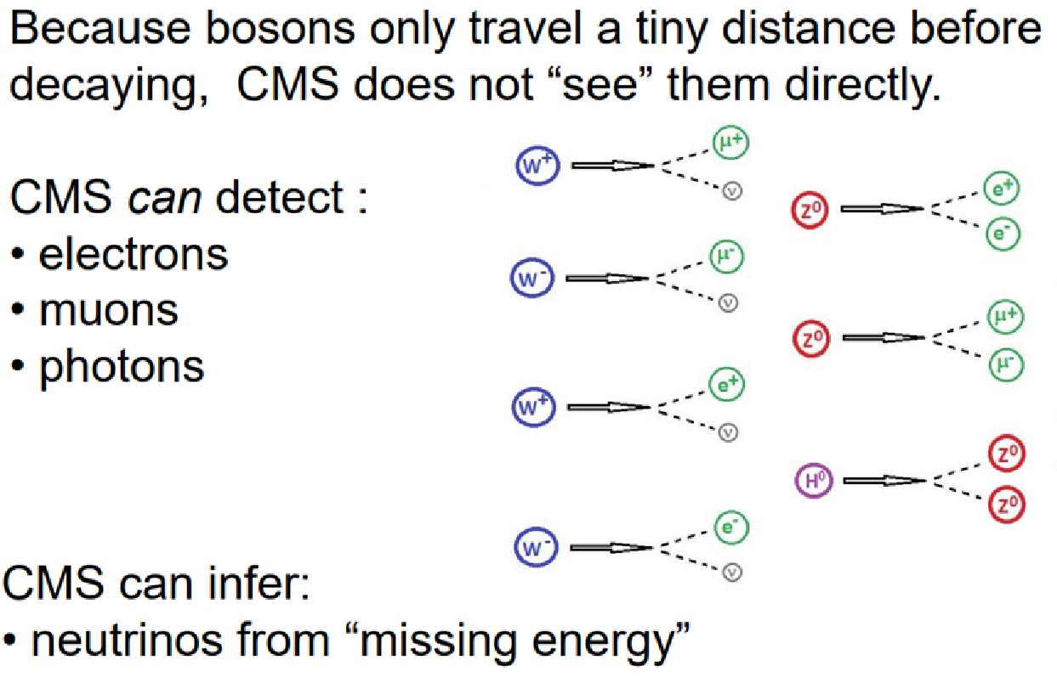
Decay summary

Slide 12
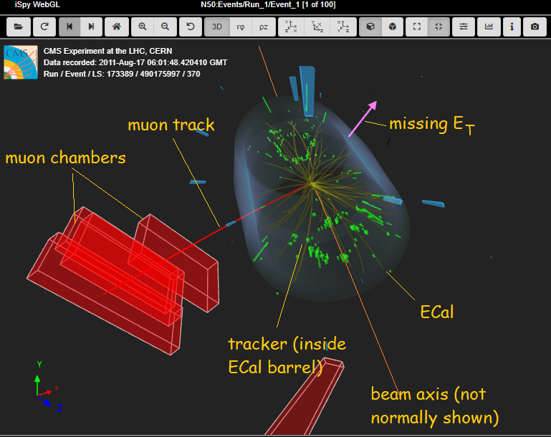
iSpy event display for CMS

Slide 13
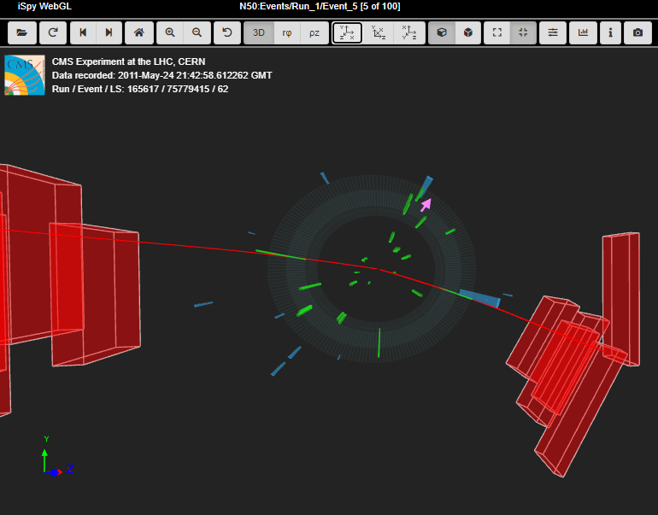
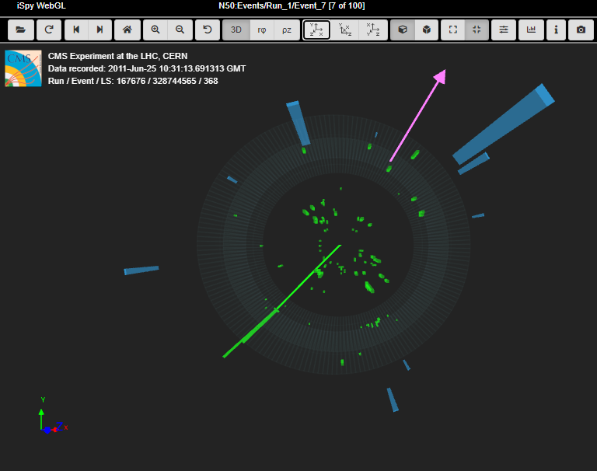
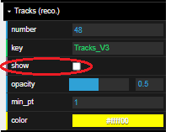
1, 2, or 4 leptons?
Which of these events has 1, 2, or 4 charged leptons? Which flavors of leptons? What else do you see?
Note Tracks (reco) turned OFF.

Slide 14
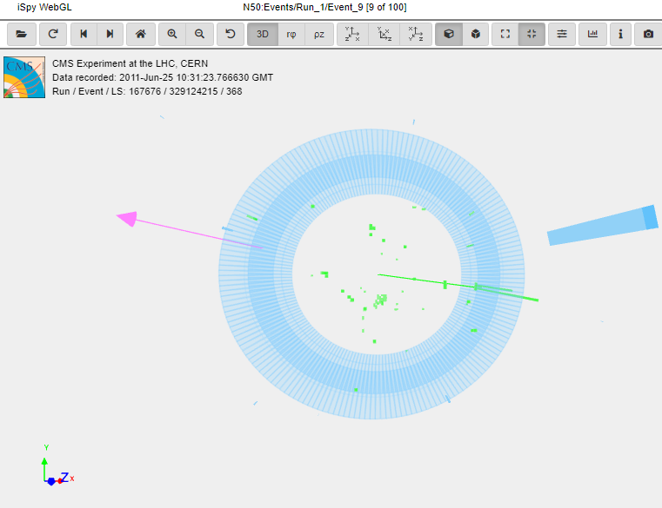
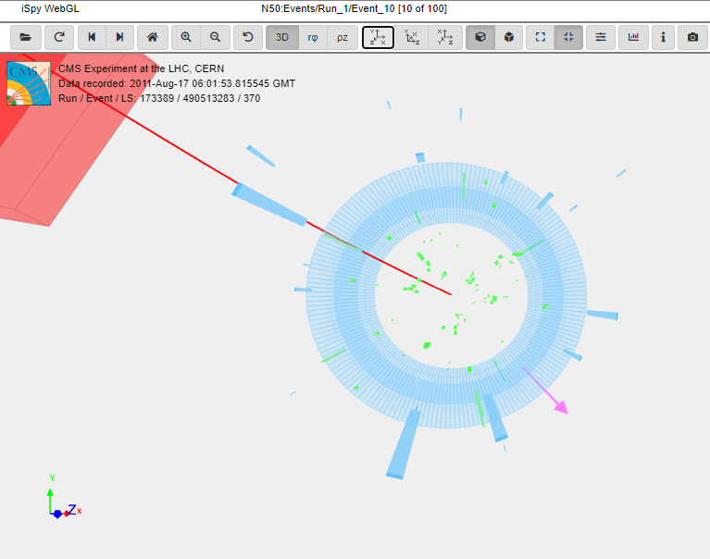
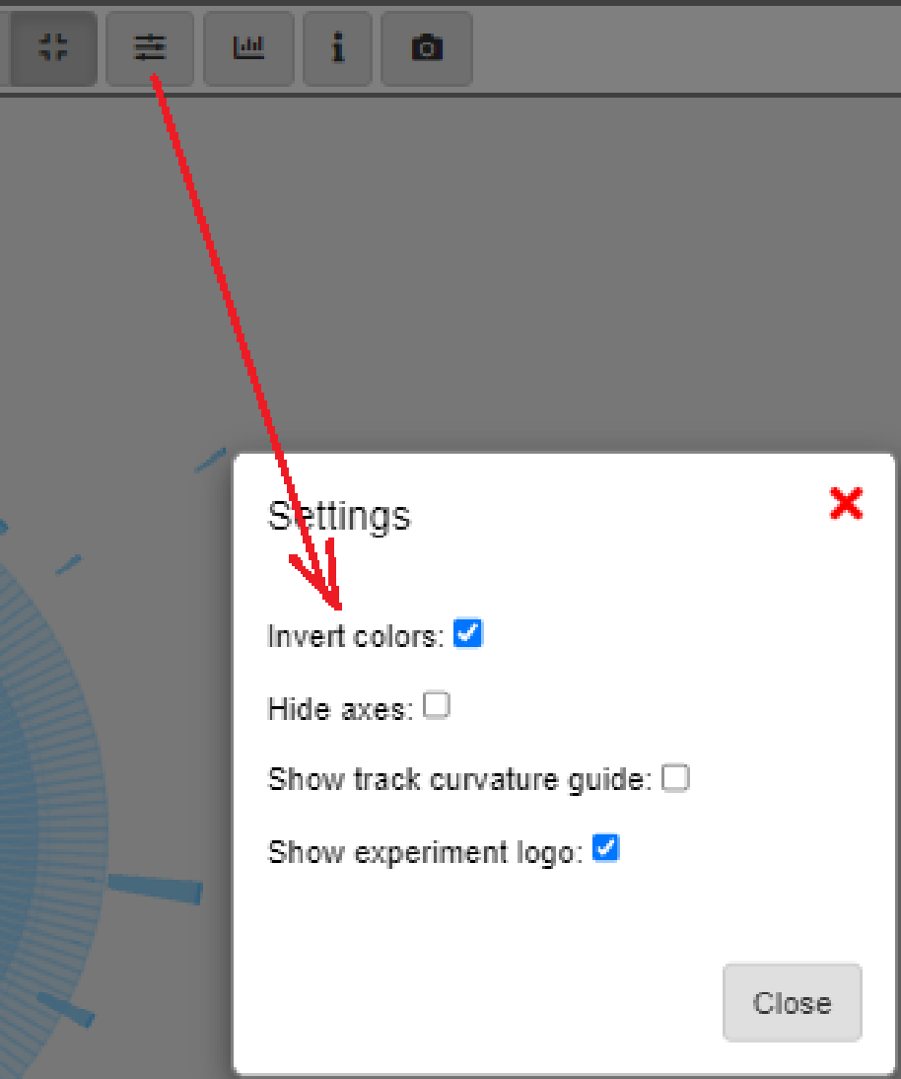
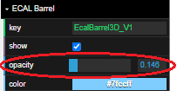
1, 2, or 4 leptons?
Which of these events has 1, 2, or 4 charged leptons? Which flavors of leptons? What else do you see?
Note Inverted Colors and increased ECal Barrel opacity.

Slide 15
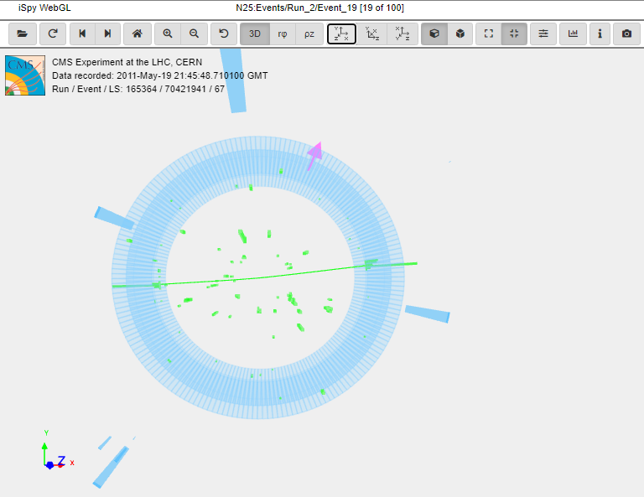
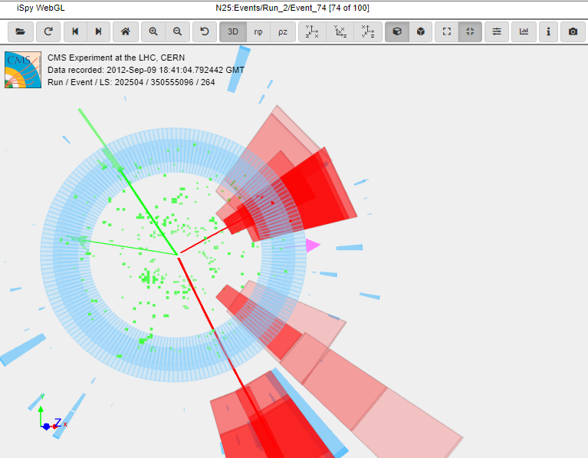
1, 2, or 4 leptons?
Which of these events has 1, 2, or 4 charged leptons? Which flavors of leptons? What else do you see?

Slide 16
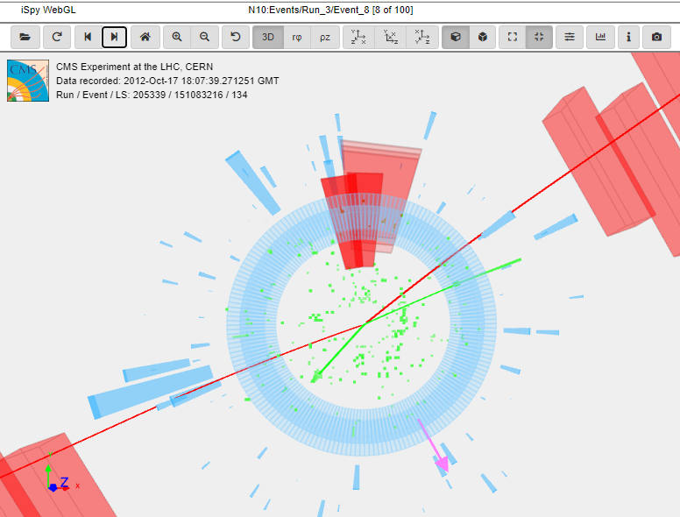
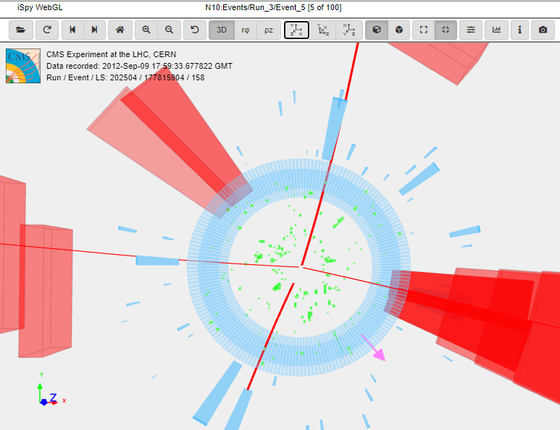
1, 2, or 4 leptons?
Which of these events has 1, 2, or 4 charged leptons? Which flavors of leptons? What else do you see?

Slide 17
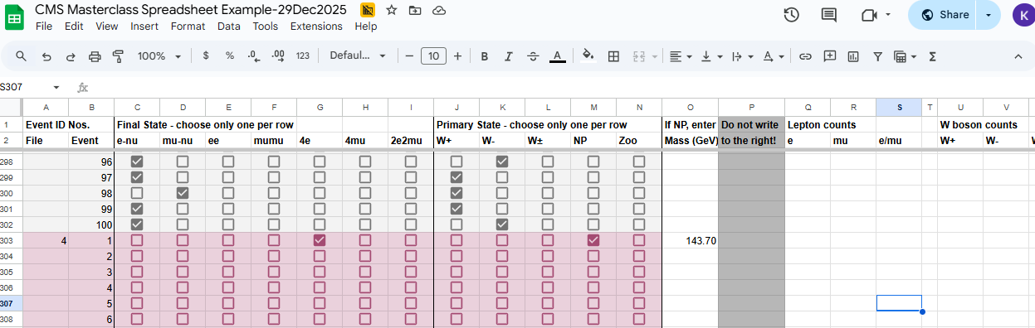
CMS Masterclass Spreadsheet
Enter data on each event in the Google Sheet:

Slide 18
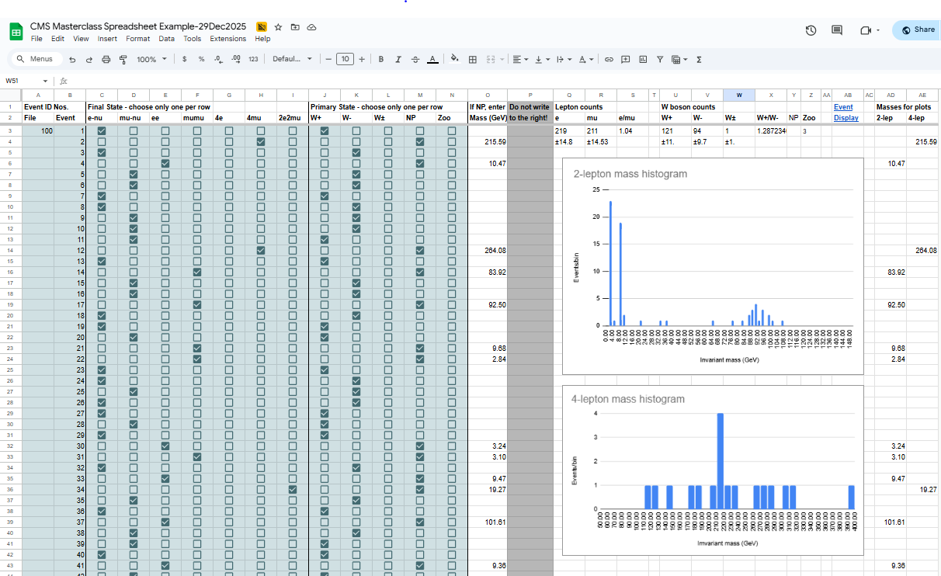
CMS Masterclass Spreadsheet
Your spreadsheet makes mass histograms automatically:

Slide 19

CMS Masterclass Spreadsheet
It also tabulates data for key ratios:

Slide 20
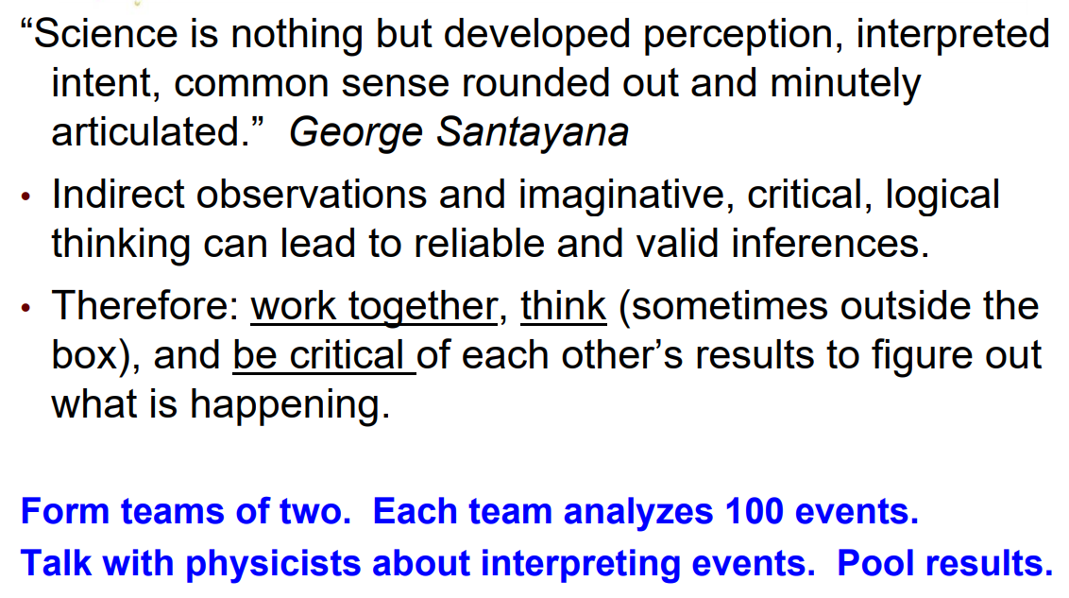
Parting words…

