Slide 1
Least Action and Lagrangian Mechanics
Boston QuarkNet Meeting
At Northeastern University 11/13/2025
Rick Dower
Charles T. Bauer Professor, Emeritus The Roxbury Latin School

Slide 2
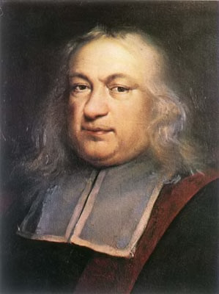
Least Time Minimum Principle in Optics
Pierre de Fermat (1657): “There is nothing as probable or apparent as the assumption that Nature always acts by the easiest means, . . . by the shortest time.”
Fermat showed that straight-line travel, reflection, and refraction of light could all be explained by his least-time principle.

Slide 3
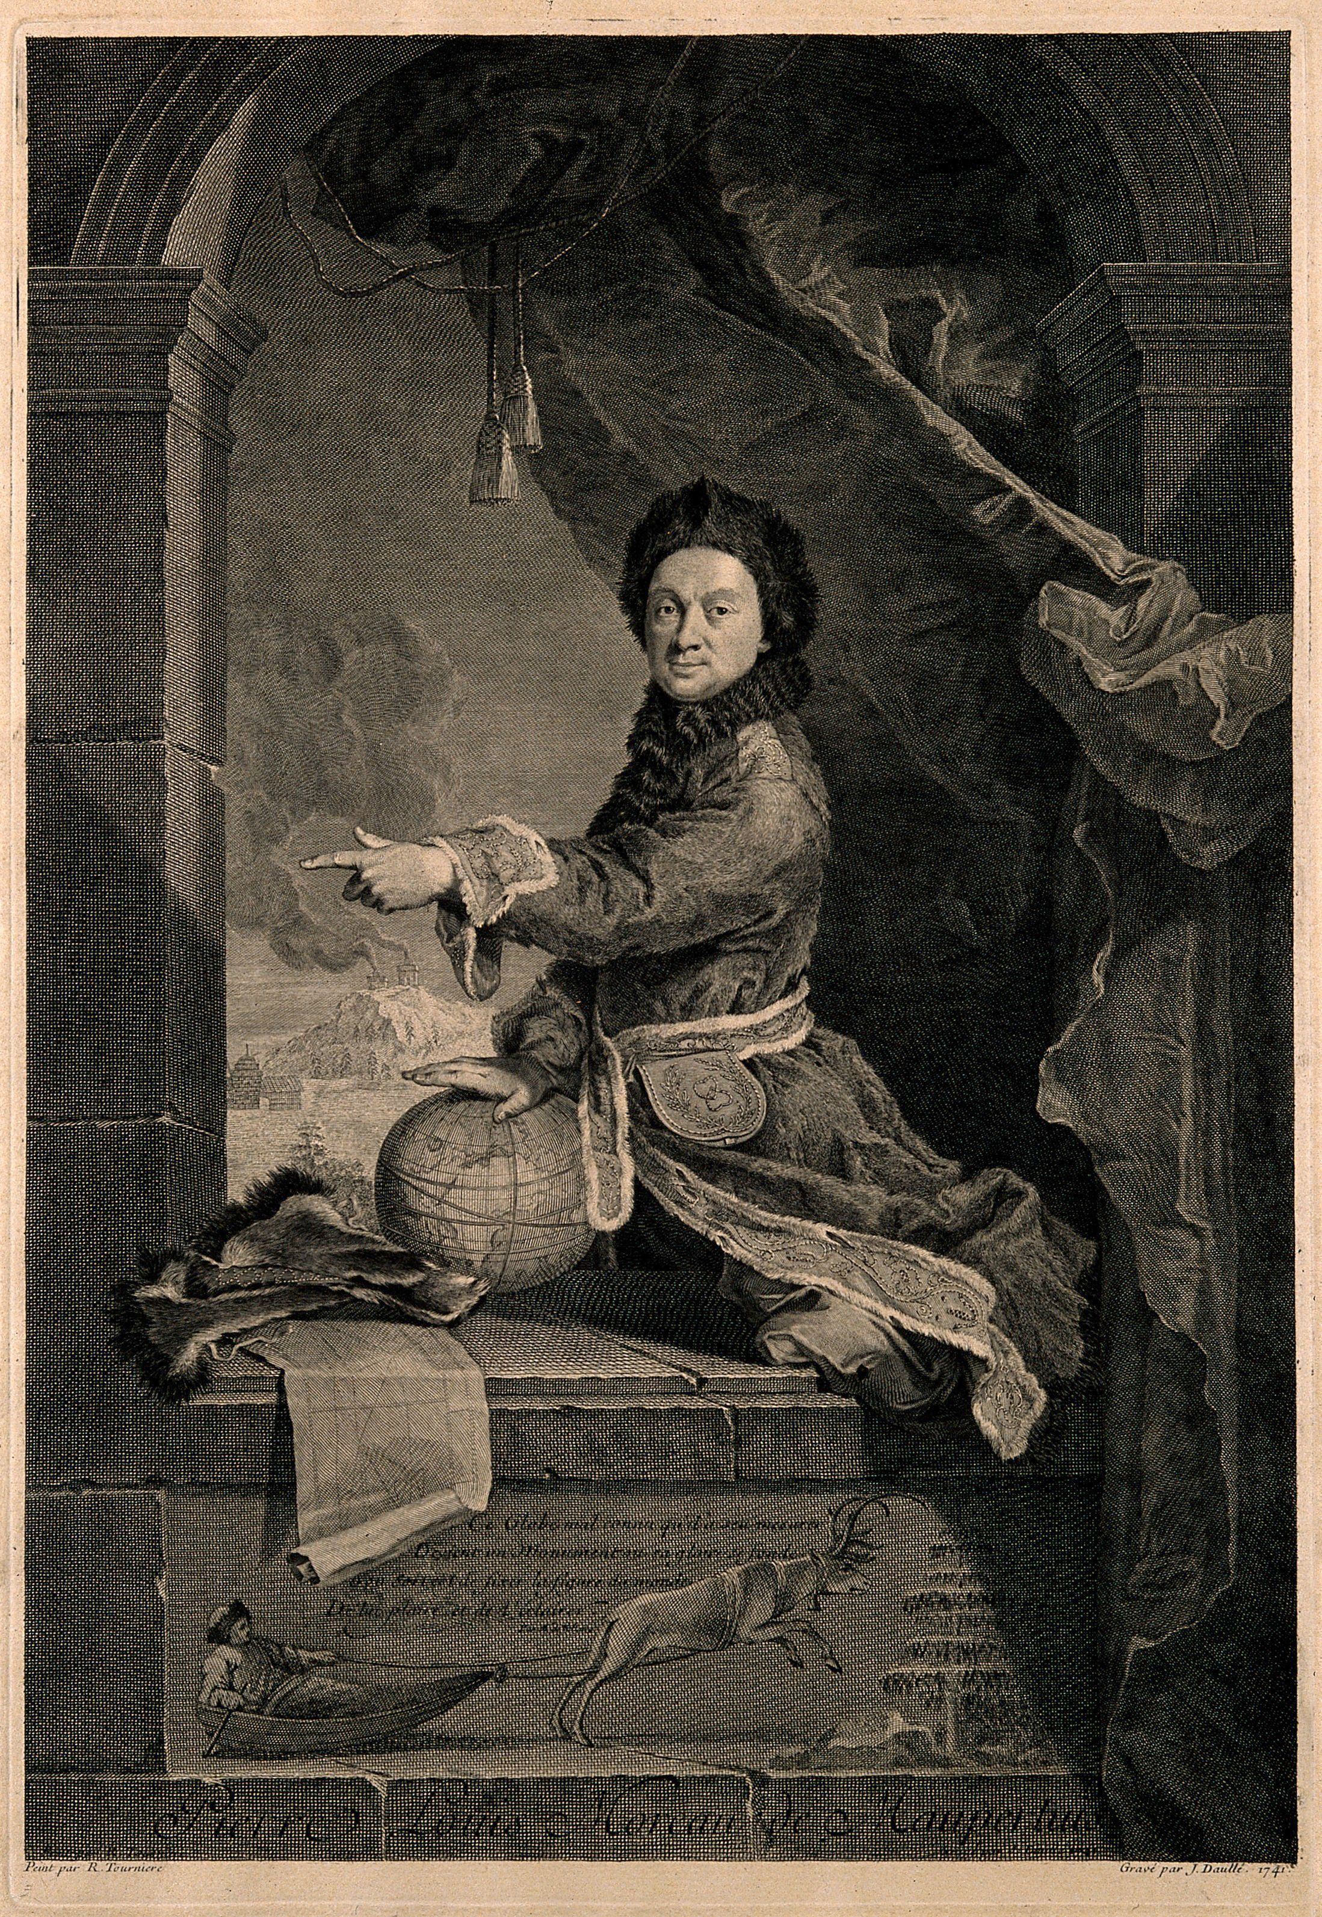
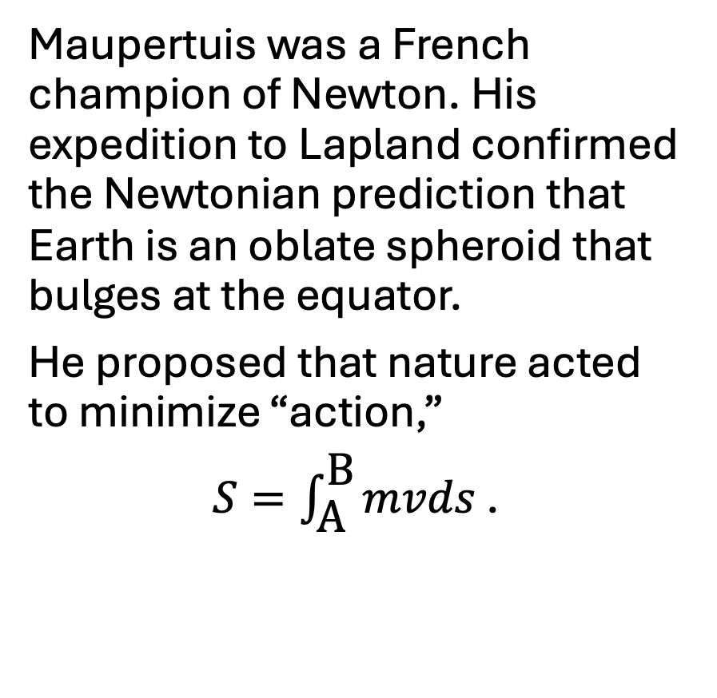
Pierre Louis Moreau de Maupertuis
Maupertuis was a French champion of Newton. His expedition to Lapland confirmed the Newtonian prediction that Earth is an oblate spheroid that bulges at the equator.
He proposed that nature acted to minimize “action,”
$S=\int_{\text{A}}^{\text{B}}{mvds}$ .

Slide 4
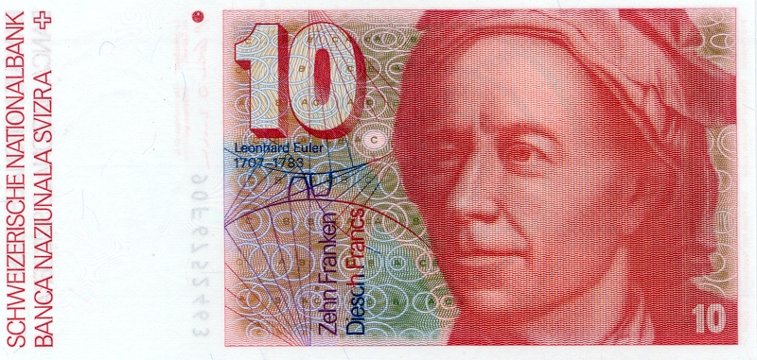
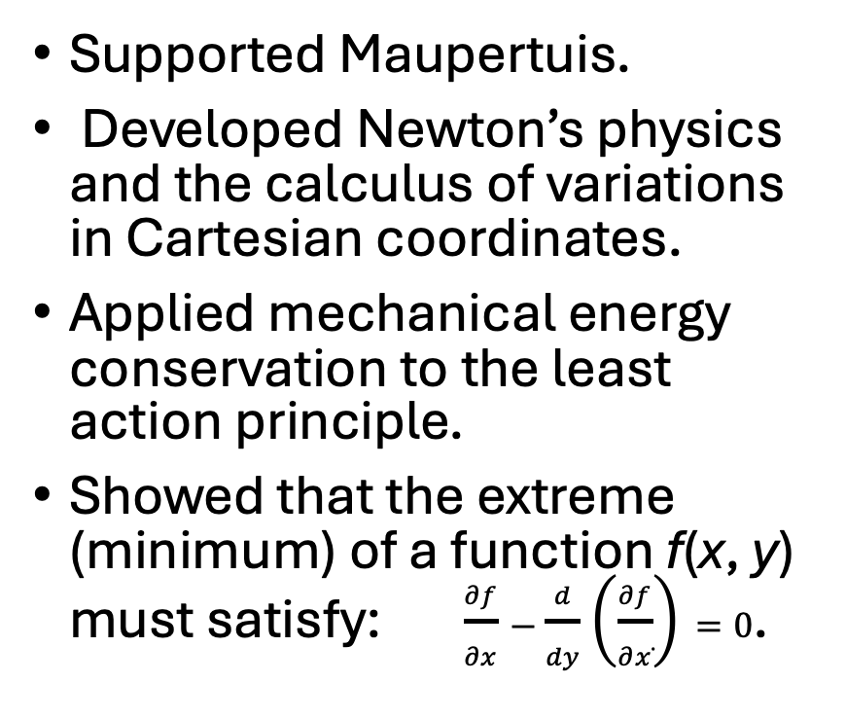
Leonhard Euler (1707-1783)
Supported Maupertuis.
Developed Newton’s physics and the calculus of variations in Cartesian coordinates.
Applied mechanical energy conservation to the least action principle.
Showed that the extreme (minimum) of a function f(x, y) must satisfy: $\frac{∂f}{∂x}−\frac{d}{dy}\left(\frac{∂f}{∂\dot{x}}\right)=0$.

Slide 5
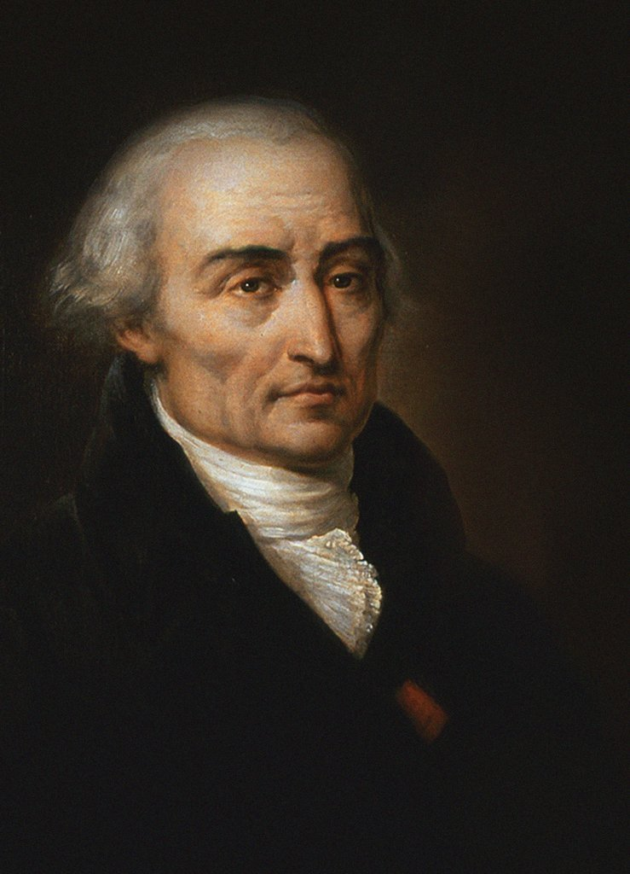
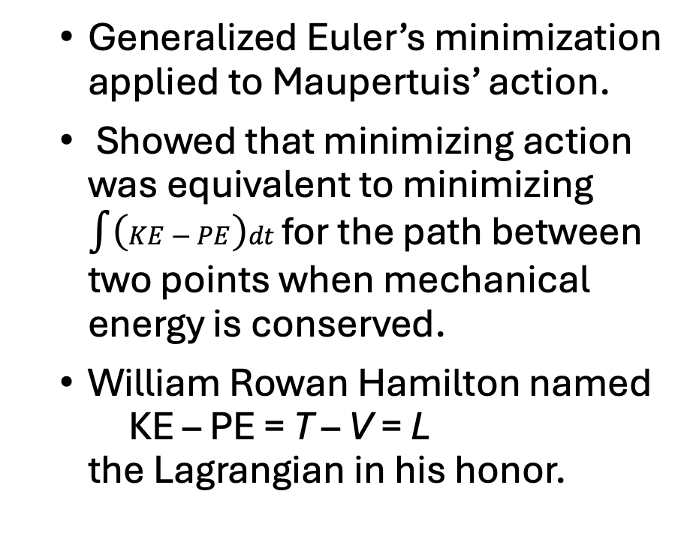
Joseph-Louis Lagrange (1736-1813)
Generalized Euler’s minimization applied to Maupertuis’ action.
Showed that minimizing action was equivalent to minimizing $\int{\left(KE−PE\right)dt }$for the path between two points when mechanical energy is conserved.
William Rowan Hamilton named KE – PE = T – V = L the Lagrangian in his honor.

Slide 6
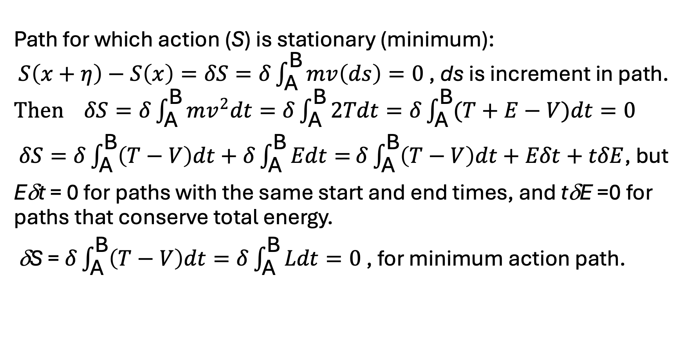
Why Does L = (T – V)?
Path for which action (S) is stationary (minimum): $S\left(x+η\right)−S\left(x\right)=δS=δ\int_{\text{A}}^{\text{B}}{mv\left(ds\right)=0}$ , ds is increment in path. $Then δS=δ\int_{\text{A}}^{\text{B}}{mv^{2}dt=δ\int_{\text{A}}^{\text{B}}{2Tdt=δ\int_{\text{A}}^{\text{B}}{(T+E−V)dt=0}}}$
$δS=δ\int_{\text{A}}^{\text{B}}{\left(T−V\right)dt}+δ\int_{\text{A}}^{\text{B}}{Edt=}$ $δ\int_{\text{A}}^{\text{B}}{\left(T−V\right)dt}+Eδt+tδE$, but
Eδt = 0 for paths with the same start and end times, and tδE =0 for paths that conserve total energy.
δS = $δ\int_{\text{A}}^{\text{B}}{\left(T−V\right)dt=δ\int_{\text{A}}^{\text{B}}{Ldt}=0}$ , for minimum action path.

Slide 7
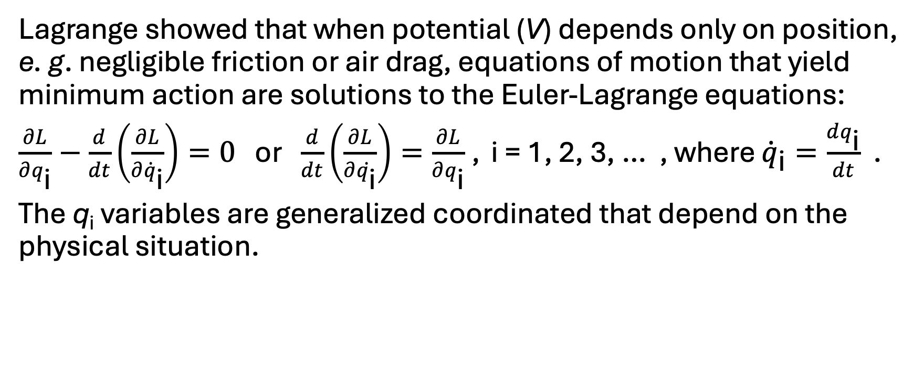
Euler-Lagrange Equations
Lagrange showed that when potential (V) depends only on position, e. g. negligible friction or air drag, equations of motion that yield minimum action are solutions to the Euler-Lagrange equations:
$\frac{∂L}{∂q_{\text{i}}}−\frac{d}{dt}\left(\frac{∂L}{∂{\dot{q}}_{\text{i}}}\right)=0$ or $\frac{d}{dt}\left(\frac{∂L}{∂\dot{q_{\text{i}}}}\right)=\frac{∂L}{∂q_{\text{i}}}$ , i = 1, 2, 3, … , where ${\dot{q}}_{\text{i}}=\frac{dq_{\text{i}}}{dt}$ .
The q_{i} variables are generalized coordinated that depend on the physical situation.

Slide 8
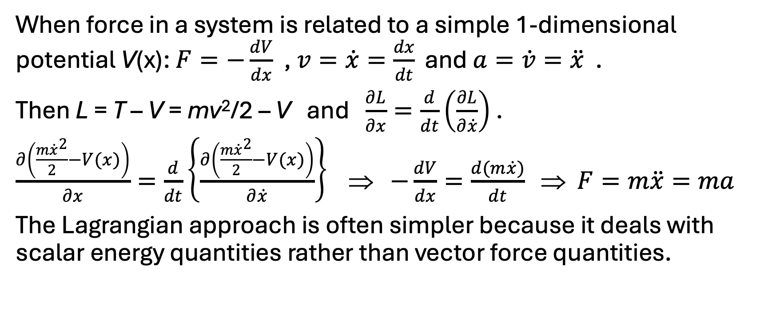
Euler-Lagrange Equations and Newton’s Law
When force in a system is related to a simple 1-dimensional potential V(x): $F=−\frac{dV}{dx}$ , $v=\dot{x}=\frac{dx}{dt} \text{and} a=\dot{v}=\ddot{x}$ .
Then L = T – V = mv²/2 – V and $\frac{∂L}{∂x}=\frac{d}{dt}\left(\frac{∂L}{∂\dot{x}}\right)$ .
$\frac{∂\left(\frac{m{\dot{x}}^{2}}{2}−V(x)\right)}{∂x}=\frac{d}{dt}\left\{\frac{∂\left(\frac{m{\dot{x}}^{2}}{2}−V(x)\right)}{∂\dot{x}}\right\}$ ⇒ $−\frac{dV}{dx}=\frac{d(m\dot{x})}{dt}$ ⇒ $F=m\ddot{x}=ma$
The Lagrangian approach is often simpler because it deals with scalar energy quantities rather than vector force quantities.

Slide 9
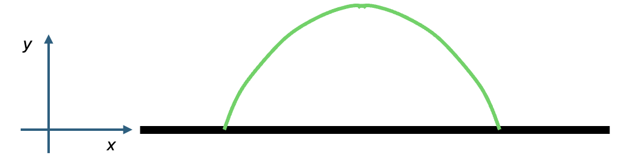
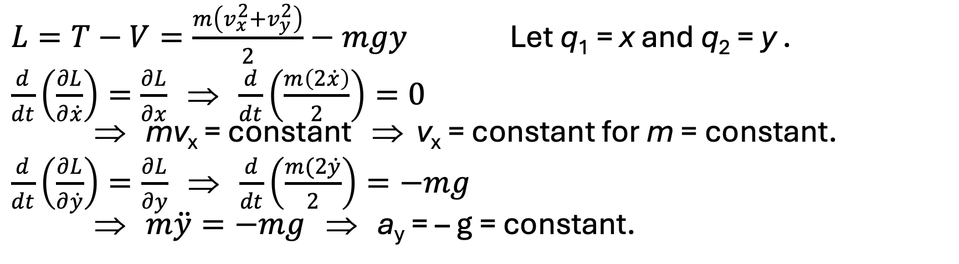
Euler-Lagrange Equations Example 1: Simple Projectile Motion
$L=T−V=\frac{m\left(v_{x}^{2}+v_{y}^{2}\right)}{2}−mgy$ Let q₁ = x and q₂ = y .
$\frac{d}{dt}\left(\frac{∂L}{∂\dot{x}}\right)=\frac{∂L}{∂x}$ ⇒ $\frac{d}{dt}\left(\frac{m\left(2\dot{x}\right)}{2}\right)=0$ ⇒ mv_{x} = constant ⇒ v_{x} = constant for m = constant.
$\frac{d}{dt}\left(\frac{∂L}{∂\dot{y}}\right)=\frac{∂L}{∂y}$ ⇒ $\frac{d}{dt}\left(\frac{m(2\dot{y}}{2}\right)=−mg$ ⇒ $m\ddot{y}=−mg$ ⇒ a_{y} = – g = constant.

Slide 10
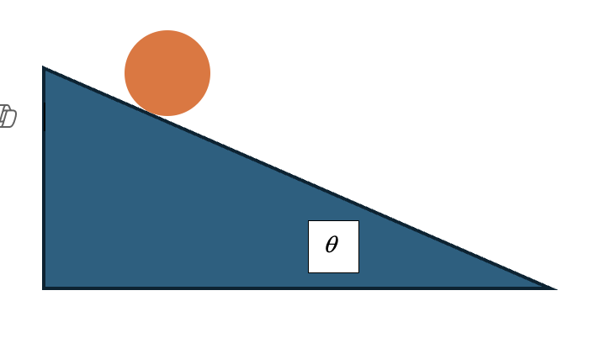
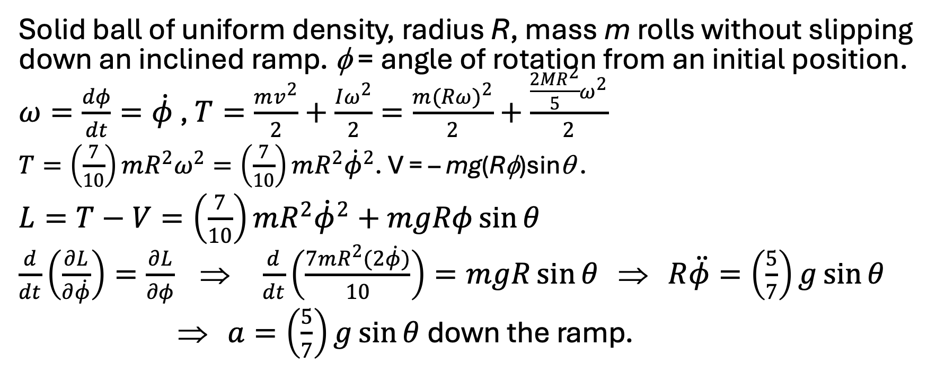
Euler-Lagrange Equations Example 2: Ball Rolling on a Ramp
Solid ball of uniform density, radius R, mass m rolls without slipping down an inclined ramp. φ = angle of rotation from an initial position. $ω=\frac{dφ}{dt}=\dot{φ}$ , $T=\frac{mv^{2}}{2}+\frac{Iω^{2}}{2}=\frac{m{(Rω)}^{2}}{2}+\frac{\frac{2MR^{2}}{5}ω^{2}}{2}$
$T=\left(\frac{7}{10}\right)mR^{2}ω^{2}=\left(\frac{7}{10}\right)mR^{2}{\dot{φ}}^{2}$. V = – mg(Rφ)sinθ .
$L=T−V=\left(\frac{7}{10}\right)mR^{2}{\dot{φ}}^{2}+mgRφ\sin{θ}$
$\frac{d}{dt}\left(\frac{∂L}{∂\dot{φ}}\right)=\frac{∂L}{∂φ}$ ⇒ $\frac{d}{dt}\left(\frac{7mR^{2}(2\dot{φ})}{10}\right)=mgR\sin{θ}$ ⇒ $R\ddot{φ}=\left(\frac{5}{7}\right)g\sin{θ}$
⇒ $a=\left(\frac{5}{7}\right)g\sin{θ}$ down the ramp.

Slide 11
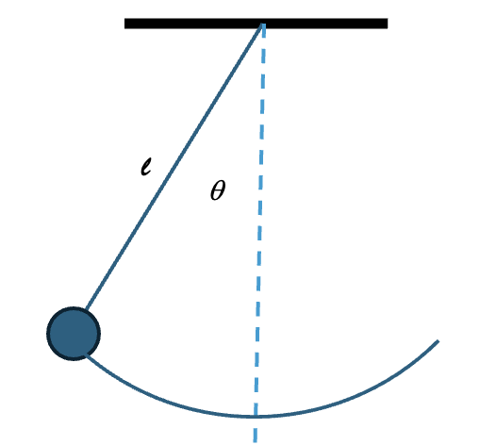
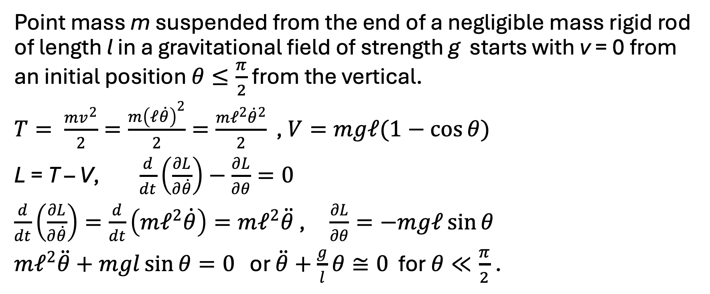
Euler-Lagrange Equations Example 3: Simple Pendulum
Point mass m suspended from the end of a negligible mass rigid rod of length l in a gravitational field of strength g starts with v = 0 from an initial position $θ≤\frac{π}{2}$ from the vertical.
$T= \frac{mv^{2}}{2}=\frac{m{\left(𝓁\dot{θ}\right)}^{2}}{2}=\frac{m𝓁^{2}{\dot{θ}}^{2}}{2}$ , $V=mg𝓁(1−\cos{θ})$
L = T – V, $\frac{d}{dt}\left(\frac{∂L}{∂\dot{θ}}\right)−\frac{∂L}{∂θ}=0$
$\frac{d}{dt}\left(\frac{∂L}{∂\dot{θ}}\right)=\frac{d}{dt}\left(m𝓁^{2}\dot{θ}\right)=m𝓁^{2}\ddot{θ}$ , $\frac{∂L}{∂θ}=−mg𝓁\sin{θ}$
$m𝓁^{2}\ddot{θ}+mgl\sin{θ}=0$ or $\ddot{θ}+\frac{g}{l}θ≅0$ for $θ≪\frac{π}{2}$ .

Slide 12
Cause and Effect
Newton’s F = ma law: Vector total of forces acting on the object at an instant cause the effect of the vector acceleration a of the object at that instant.
The Lagrangian approach seems to suggest that Nature somehow evaluates the total action between given points over many paths before the motion occurs and selects the path for which action is a minimum.
However, to minimize the total action integrated over a path, the action must be a minimum for each infinitesimal part of the path. The optimal path need not be known in advance for the path taken to have the least total action. The path is determined by the minimum of the scalar Lagrangian function moment by moment.

