Slide 1
Boston QuarkNet
Quantum Properties Workshop
Discovery of the Neutron
Rick Dower
August 7, 2025

Slide 2
1920s Model of the Nucleus
Ernest Rutherford, Hans Geiger, and Ernest Marsden demonstrated the existence of the atomic nucleus with their α-particle scattering experiments 1909-1913.
Rutherford showed in 1919 that α-particle (He nucleus) collisions with N nuclei eject protons. Thus, the atomic nucleus contains protons.
Since electrons are ejected from the nucleus in β-decay, an early model assumed that a nucleus of atomic number Z and atomic mass A was composed of A protons and (A-Z) electrons.

Slide 3
Problems with the pe-model of the Nucleus
The de Broglie relation p = h/λ indicates that an electron whose wavelength is confined within a typical nuclear diameter of 10⁻¹⁴ m would have a corresponding kinetic energy of about 123 MeV, much too large to be held by the nuclear electrostatic potential energy.
The molecular spectrum of N₂ indicates that the total spin of a N nucleus was integer, whereas, an N-14 nucleus composed of 14 protons and 7 electrons (21 half-integer spin particles) would have total half-integer spin.

Slide 4
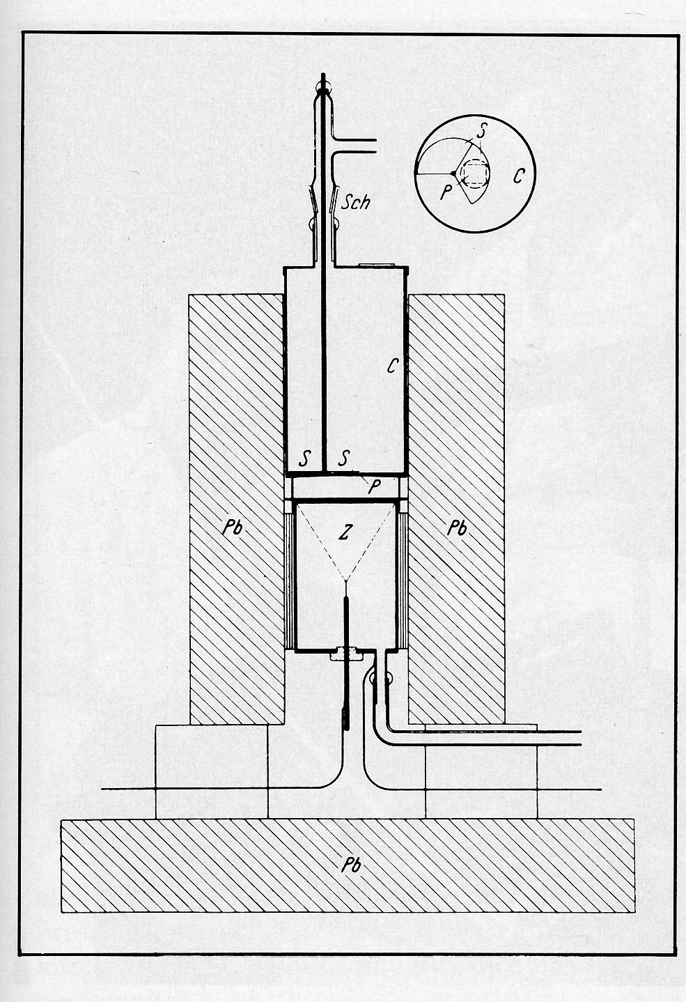
1930 - Bothe and Becker
In 1930 Walther Bothe and Herbert Becker reported that beryllium bombarded by α-particles from Po produced high energy uncharged radiation that they interpreted as γ rays from the Be nucleus.
Z in the Figure indicates the Geiger counter [Zeitschrift fur Physik, 66, 289 (1930)].

Slide 5
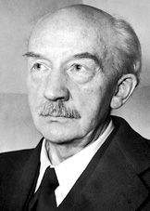
Walther Bothe (1891 – 1957)
In 1954 Bothe was awarded the Nobel Prize in Physics for his development (with Hans Geiger) of coincidence methods for particle counter experiments and subsequent discoveries he made with that technique.
(Image from nobelprize.org)

Slide 6
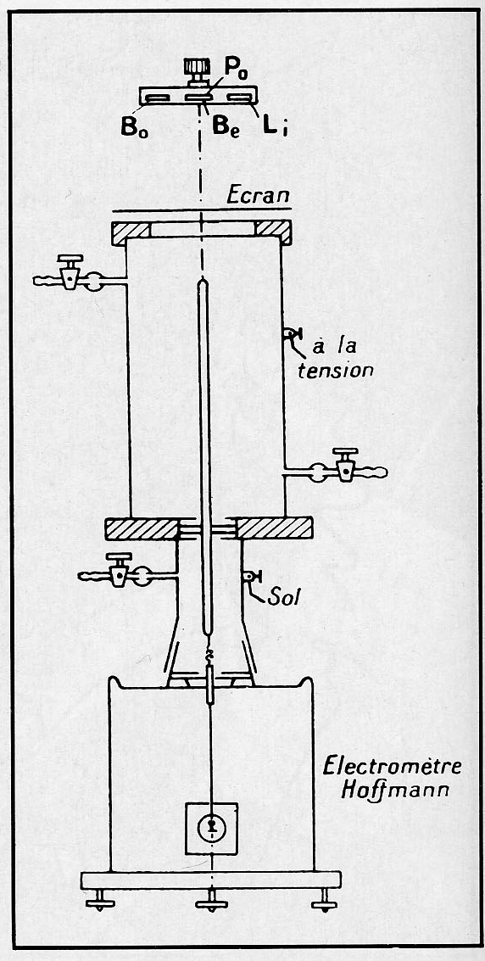
1932 January 18 – F. and I. Joliot-Curie
Frédéric and Irène Joliot-Curie, using a strong Po source of
α-particles, reported that the neutral radiation from Be was able to eject protons from paraffin, a very surprising result if, as they supposed, it was due to Compton interaction between γ-ray and proton.
[Figure from Comptes-rendus Academie des Sciences, Paris, 194, 273 (1932).]

Slide 7
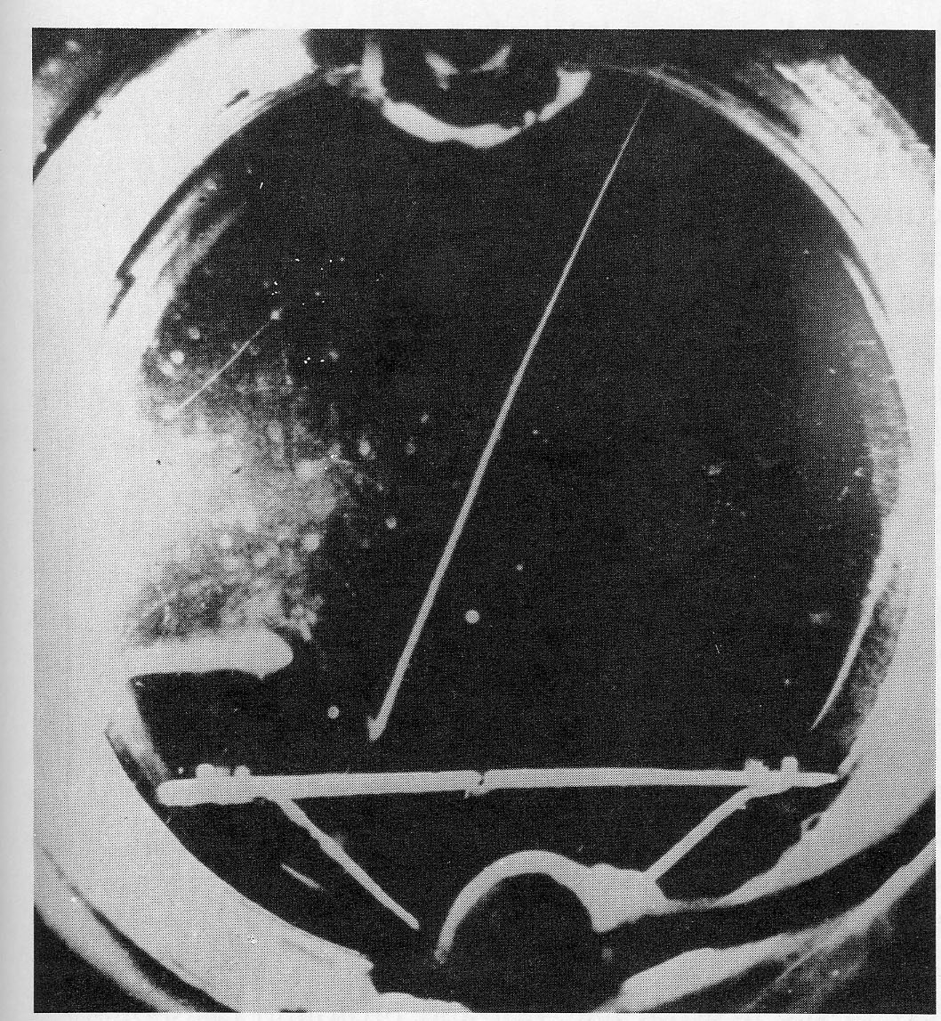
Ejected Protons Confirmed
On 22 February 1932 the Joliot-Curies published this cloud chamber photo confirming the ejection of protons from paraffin (diagonal track from lower left to upper right).
[Figure from Comptes-rendus Academie des Sciences, Paris, 194, 847 (1932).]

Slide 8
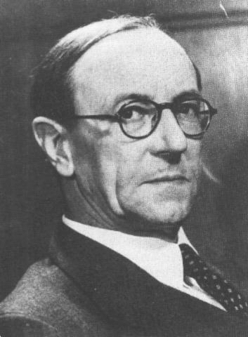
1932 February – James Chadwick
James Chadwick (1891 – 1974), with Ernest Rutherford, had been looking for over ten years for evidence of a neutral particle (which Rutherford had called a “neutron” in 1920) with mass about the proton mass to account for the difference between nuclear masses (A) and nuclear charges (Z).
When they discussed the Joliot-Curie’s γ-ray interpretation, Rutherford responded, “I do not believe it.” Chadwick began constructing his experiment.

Slide 9
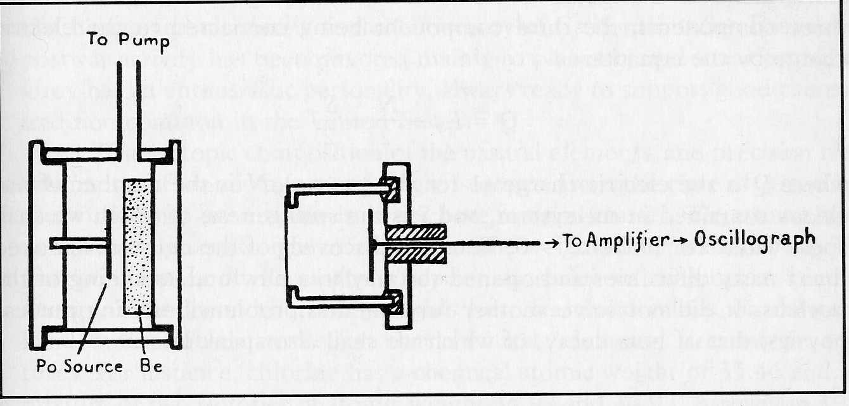
Chadwick’s Apparatus
The counting rate, due to N atoms in the ionization chamber set in motion by impact, for the neutral radiation remained the same (about 8 times background) when 2 cm of lead was placed between the source and the counting chamber.
γ-rays would have experienced much greater absorption.
[Figure from Proc. Roy. Soc. A, 136, 695 (May 1932).]
Po deposited on a 1 cm diameter silver disk in front of a 2 cm diameter beryllium disk placed 3 cm from an ionization chamber.

Slide 10
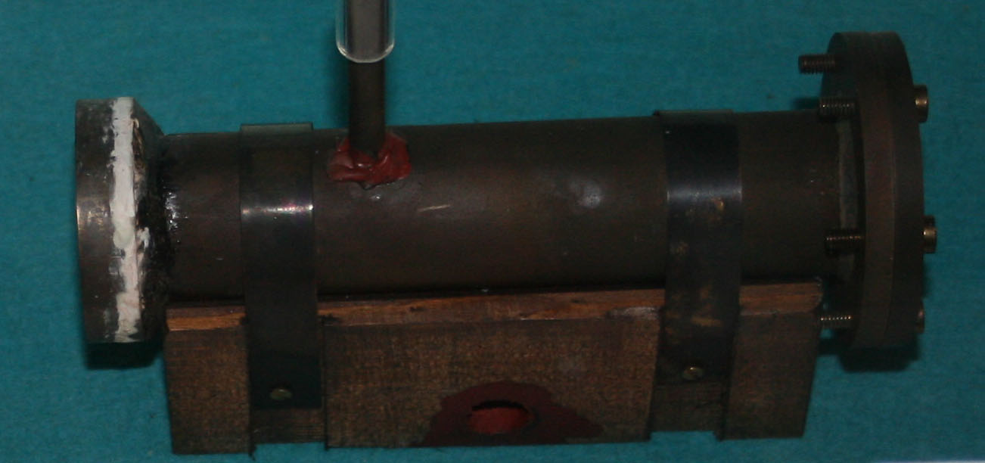
Replica of James Chadwick’s apparatus made by Ray Flaxman in the Cavendish Laboratories. (Photo by R. Dower 2010)

Slide 11
Chadwick’s Measurements
In a brief letter [Nature, 129, 312 (Feb. 27, 1932)], and a more complete account [Proc. Roy. Soc. A, 136, 692-708 (May 1932)], Chadwick described his measurements and conclusions.
When he placed a 2 mm thick sheet of paraffin between the source and the ionization chamber, the counting rate increased dramatically. Placing aluminum foil sheets between the paraffin and the chamber allowed him to plot an absorption curve. It matched the absorption curve for protons and indicated an initial proton speed of
3.3 x 10⁷ m/s and energy of 5.7 MeV.
Lithium, beryllium, boron, and carbon in succession replaced the paraffin in front of the ionization chamber. Hydrogen, helium, nitrogen, oxygen, and argon gases were used to fill the ionization chamber. In all cases, recoil atoms produced significant numbers of counts in the chamber. N recoil atoms had speeds of 4.7 x 10⁶ m/s and energies of 1.6 MeV.

Slide 12
Chawick’s Collision Model
Chadwick calculated that a 55 MeV photon would be required to produce the H atom recoil speeds. A 90 MeV photon was needed to produce the N atom speeds.
Chadwick noted “we must either relinquish the applications of the conservation of energy and momentum in these collisions or adopt another hypothesis about the nature of the [beryllium] radiation.”
However, “If we suppose that the radiation consists of particles of mass very nearly equal to that of a proton, all the difficulties connected with the collisions disappear.”
The transformation is ⁴He + ⁹Be → ¹²C + ¹n.

Slide 13
Chadwick’s Calculations - 1
Applying classical momentum and kinetic energy conservation for elastic collisions (all the speeds are nonrelativistic) to the hydrogen and nitrogen measurements, Chadwick was able to deduce the neutron’s mass from the speeds of the recoil protons and nitrogen atoms (with uncertainty due to 10% uncertainty in nitrogen recoil speed):

Slide 14
Chadwick’s Calculations - 2
At that time Aston had not yet measured with his mass-spectrograph an accurate mass for a Be nucleus. However, the ¹¹B nuclear mass had been measured. To obtain a more precise value for the neutron mass, Chadwick examined the neutrons and nitrogen atoms resulting from α-particle collisions with boron atoms.

Slide 15
Chadwick’s Calculations - 3
¹¹B + ⁴He →¹⁴N + ¹n
m_{B} + (m_{He} + KE_{He}) = (m_{N} + KE_{N}) + (m_{n} + KE_{n})
From his measurement of the particle kinetic energies and his knowledge of m_{B}, m_{He}, and m_{N}, Chadwick concluded
m_{n} = 1.0067 ± 0.002 u
Today’s best measurements give
m_{n} = 1.00866 u

Slide 16
Chadwick’s Calculations - 4
Having established the mass of the neutron, Chadwick used neutron scattering measurements to determine the size of Pb, Cu, and C nuclei.
Let πr² = nuclear scattering cross-section,
n = density of scattering centers in substance,
t = thickness of sample.
Then πr²nt = fraction of neutrons scattered.
Chadwick found that placing a 1 inch block of lead between his source and counter reduced the neutron count rate from 190/hr to 166/hr. From this he concluded, r_{Pb} = 7 x 10⁻¹⁵ m = 7 fm.
For Cu and C he found: r_{Cu} = 6 fm and r_{C} = 3.5 fm.

Slide 17
Problems Solved
With Chadwick’s discovery, scientists no longer supposed that the nucleus contained electrons. An atomic nucleus consists of Z protons and
(A-Z) neutrons.
With 7 protons and 7 neutrons (14 half-integer spin particles), the integer spin of the nitrogen nucleus was explained.

Slide 18
Nobel Prize
James Chadwick was awarded the 1935 Nobel Prize in Physics. As noted in the presentation speech, “By a combination of intuition, logical thought, and experimental research Professor J. Chadwick … has succeeded in proving the existence of the neutron and establishing its properties.” (www.nobelprize.org)

Slide 19
Related Developments
Deuterium - 1
A few weeks before Chadwick’s experiments, Harold Urey, working with Ferdinand Brickewedde, and George Murphy, had demonstrated the existence of ²H or deuterium, the hydrogen isotope that contains one proton and one neutron. They had evaporated two
4 liter samples of liquid hydrogen down to a few cm³ at the triple point of hydrogen (13.95 K) and examined the residue (excited in a discharge tube) with a high dispersion spectrograph.

Slide 20
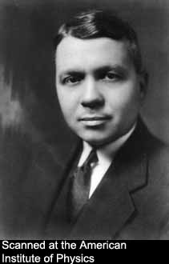
Related Developments
Deuterium - 2
In the concentrated residue, Urey found the faint companion lines due to ²H less than 0.2 nm from the familiar Balmer lines of the hydrogen spectrum.
For this discovery Urey was awarded the Nobel Prize in Chemistry in 1934.
[Photo from Emilio Segrè Visual Archives of AIP.]

Slide 21
Related Developments
Induced Radioactivity - 1
The Joliot-Curies continued their α-particle collisions with atoms of various elements.
Aluminum bombarded with α-particles produced neutrons and positrons.
When they removed the aluminum from the
α-particle source, neutron production stopped, but positron emission continued at an exponentially decreasing rate with characteristic time about 3.3 minutes.
Chemical analysis showed that the source of the positrons was radioactive phosphorus.

Slide 22
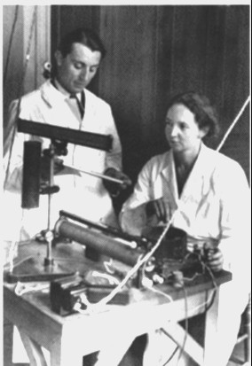
Related Developments
Induced Radioactivity - 2
They had discovered induced radioactivity.
⁴He + ²⁷Al → ³⁰P + ¹n
³⁰P → ³⁰Si + e⁺
For this work they received the Nobel Prize in Chemistry in 1935, the year Chadwick received the Physics Prize.
[Photo from Emilio Segrè Visual Archives of AIP.]

Slide 23
Related Developments β-decay
Enrico Fermi, building on Wolfgang Pauli’s 1930 proposal of a low mass, low interaction, neutral particle emitted in
β-decay, developed a theory in 1933 in which a neutron decays to a proton, electron, and neutrino (“little neutral one”).
We now know the neutrino produced in this process is an electron antineutrino:
n → p⁺ + e⁻ + ν_{e}

Slide 24
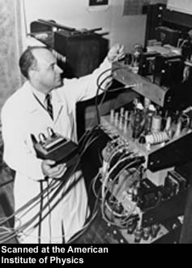
Related Developments
Slow Neutrons
In 1938 Enrico Fermi received the Nobel Prize in Physics “for his demonstrations of the existence of new radioactive elements produced by neutron irradiation, and for his related discovery of nuclear reactions brought about by slow neutrons.”
(www.nobelprize.org)
[Photo of Fermi at U. Chicago cyclotron from Emilio Segrè Visual Archives of AIP.]

Slide 25
Related Developments
Nuclear Fission
In 1938, while examining the action of slow neutrons on heavy elements, Otto Hahn and Fritz Strassmann discovered barium among the reaction products.
In 1939 Hahn’s long-time collaborator, Lise Meitner and her nephew Otto Frisch proposed the theory that the uranium nucleus had split nearly in two, i.e. nuclear fission.
In 1944 Hahn was awarded the Nobel Prize in Chemistry.

Slide 26
Summary
The discovery of the neutron, radioactivity induced by α-particles and slow neutrons, and nuclear fission during the 1930s marked the conclusion of the era of particle discovery with naturally occurring radioactive substances.
Further progress in comprehending the structure of matter required investigations of interactions at higher energies produced by:
(a) cosmic rays and
(b) particle accelerators.

Slide 27
References
Collections of primary sources (almost all in English):
1. Henry Boorse and Lloyd Motz, ed., The World of the Atom, Basic Books, Inc., New York, 1966 and
2. Robert Cahn and Gerson Goldhaber, The Experimental Foundations of Particle Physics, Cambridge University Press, 1989.
Successively more detailed accounts:
3. Emilio Sergè, From X-rays to Quarks, W. H. Freeman, San Francisco, 1980,
4. Abraham Pais, Inward Bound, Oxford University Press, 1986, and
5. Michael L’Annunziata, Radioactivity, Elsevier, Amsterdam, 2007.

