Slide 1
Boston QuarkNet
Quantum Science Workshop
Numbering the Elements
August 7, 2025
Rick Dower

Slide 2
The effort to identify and enumerate the elements that make up all visible things has a long history …
Chinese – Earth, Wood, Metal, Water, Fire
Greeks – Thales (c. 600 BCE) → water
Anaximander (c. 550 BCE) → air
Heraclitus (c. 500 BCE) → fire
Empedocles (c. 450 BCE) → Earth, Water, Air, Fire
Plato (c. 400 BCE) → Earth, Water, Air, Fire
Aristotle (c. 350 BCE) → Earth, Water, Air, Fire, Quintessence
Paracelsus (1493-1541), an alchemist and physician advocated mercury, sulfur, salt as fundamental principles of all matter.

Slide 3
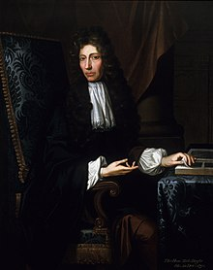
Robert Boyle (1627 – 1691)
The Sceptical Chymist (1661)
Matter consists of corpuscles (small bodies) in motion.
“I now mean by Elements … perfectly unmingled bodies.”
But no visible substances are elements. All observed bodies are compounds.

Slide 4
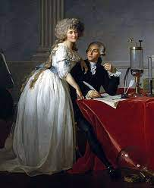
Antoine Lavoisier (1743 – 1794)
Elements of Chemistry (1789)
Lavoisier established the conservation of mass in chemical reactions
Chemical element is a substance that cannot be separated into simpler substances by ordinary chemical processes.
List of 3 gaseous elements,
6 non-metallic solids, 17 metals,
5 ”earthy substances”,
plus light and caloric

Slide 5
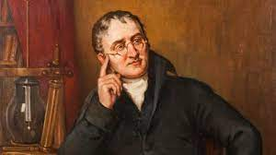
John Dalton (1766 – 1844)
The Chemical Atom
1808 – In A New System of Chemical Philosophy, Dalton listed 20 elements and 17 molecules of simple compounds, e. g. water, ammonia, composed of elemental atoms.
Dalton developed a list of relative atomic weights from hydrogen (1) to mercury (167) based on his ideas of compounds and chemical analysis of elements in compounds.

Slide 6
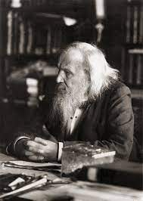
Dmitri Mendeleev (1834-1907)
Ordering the Atoms
1869 – Mendeleev published a table of 64 elements, increasing in relative atomic mass and organized by similar chemical properties.
1871 – revised table included several blank spots for undiscovered elements, including three for which he predicted atomic mass and chemical properties

Slide 7
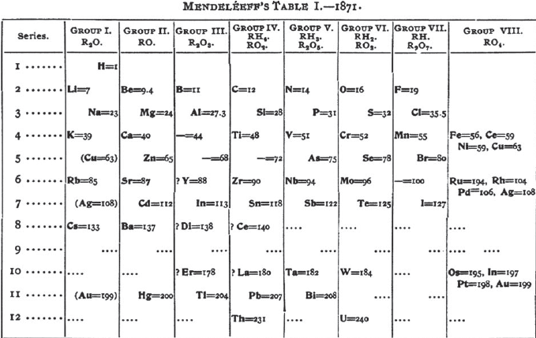
Mendeleev’s Periodic Table
Mendeleev’s “eka-aluminum” purified in 1875:
Ga (gallium) M = 69.7
Mendeleev’s “eka-silicon” isolated in 1886:
Ge (germanium) M = 72.6
Mendeleev’s “eka-boron” identified by spectrum in 1879, separated in 1937:
Sc (scandium) M = 45.0

Slide 8
Anomalies
Mendeleev’s periodic table, ordered by atomic weight, contained three anomalies that allowed him to arrange elements with similar chemical properties in vertical columns:
Ar (Z = 18, M = 39.9), K (Z = 19, M = 39.1)
Co (Z = 27, M = 58.9), Ni (Z = 28, M = 58.7)
Te (Z = 52, M = 127.6), I (Z = 53, M = 126.9).

Slide 9
Rare Earths and Nobel Gases
1870s, 1880s – 11 new elements discovered, primarily from the
Lanthanide “rare earth” series
1868 – Unknown yellow line observed in solar spectrum
1882 – Same line observed in lava from Vesuvius
1895 – William Ramsey observes the yellow line in uranium ore cleveite. Helium isolated by Cleve and Langlet.
1894 – Lord Rayleigh and Ramsey Noble gases isolate argon.
1898 – Ramsey isolates and identifies neon, krypton, and xenon
1898 – Radon identified. Ramsey measured its atomic weight in 1910.

Slide 10
Elemental Questions
Atomic numbers were a convenient ordering system,
not as a fundamental characteristic of elements.
Are there undiscovered elements lighter than H or between H and He?
Is there a limit to the number of elements?

Slide 11
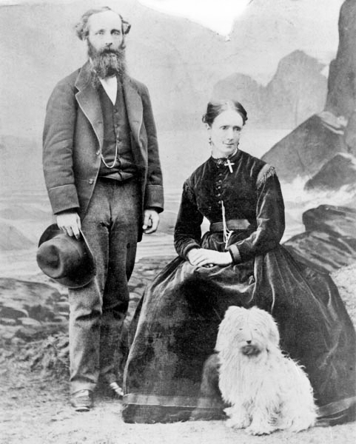
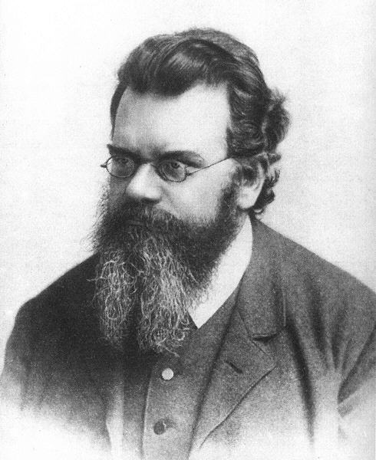
The Physical Atom
Kinetic Theory of Gases
James Maxwell (1831-1897)
KE_{avg} = m(v²)_{avg}/2 = 3kT/2
Ludwig Boltzmann (1844-1906)
S = k(lnW)
Notes:
Gas pressure due to innumerable collisions of randomly moving gas molecules.
Temperature of matter is a measure of the average kinetic energy of atoms or molecules. mv²/2 = 3kT/2
Heat flows from hot to cold objects due to statistical chance.

Slide 12
Molecular Size
The physical size of gas molecules was estimated in the 1870s from diffusion measurements applied to kinetic theory of molecular mean free path in gases.
Molecular thickness was also estimated by measurements of soap film thickness from light reflection and interference of known wavelengths.

Slide 13
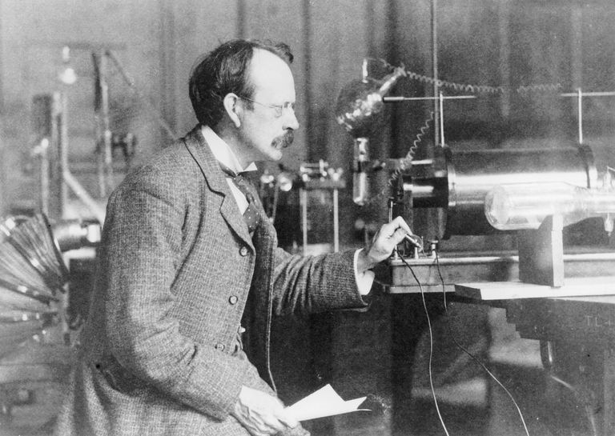
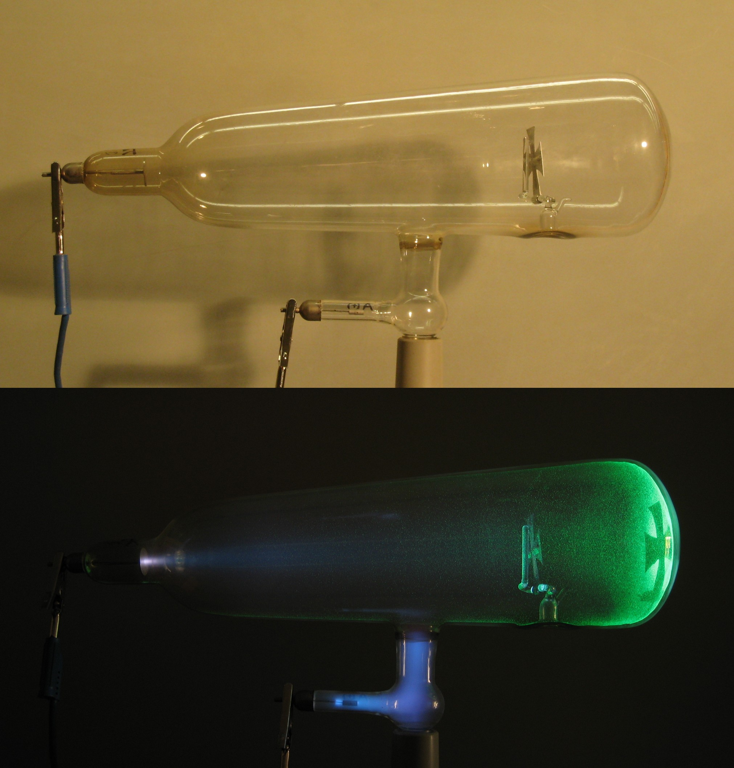
Cathode Rays
Crookes Tube
J. J. Thomson (1856-1940)
1906 Nobel Prize in Physics
Notes:
Interpretation controversy (magnetic deflection but not electric deflection) – German vs. English physicists
Thomson, with a better vacuum pump, demonstrated cathode rays are electrically charged particles of matter.

Slide 14
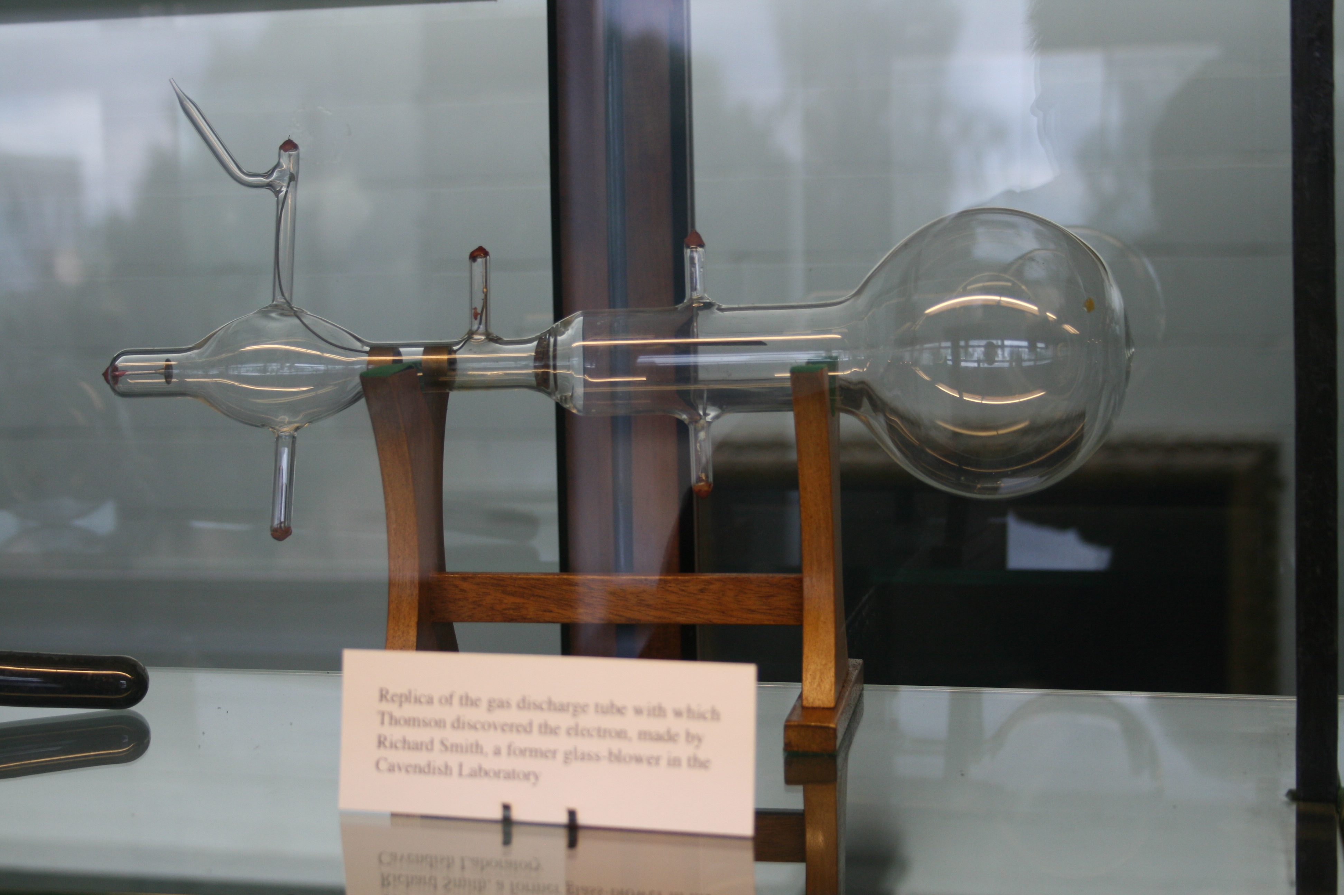
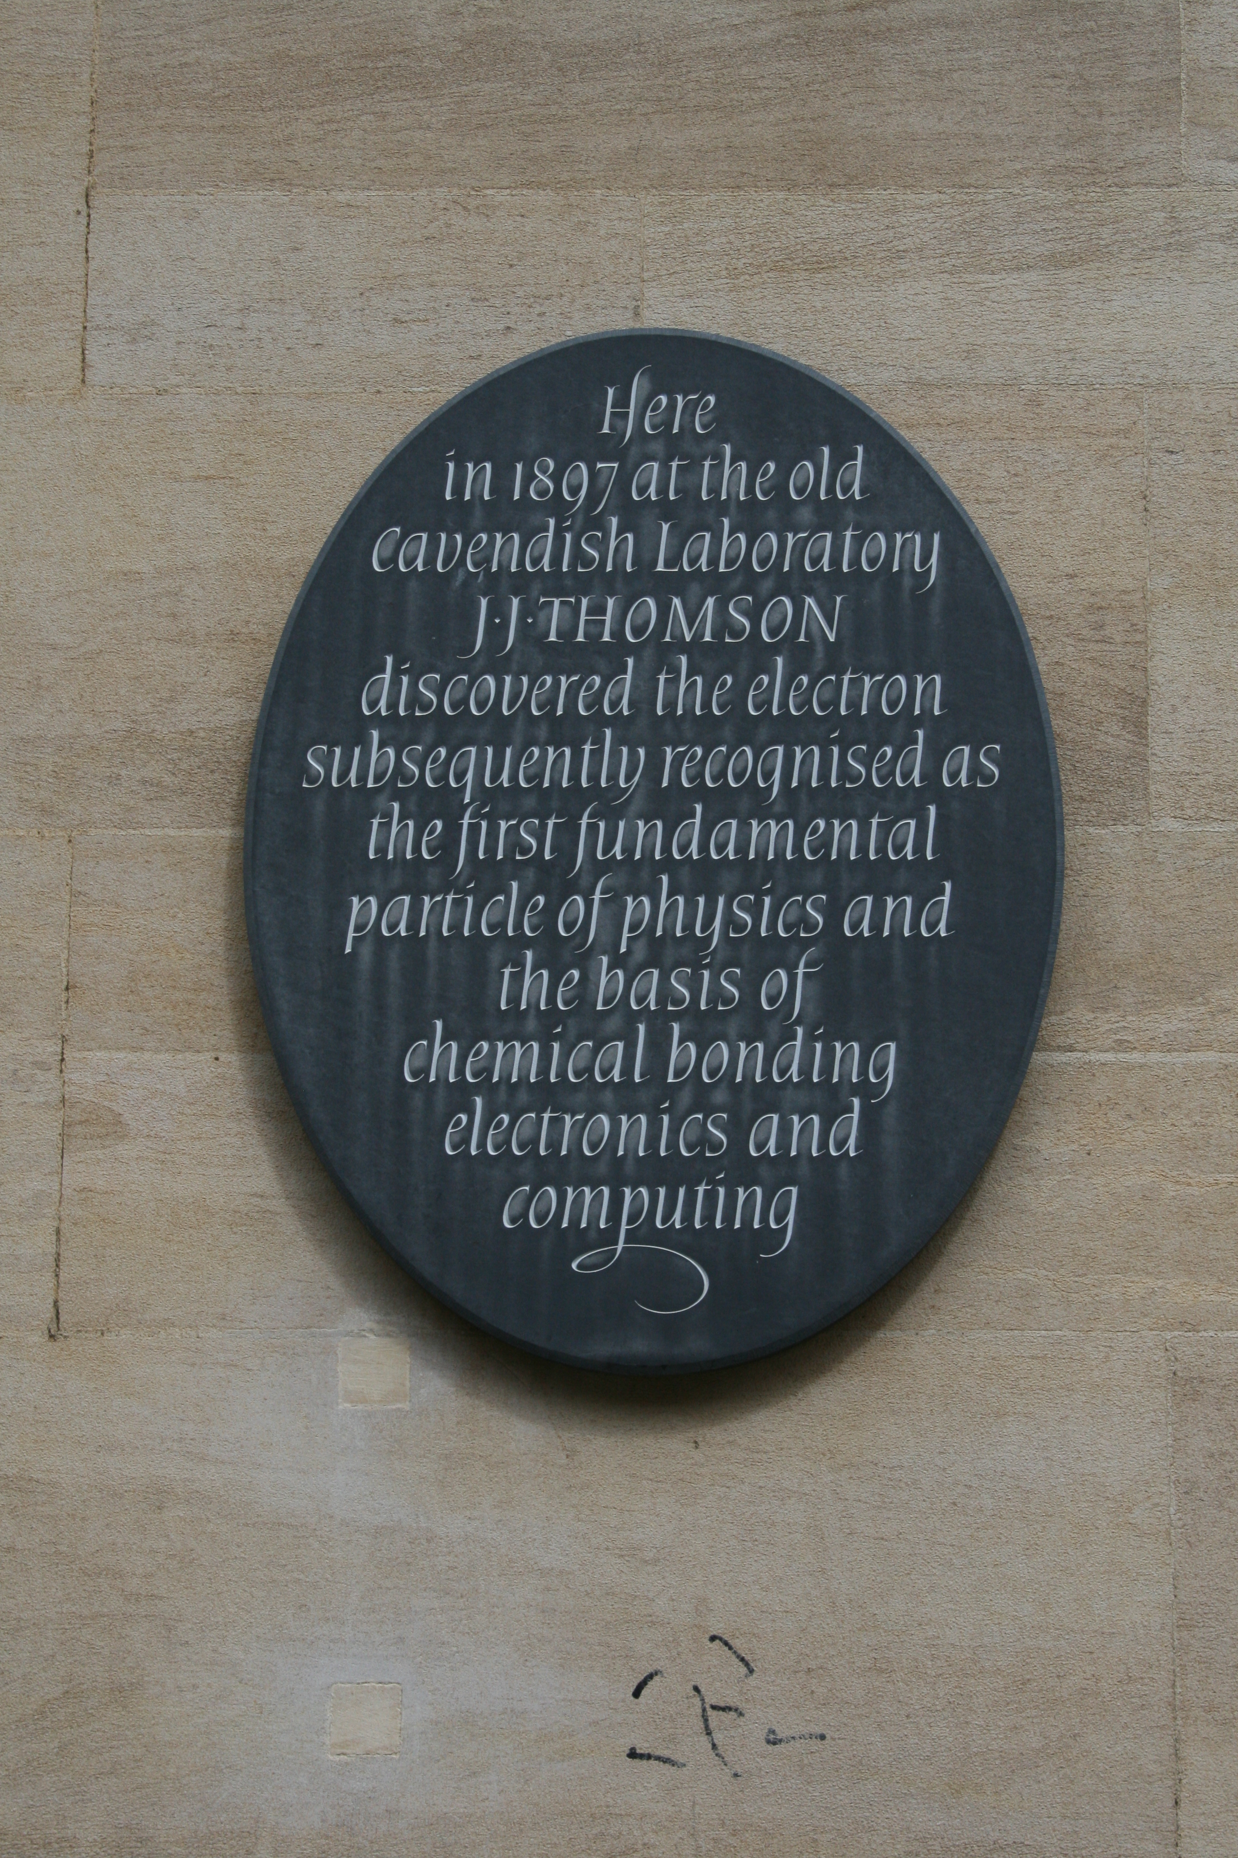
Electrons – Constituents of Atoms
Replica of Thomson’s Apparatus
Plaque on Cavendish Laboratory
Notes:
Note electric deflection plates in apparatus, but magnet coils are absent from apparatus replica in Cavendish Laboratory.

Slide 15
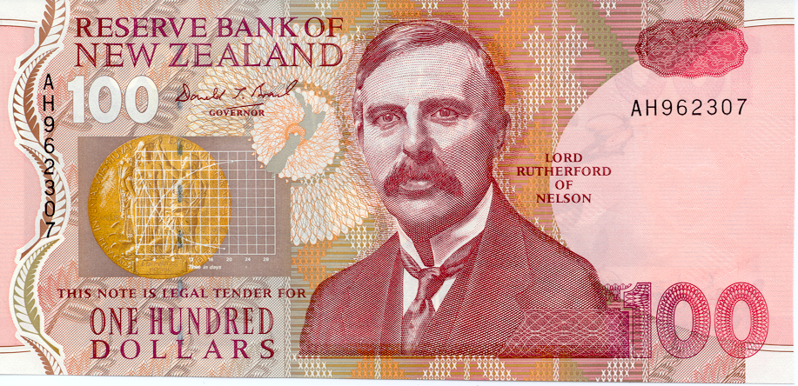

Radioactivity –Transmutation
Ernest Rutherford (1871-1937)
1908 Nobel Prize in Chemistry
Marie Curie (1867-1934)
Pierre Curie (1859-1906)
Nobel Prizes 1903 , 1911
Notes:
Rutherford discovered exponential decay and transmutation of radioactive substances.
Marie and Pierre Curie discovered Po and Ra. The stylized alpha, beta, and gamma tracks are adopted from Marie’s doctoral thesis.

Slide 16
From A to Z,
Atomic Weight to Atomic Number
1913 – Antonius van der Broek, used Geiger and Marsden data on Rutherford theory for scattering of a particles by thin foils of five metal to propose that atomic number was a better indication of nuclear charge than (atomic weight)/2, which had been suggested by Geiger and Marsden
1913 – Frederick Soddy introduced the term “isotope” for atoms with the same atomic number but different weights, e. g. an atom undergoing α decay followed by two β decays.
Soddy supported van der Broek’s idea.

Slide 17
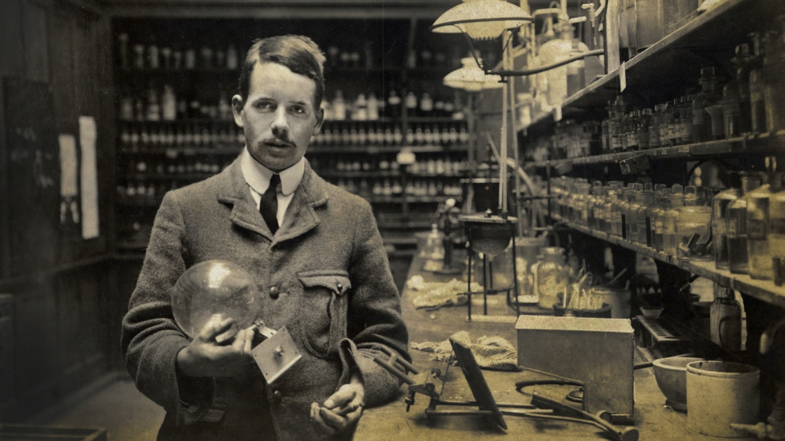
Henry Gwyn Jeffreys Moseley (1887 – 1915)
After graduating from Oxford (1910), Moseley worked with Rutherford in Manchester until late 1913, when he returned to Oxford.
While at Manchester he began his studies of X-rays with C. G. Darwin and built an X-ray spectrometer with photographic plates to detect the diffracted X-rays.
William and Lawrence Bragg used their spectrometer to study crystal structure. Moseley used his to study the structure of elements.

Slide 18
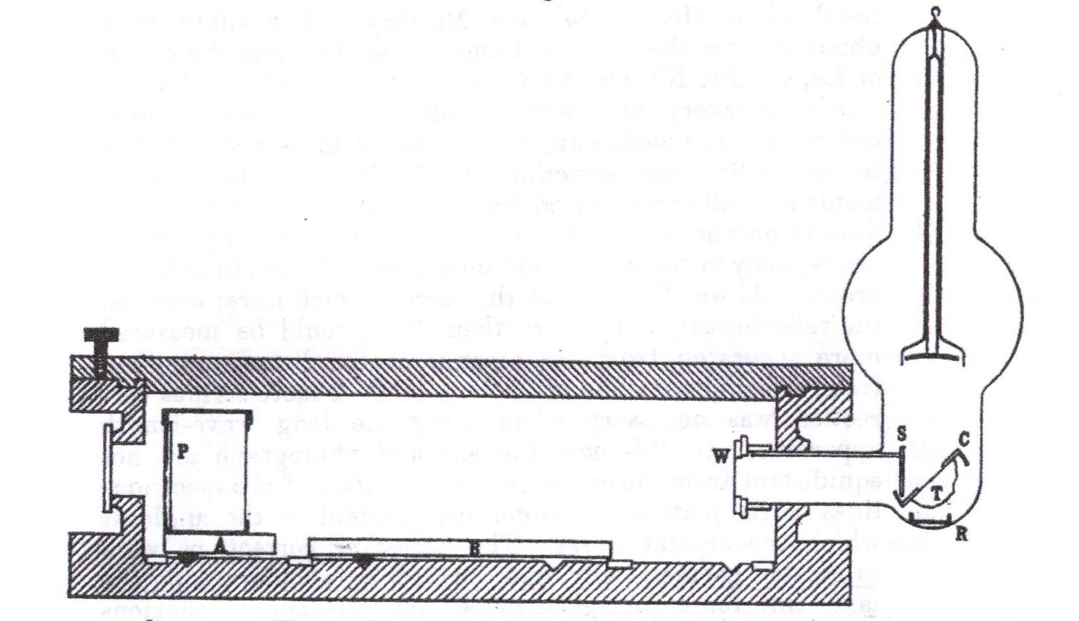
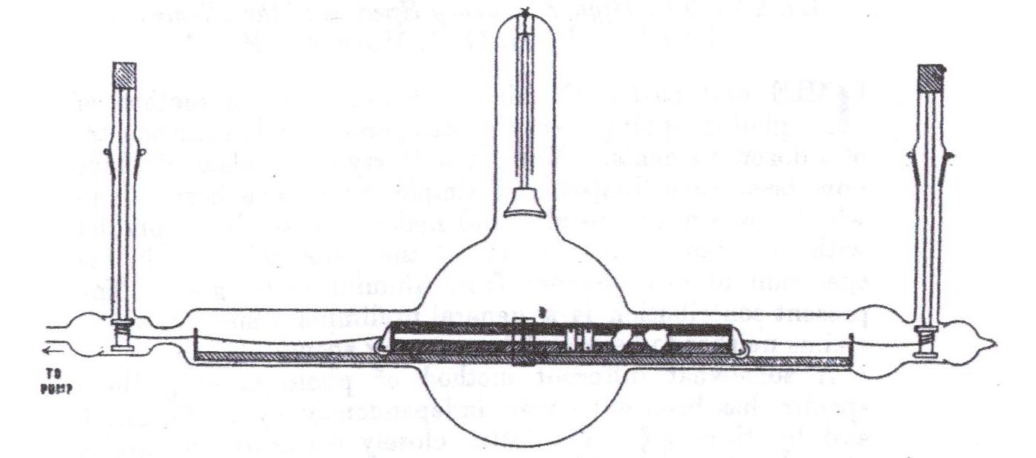
Moseley’s X-ray Tube
(Phil. Mag., 27 (1914), 704, 705)
Side view with truck holding metal samples as anodes
End view with evacuated iron spectrometer box, crystal table (B), and photographic plate (P)

Slide 19
From Moseley’s Letters
13 August 1913 to his sister Margery:
“I am now struggling with an X ray tube with a truck inside carrying pieces of all the metals I can get hold of …. I want in this way to find the wave-lengths of the X ray spectra of as many elements as possible, as I believe they will prove much more important and fundamental than ordinary light spectra.”
16 November 1913 to Niels Bohr:
“I have found that they [K_{α} X-ray wavelengths] lend great weight to the general principles which you use.”

Slide 20
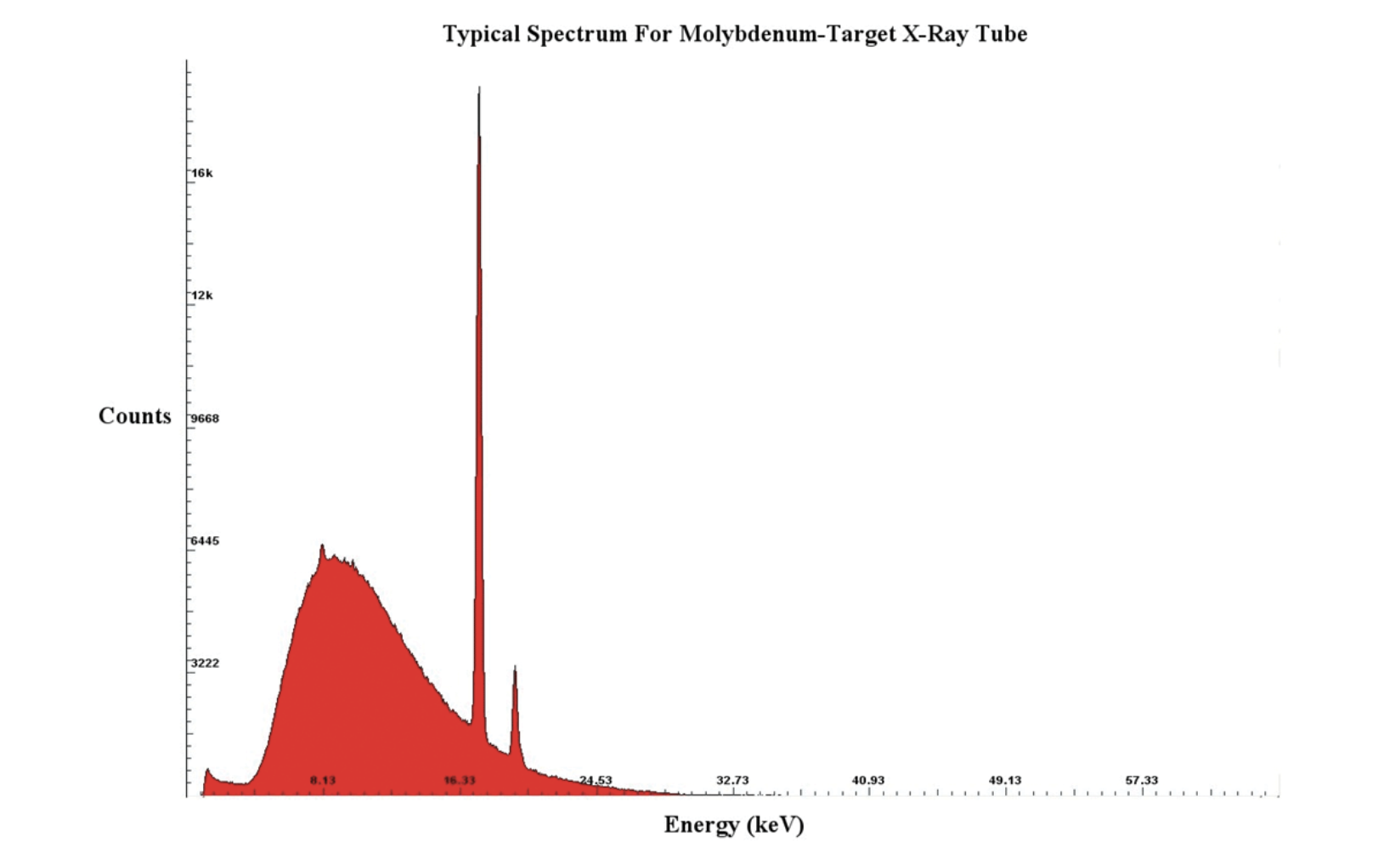
X-Ray Spectrum
Spectrum: peaks for K_{α}, K_{β}, and L_{α} lines, bremsstrahlung continuum:

Slide 21
Successes of Moseley’s Analysis
“The prevalence of [X-ray spectral] lines due to impurities suggests that this may prove a powerful method of chemical analysis.”
“It may even lead to the discovery of missing elements, as it will be possible to predict the position of their characteristic [spectral] lines.”
(Phil Mag., 26 (1913), 1030.)
French chemist George Urbain after two days with Mosley examining his samples: Moseley “untangled in a few days conundrums [about the identities and periodic table positions of proposed rare earth elements] that had taken chemists six generations merely to propose.”

Slide 22
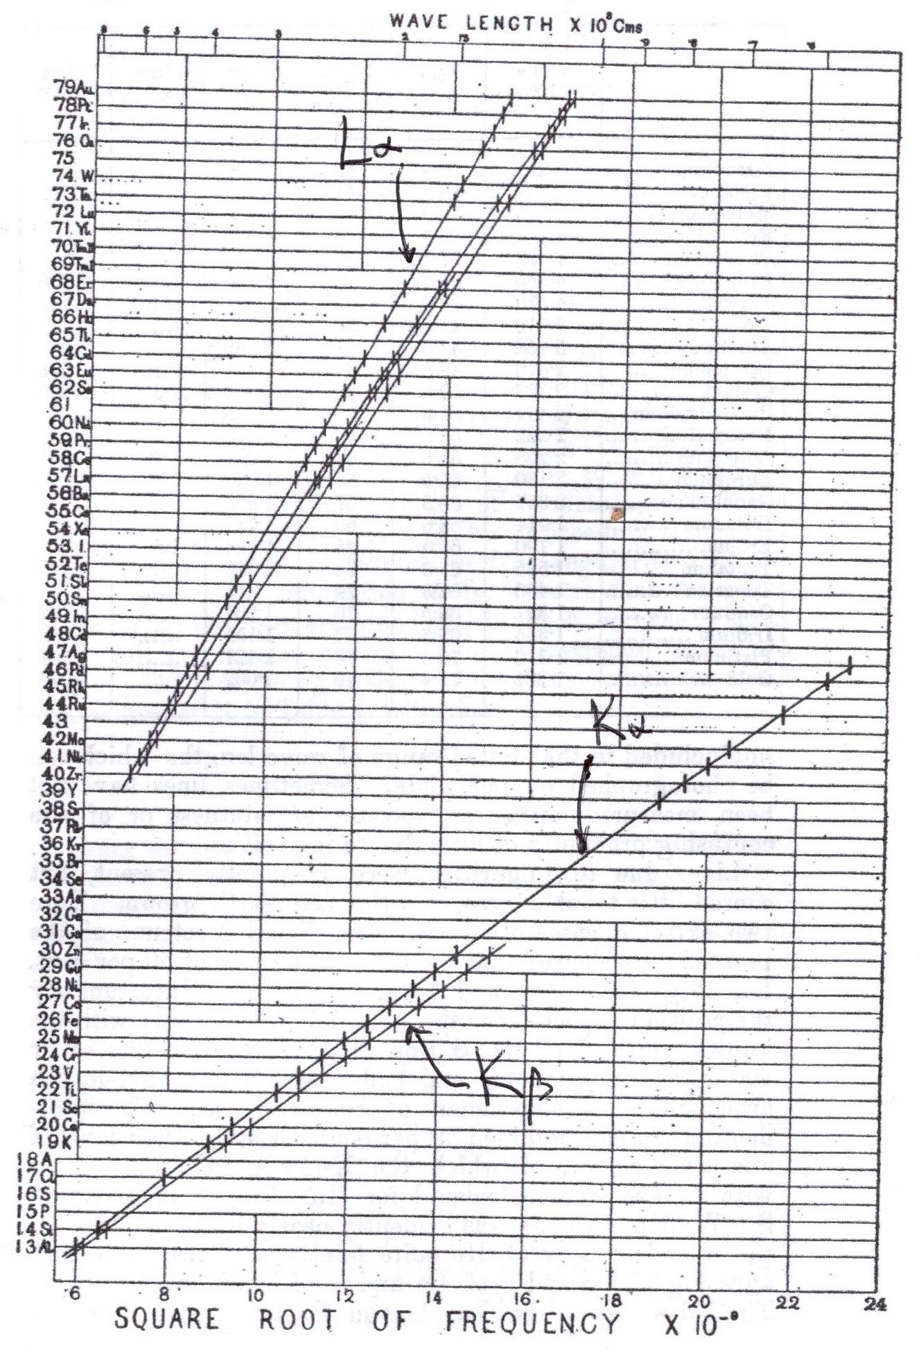
Aluminum (Z = 13) to Gold (Z = 79)
Empty spots for Z = 43, 61, and 75
Later discovered and identified:
Z=43 Tc (technetium - radioactive) predicted in 1871 by Mendeleev as eka-manganese,
Z=61 Pm (promethium - radioactive), isolated in 1945 ,
Z=75 Re (rhenium) isolated in 1925,
last stable element isolated

Slide 23
Subsequent Developments
Walther Kossel argued that K_{α} X-rays resulted from an electron transition from the n=2 shell to the n=1 shell after an n=1 electron was ejected by an incident X-ray, K_{β} arose from an n=3 to n=1 electron transition, and L_{α} X-rays were produced by n=3 to n=2 electron transitions.
With Arnold Sommerfeld’s extensions to Bohr’s theory with azimuthal and magnetic quantum numbers, the results of Franck-Hertz experiments, and Kossel’s account of K and L X-rays, Bohr’s theory of atomic structure and the association of atomic number with the number of positive nuclear charges became widely accepted by 1920.

Slide 24
Elemental Questions Answered
Atomic number (Z) is the number of positive charges in the atomic nucleus. Z determines the number of atomic electrons and, hence, chemical properties.
Are there undiscovered elements lighter than H or between H and He? NO.
Is there a limit to the number of elements?
Currently Z = 118 Organesson (2002)

