Slide 1
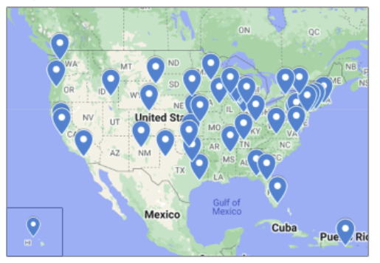
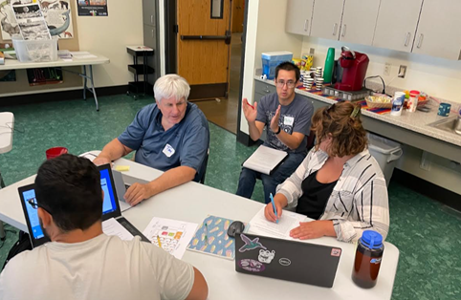
Center Workshops
Cooperative Effort
Mentors
Lead Teachers
QuarkNet Staff
QuarkNet Fellows

Slide 2
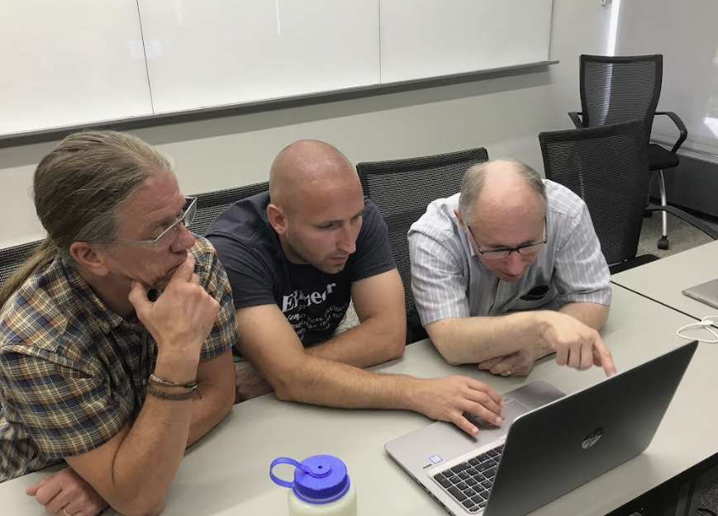
Center Workshops
Common Workshop Components
Data Activities Portfolio – student/teacher modes
Progression: Level 0 activities → Higher-level Activities
Data analysis from particle physics experiments
Mentor/scientist talk(s) & tour(s)
Teachers sharing strategies
Classroom implementation:
Discussion & plans

Slide 3
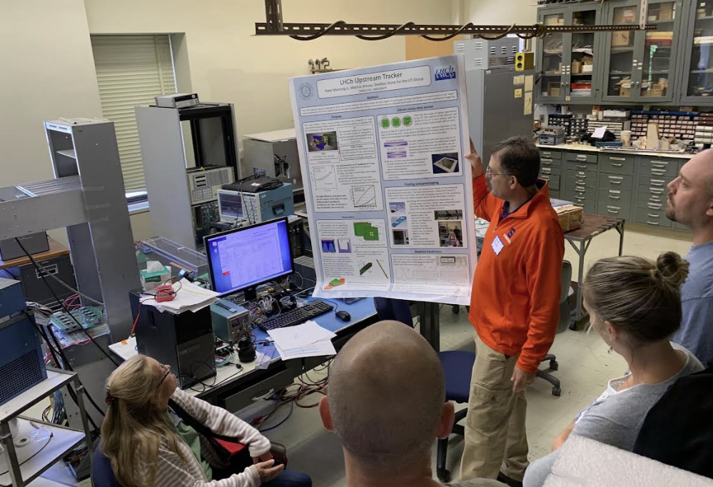
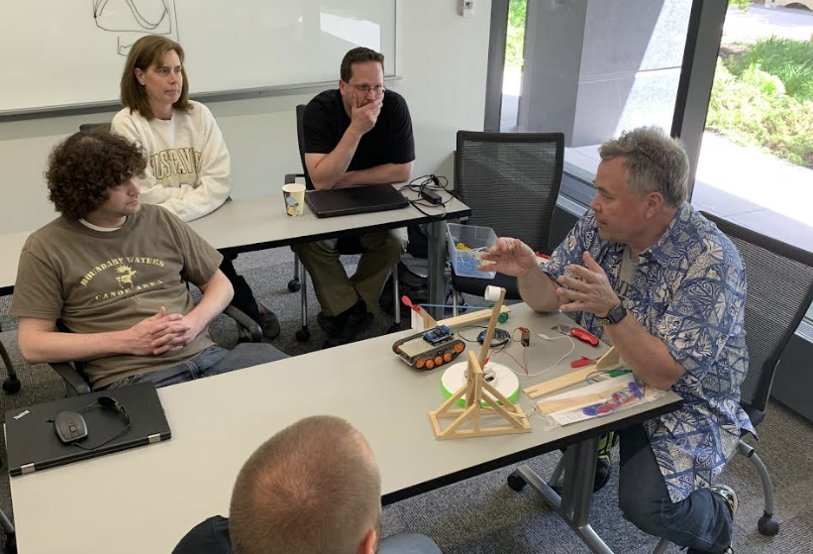
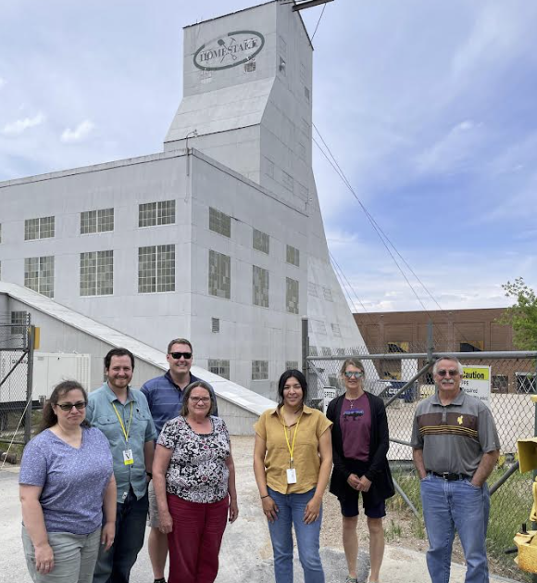
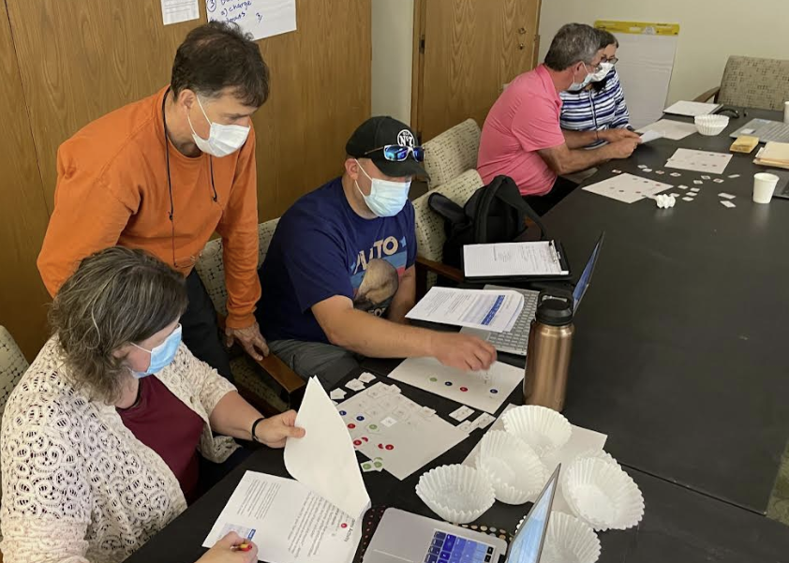
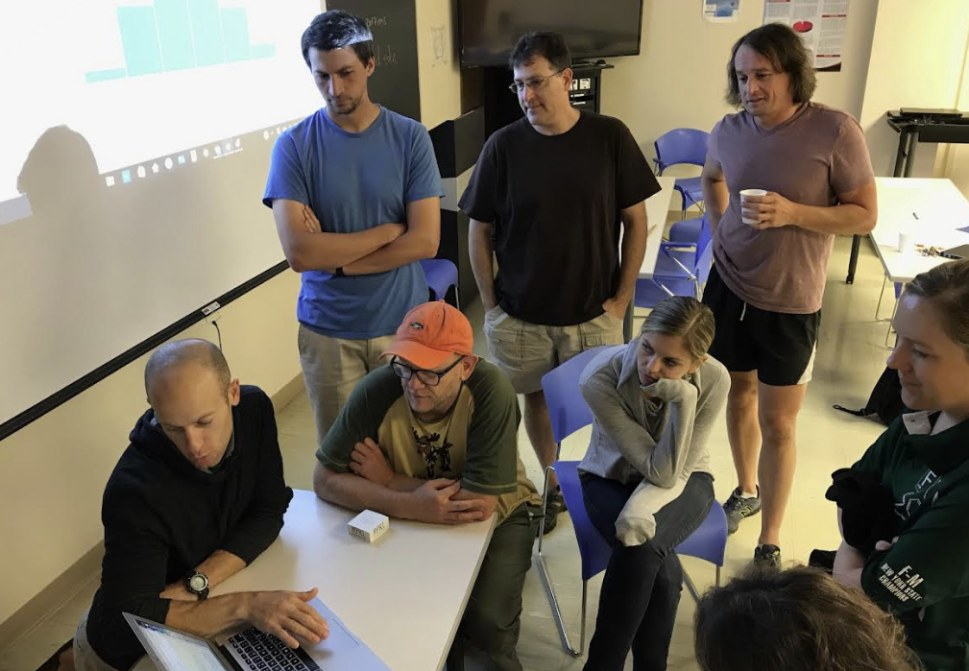
Center Workshops
Center-Derived Workshops
Mentor, lead teacher, and/or associate teachers plan & facilitate.
Notes:
These often focus on local labs, research groups, and expertise.

Slide 4
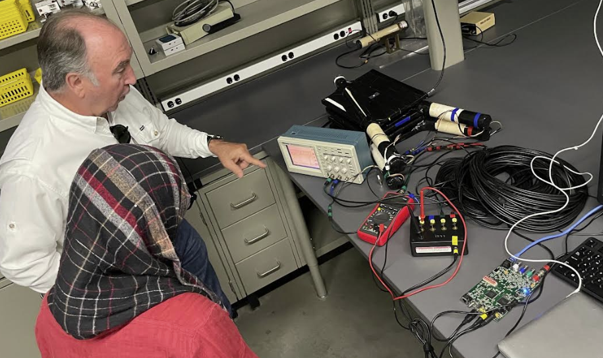
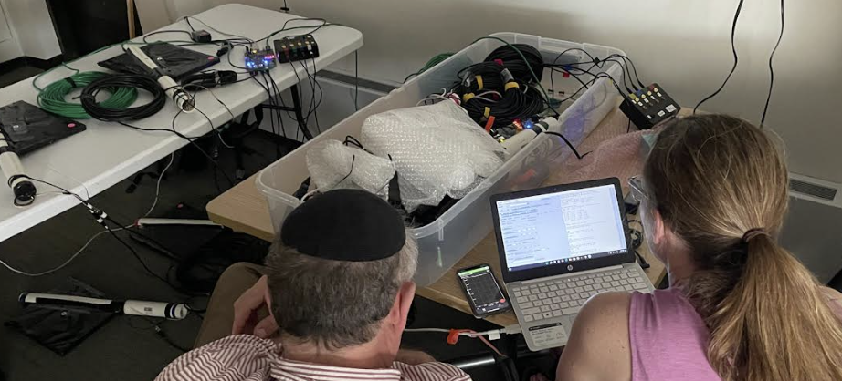
Center Workshops
QuarkNet Cosmic Workshops
Includes: Cosmic ray detector assembly & cosmic ray studies using e-Lab & cosmic watches
Facilitation: QuarkNet staff & cosmic fellows
Supports: Use of detector & e-Lab, preparation for International Muon Week & International Cosmic Day
Notes:
Point out that national workshops

Slide 5
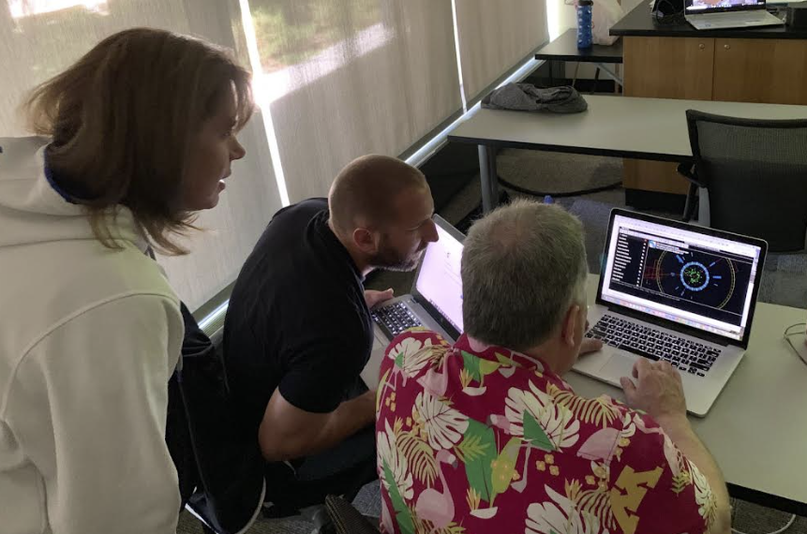
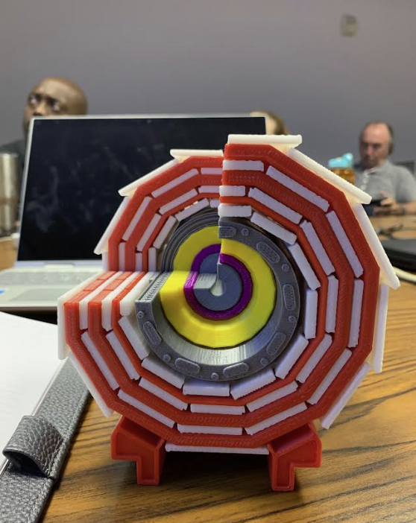
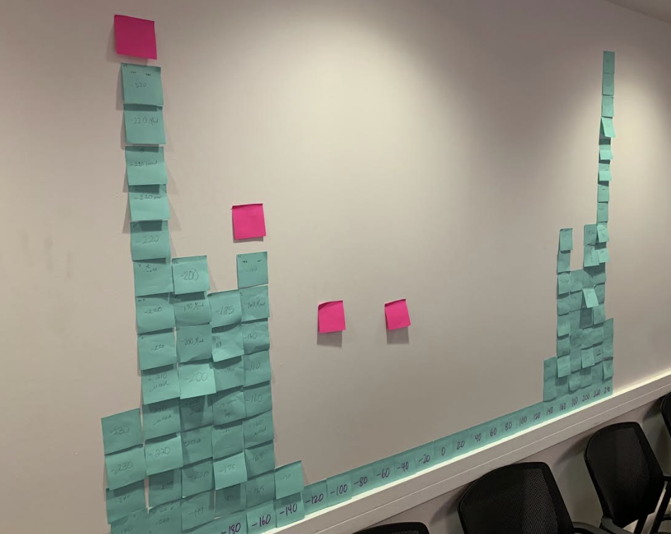
Center Workshops
QuarkNet LHC Workshops
Includes: CMS Data, ATLAS Data, CMS e-Lab . . . .
Facilitation: QuarkNet staff & LHC fellows
Supports: Preparation for World Wide Data Day (W2D2) and/or LHC Masterclasses

Slide 6
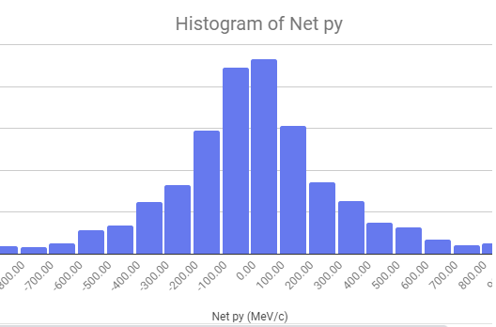
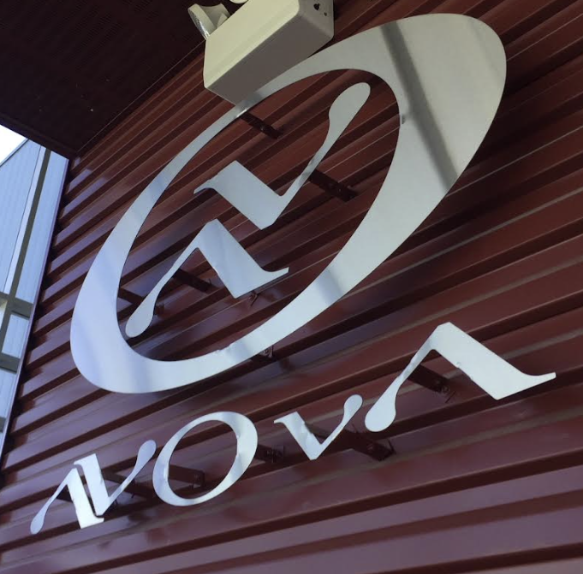
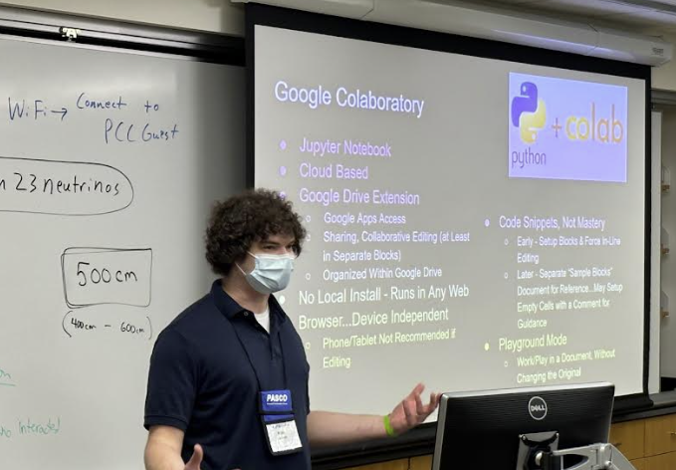

Center Workshops
QuarkNet Neutrino Workshops
Includes: MINERvA Data & NOvA Data
Facilitation: QuarkNet staff & Neutrino fellows
Supports: Preparation for Neutrino Masterclasses

Slide 7
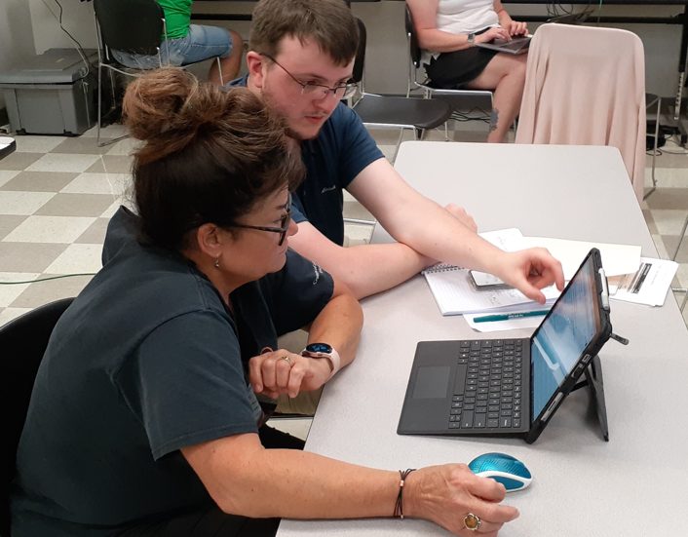
Center Workshops
QuarkNet Coding Workshops
Includes: Coding Notebooks
Facilitation: QuarkNet staff and Coding fellows
Supports: Coding in the physics classroom
May be used in conjunction with other workshop threads: cosmic, LHC, neutrino…

Slide 8

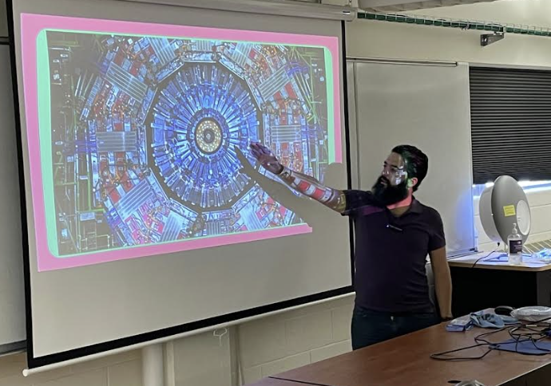
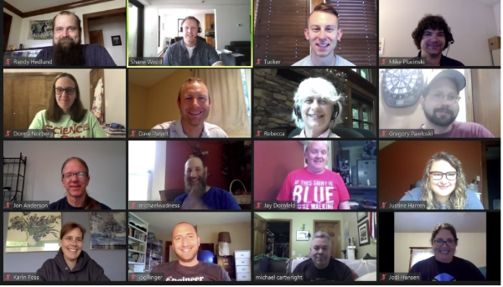
Center Workshops
Other QuarkNet Workshops
Timely topics: Higgs@10 in 2022
STEP UP, IRIS-HEP
STEAM – Science, Technology, Engineering, Art & Math
Workshop X – Follows an “un-conference” model
New Questions in Particle Physics
Virtual, especially in 2020
Others…

