Slide 1
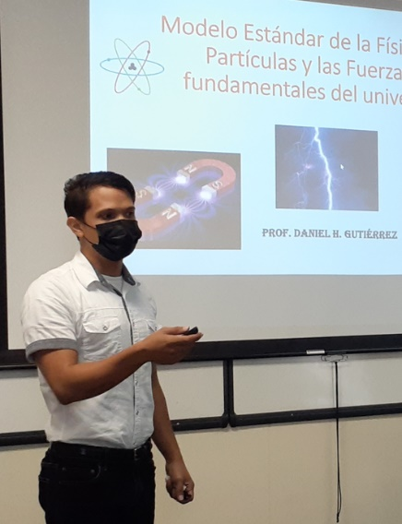
Broadening Participation
QuarkNet Centers of Interest
QuarkNet centers reach a broad population.
Minority-serving examples:
  University of Puerto Rico Mayagüez
  University of New Mexico
  Sanford Lab/Black Hills State
  Catholic University of America (D.C.)
Rural examples:
  Idaho State University
  University of Oklahoma, Oklahoma State
More…

Slide 2
Broadening Participation
Needs Assessment Workshops
Pilot initially with ~3 centers.
Bring teachers of underserved students together to listen and learn how their needs and interests might align with QuarkNet goals and programs.
Based on pilot, identify new resources and adapt workshops to better support these teachers.
Possibly extend Needs Assessment Workshops beyond pilot.

Slide 3
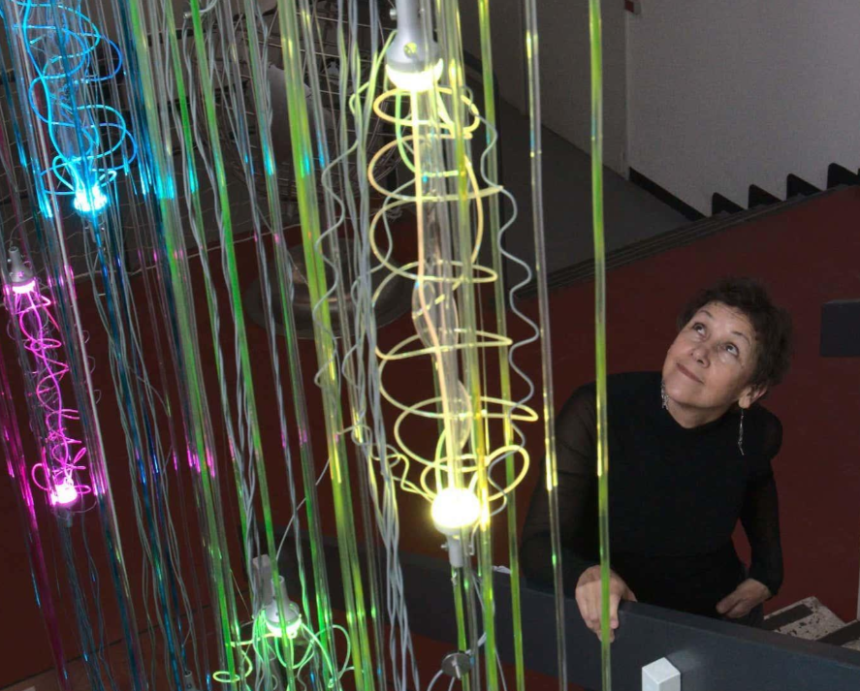
Broadening Participation
Science, Technology, Engineering, Art, & Math (STEAM)
Partnership with artist/educator
Agnes Chavez and others.
Started as outreach to schools in
New Mexico that serve high numbers
of Native American students.
Evolved into integrating STEAM into teacher workshops:
  New Mexico 2023 teacher workshop → 2023 Albuquerque International Balloon Fiesta

Slide 4
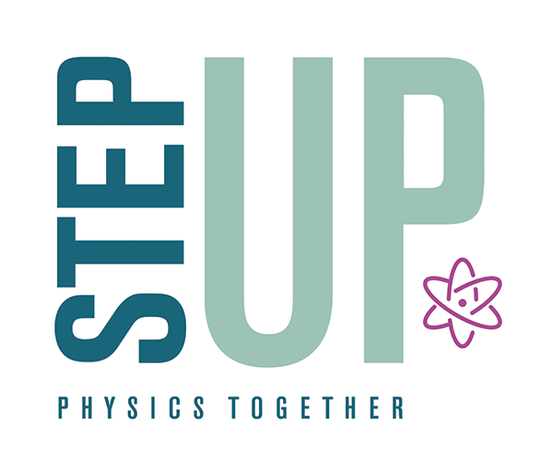
Broadening Participation
STEP UP
STEP UP provides high school teachers
with resources to reduce barriers and
inspire young women to major in physics.
QuarkNet–STEP UP partnership began in 2019.
Numerous STEP UP workshops given by QNet STEP UP ambassadors, and more than 100 teachers trained by QNet STEP UP ambassadors to date.
QNet continues to offer STEP UP workshops and to reference STEP UP resources.

Slide 5
Broadening Participation
Impact of Cosmic Watches
Extend the reach of authentic research activity to all students, not just research groups, by moving cosmic ray studies into classrooms.
Increase the number of teachers using cosmic rays to teach about elementary particles and observing the invisible.
48 cosmic watches (MIT design) produced at University of Notre Dame; undergoing testing; activities developed by fellows; teachers will pilot activities in classrooms in the fall.

Slide 6
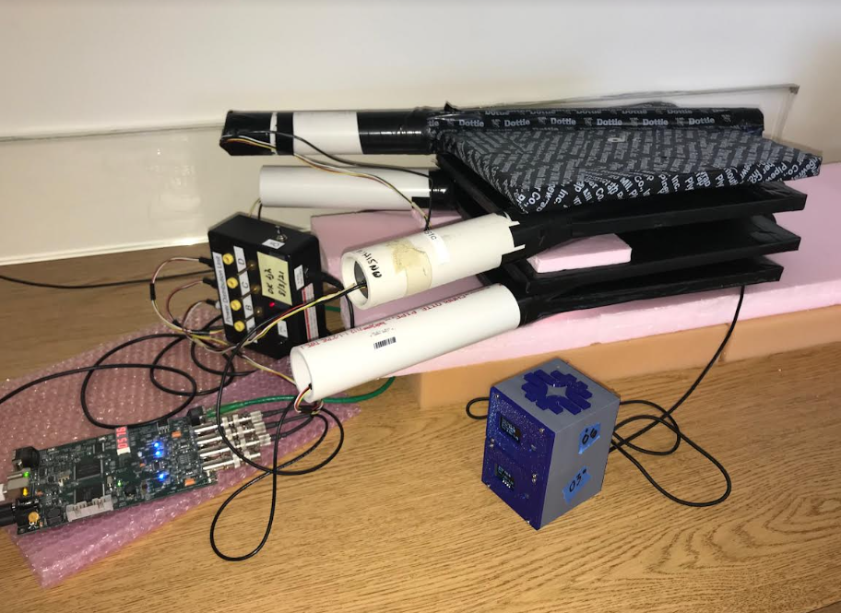
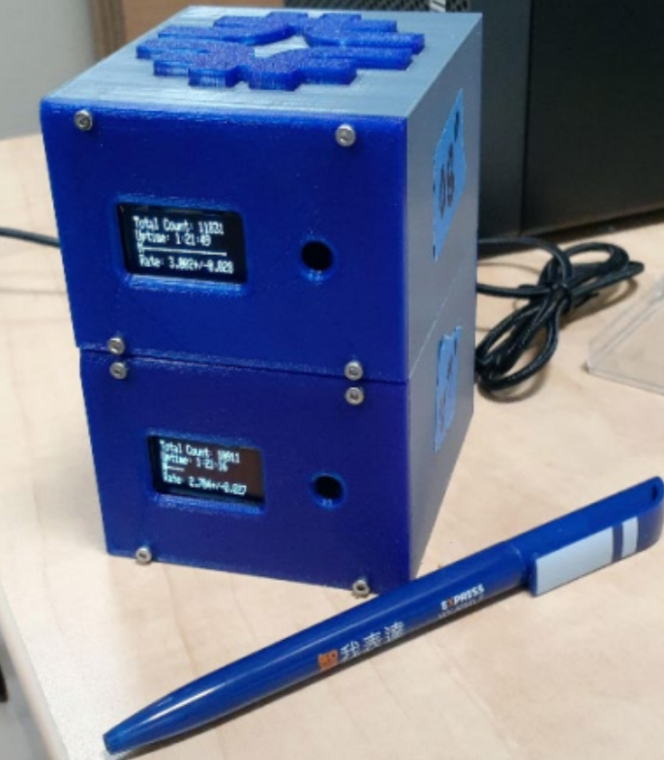
Broadening Participation
Impact of Cosmic Watches

Slide 7
Broadening Participation
IRIS-HEP & QuarkNet Camps
Coding Camp 2 plus 6 smaller events required elevating more teachers to fellows & reaching more teachers from non-QuarkNet areas in the U.S.
Increasing diversity – Fellows:
  1st 2 Latina, 1st AAPI, & 1st 2 Black fellows
  Women fellows increased from 40% to 53%; half are Coding fellows.
  2022 CC2 – led entirely by women

Slide 8
Broadening Participation
IRIS-HEP & QuarkNet Camps
Increasing diversity – Participants:
  Camps & short workshops include more women, Black, & Latinx teachers, teachers at Title 1 schools, and teachers of marginalized students
  2022 CC1 - QNet’s first group of 4 Black women at a camp

Slide 9
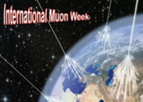
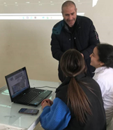
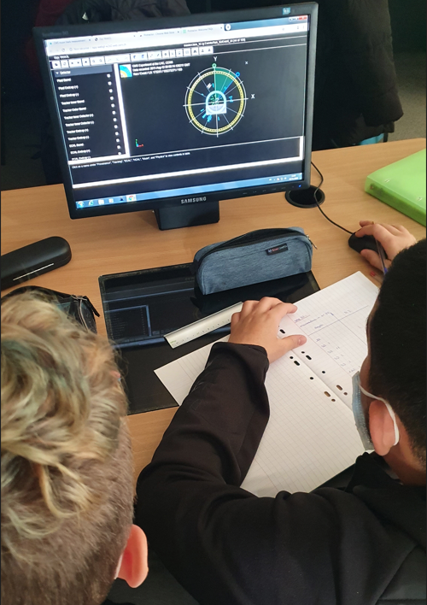
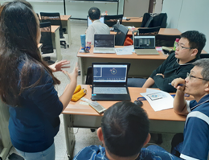
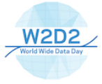
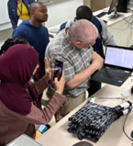
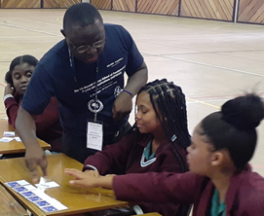
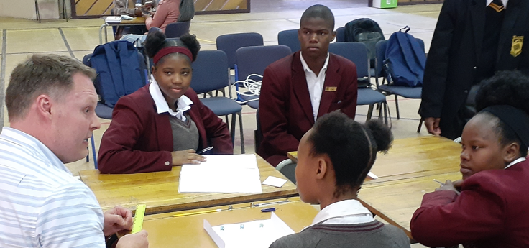
Broadening Participation
International Collaboration and Outreach

Slide 10
Broadening Participation
Active in Professional Organizations
American Physical Society
American Association of Physics Teachers
  Outreach to schools near conference in partnership with AAPT Contemporary Physics Committee.
Local chapters of NSTA, AAPT, etc.
Snowmass
Others…
Link to presentations

