Slide 1
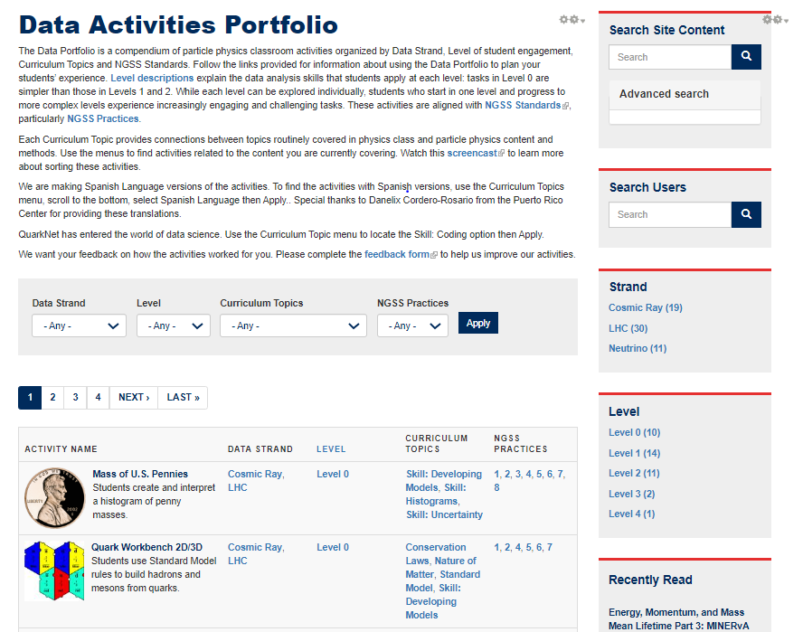
Data Activities Portfolio

Slide 2
Data Activities Portfolio
In the Beginning
In the Beginning | Now
14 Activities | 38 Activities
Variety of structures | Specific structure
No Protocol | Protocol Aligned with PD Criteria
Level 1-3 | Level 0 - 4
No Teacher Answer Key | Teacher Answer Key Provided
No Coding Activities | 2 Coding Activities
No Spanish Language Versions | Spanish Language Posted for 5 Activities

Slide 3
Data Activities Portfolio
Guiding Principles
Improvements
Accessibility for all teachers
Activities tied to curriculum topics
Linked activities of increasing challenge
Ultimate goal: Student Research

Slide 4
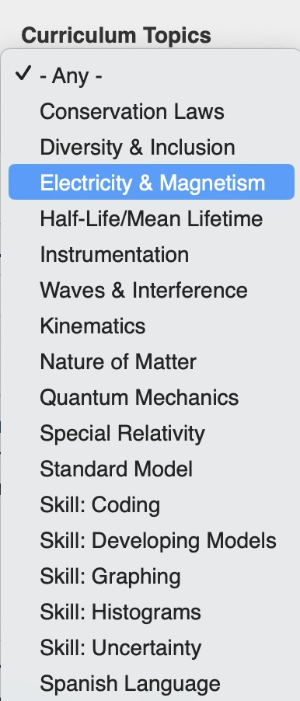
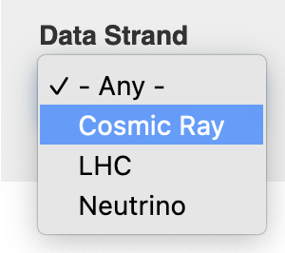
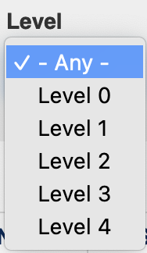
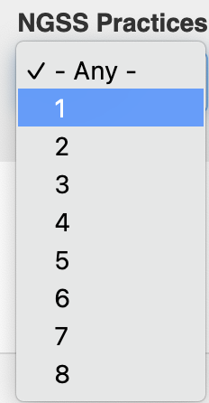
Data Activities Portfolio
Improvements
Data Strand
Level
Curriculum Topics
NGSS Practices

Slide 5
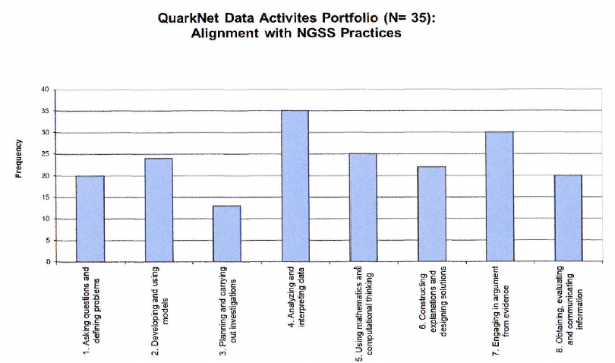
Data Activities Portfolio
NGSS Best Practices

Slide 6
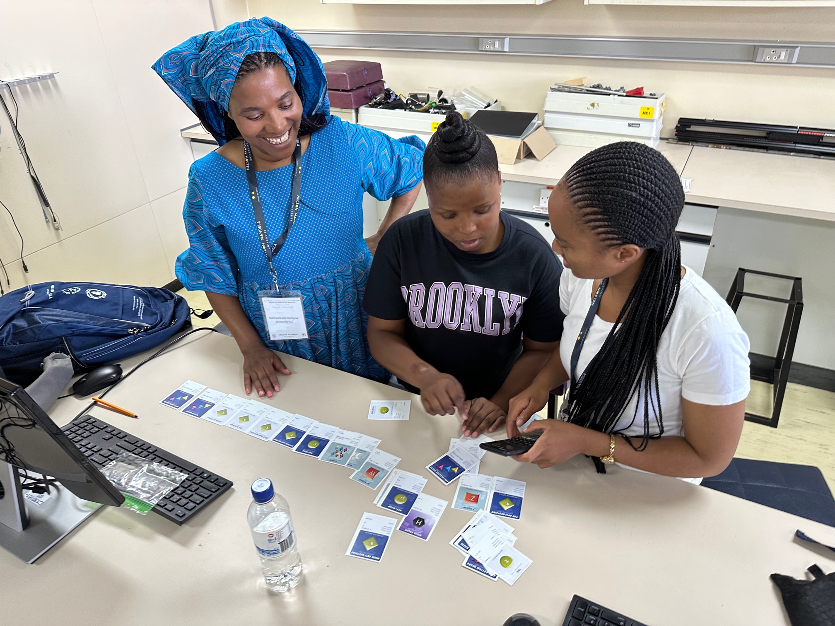
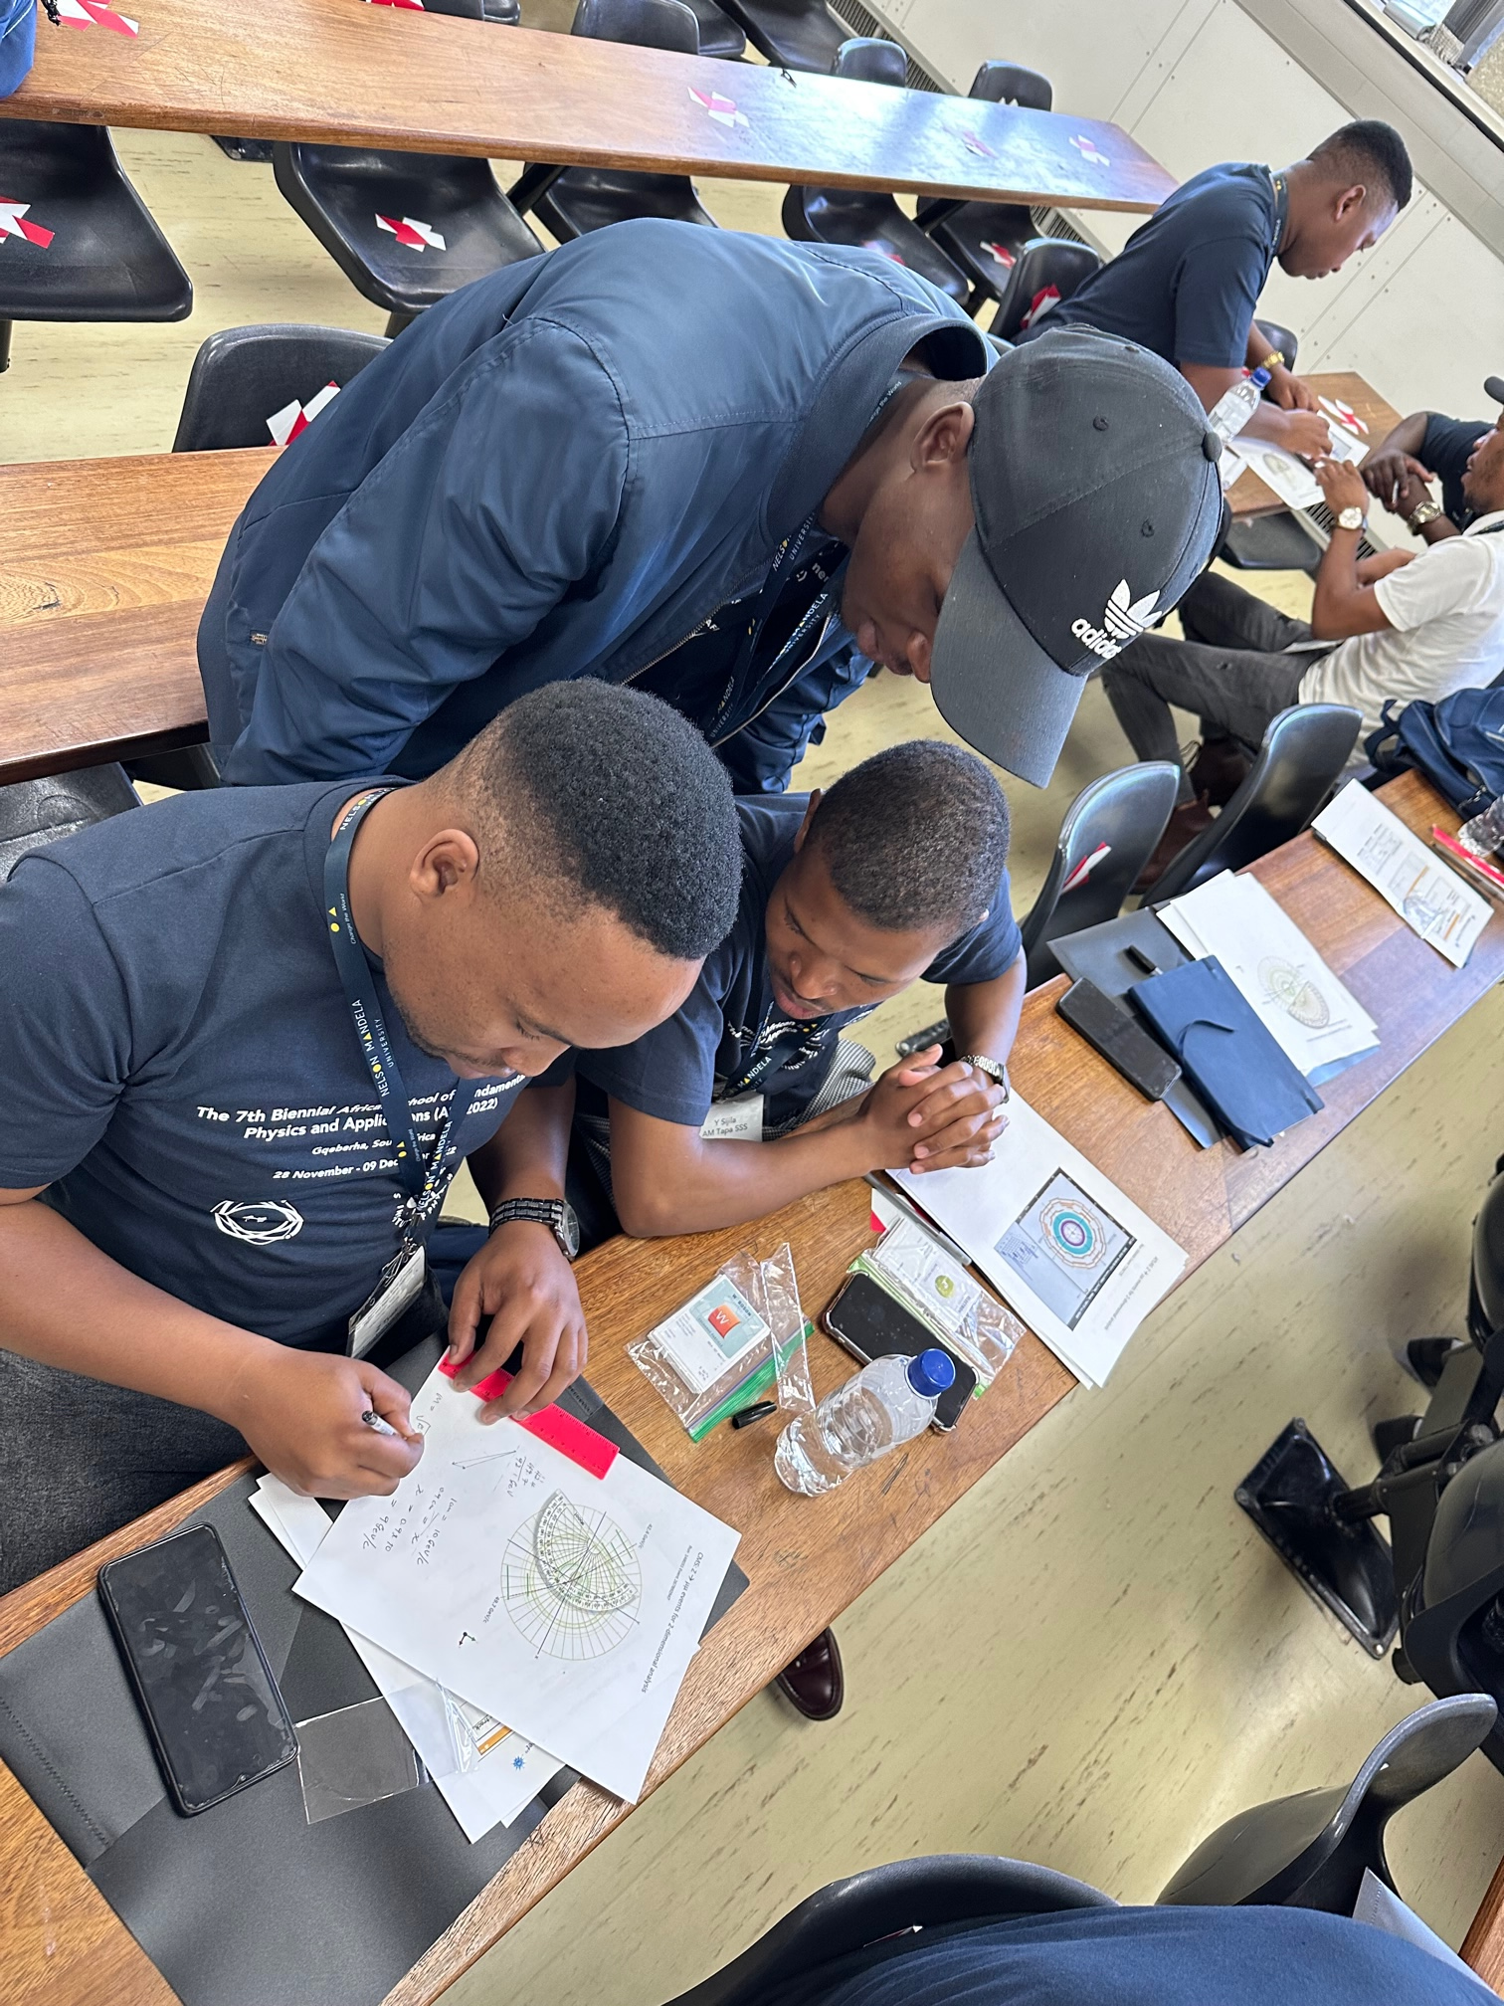
Data Activities Portfolio
Most Used Activities
2019 | 2020
Rolling with Rutherford | Rolling with Rutherford
Quark Workbench | Dice, Histogram and Probability
Mass of U. S. Penny | Calculate the Z Mass

Slide 7
Data Activities Portfolio
Connections
Data Activities Portfolio Supports:
Workshops
Camps
Masterclasses
Broadening Participation

Slide 8
Data Activities Portfolio
Initiatives
Infuse Data Science into existing activities.
Implement using coding notebooks.
Add Spanish language versions to existing activities.

Slide 9
Data Activities Portfolio
The Future
Goals:
Infuse Data Science where appropriate.
Implement coding activities accessible to all teachers.
Add Spanish language versions to all activities.
Continue to develop accessible activities explaining new discoveries.

Slide 10
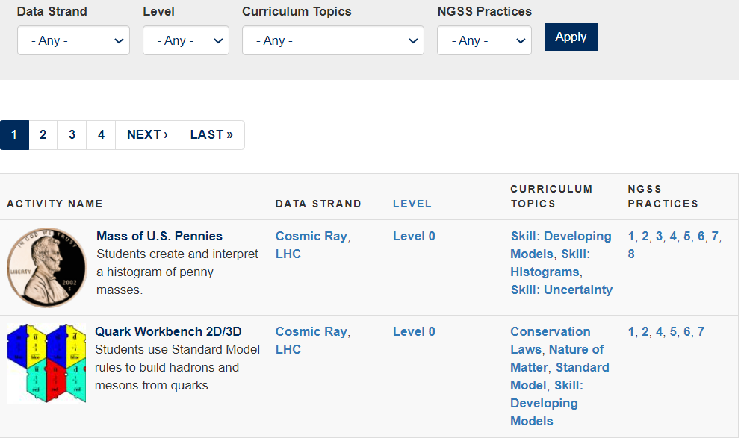
Data Activities Portfolio

