Slide 1



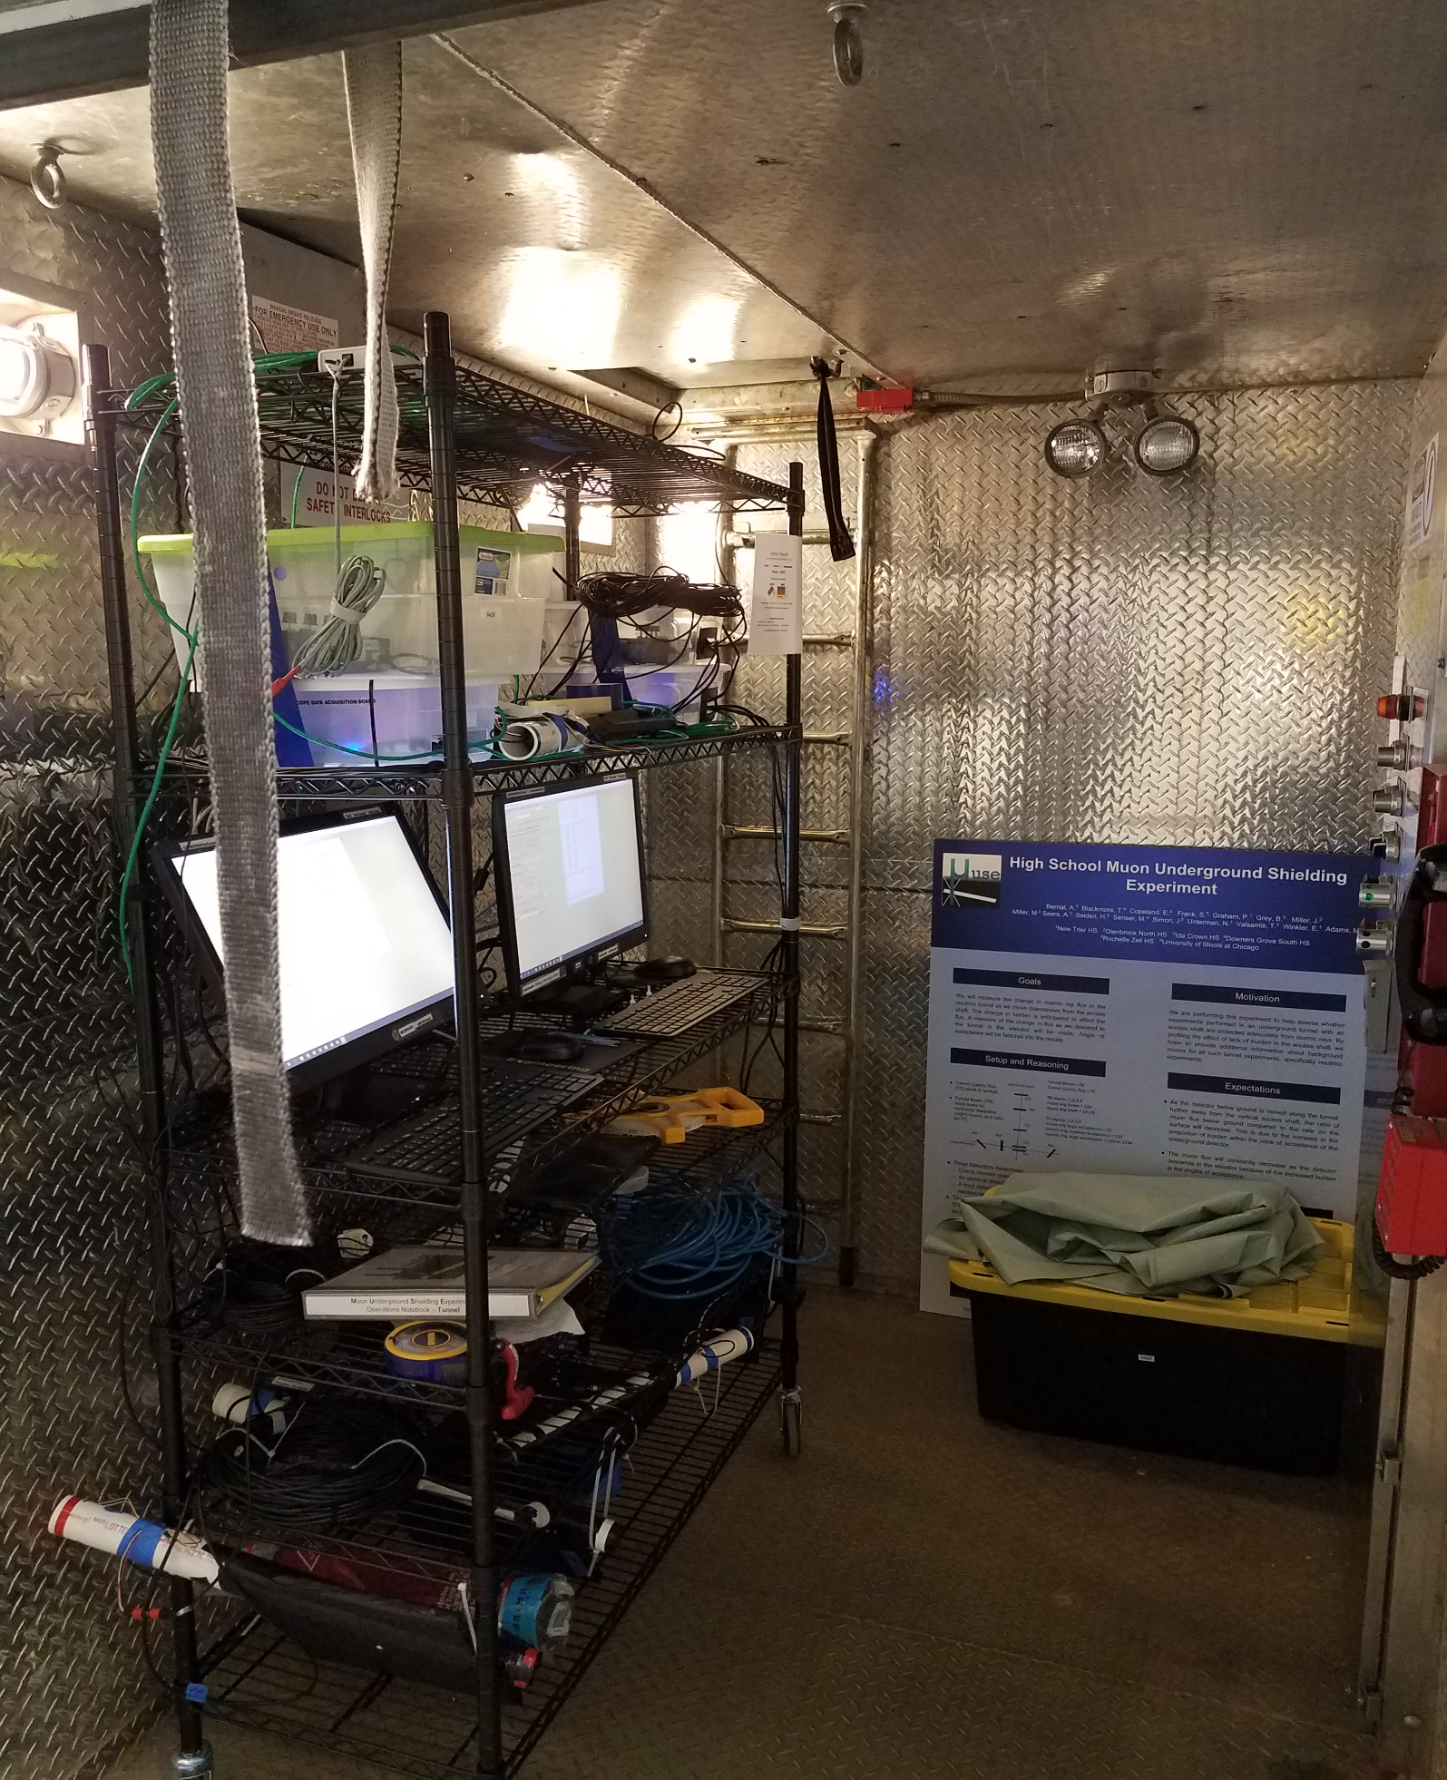
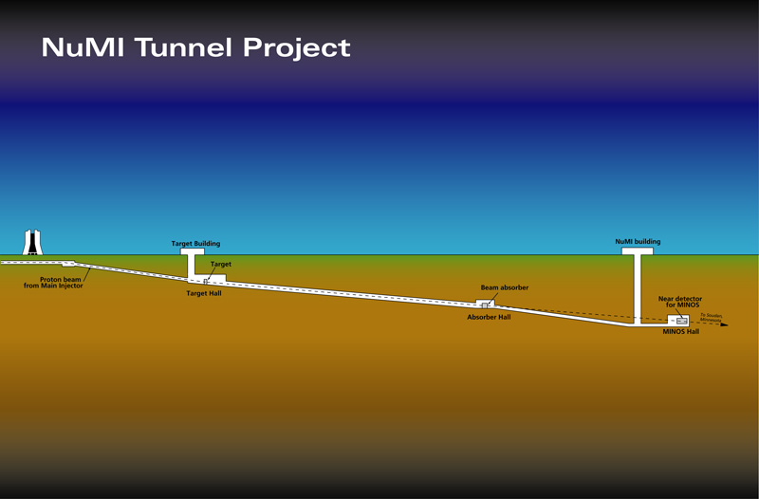
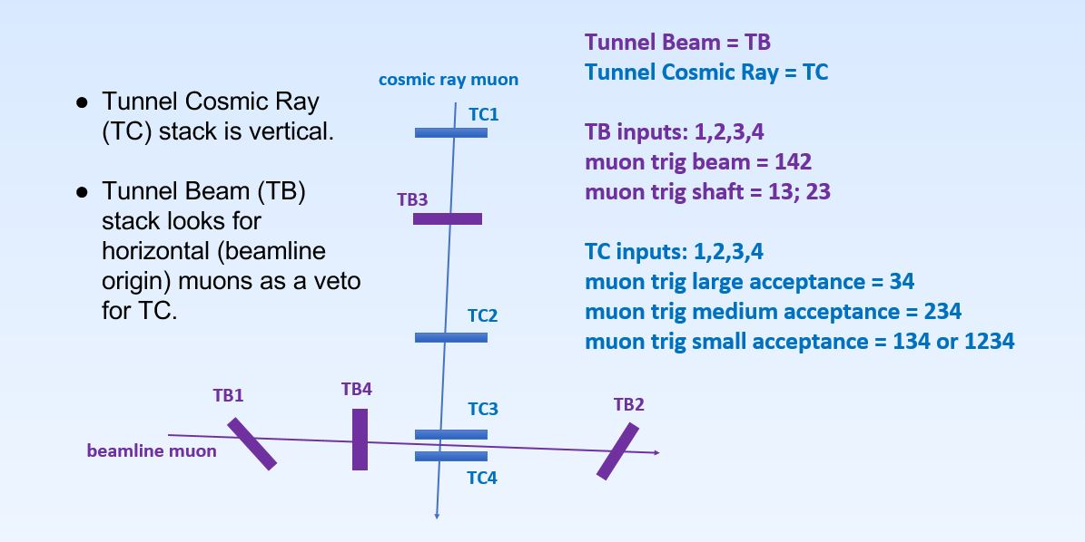


Studying Muon Count Rates as Underground Depth Increases
Paul Graham†, Emmanuelle Copeland‡, Eleanor A. Winkler†, Nathan A. Unterman†, Marybeth Senser‡
†New Trier High School, Winnetka, IL, ‡ Downers Grove South High School, Downers Grove, IL
Motivation
Methodology
Results
Discussion
The MUSE experiment was designed to measure the cosmic ray flux as a function of horizontal distance from the access shaft in the MINOS tunnel at Fermilab. Since the shaft has missing burden, does the empty shaft affect cosmic ray flux inside the horizontal tunnel?
As a part of this greater MUSE experiment, the researchers measured muon flux as a function of depth during descent in the access shaft elevator. This presents a more complete picture of how burden around the shaft would affect cosmic ray flux.
The rise in count rates in Figure 5 was due to the elevator moving through the path of the MINOS beamline at a depth of 96 meters. The TB horizontal detector also measured the flux increase at this depth. The MINOS neutrino beam, when interacting with rock, creates muons. This explanation was further confirmed by establishing that the beamline was active during time of elevator passage.
Figure 4
Results, shown with trend lines.
Conclusion
Hypothesis
Data taken from the vertical detector, TC, is plotted in Figure 4. The graph indicates a decrease in muon flux as depth increases. Two data sets are shown, one with two-fold coincidence using channels three and four, producing an angle of acceptance of 63° (blue) and one with three-fold coincidence using channels two, three, and four, to achieve an angle of acceptance of 23° (orange). Binning width was 20 seconds. The control detector on the surface experienced no change.
As the elevator descended, the muon flux dropped exponentially, as we predicted earlier in our hypothesis. Increased burden greatly attenuates the muon flux. The team had not anticipated the MINOS neutrino beamline’s impact on the experiment, since the MINOS experiment was no longer in operation. However, the Neutrino Division of Fermilab, confirmed that the beam had been operational. This, along with data from the TB detector, explained the anomaly. Since the neutrino beamline was visible, it must be considered in the primary MUSE experiment analysis.
As the elevator descends, the cosmic ray muon flux will decrease exponentially.
Figure 2
Detector set up inside the elevator.
Equipment
This detector system collected data while descending in the elevator, which has a shaft height of 103 meters and a descent time of 135 seconds. Acceleration time was minimal. The elevator speed was the same in ascent as descent. This enabled accurate depth determination.
Two QuarkNet cosmic ray muon detectors were assembled and held by shelving units. Both detectors consisted of four counters and had unique geometric configurations. One detector (TC) consisted of stacked counters with varying angles of acceptance. The other detector (TB) included three counters horizontally arranged with one counter above them, and was used to sense MINOS’s neutrino beam. A control detector was placed on the surface employing the TC detector’s geometry.
Figure 5 highlights an outlier 96 meters in depth. These data are the accumulation of three independent elevator runs. This spike in count rates occurred in both angle of acceptance data sets and all three elevator runs.
Contacts
Paul Graham: 20210425@student.nths.net
Emmanuelle Copeland: emmanuelle.copeland@comcast.net
Eleanor A. Winkler: ellieaw13@gmail.org
Nathan A. Unterman: nunterman@gmail.com
Marybeth Senser: msenser@csd99.org
Figure 5
Results using a vertical log scale
Acknowledgements
University of Illinois QuarkNet Center: Equipment and faculty mentors.
New Trier Township High School, Rochelle Zell Jewish High School, Glenbrook North High School, Ida Crown High Jewish Academy, Downers Grove South High School, University of Illinois at Chicago
Fermilab: Facility, safety training, expert support, beamline information.
Mark Adams, QuarkNet, for advocacy and guidance.
Diagram Source: Fermilab
Figure 3
MINOS tunnel schematic
Figure 6
Vertical log results with outlier removed
The access shaft used for this experiment was on the far right on Figure 3.The neutrino beamline penetrates rock just before the elevator shaft. The beam crosses. the elevator shaft at about 96 meters below the surface.
Figure 1
Geometries of two detectors in the elevator
The best fit trend line in Figure 6 for the data taken with acceptance angle 63° was F = 164.68e^{0.048x}. For the data with the smaller angle (23°), the best fit trend line equation was
F = 48.004 e^{0.0484x}. The R² values of Figure 6 were better than those of Figure 5, since the outlier was removed.

