Slide 1
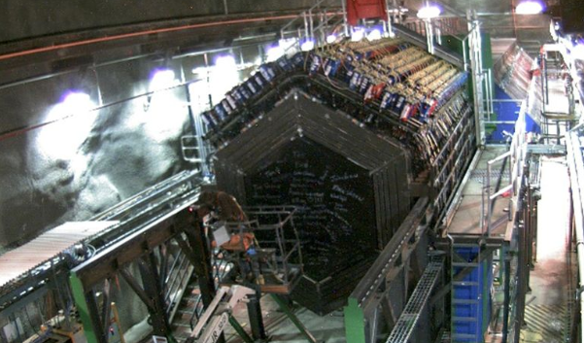






​ ​​
MINERvA Masterclass Start-up

Slide 2

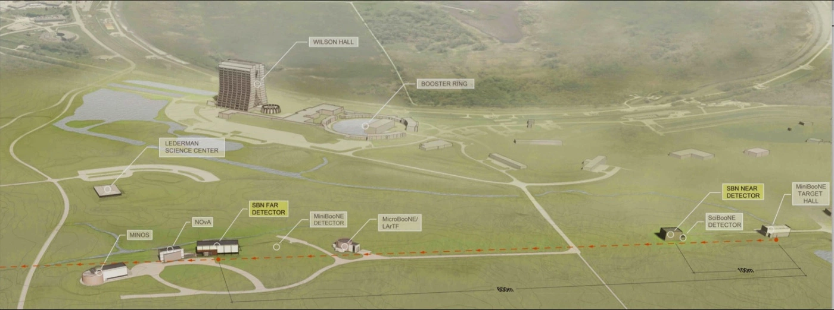
Fermilab
The Fermi National Accelerator Laboratory (Femilab) is the place to be to study neutrinos. The short- and long-baseline programs investigate all sorts of neutrino behaviors and shed light on the nature of the universe.

Slide 3
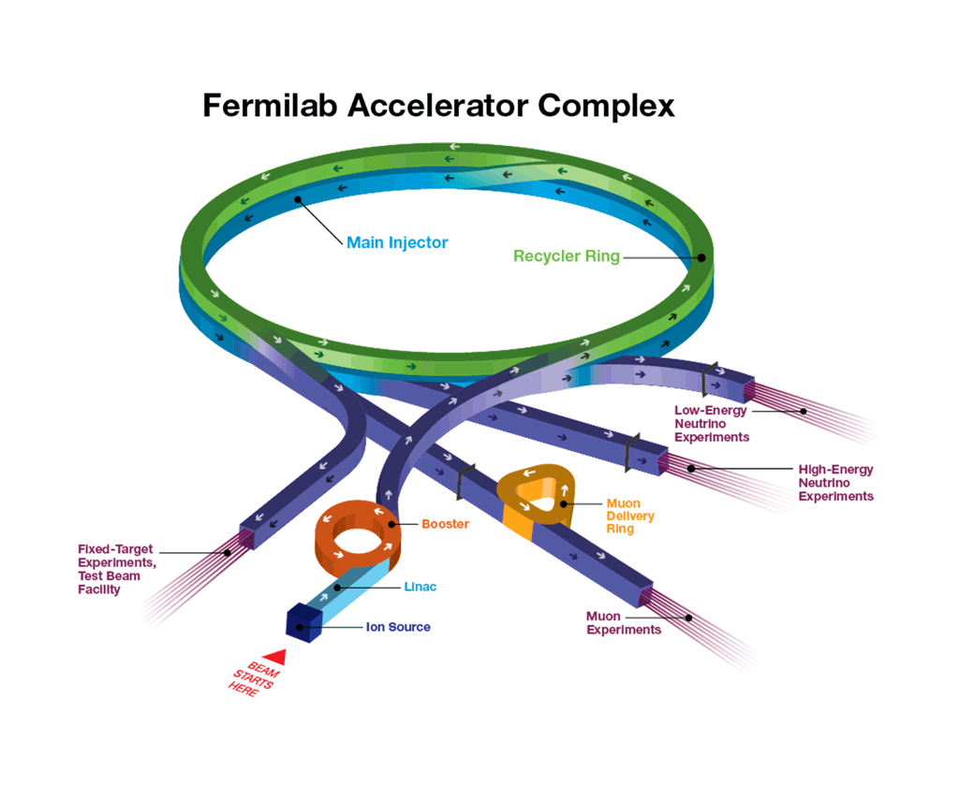
Fermilab
Neutrino Beams
Notes:
The Fermilab Main Injector sends protons to a targets for different purposes. Some are sent to create neutrino beams.

Slide 4
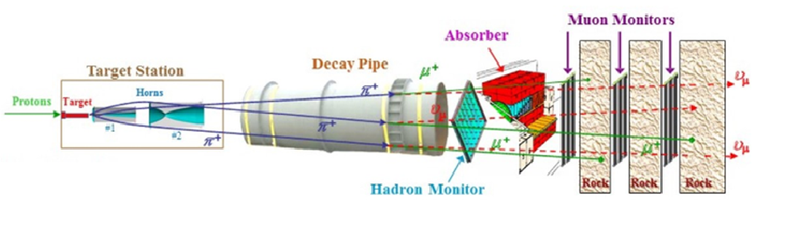
MINOS and MINERvA
protons → target → pions → muons + neutrinos → neutrino
beam
Video Options: How to Make a Neutrino Beam (cartoon) OR
How do You Make a Neutrino Beam? (Don Lincoln)
Notes:
Cartoon Video: https://www.youtube.com/watch?v=U_xWDWKq1CM
Don Lincoln video: https://www.youtube.com/watch?v=y8kJFXhN7Po

Slide 5
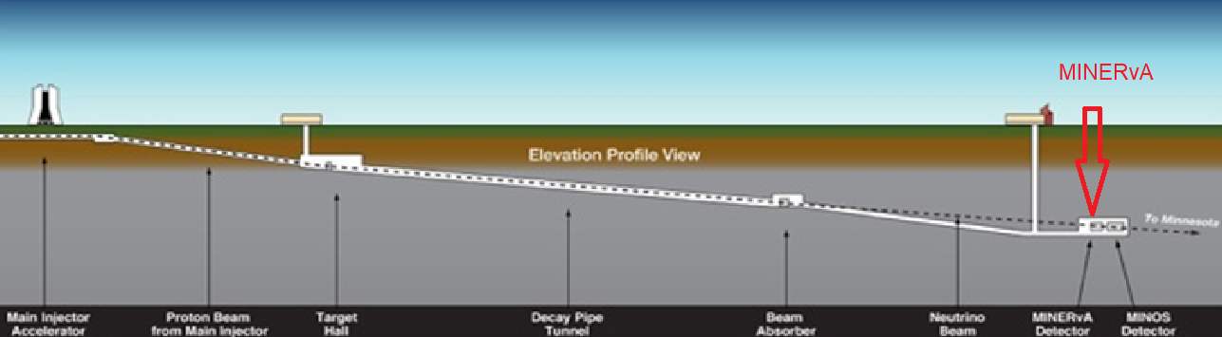
The MINERvA Detector

Slide 6
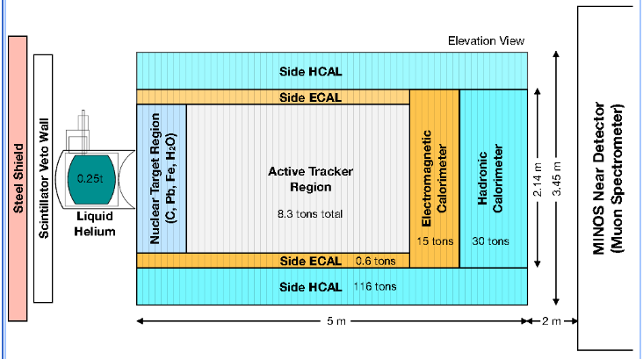
MINERvA – Our interaction zone
Incoming Neutrino Beam
Incoming Neutrino Beam
Muon neutrinos hit the carbon target. MINERvA measures the products of the interaction.
Notes:
6

Slide 7
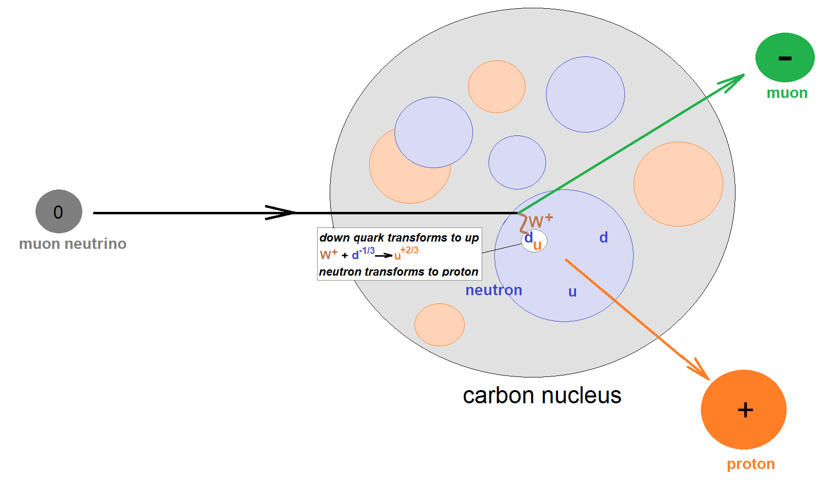
The Interaction
A muon neutrino interacts with a carbon nucleus. The interaction results in a muon and a proton that are ejected from the nucleus. What happens to the momentum initially carried by the muon neutrino?
Notes:
7

Slide 8
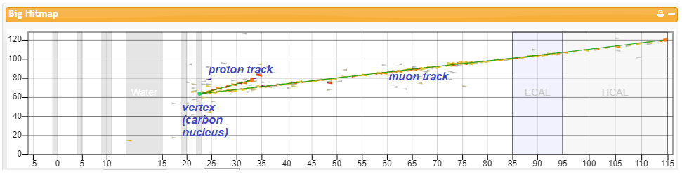
Measurement
Neutrino (no track) → proton + muon
MINERvA can measure the momentum of both the proton and muon.
Notes:
8
This is what MINERvA “sees”. The neutrino comes from the left, undetected. It hits a carbon nucleus and interacts with a neutron. The interaction transforms the neutrino into a muon and the neutron into a proton. MINERvA can measure the momentum of each.

Slide 9
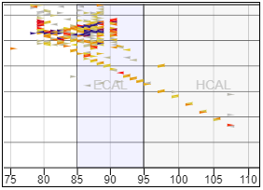
Signal vs. Background
Background events:
Do not fit signal paradigm of one short proton track, one long muon track, or
Confound the ability of MINERvA to measure momentum accurately.
Notes:
9

Slide 10
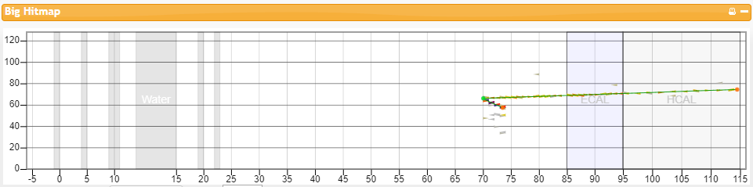
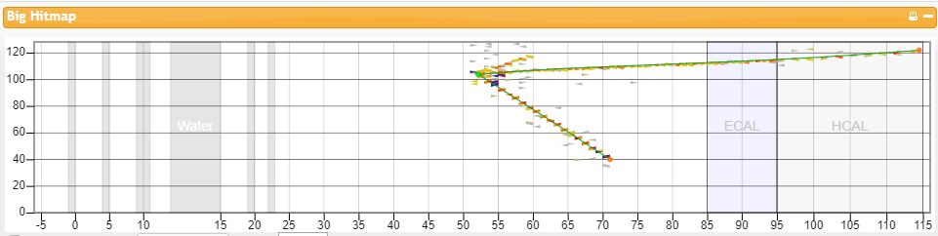
Signal vs. Background
One of these is signal, one is background. Which is which? Why?
Notes:
10

Slide 11
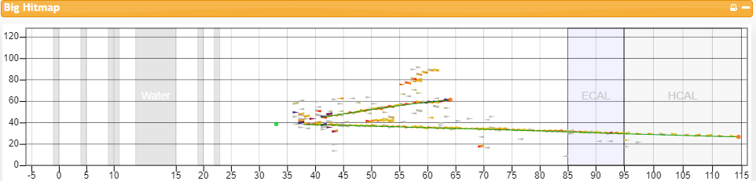
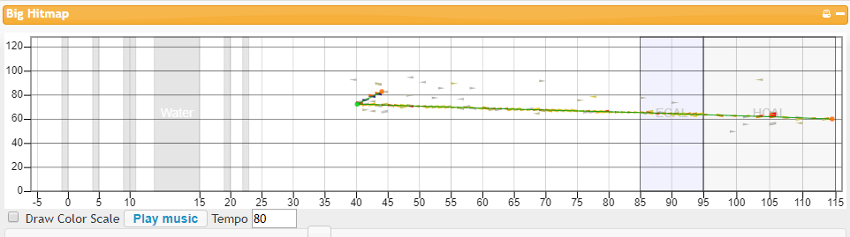
Signal vs. Background
One of these is signal, one is background. Which is which? Why?
Notes:
11

Slide 12
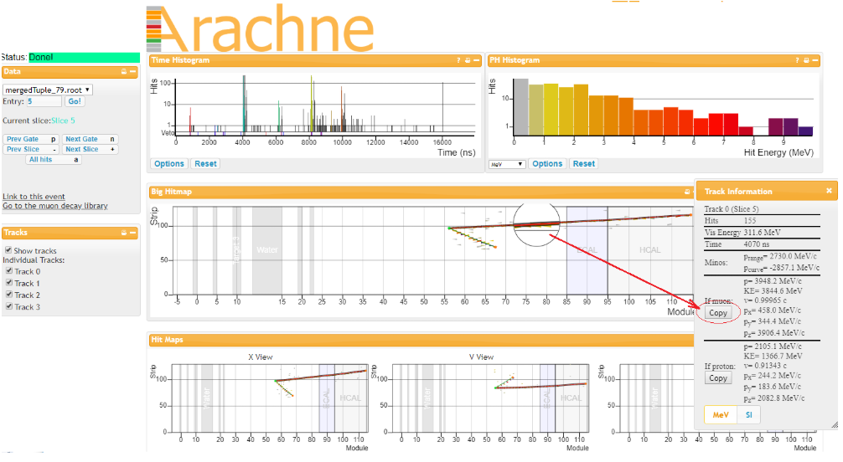
Measure signal in Arachne
Notes:
12

Slide 13
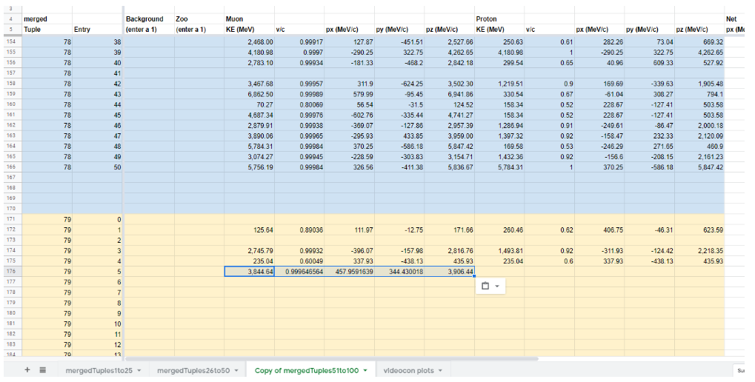
Transfer to spreadsheet
Notes:
13

Slide 14
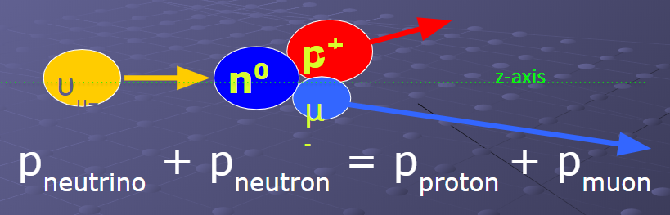
What do we know?
Conservation of Momentum
Initial momentum:
p_{ν} all in z (beam) direction
Final momentum:
  p_{z} = p_{zp} + p_{zμ}
  p_{x} = p_{xp} + p_{xμ}
  p_{y} = p_{yp} + p_{yμ}
Notes:
14

Slide 15
What will we investigate?
If we measure final p_{x} , p_{y} , and p_{z} for many events in MINERvA, what do we get? Why?
What does this imply?
Notes:
15

Slide 16
Keep in Mind. . .
“Science is nothing but developed perception, interpreted intent, common sense rounded out and minutely articulated.” George Santayana
Indirect observations and imaginative, critical, logical thinking can lead to reliable and valid inferences.
Therefore: work together, think (sometimes outside the box), and be critical of each other’s results to figure out what is happening.

Slide 17
Let’s Analyze Events!
Make teams of two.
Practice.
Talk with physicists.
Find good p⁺ + μ⁻ candidates.
Which events go to the spreadsheet?
Let’s plot final p_{x}, p_{y}, and p_{z}.
Let’s see what they mean!
Report! Rapport! Rejoice! Relax!

