Slide 1
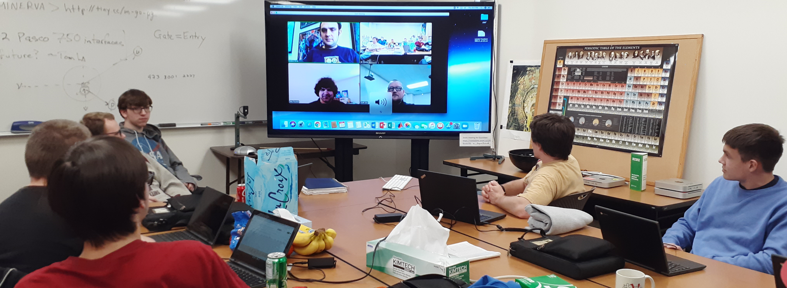
Students and Teachers Making Connections
Collaborating with the
International Particle Physics Outreach Group
QuarkNet is a key contributor to and participant in International Masterclasses, affording learning opportunities for teachers and students, and professional growth for teachers.

Slide 2
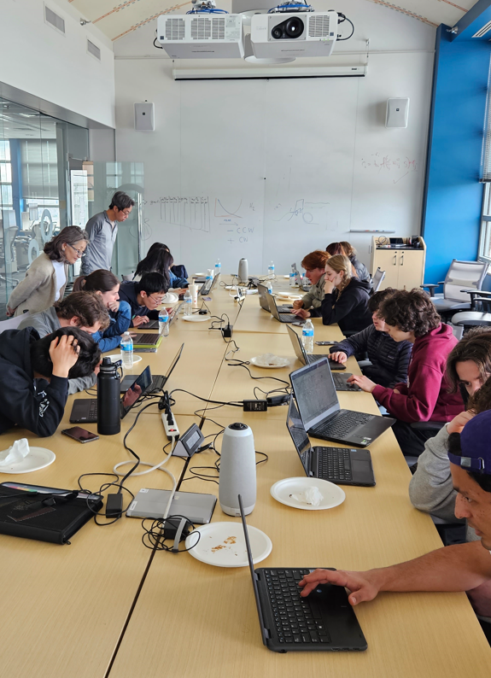
Physics Masterclasses
What is a Masterclass?
Like a cello masterclass, but
Physicists are the “masters.”
Instead of playing music, students analyze data.
Final “concert” is discussion of results and videocon with other groups.
Participants become “particle physicists for a day.”

Slide 3
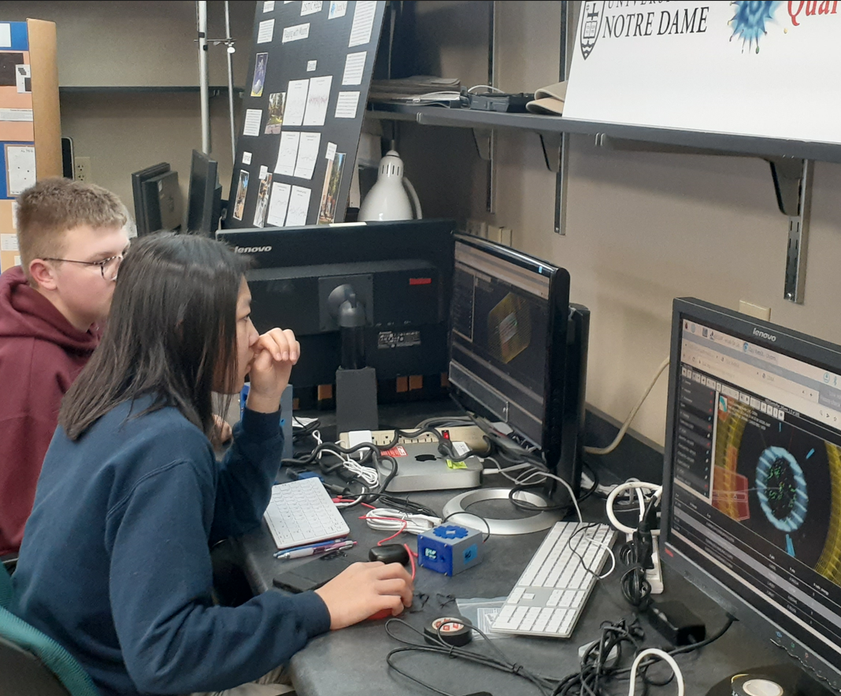
Physics Masterclasses
The Masterclass Day
Teachers bring students to university or lab for a day.
Standard Model presentation
Intro to measurement
  ATLAS, CMS, or MINERvA
  NOvA in development
  Belle II organized by Ole Miss
Data analysis
Discussion of results.
Videoconference with up to 5 other masterclasses
  Moderators from CERN, Fermilab, KEK

Slide 4
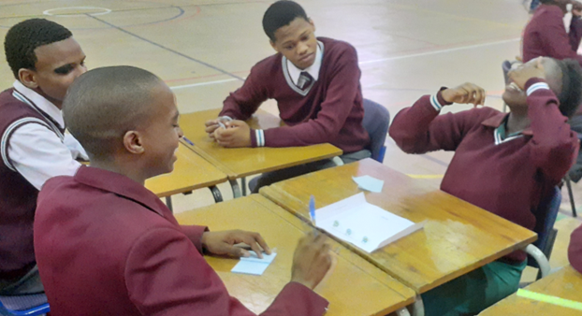
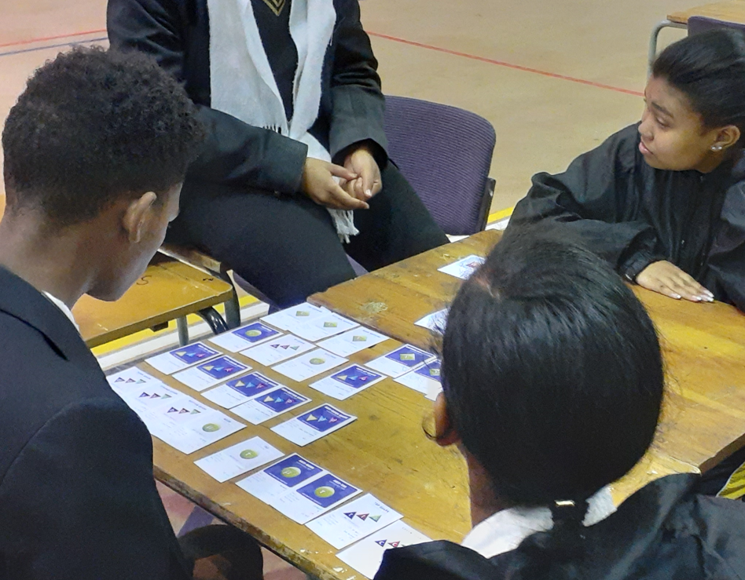
Physics Masterclasses
Masterclasses the QuarkNet Way
Unique approach:
Staff orient mentors and teachers beforehand.
Teachers lead students in prep activities beforehand.
Teachers assist mentors in helping students.

Slide 5
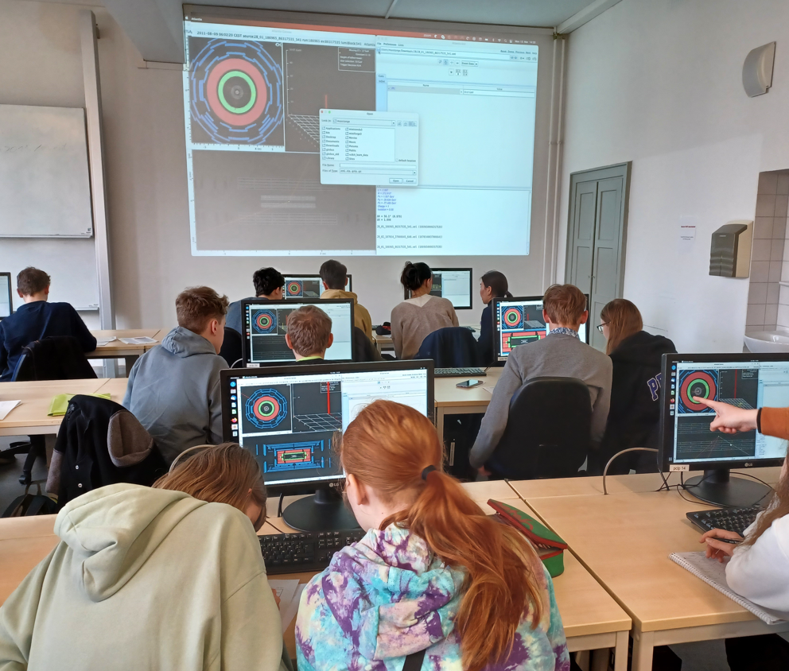
Physics Masterclasses
Why Masterclasses for QuarkNet?
For Students:
Hands-on, authentic particle data
Work with students from:
  Other schools
  Other QuarkNet centers
  Other countries
For Teachers:
All of the above and professional development

Slide 6
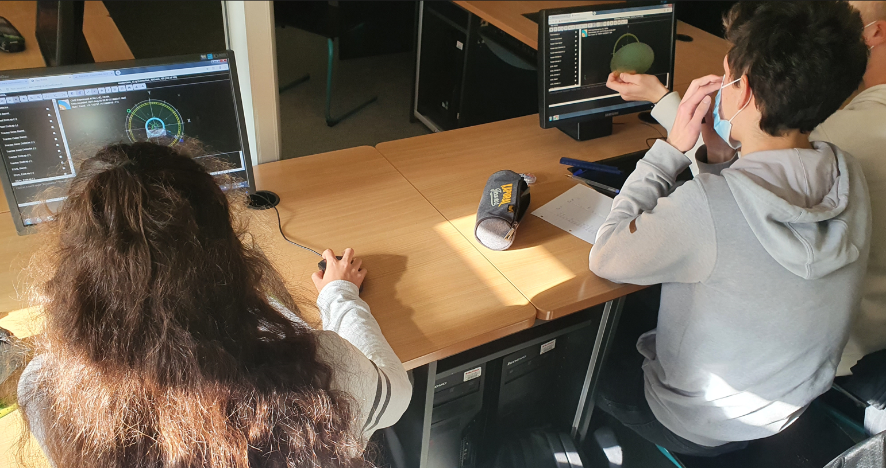
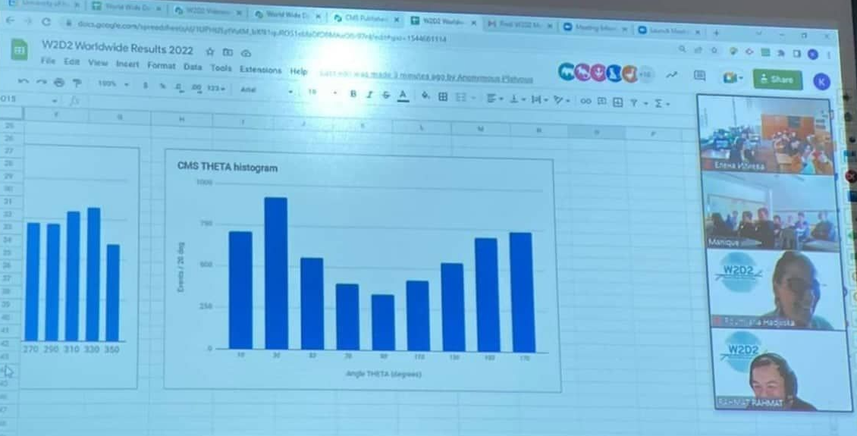
Physics Masterclasses
Made by QuarkNet
QuarkNet developed:
CMS & Neutrino masterclasses
World Wide Data Day: in-school teacher-run masterclass
International Muon Week: masterclass-inspired interactions

Slide 7
Physics Masterclasses
IMC 2023 by the Numbers
QuarkNet Masterclasses:
~80 teachers, ~650 students in 26 FNAL videocons
Global Masterclasses:
~10,000 students in 337 masterclasses
World Wide Data Day:
11 U.S. classrooms, 42 classrooms worldwide
International Muon Week:
14 U.S. nodes, 26 nodes worldwide

Slide 8
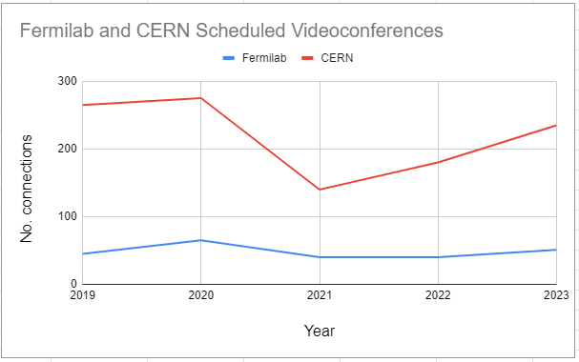
Physics Masterclasses
Scheduled Videocons Since 2018

Slide 9
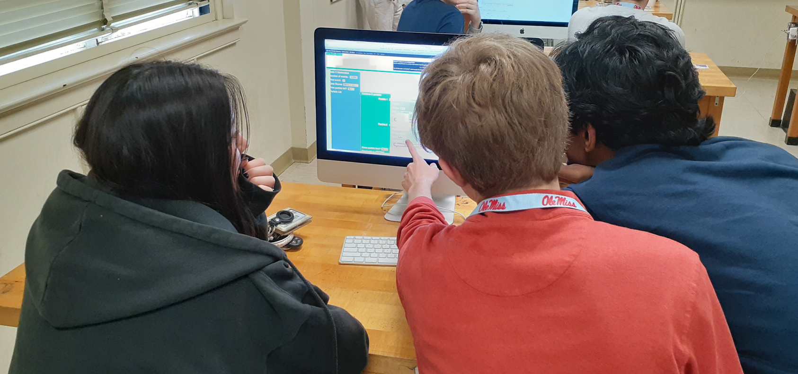
Future Plans: Continue Growth and . . .
LHC
Data Camp ←→ Masterclass ←→ Workshops
  e.g. W-mass in New Questions workshop 2023
More, new data
Improvements
New Neutrino
NOvA 2023
ProtoDUNE ~2025
More
Belle II expansion
Masterclasses to New Countries . . . and new counties

