Slide 1
Bachelors Degrees in Physics: What you didn’t know

Slide 2
Job Stability & Satisfaction
Based on national surveys of students with bachelor’s degrees in physics
High employment rates (95%)
High job satisfaction in terms of
Feelings of job security
75% to 93% (depending on sector) felt secure
Overall satisfaction
71% to 90% (depending on sector) felt a sense of satisfaction
2

Slide 3
Job Opportunities
Flexible options and sectors including:
National Labs
Professional Schools (e.g. Medicine, Health)
Environmental/Climate Science, Energy
Space Science
Government/Policy
Public Administration, Business
Communication (e.g. Science Writing, Media)
Education (e.g. High School, College/University)
Engineering, Computing
Arts (e.g. Music, Television)
Not-for-Profit Organizations
Graduate Studies (e.g. multiple STEM disciplines)
3
Notes:
Reference: IOP, 2017; Mulvey & Pold, 2017; Tesfaye & Mulvey, 2012

Slide 4
Job Opportunities
On the MCAT (Medical College Admission Test), which major from amongst the following gets the highest scores? Lowest scores?
A. Biology B. Psychology C. Chemistry D. Physics E. Engineering
On the LSAT (Law School Admission Test), which major from amongst the following gets the highest scores? Lowest scores?
A. Biology B. Psychology C. Chemistry D. Physics E. Engineering
4
Notes:
Reference: IOP, 2017; Mulvey & Pold, 2017; Tesfaye & Mulvey, 2012

Slide 5
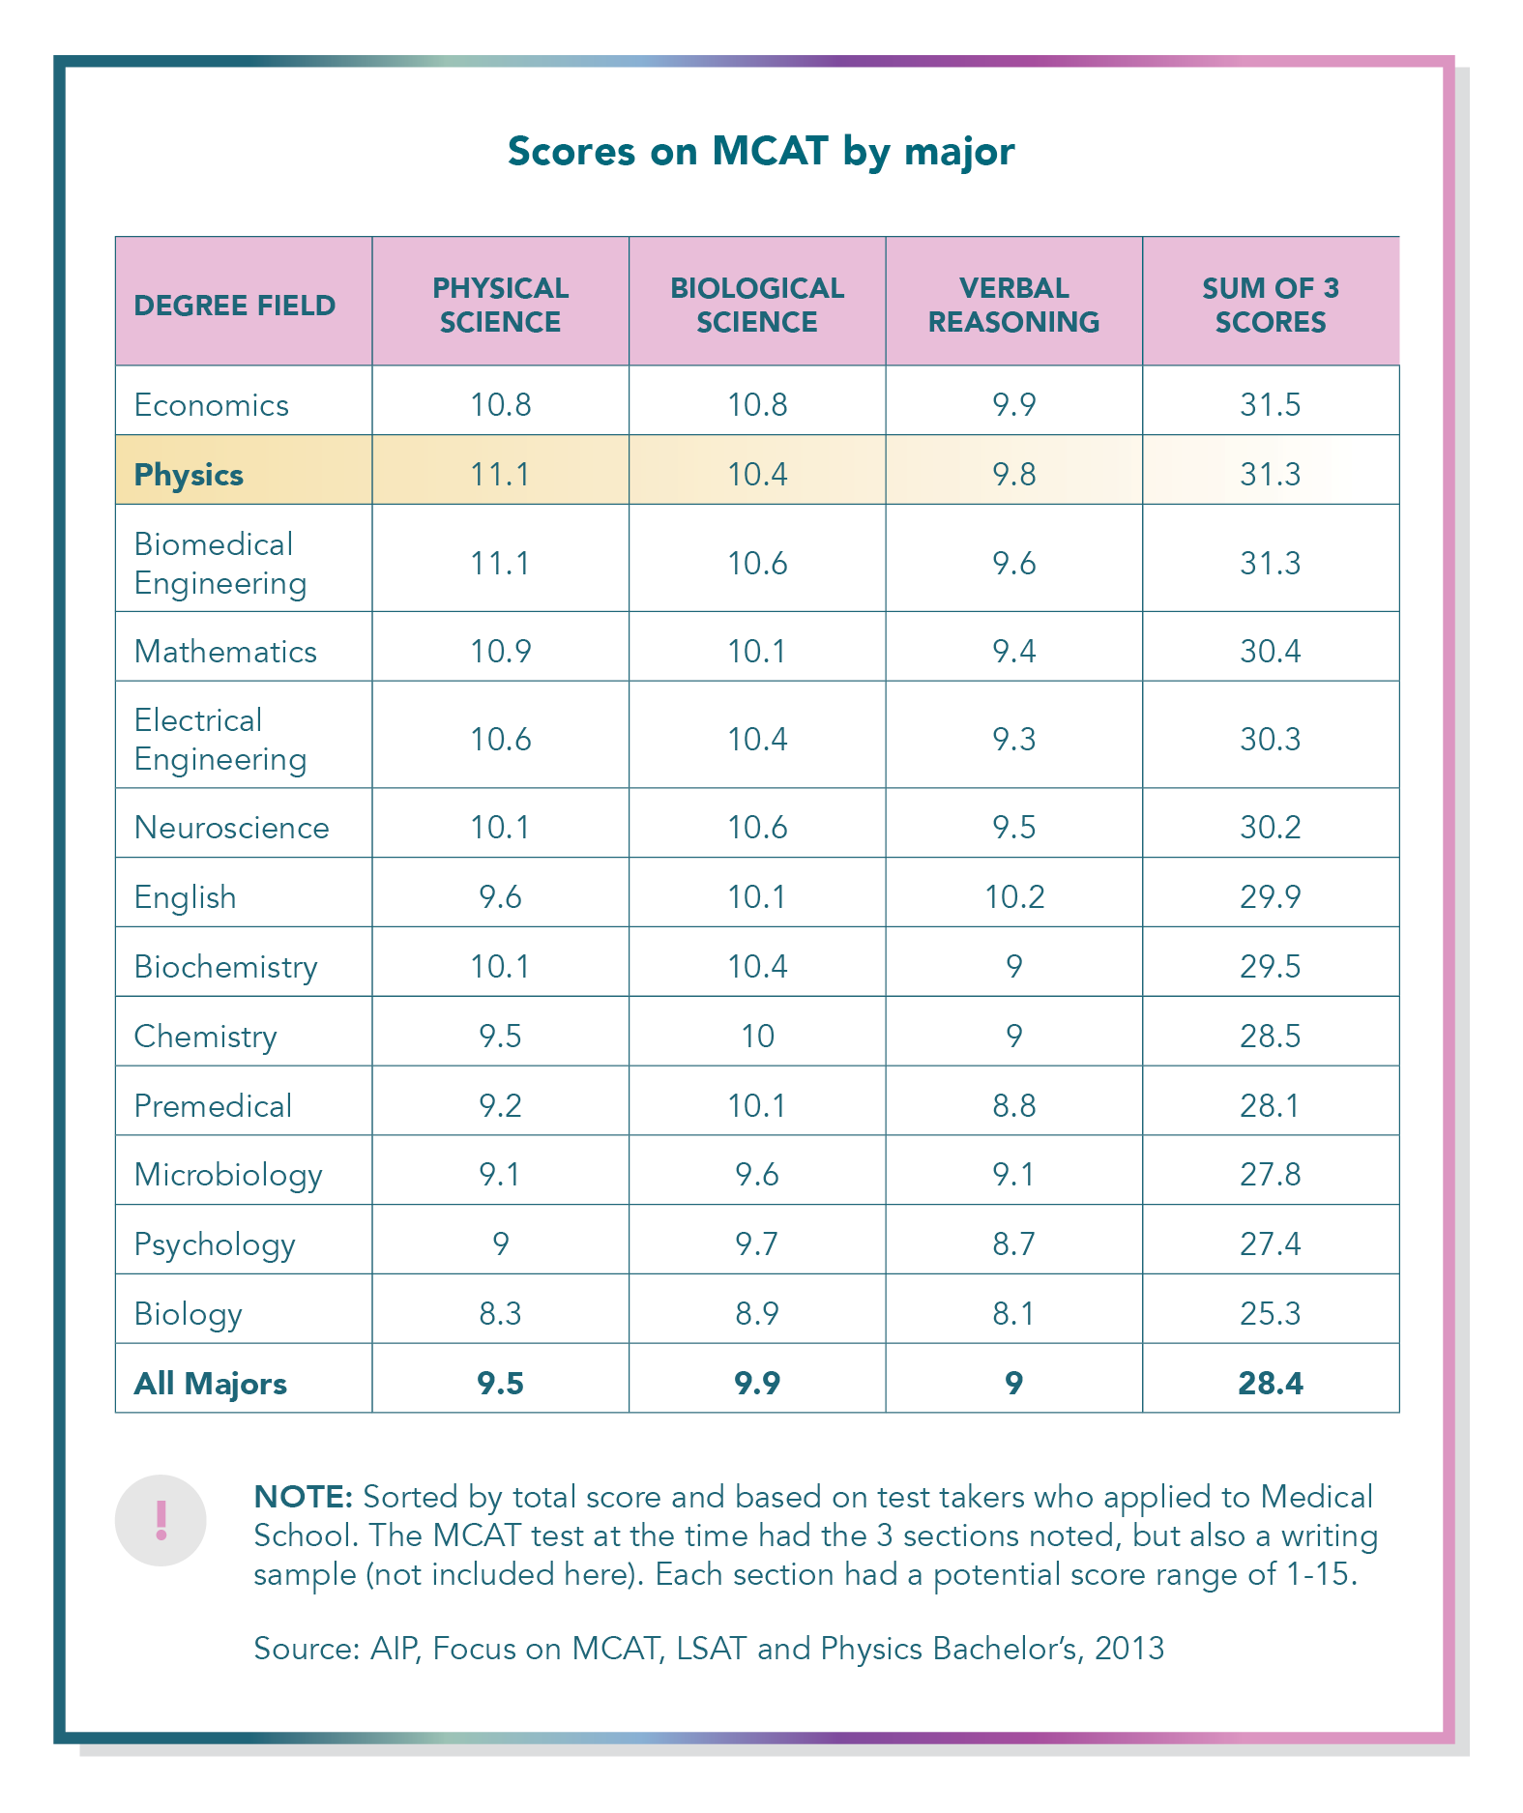
Surprising Facts: Medicine
Physics Majors and Medical School
Physics majors get very high scores on the MCATs
5
Notes:
Reference: Tesfaye & Mulvey, 2013

Slide 6
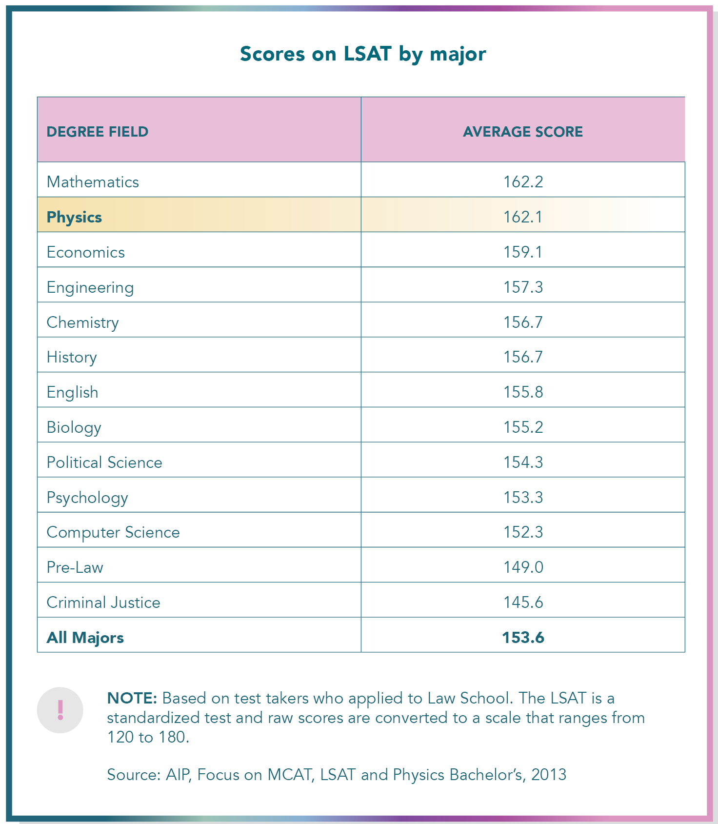
Surprising Facts: Law
Physics Majors and Law School
Physics majors get very high scores on the LSATs
6
Notes:
Reference: Tesfaye & Mulvey, 2013

Slide 7
Surprising Facts: Salaries
Physics Majors and Earnings
Physics bachelors earn comparatively more
7
Notes:
Reference: AIP, Spring 2020: https://www.aip.org/statistics/physics-trends/what-do-new-bachelors-earn

Slide 8
Surprising Facts: Helping Society
Physics Majors Help Others
Improving people’s health
Diagnosis and treatment of illness, for example:
Cancer treatment using radiation, new nanobot technology to target individual cancer cells
Body imaging using X-rays, ultrasound, NMR and PET scans
New methods using infrared light to monitor our blood
Addressing environmental issues
Energy needs and climate change effects, for example:
New renewable energy technology
Climate change effects on humans, animals (e.g. penguin populations), and land (size of the Sahara Desert)
Environmentally friendly transportation methods
And many more…
8
Notes:
Reference: AIP, 2016

Slide 9
Surprising Facts: Helping Society
9

Slide 10
Summary
Students who earn a degree in physics:
Have high employment and job satisfaction
Work in many different sectors (STEM/non-STEM)
Gain skills that give them a competitive edge for Medical and Law School
Earn comparatively higher salaries than most other bachelor’s degrees
Have the opportunity to help society in substantial ways
10

Slide 11
Discussion Questions
What surprised you about the:
Areas in which physicists work?
Skills physicists apply working in such diverse areas?
Benefit physicists can have on the lives of others?
11

Slide 12
References
AIP Statistics (2016). What’s a Bachelor’s Degree Worth? American Institute of Physics (AIP). Retrieved from: https://www.aip.org/sites/default/files/statistics/physics-trends/fall16-bs-deg-worth.pdf
IOP (2017). Institute of Physics (IOP) Careers from physics. Retrieved from: http://www.physics.org/careers.asp?contentid=381
Mulvey, P., & Pold, J. (2017). Physics Bachelor: Initial Employment. American Institute of Physics (AIP) Report. Retrieved from: https://www.aip.org/sites/default/files/statistics/employment/bachinitemp-p-14.1.pdf
Pold, J., & Mulvey, P. (2016). Physics Bachelors: One Year after Degree. American Institute of Physics (AIP) Report. Retrieved from: https://www.aip.org/sites/default/files/statistics/employment/bach1yrafterdeg-p-14.1.pdf
Tesfaye, C.L., & Mulvey, P. (2012). Physics Bachelor’s Initial Employment. American Institute of Physics (AIP) Report. Retrieved from: https://www.aip.org/sites/default/files/statistics/employment/bachinitemp-p-10.pdf
Tesfaye, C.L., & Mulvey, P. (2013). MCAT, LSAT and Physics Bachelor's. American Institute of Physics (AIP) Report. Retrieved from: https://www.aip.org/sites/default/files/statistics/undergrad/mcat-lsat1.pdf
12

