Slide 1
Appendix
Statistical Analyses in Support Preliminary Evaluation Results
Kathryn Race
Race & Associates, Ltd.
race_associates@msn.com

Slide 2
2019 QuarkNet Teacher Survey
Examples of Teacher
Demographic Data
(See slide notes if helpful.)

Slide 3
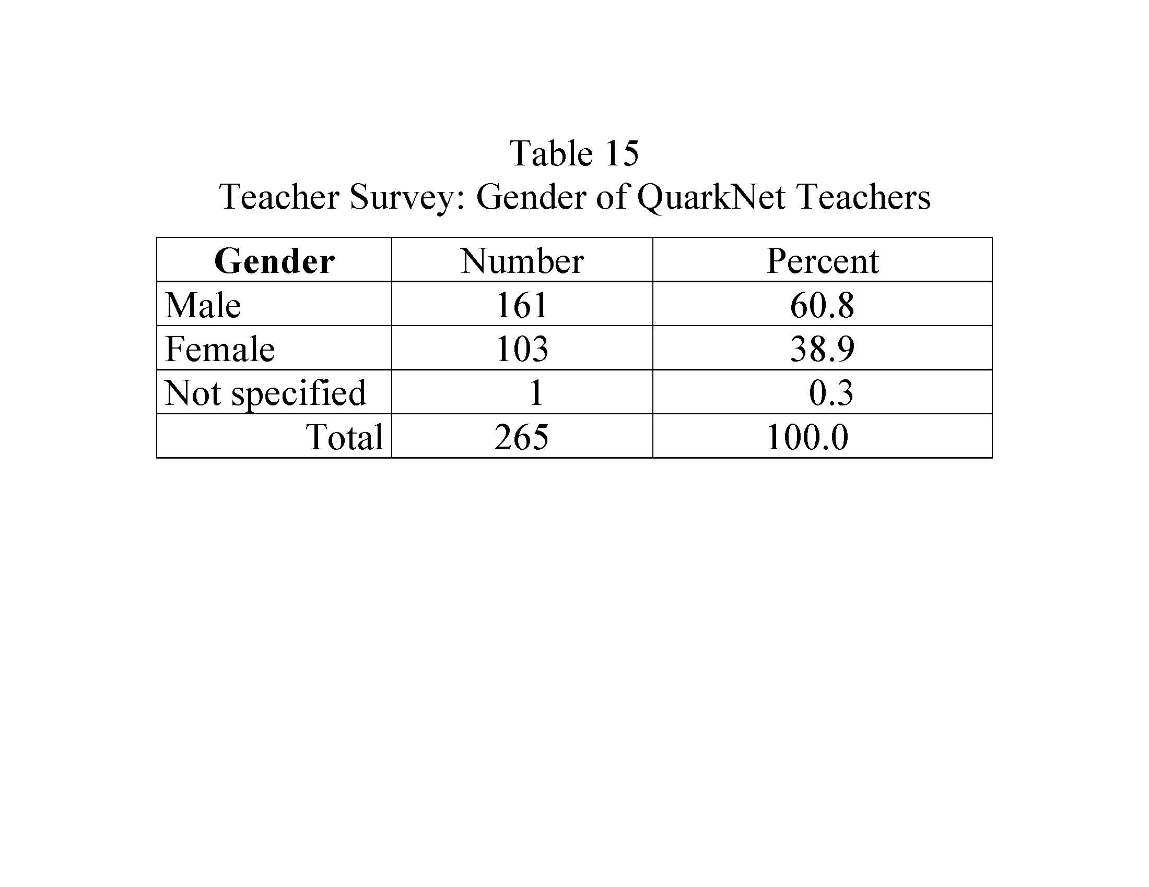
Notes:
Table 15 refers to the table number used in the Evaluation Report 2020.

Slide 4
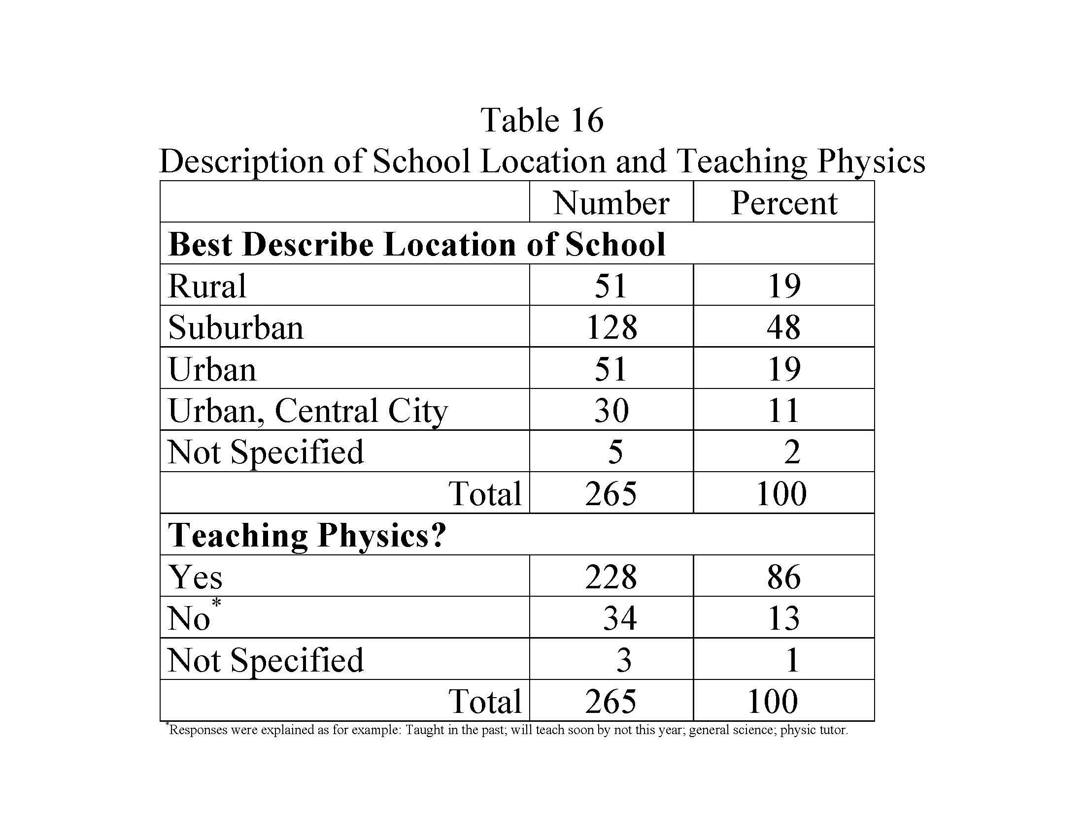

Slide 6
Overview of Analyses Related to Teacher (and their Students) Outcomes
Program Exposure
Teacher Outcomes
Student Outcomes
Data Camp
Exposure to Implemented
Core Strategies
Approach to Teaching
Student Engagement
Workshops
Masterclasses
Use of DAP
Notes:
In the next several slides, I have opted to include some of the statistical summary tables that underly the preliminary conclusions made about Teacher Outcomes and (their) Student Outcomes. All analyses are fully described in the evaluation report, https://quarknet.org/group/evaluation-team.

Slide 7
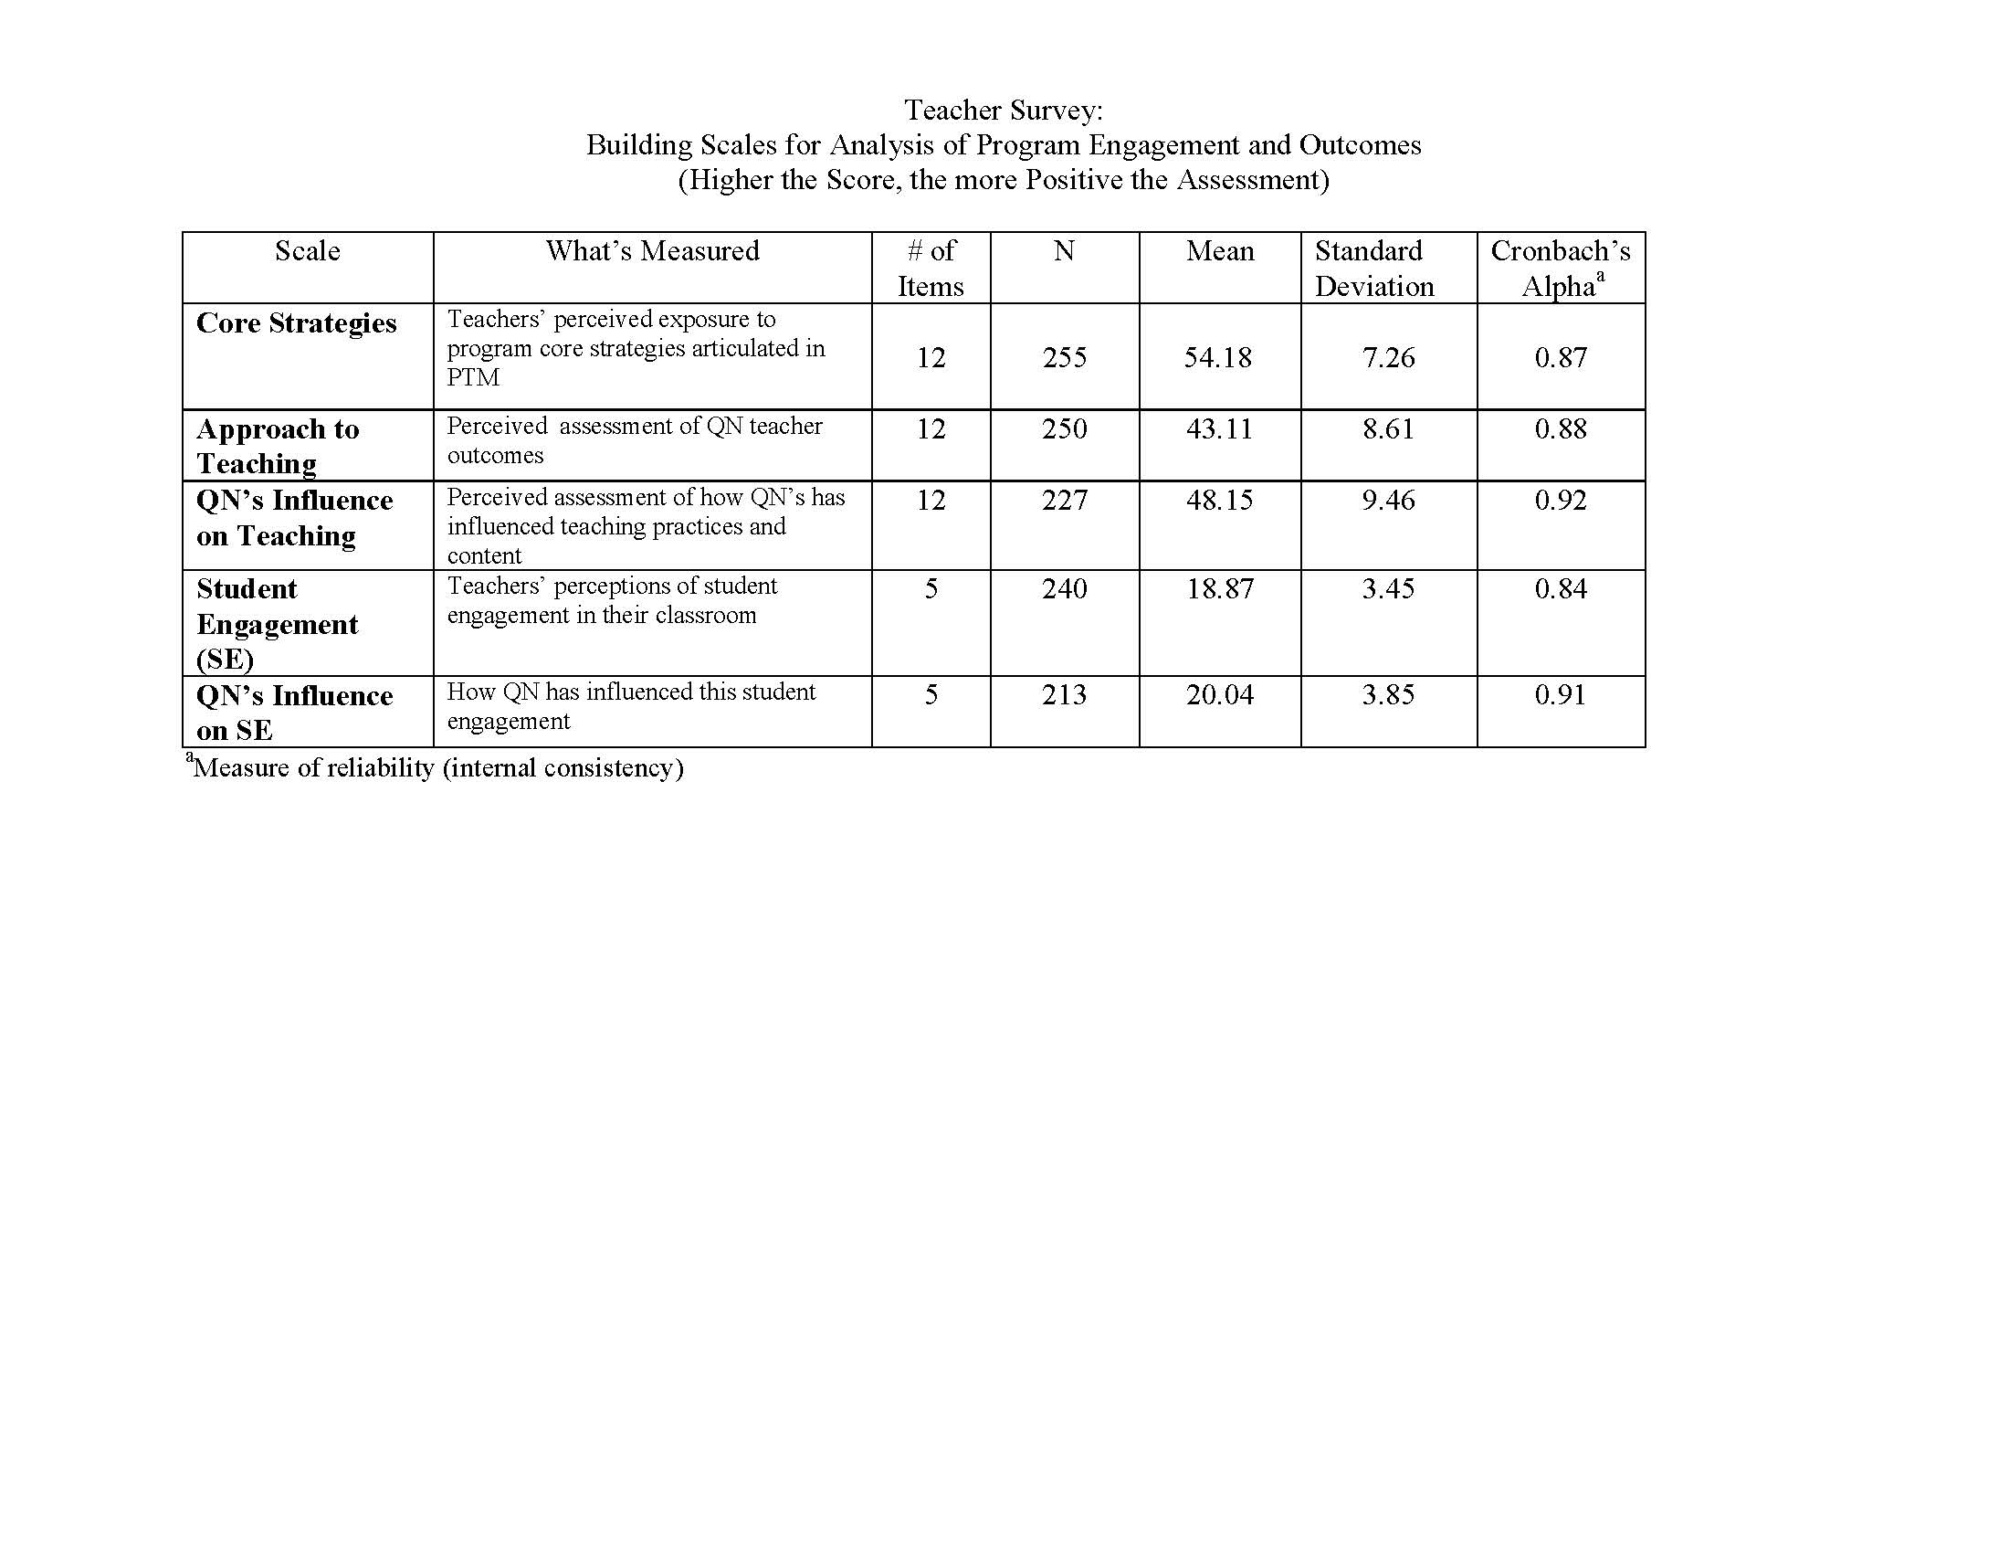
Scale Scores for Analyses
Notes:
To begin we created Scale Scores (summed survey responses to specific sets of survey items in these analyses) because of the improved reliability of using responses based on multiple items and to help simply more complex analyses. As can be seen, this table summarizes the number of survey items that comprise each scale, the descriptive statistics that support the use of these scales, including number of items, mean and standard deviation, as well as the internal reliability of the scale as measured by Cronbach’s alpha.

Slide 8
Exposure to Core Strategies
In preliminary analyses (highlighted in Table 19 next slide) …..
Regarding Core Strategies, program engagement and measurement of exposure to core program strategies were shown to be related in a meaningful way (that is, the more engagement by type of event, the higher the perceived exposure to core strategies; and more reported use of activities from the Data Activities Portfolio in the classroom).
This speaks to the fidelity of the implemented program as compared to the program as designed as perceived by participating teachers who completed the Teacher Survey.

Slide 9
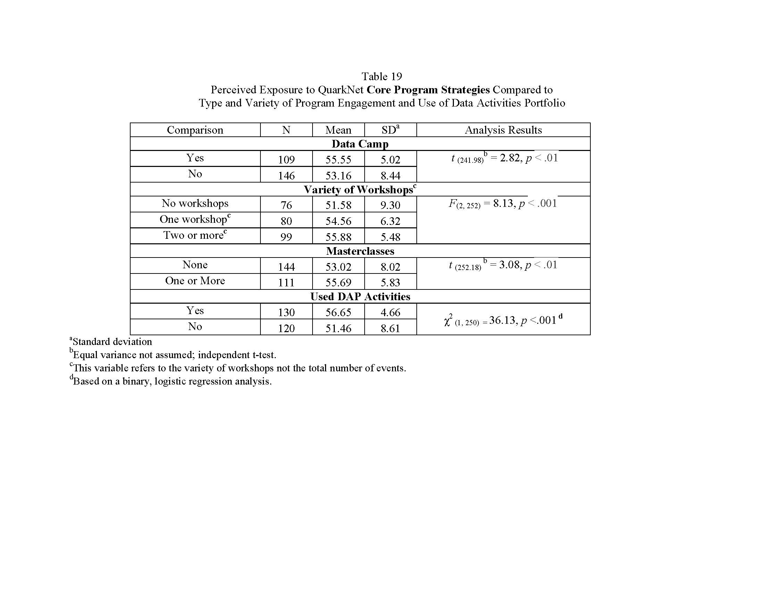
Notes:
The higher the score, the more positive the response.
The table number refers to the table number used in the full evaluation report. https://quarknet.org/group/evaluation-team.

Slide 10
Approach to Teaching
In preliminary analyses…..
Regarding, Approach to Teaching, teaching outcomes were shown to be related to perceived QuarkNet’s Influence and the use of activities from the Data Activities Portfolio in the classroom as reported by participating teachers. (See Tables 21 and 22 next slides.)
Use of DAP activities was shown to be related to exposure to Core Strategies, Approach to Teaching, and all of the types of QuarkNet program events (Data Camp, Variety of Workshops, and Masterclass engagement). (Summary statistics table is not shown.)

Slide 11
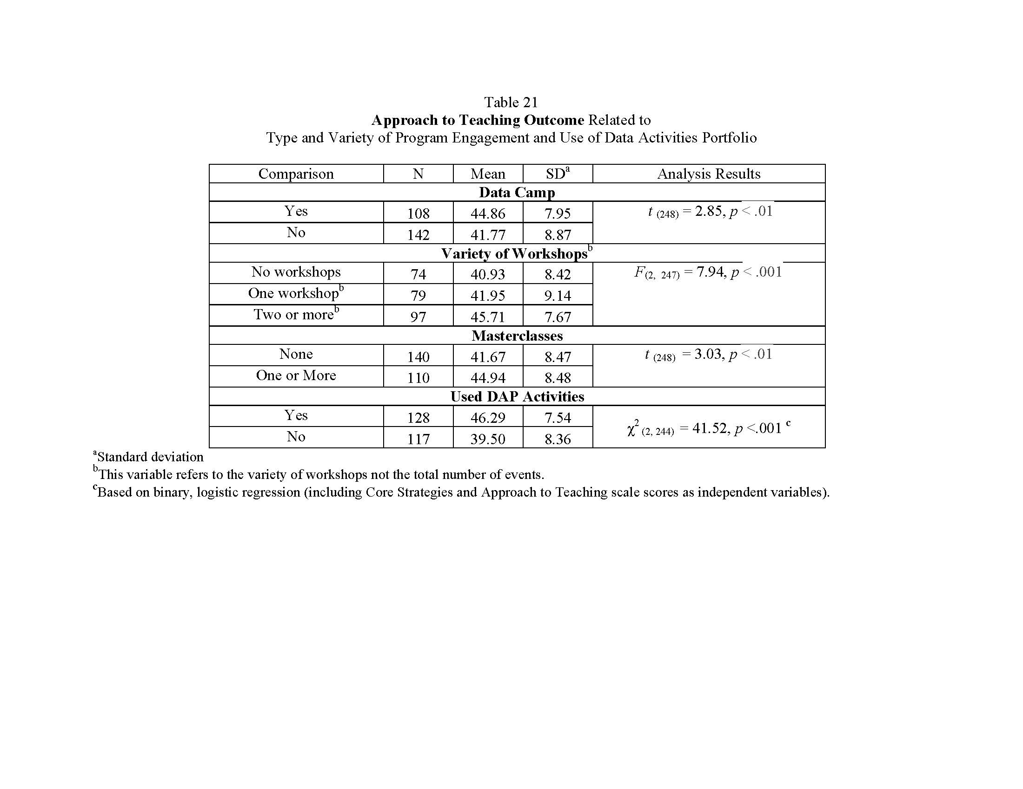
Notes:
Individual analyses where Data Camp exposure, Variety of Workshops, Masterclass engagement and use of DAP activities are analyzed separately. The higher the score, the more positive the response.
This table summaries individual analyses of type of engagement QuarkNet and Approach to Teaching; and then, Use of DAP activities.
Next slide shows the statistics when these variables are analyzed simultaneously in one omnibus analysis , where this exposure is analyzed simultaneously with Approach to Teaching Outcome as the dependent measure. Use of DAP activities is analyzed based on binary logistical regression where binary DAP use the dependent measure.
https://quarknet.org/group/evaluation-team.

Slide 12
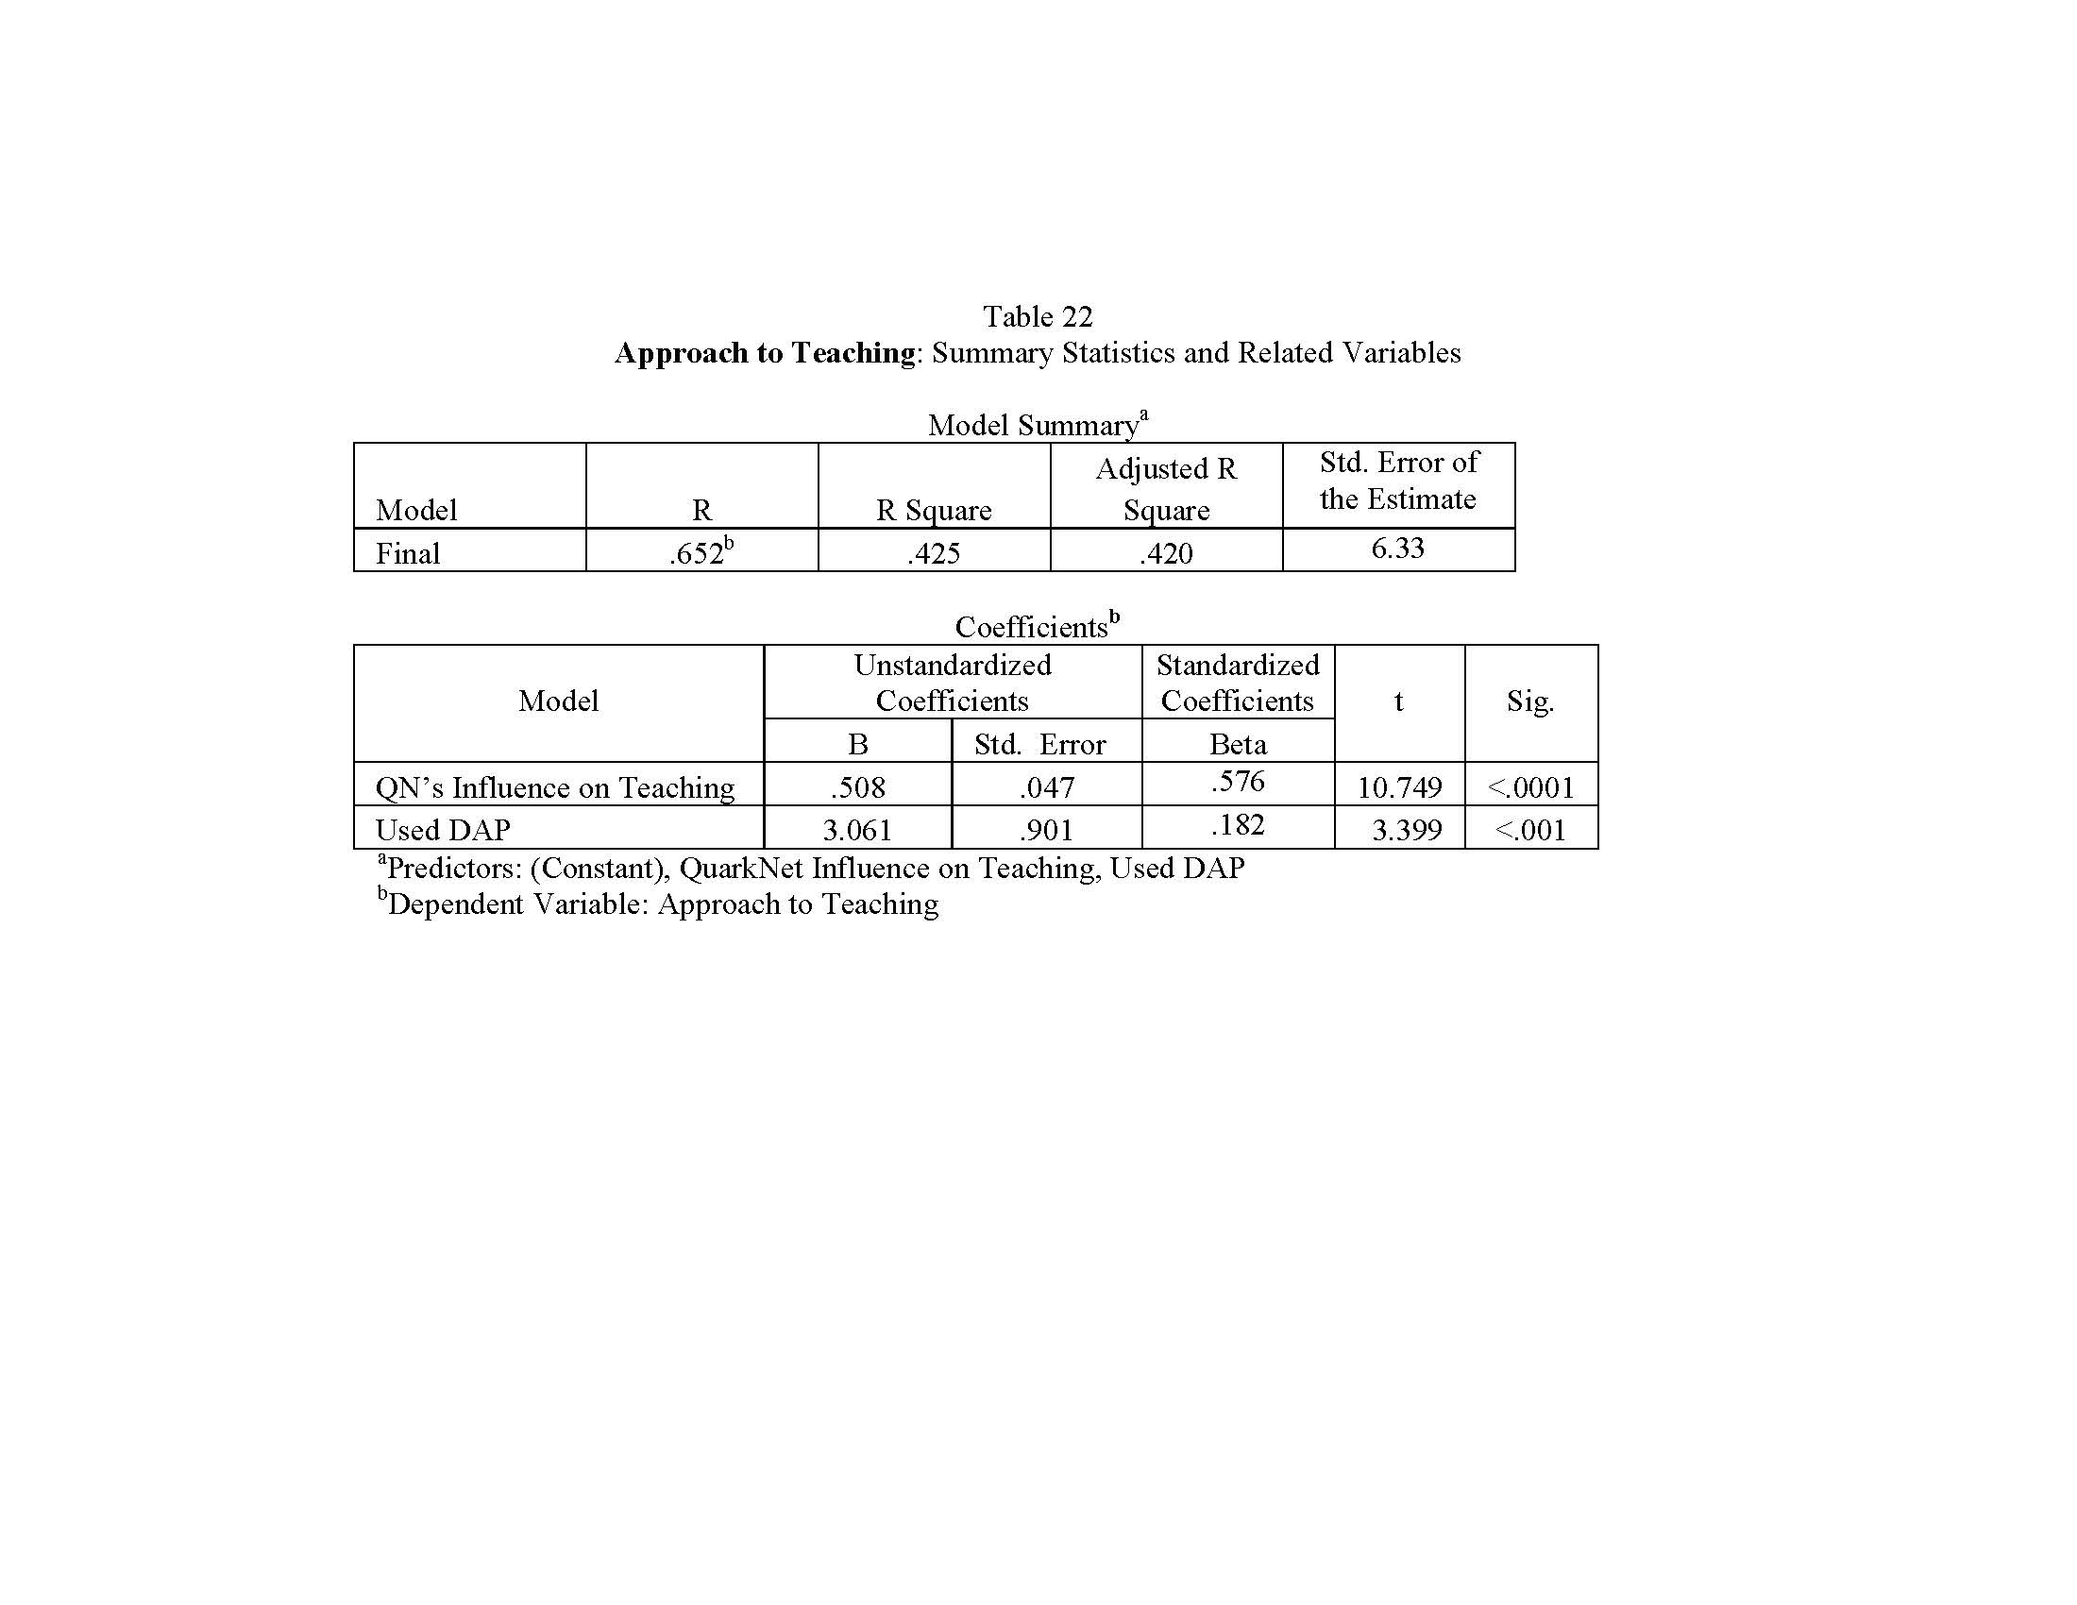
Notes:
Summary statistics of the more complex analysis where QN engagement is analyzed simultaneously with Approach to Teaching Outcome as the dependent measure. Summary statistics for Use of DAP activities analysis not shown.
https://quarknet.org/group/evaluation-team.

Slide 13
Student Engagement
In preliminary analyses (See Table 24)….
Regarding, Student Engagement, QuarkNet’s Influence on Student Engagement and Approach to Teaching were related to perceived student engagement in inquiry-based science based on the perceptions of their participating teachers.

Slide 14
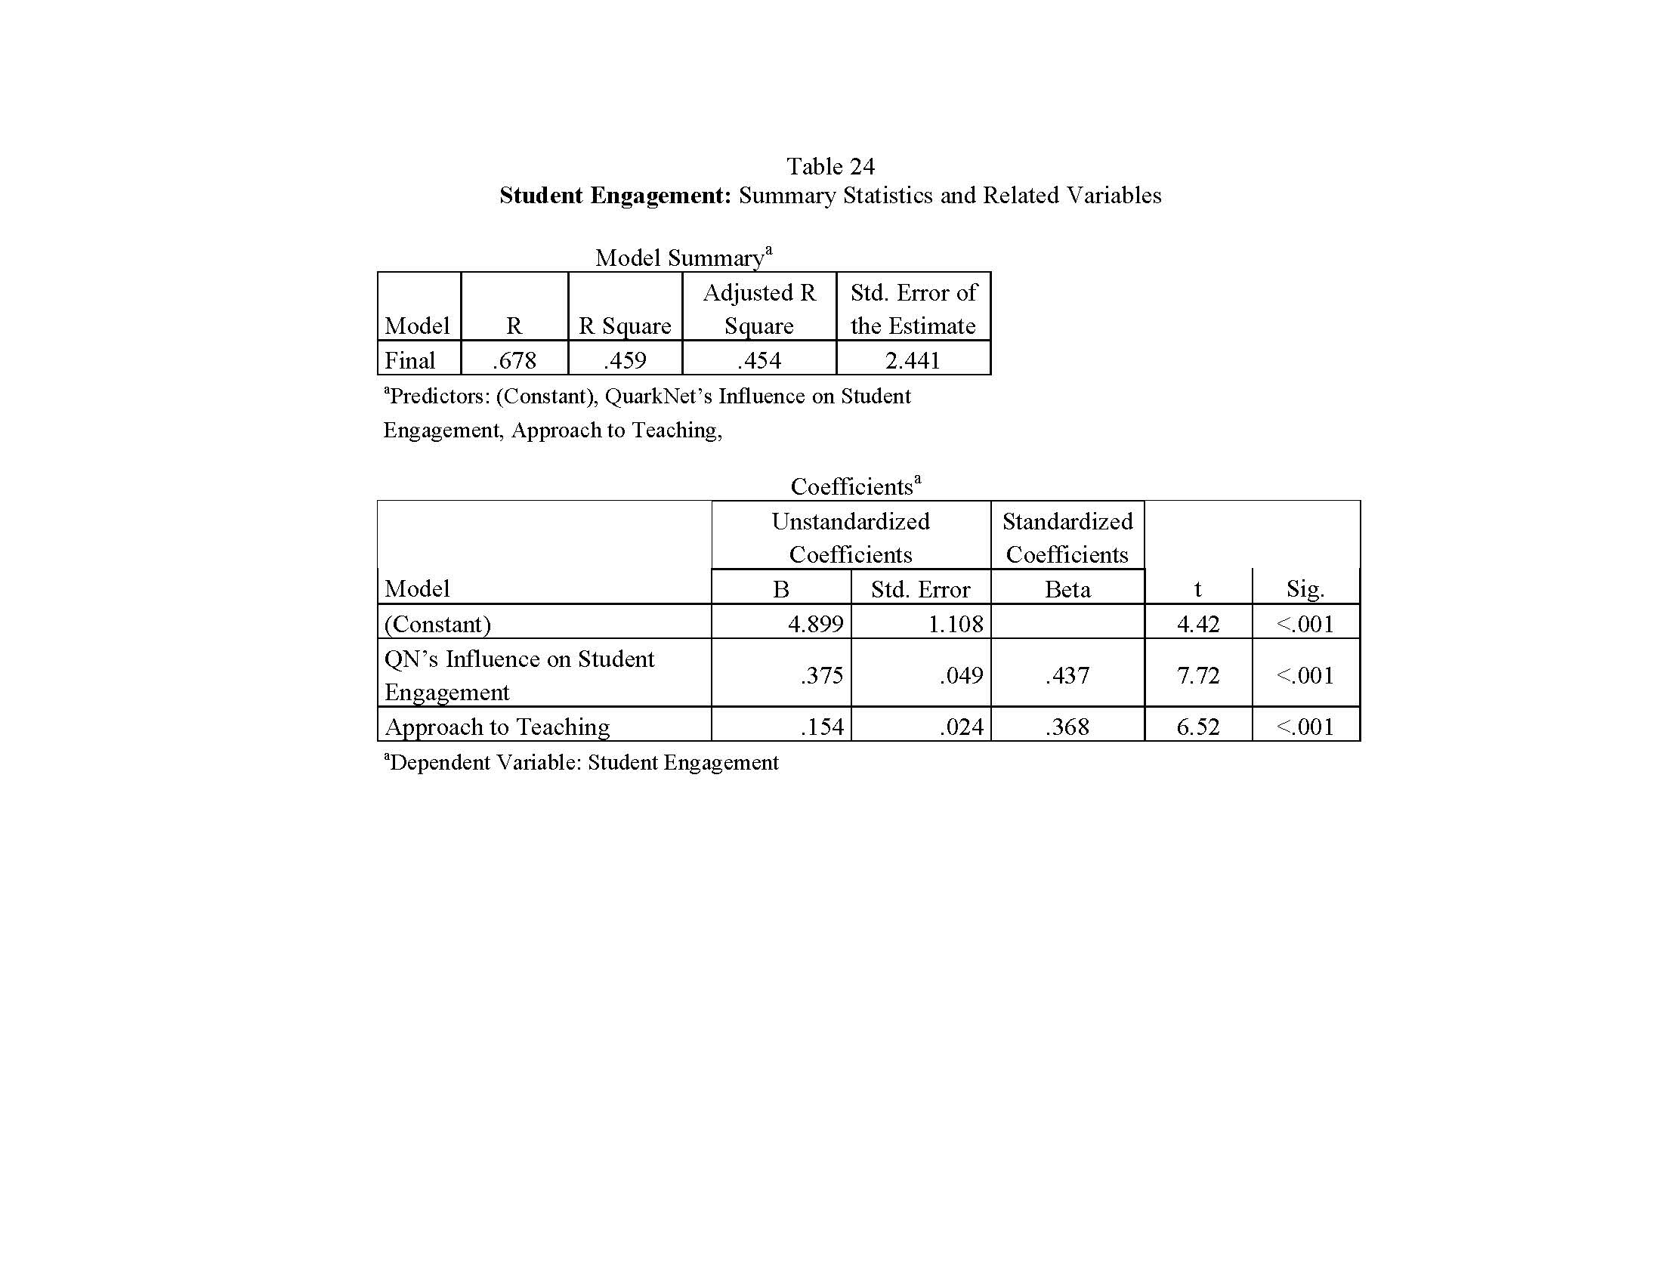
Notes:
https://quarknet.org/group/evaluation-team.

Slide 15
In Summary
So far ….
the weight of these analyses suggests that there is a positive relationship between Teacher Engagement in QuarkNet and exposure to Core Program Strategies; and, that the type and degree of program engagement is related to teacher outcomes Approach to Teaching; the use of activities from the Data Activities Portfolio in the classroom; and teachers’ perceptions of Student Engagement in inquiry-based science.

Slide 16
Center Feedback Template
Just beginning to analyze Center Outcomes –
Here’s an example of how we’re combining data sources

Slide 17
Before we do that
The next set of graphs looks at Next Generation Science Practices, these are ….
Asking questions and defining problems.
Developing and using models.
Planning and carrying out investigations.
Analyzing and interpreting data.
Using mathematics and computational thinking.
Constructing explanations and design solutions.
Engaging in argument from evidence.
Obtaining, evaluating and communicating information.

Slide 18
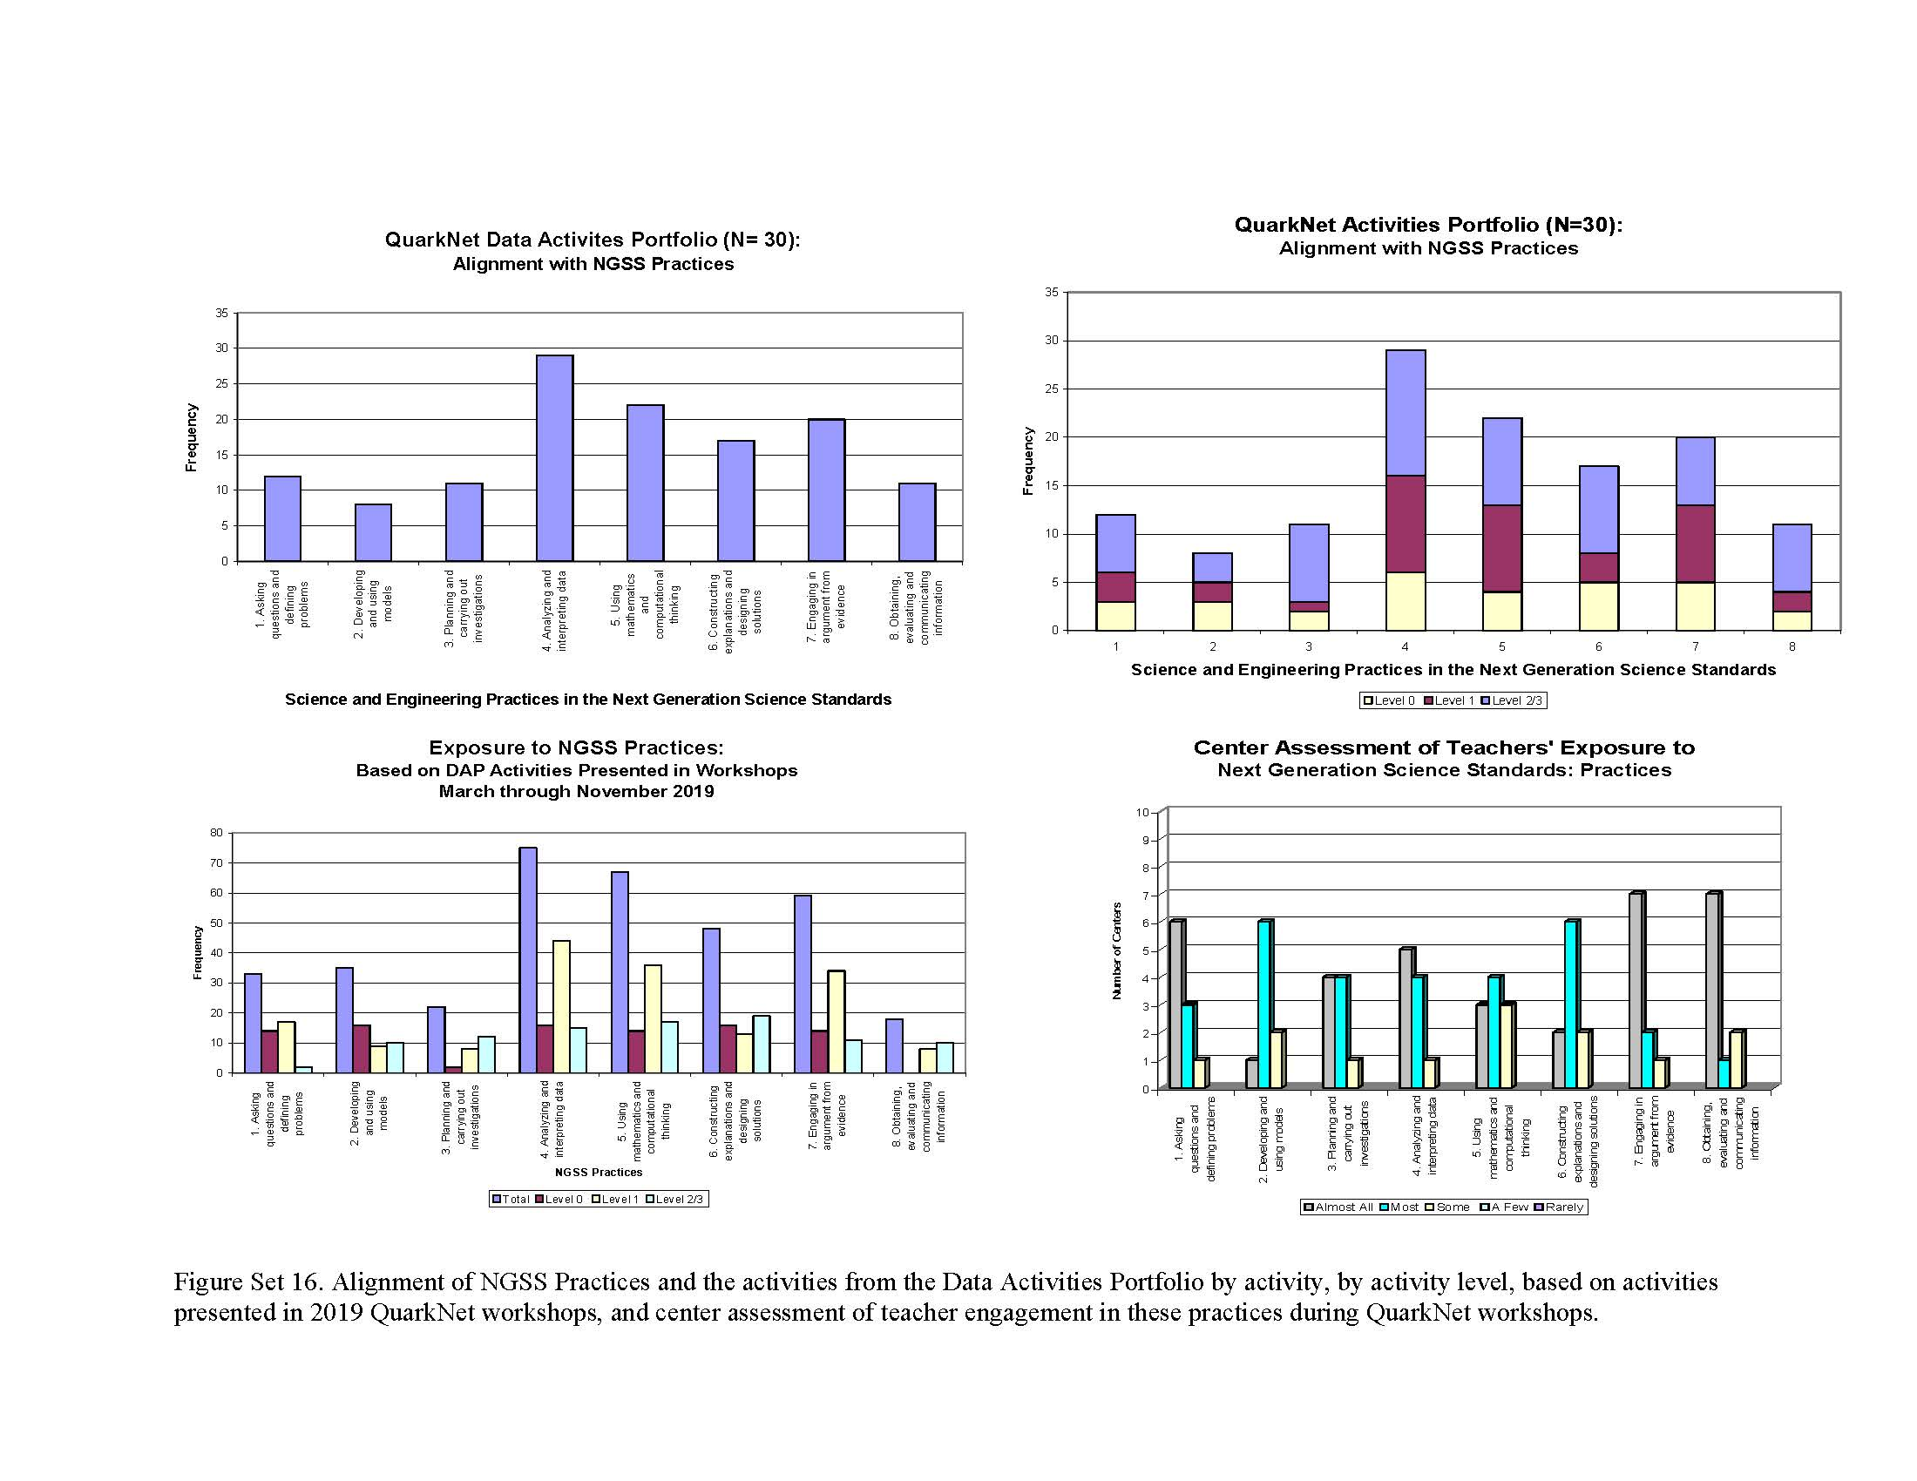
Notes:
The upper graphs show the alignment of DAP activities with the NGSS Science and Engineering Practices as designed (upper left for all activities; and, upper right for activities broken down by activity level (0, 1, and 2/3).
The lower left-hand graph shows the alignment of DAP activities with the NGSS practices as implemented in QuarkNet workshops conducted March-November 2019,
by all activities; and, then broken down by activity level (0, 1, and 2/3).
The lower right-hand graph shows the assessment of 10 Centers as to the engagement level of teachers who participated in QuarkNet at their center relative to these NGSS practices. (Key = Almost All; Most; Some; A Few; and, Rarely.)

Slide 19
DAP Activities and NGSS Practices
We use this figure set to suggest that there is very good agreement between the alignment NGSS practices with DAP activities, ….
As Designed
As Implemented in workshops (March - Nov 2019), and,
As reviewed by 10 participating QN Centers (those who completed the Center Feedback Template process so far)
Notes:
This Appendix provides just a sample of the analyses and results that are summarized in the evaluation report. It is intended to provide the statistics behind the overall evaluation results highlighted in the main PowerPoint presentation. Please refer to the full evaluation report if you are interested in all preliminary evaluation analyses.
https://quarknet.org/group/evaluation-team.

