Slide 1

A Brief Introduction to Neutrino Oscillations
Diego Venegas-Vargas
Neutrino Mini-Workshop
07/21/2026
1

Slide 2
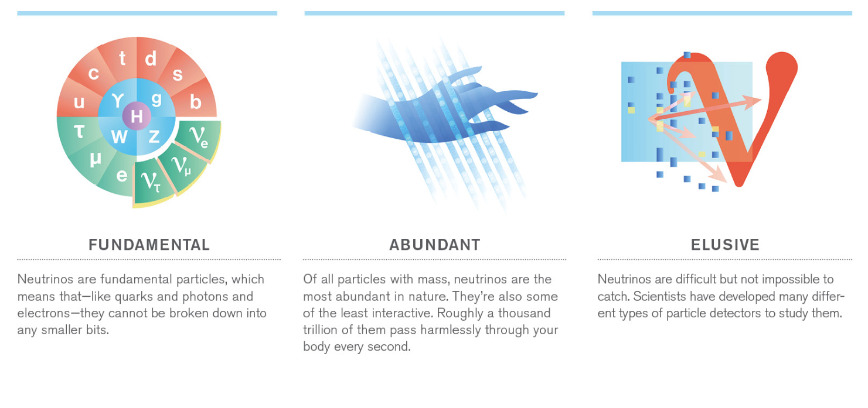
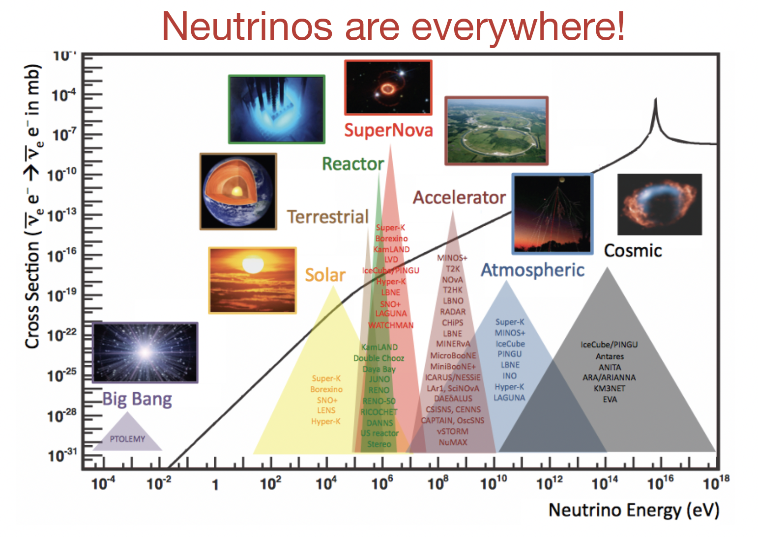
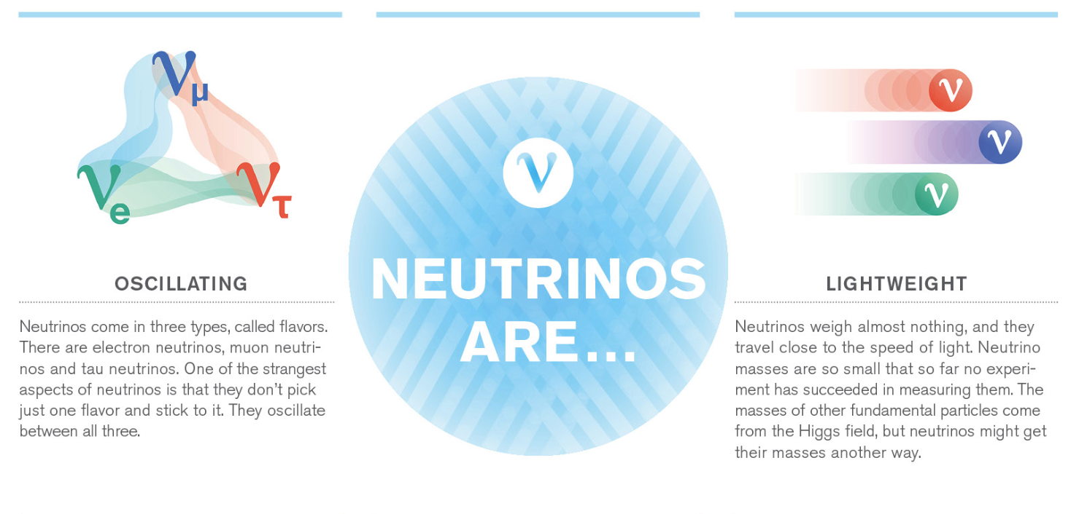
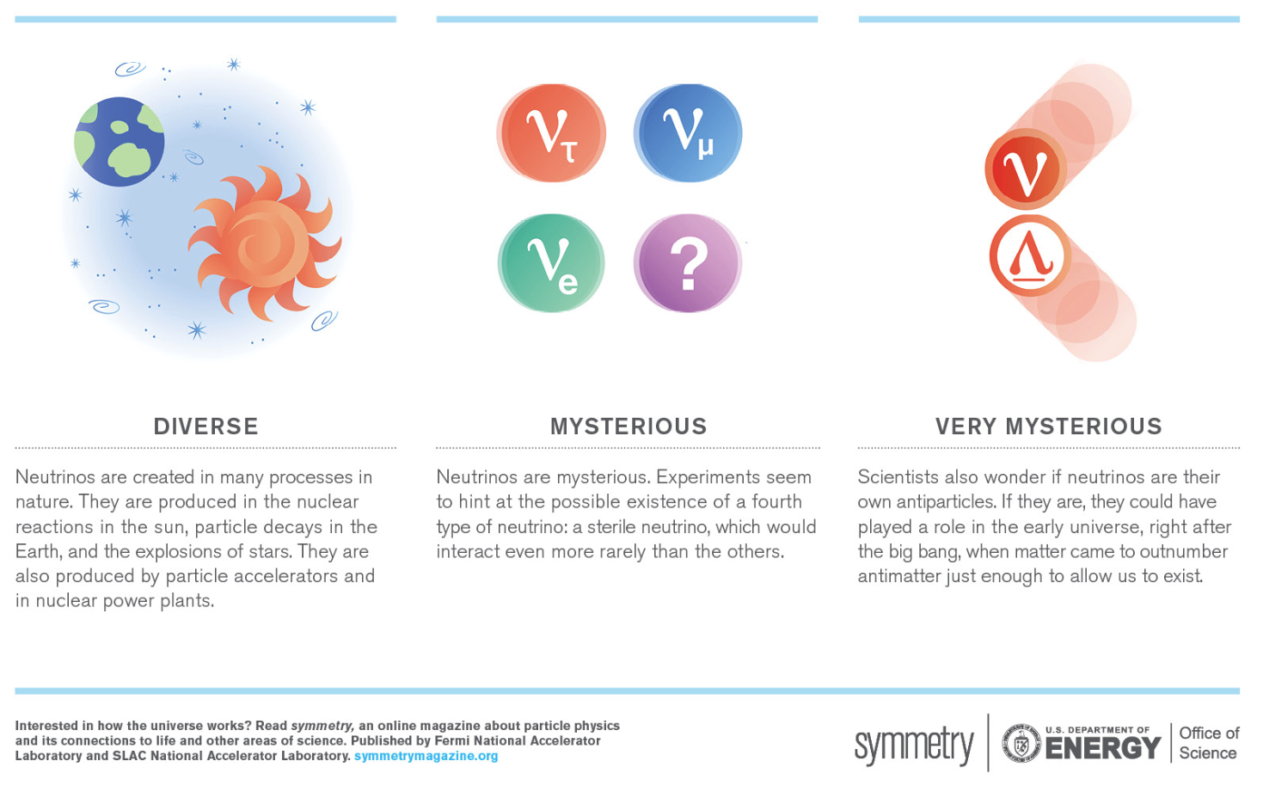

Slide 3
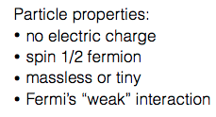
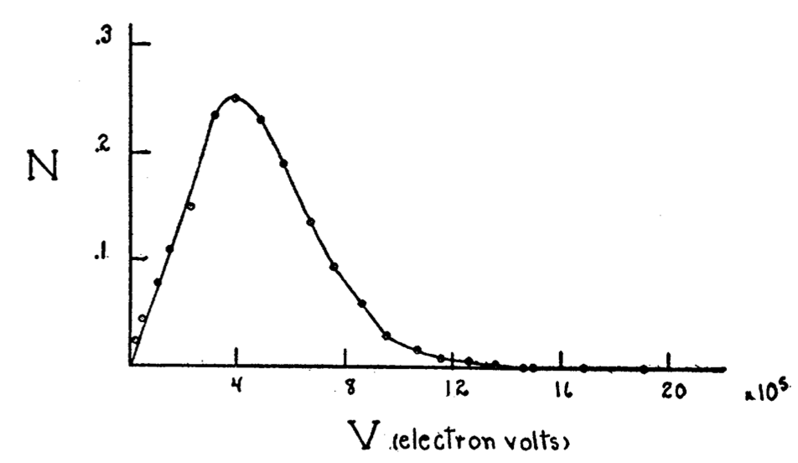
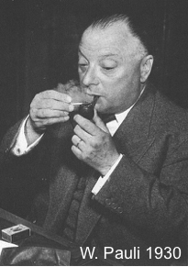
1930: Neutrino existence is postulated
Beta Decay Spectrum
Scott, F. A. Phys. Rev. 48.5 (1935): 391.
“I have done a terrible thing; I have postulated a particle that cannot be detected.”

Slide 4
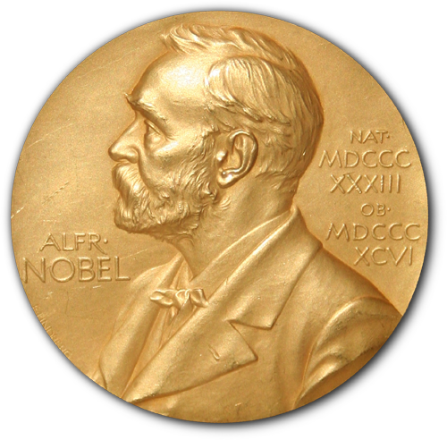
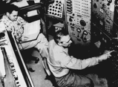
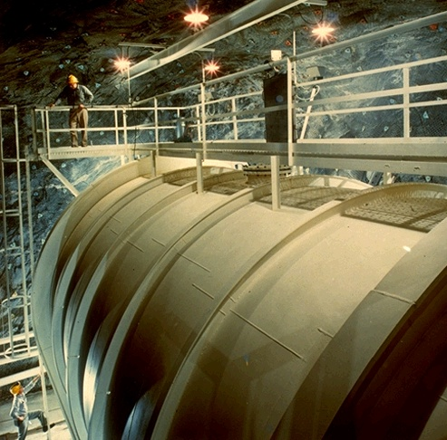
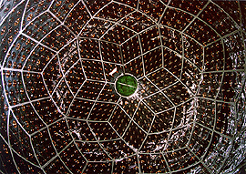
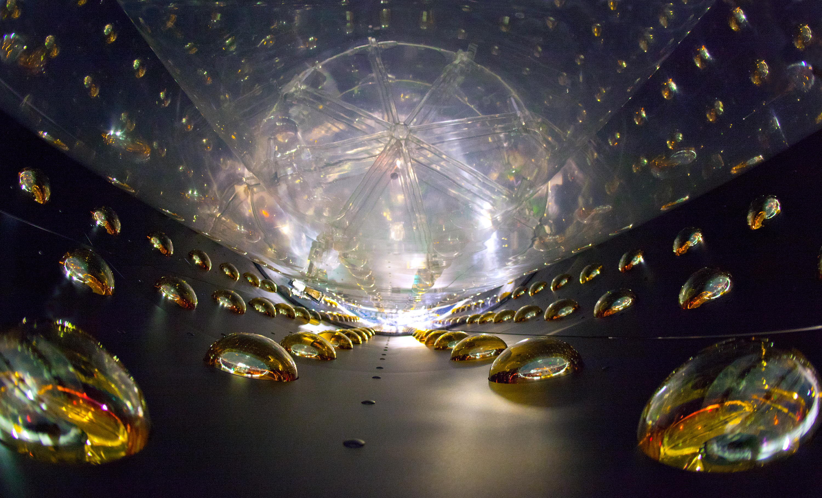
Neutrino Physics Through the Years
Neutrino postulation
First observation of neutrino
Solar Neutrino
Oscillations (mass)
Mixing angle
Neutrinos introduced by Pauli to save conservation laws in β decay experiments
Observation of (anti)neutrinos at Savannah Reactor through IBD with scintillator
Homestake experiment observed for the first-time solar neutrinos
KamLAND kiloton detector at long baselines, discovery of antineutrino oscillations (mass)
DYB,DC,RENO use near/far detectors for precision measurement of last mixing angle
1930
1950
1970
2000
2010
Scott, F. A. Phys. Rev. 48.5 (1935): 391.
Savannah reactor
Homestake mine
KamLAND
DayaBay
5

Slide 5
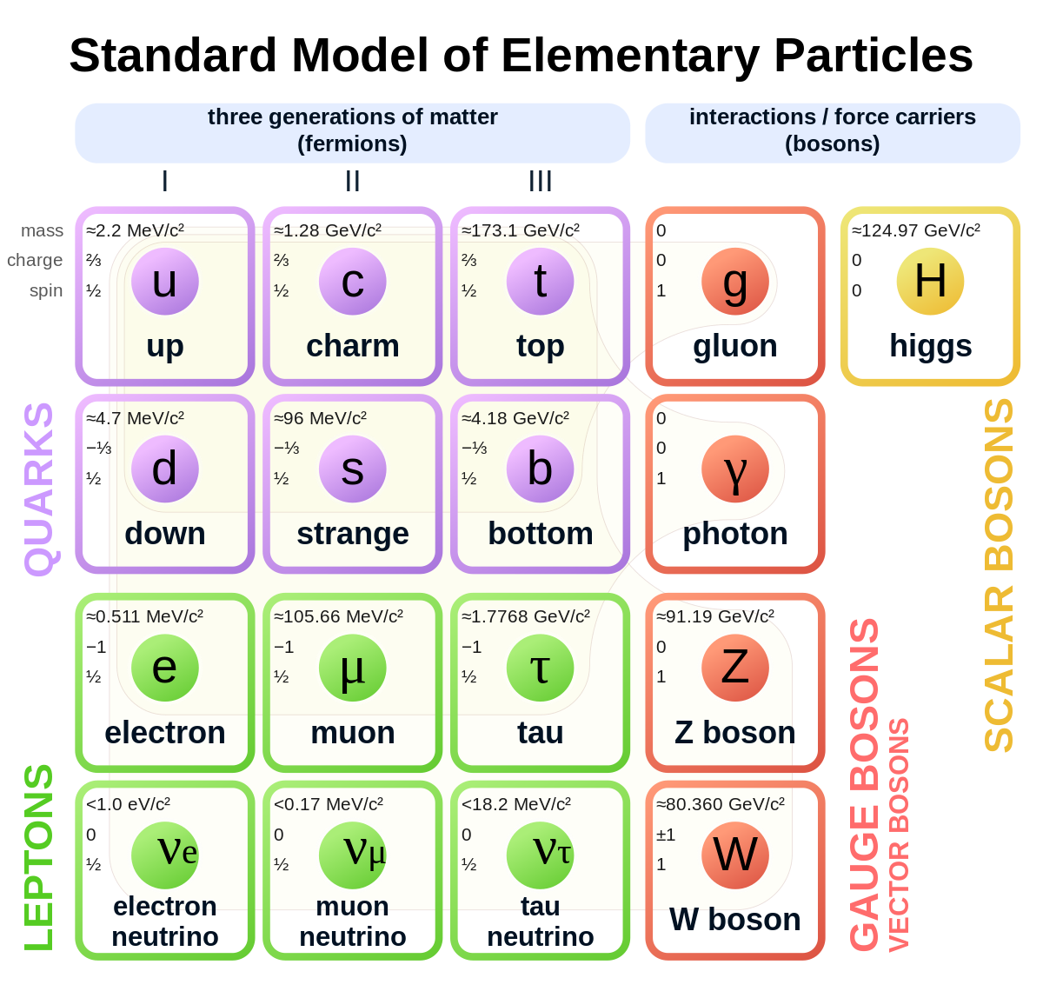
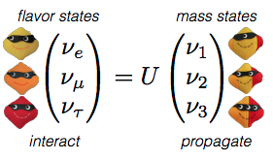
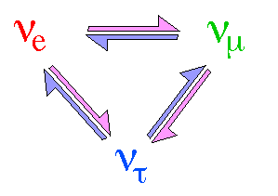
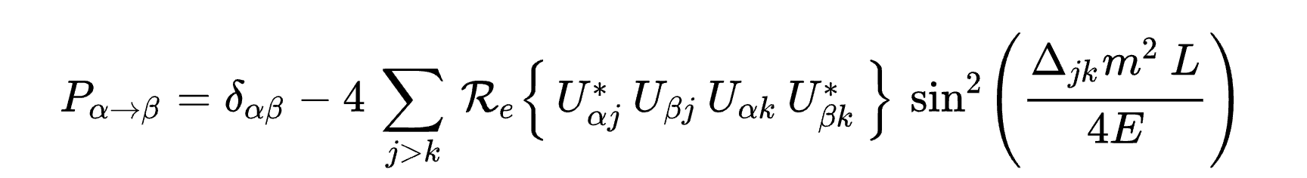
Neutrinos in the Standard Model
Current picture
3 types of neutrinos corresponding to three lepton generations
Neutrinos are massless in the SM
Electrically neutral and weakly interacting
Neutrino oscillations are evidence for the non-zero mass of the neutrino (BSM physics)
6

Slide 6
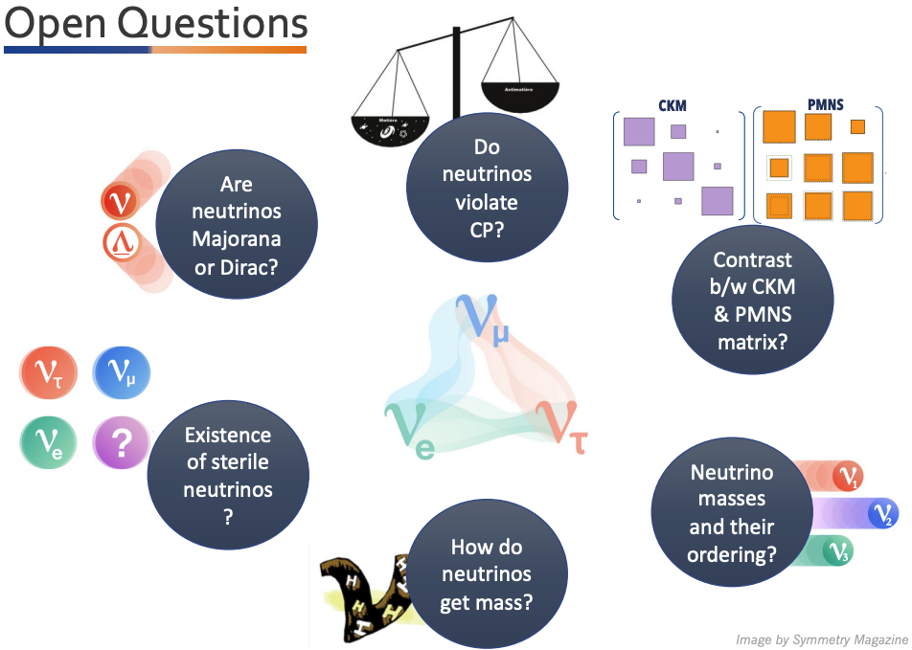
Neutrinos in the Standard Model:
- Open Questions
Many of these questions are studied with oscillation experiments
7

Slide 7
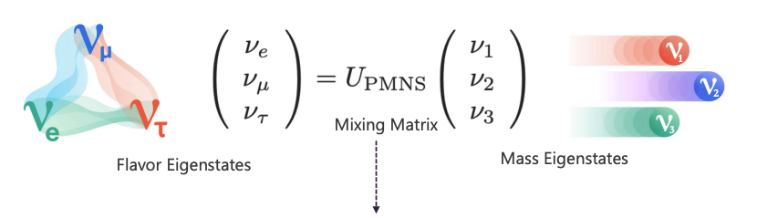
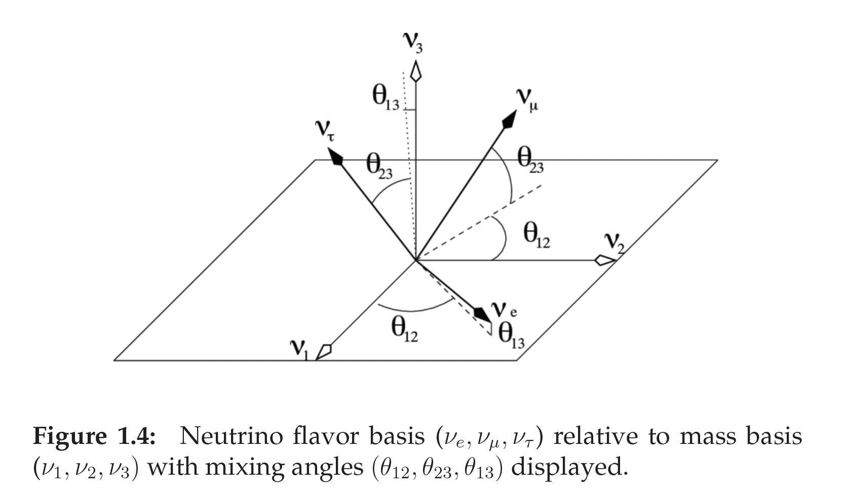
Neutrino Oscillations: 3-neutrino picture
Any quantum state can be written as a superposition — a linear combination — of a complete set of basis states.
Not an approximation: this is how quantum states work. Flavor (νe,νμ,ντ) and mass (ν1,ν2,ν3) are two different, equally valid bases for describing the same neutrino.
Same idea as an ordinary vector: written in the standard x-y axes, or in a rotated x′-y′ axes — same vector, different coordinates.
The two sets of coordinates are related by a matrix — the change-of-basis matrix. That matrix is the PMNS matrix.

Slide 8
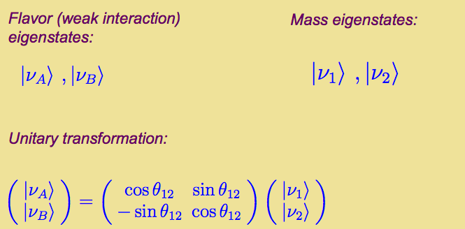
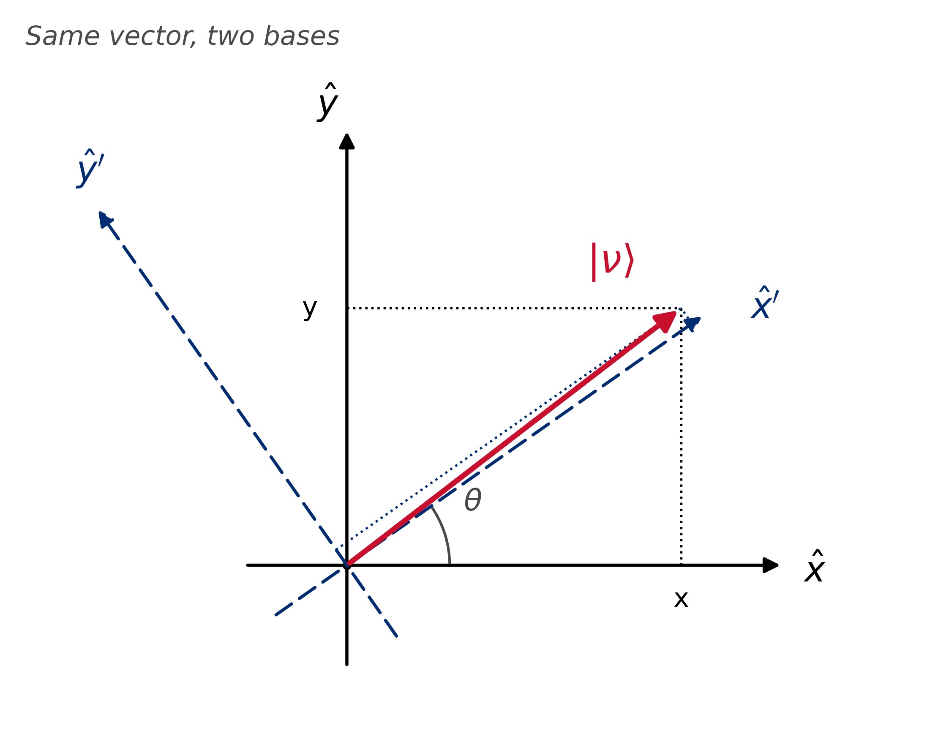
Two state system: Two-neutrino approximation
There are only two types of neutrinos: electron and muon.
The entire phenomenon takes place in a vacuum during the propagation from the Sun to the Earth

Slide 9
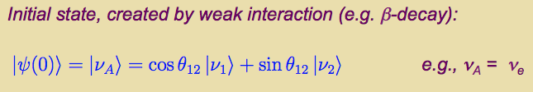
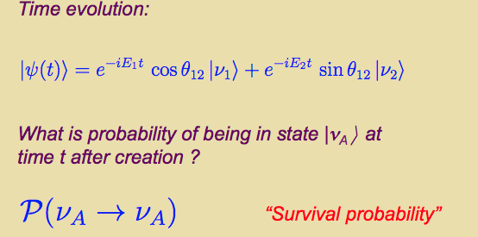

Slide 10
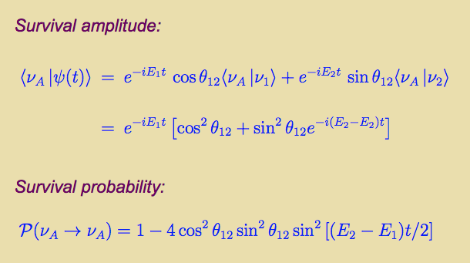
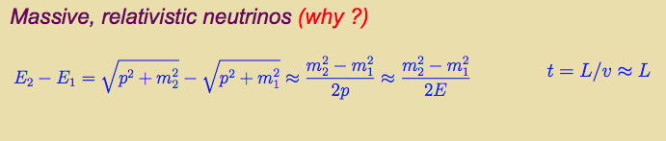

Slide 11
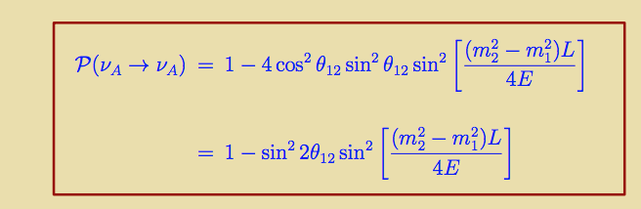
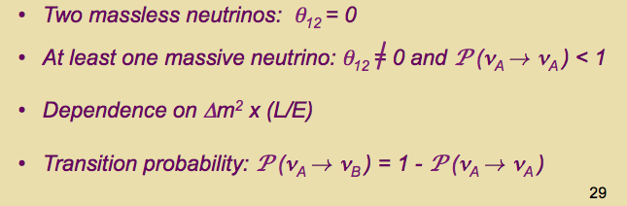

Slide 12
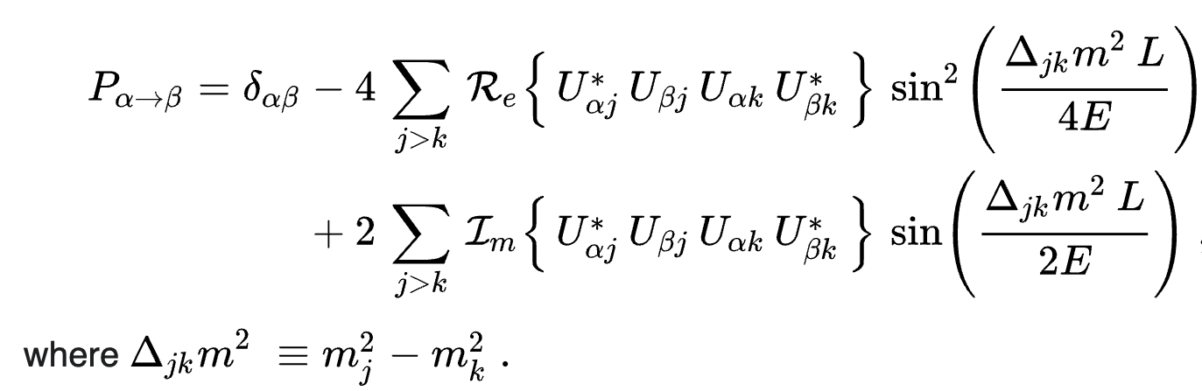
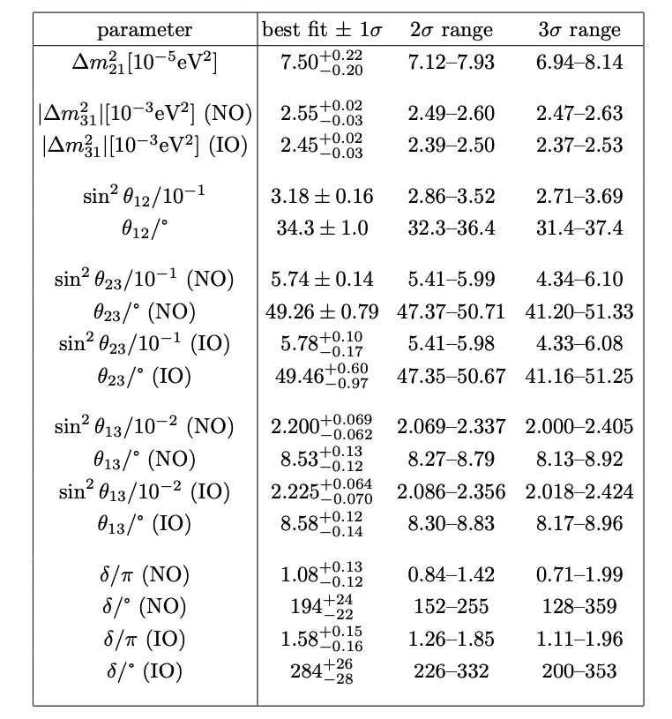
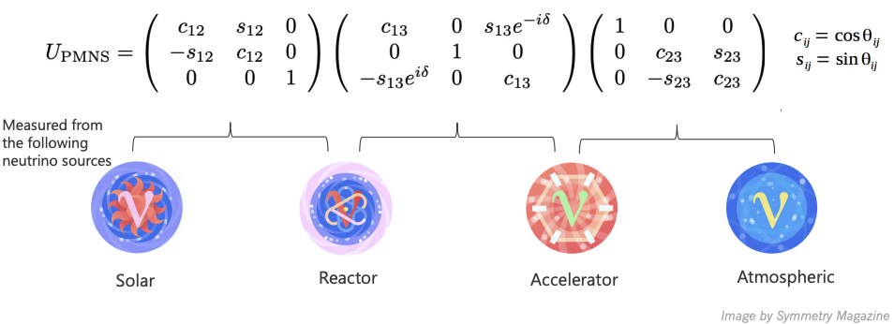
Neutrino Oscillations: 3-neutrino picture
Oscillation probability

Slide 13
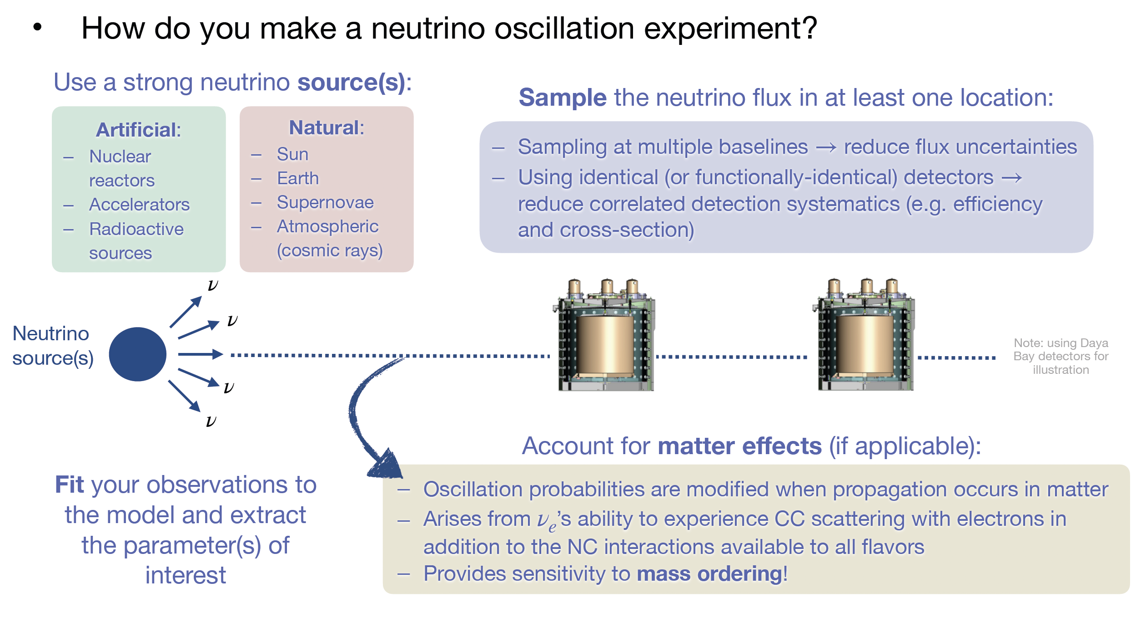
Anatomy of a Neutrino Oscillation Experiment

Slide 14
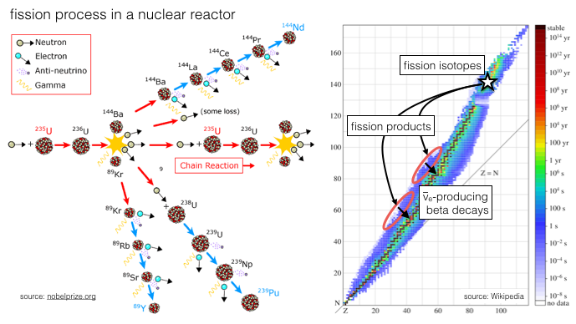
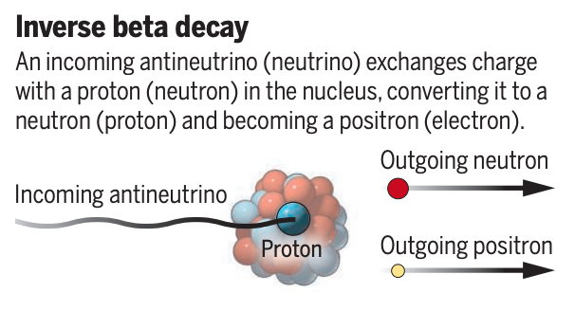
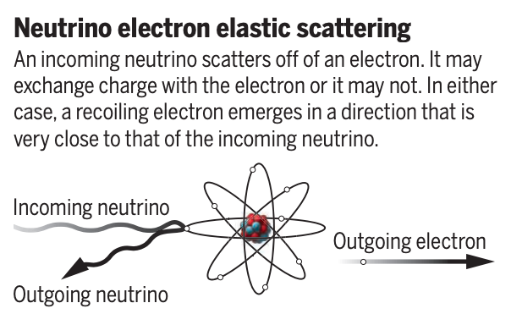
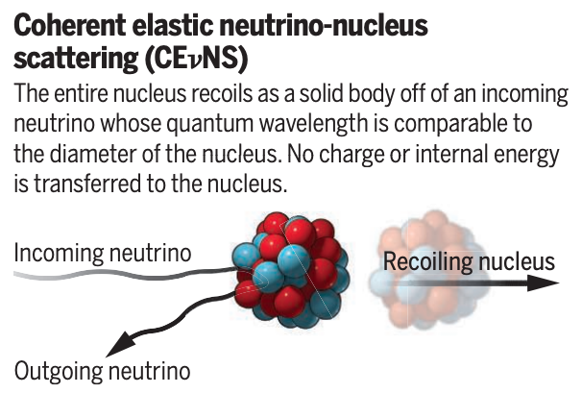
Neutrino oscillations with reactors
Nuclear reactors are the most intense terrestrial sources of neutrinos
They produce an immense flux of antineutrinos in the MeV range.
Flavor pure, only electron antineutrinos are produced
Allow for proximity to the source, and it is usually paid by others
Link J M 2017 Scattering neutrinos caught in the act Science 357 1098–1099 URL https://www.science.org/doi/abs/10.1126/science.aao4050

Slide 15
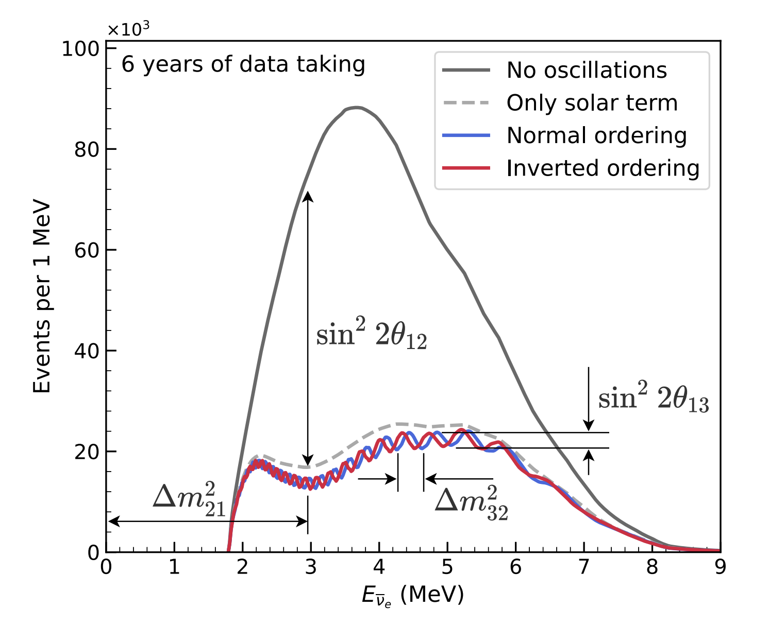
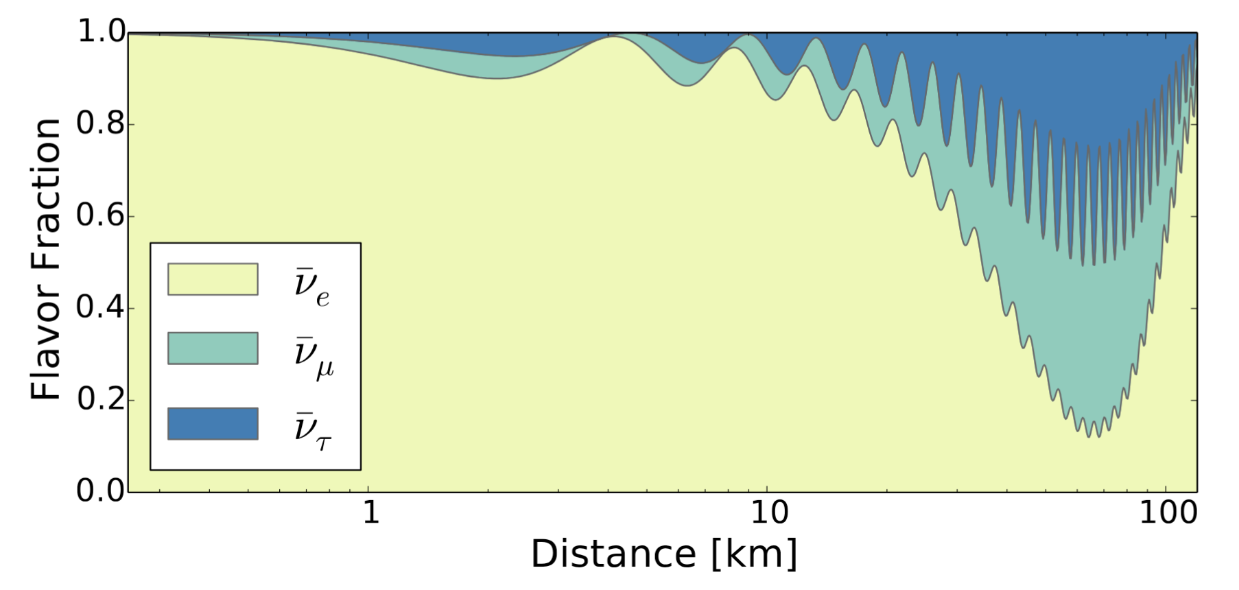
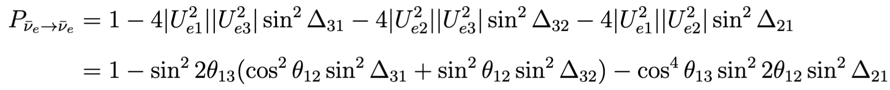
Neutrino oscillations with reactors
Expected spectrum for JUNO (L = 53 km)
Expected flavor composition of the Rx flux as
a function of L for 4 MeV neutrinos.
Only disappearance channel available at current distances for MeV neutrinos

Slide 16
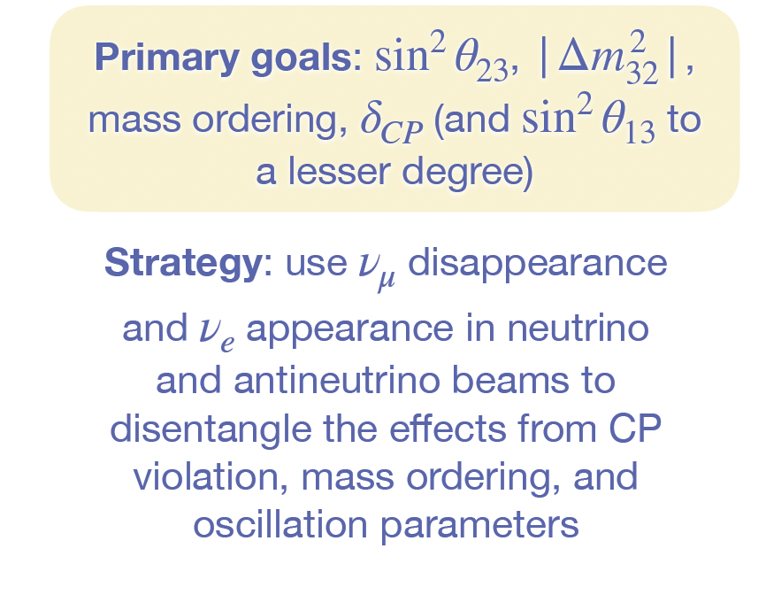
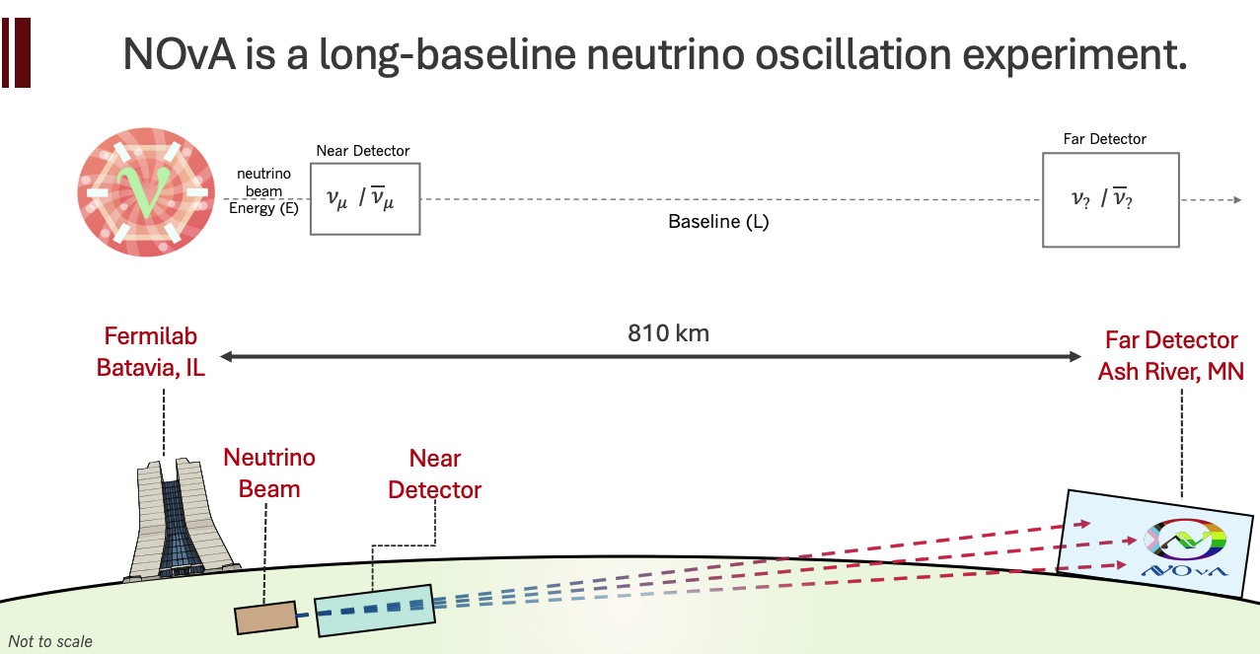
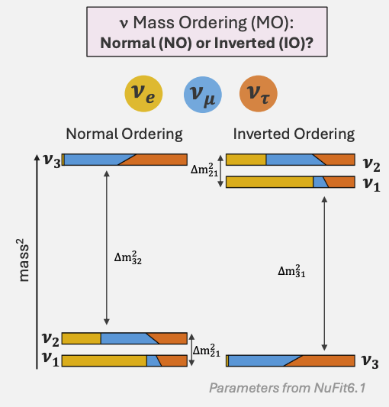
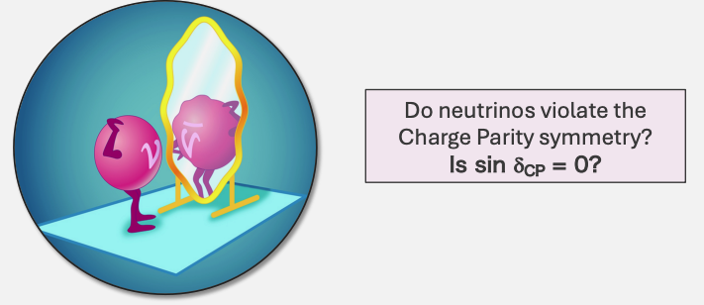
Neutrino oscillations with accelerators

Slide 17
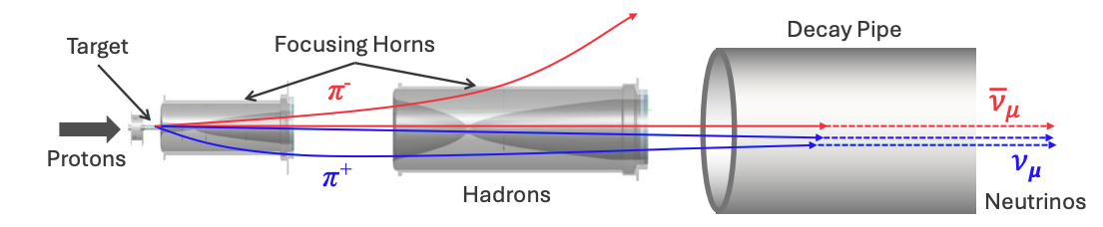
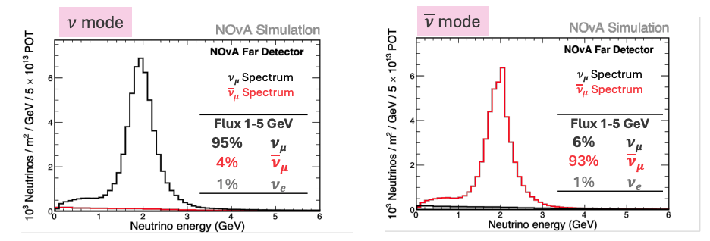
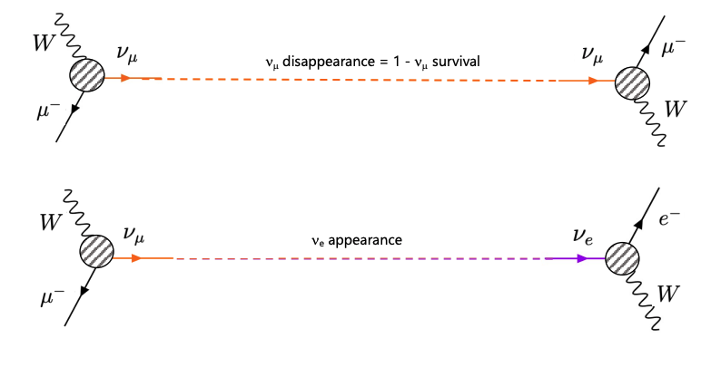
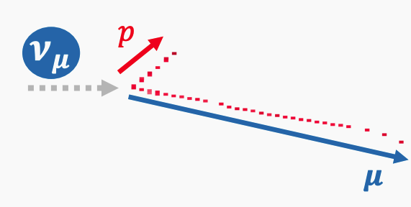
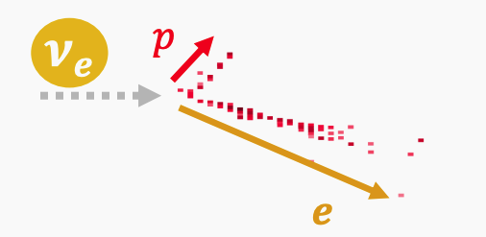
Neutrinos in NOvA:
Two complementary oscillation channels at the FD:
Muon (anti)neutrino disappearance
Electron (anti)neutrino appearance

Slide 18
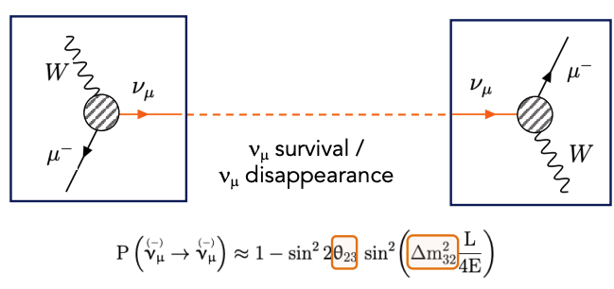
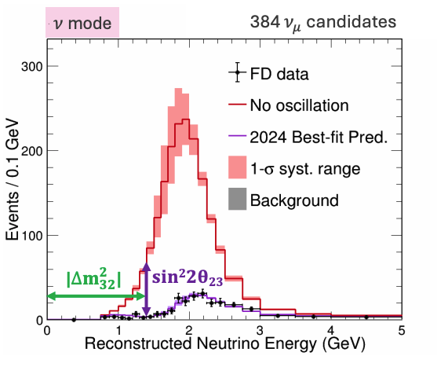
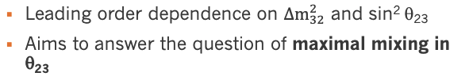
Neutrinos in NOvA: Muon (anti)neutrino disappearance

Slide 19




Neutrinos in NOvA: Electron (anti)neutrino appearance

Slide 20


Neutrinos in NOvA: CC vs NC
CC — real event display
NC — schematic (illustrative)
Source: Vallari, NDM22 (2022)
No real NC display in source material — illustrative
W boson exchange
Produces a charged lepton matching flavor
The lepton is the flavor tag: μ → long track, e → shower
Z boson exchange
No charged lepton — just a hadronic shower
Same rate for every flavor — flavor-blind
Key idea: the charged lepton (or its absence) is what tells CC and NC apart

Slide 21


Reconstructing Oscillations: CC/NC Ratio, Near vs Far
Near Detector (~1 km) — before oscillation acts
Far Detector (810 km) — after oscillation
A different ratio at Far than Near ⇒ oscillation occurred — no absolute flux prediction needed

Slide 22
Summary
Neutrinos: nearly massless, electrically neutral, and barely interacting yet essential to understanding matter, stellar energy loss, and physics beyond the Standard Model.
Oscillations: the direct proof that neutrinos have tiny but nonzero mass. Flavor states are superpositions of mass states that quantum interference lets a neutrino born as one flavor arrive as another.
NOvA: turns that effect into a measurement: comparing CC and NC rates at the Near and Far detectors reveals muon-neutrino disappearance over 810 km — exactly what you will do during the workshop.
The math you saw today, superposition, change of basis, interference, is the same math behind every result in this field. Enjoy the workshop, and thank you for bringing this into your classrooms!

Slide 23
Backup

Slide 24



PROSPECT Motivations and Goals: Sterile Neutrinos?
Sterile Neutrino, 3+1 Scenario
Expanding PMNS matrix to include sterile neutrino components
Sterile Neutrino searches become simpler at short baseline
Sin²(2𝜃) modulates the oscillation amplitude
Δm² is the oscillation phase
Δm² assumed to be ~1eV²
https://doi.org/10.1016/j.physrep.2021.06.002
12
Notes:
In fact, some of the results from these theta13 focused experiments provided us with intriguing puzzles that serve as motivation for the the PROSPECT experiment.
One of these puzzels corresponds to a deficit in the measured IBD yield with respect to model prediction.
This result led to the hypothesis that there could be neutrinos undergoing ev-scale oscillations into an active-sterile state.
This served as the first physics goal for PROSPECT, corresponding to designing an experiment capable of looking for meter s

Slide 25





Motivation for an SBL program: Experimental Anomalies
Electron (anti)neutrino appearance
LSND
MiniBooNE
From P5
Over the past decades neutrino oscillation searches at length/distance scales of 1 MeV/m have found a number of anomalous results: The liquid scintillator neutrino detector (LSND) anomaly, the reactor antineutrino anomaly, the MiniBooNE low-energy excess and the gallium anomaly. These anomalies have not been confirmed, and the reactor antineutrino anomaly has been recently resolved.
Electron (anti)neutrino disappearance
Gallium
RAA

Slide 26


Global context for the RAA: What now?
Ambiguities interpreting LBL results
Need to nail down θ₁₄ and θ₂₄ to better than ~5 degrees to correctly interpret CPV results.
J. Phys. G: Nucl. Part. Phys. 49 (2022) 070501
CPV active+sterile sector can mimic CP-conserved LBL signatures
CP-conserved ones can look like CPV at DUNE
Can reduce mass hierarchy sensitivity
Need to constrain θ₁₄ in the region from 1 to more than 100 eV²

Slide 27


Need for more reactor-based data sets
Sterile oscillations remain an important plank in phenomenological discussions of the neutrino anomalies
Reactor experiments play a key role in an integrated global effort to understand these anomalies
Diversify dataset:
  MeV and GeV regimes
  Electron and Muon
  Disappearance and appearance
Extend model to more complex sterile neutrino scenarios: 3+1+NSI, 3+1+decays, ..

Slide 28



Extensions of the 3+1 formalism: 3+1+Decay
Global 3+1 models fail to fit the low energy excess reported by MiniBooNE
Considering more exotic models in which a sterile neutrino decays into active states could help explain this anomaly
Currently, this model predicts no excess in MiniBooNE data
As reactor data will be insensitive to these decays, more 3+1 disappearance data will help constrain this model
Phys. Rev. D 104, 095005 (2021)
Heavy neutral leptons only relevant at higher energies O(100) MeV

Slide 29




Extensions of the 3+1 formalism: 3+1+Decoherence
Reactor and radioactive sources experiments are ideal to study decoherence effects
Simple 3+1 picture assumes that neutrinos propagate as plane waves (PW)
Corrections accounting for finite-size wave packet (WP) have an impact on the dampening of the oscillation
Solid lines correspond to the combination of Daya Bay, NEOS and PROSPECT data
Phys. Rev. D 107, 036004 (2023)

