Slide 1

JHU QuarkNet
2019 Agenda

Slide 2
Topics
Marc
Who’s Coming
PM Work
Musings
For Fun (naughtier fun)

Slide 3
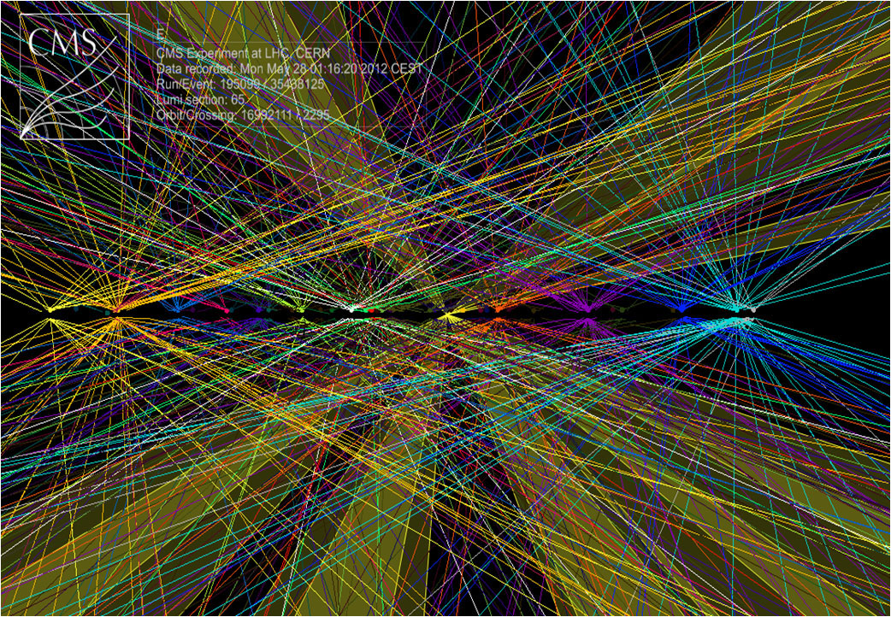
Mon
Morris: the High-Luminosity LHC/CMS Upgrade
Andrei: Probably something heady, as usual

Slide 4

Tue
B. Blair: JWST status
K. Hall: cool astro stuff (DM, black holes, cosmology)
K. Boddy:Dark matter constraining using the CMB

Slide 5
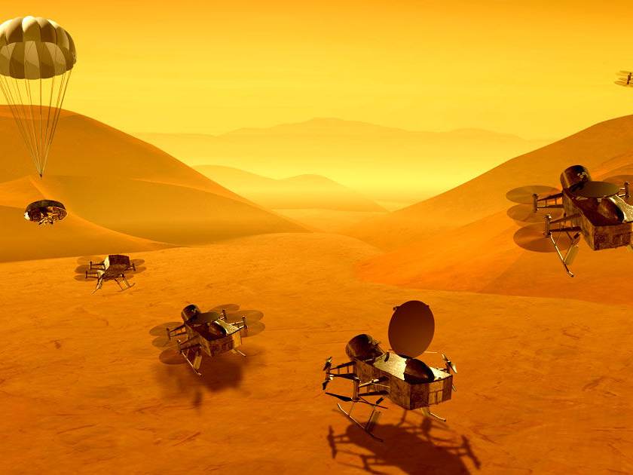
Wed
B. Leheny: squishy condensed matter
A. Barik: MHD
Sabine: who cares, she’s great

Slide 6
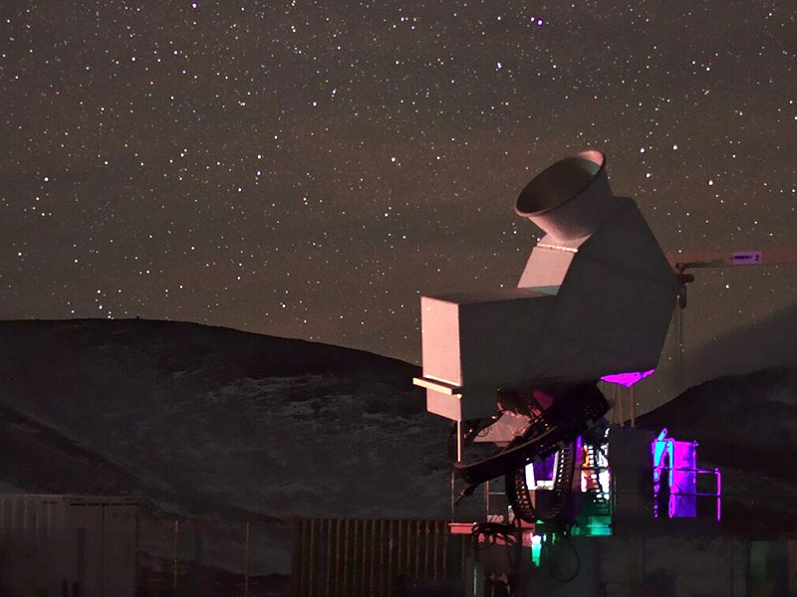
Thu
T. Marriage: CLASS
D. Kaplan: Dark Matter
S. Rajendran: Matters of Gravity

Slide 7
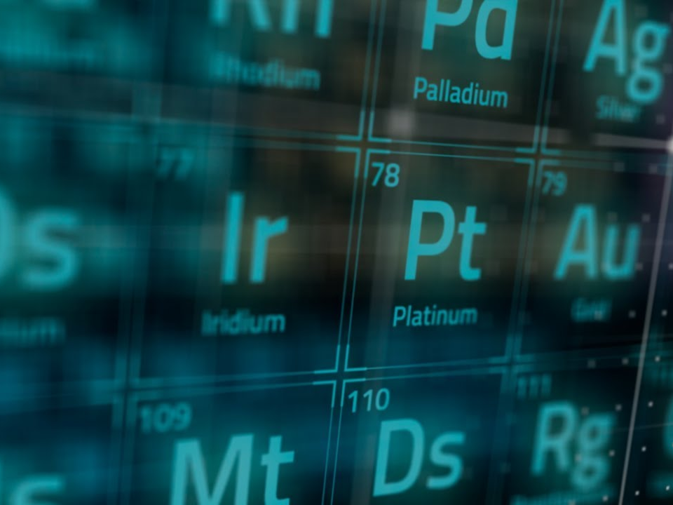
Fri
T. McQueen: Applied physics
V. Perera: moon history
Nima: who knows with that guy.

Slide 9
PM Stuff
Decent quality videos?
New Bauder application?
SRT workgroup
CRMD workgroup(s)
Fri: board assembly

Slide 11

Musings
What is science?

Slide 13
More Fun
The Everywhere Stretch
200k notes in 6 seconds
Pocket Black Hole

