Slide 1


Helpful Ideas
Nathan Unterman
University of Minnesota June 2022

Slide 2

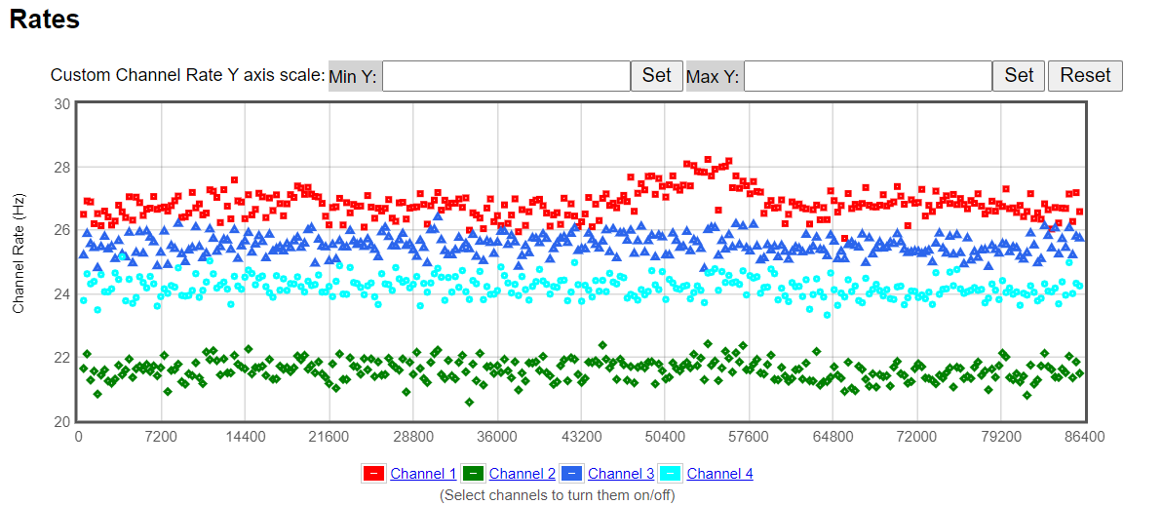
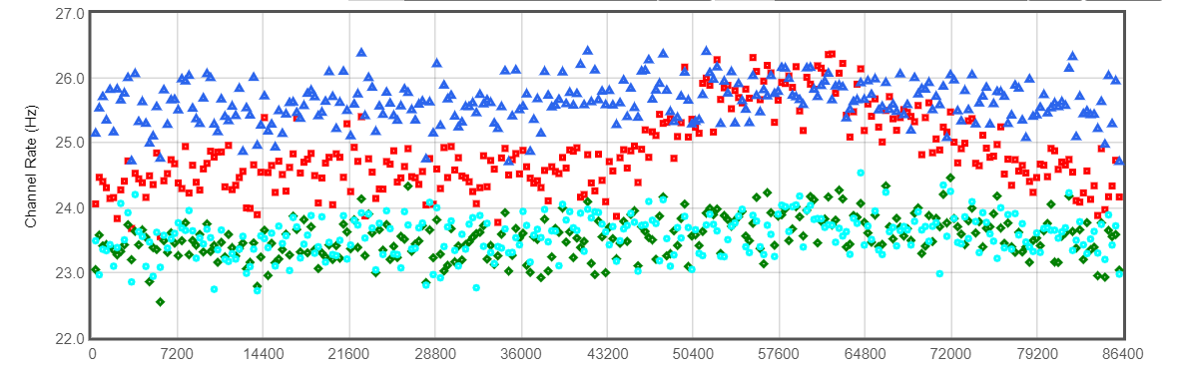
Detector Calibration
Plateau
Temperature sensitivity
Light leaks
Notes:
Plateauing has been done in previous workshops. See me for details. Instructions and templates are in the Library Resources of eLab.
Temperature: Sun, HVAC vent can cause variability in PMTs.
Light leaks – look for daily cycles.

Slide 3
Detector Calibration continued
Barometer Calibration and altitude limits (also accelerometer limits)
t₀ wire length/timing
Multiple detectors, normalization
Notes:
t0 is a hack.

Slide 4


Barometer Calibration
Does not work at altitudes above 3300 feet.
Many smartphones have a barometer. Use Physics Toolbox Suite or Phyphox to access.
On the Command Prompt in Equip, enter BA <Enter>
Returned information gives a 4-digit number and the pressure readind, Adjust the 4 digit number (voltage) by typing BA nnnn
Once the correct reading is received, enter ‘SA 1’
Notes:
Check calibration monthly. Some drift is normal. If it does not calibrate, file a Help Desk ticket.

Slide 5
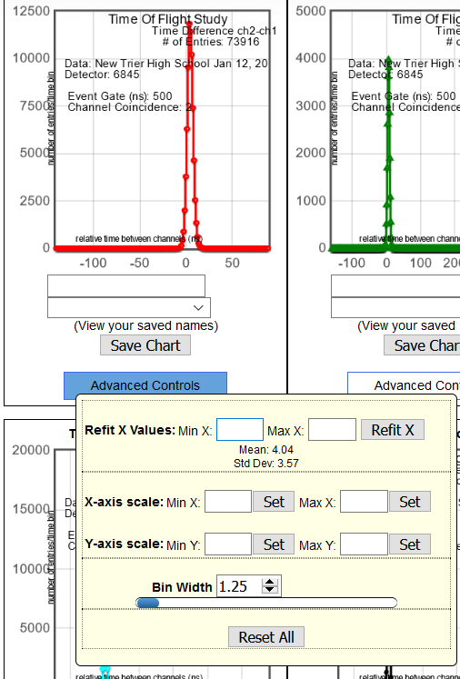
T₀ Wire Timing Calibration
Use Channel 1 as a reference (do not change)
Tightly stack Counter 1 with Counter 2. Disconnect the other channels. Do a minimum of 10 minute trial.
Analyze using the Time of Flight tool. The time should be under 0.1 ns. If yes, do the same with Counter 3, etc. If not:

Slide 6
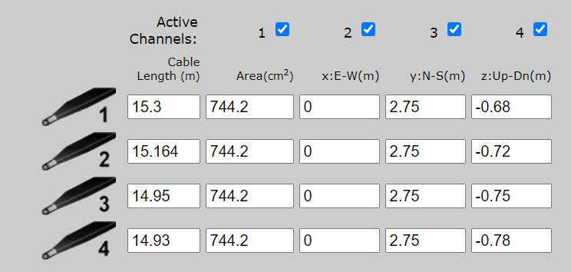
T₀ Wire Timing Calibration continued
In Geometry, adjust the Cable Length. It is about 4.9 ns per meter. Save and rerun Time of Flight. Keep changing iteratively until you are under 0.1 ns in TofF.

Slide 7
Multiple Detectors
BEST
  Run in same geometry in the same room at the same time.
ACCEPTABLE
  Run the same geometry at the same time.
Compare flux rates
Notes:
Find the typical ratios of the detectors, per channel.

Slide 8
Tools and Enhancements
Box for PDU and DAQ (Indoors box versus Outdoor box)
Spacers
Knobs and Standoffs
Labeling
Tape Measure
Inclinometer
Wire hygiene
Tote box
Shelving
Safety plaque

Slide 9
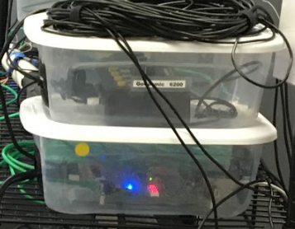
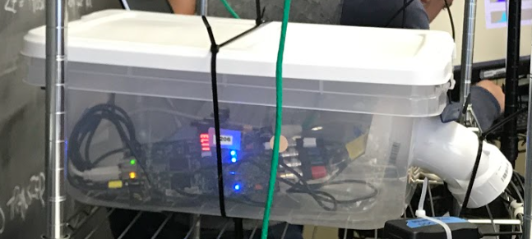
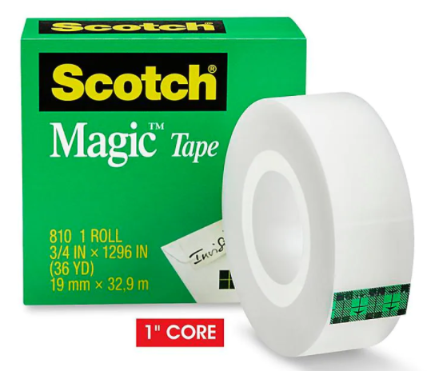
Tools and Enhancements continued
Box for PDU and DAQ
Indoor Outdoor
Spacer

Slide 10
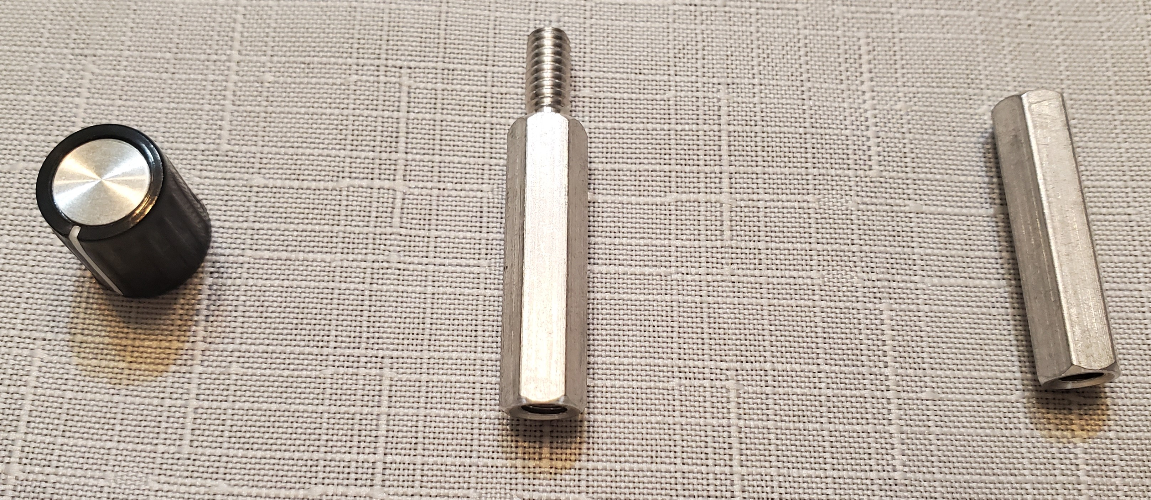
Knobs and Standoffs
Ribbed Knob 0.125” MPKG40B18 Digi-Key 679-3543-ND
OR Jameco Knob 1/8 “ JK-901D-3 .2 SKU 2239111
Stand Offs/Spacers
  Arndt Electronics 0.250” hex female 8 – 32 thread 2112-832A
  Arndt Electronics 0.0250” hex m/f 8 – 32 thread 4542-832A
OR Hex Standoff 4-40 Alum 1” 1772-1107-ND Digikey
  Hex nut 3/16” steel 4-40 SKU 36-4694-ND Digikey

Slide 11
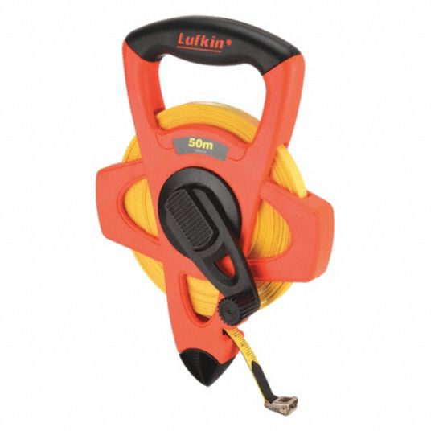
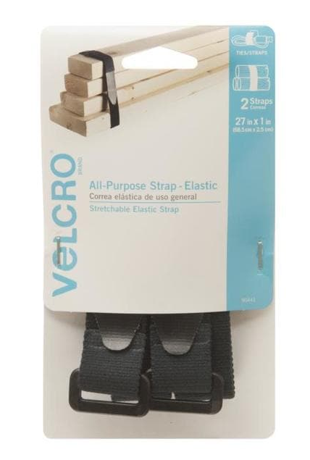
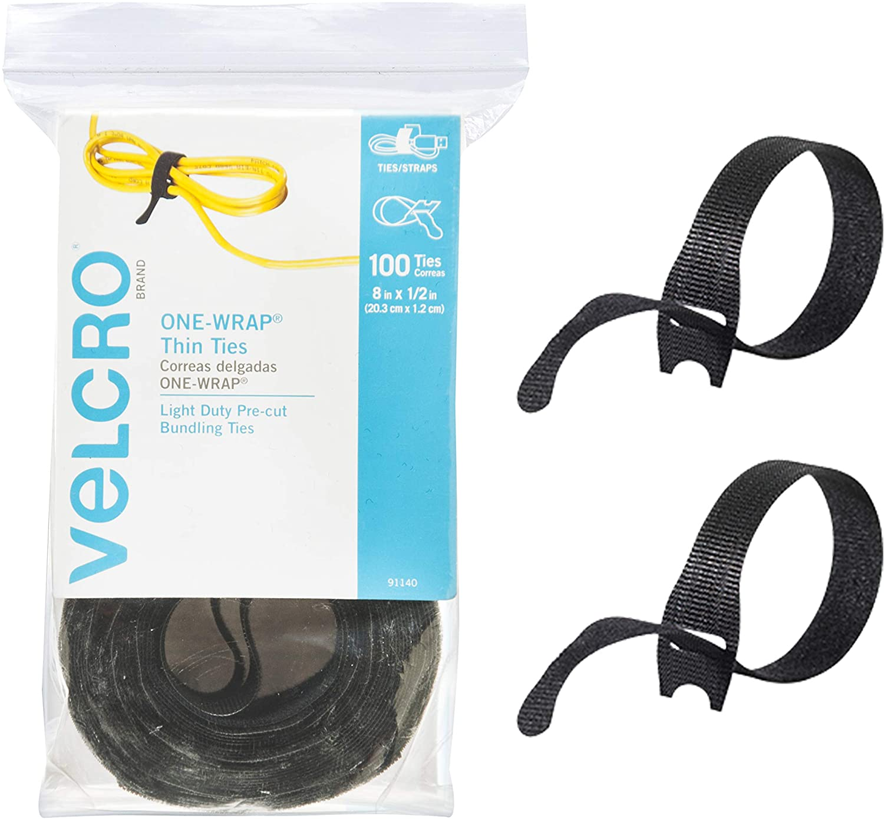
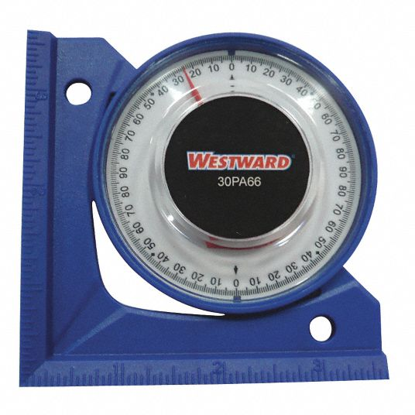
Tools and Enhancements continued
50 meter Tape Measure
Inclinometer Velcro Ties

Slide 12
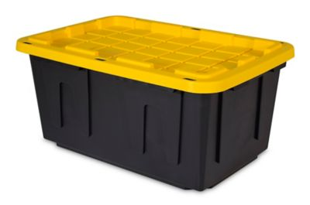
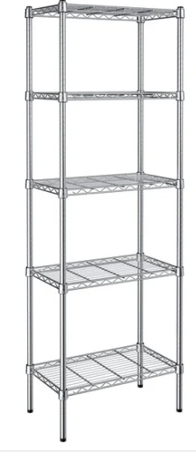
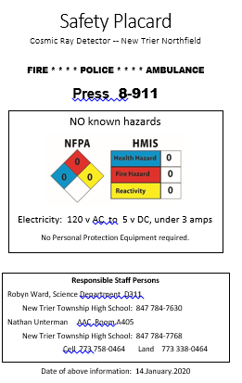
Tools and Enhancements continued
27 gallon Tote box Shelving Safety Placard

Slide 13
Computer
If you have problems interfacing with school network:
  Tell IT to set up the program, turn off updates, turn off sleep mode. Verify interface and data saving.
    Current Java Script problem
  Disconnect WiFi
  Shuttle data to eLab with thumb drive
  Local computer ID signon (NOT network)
Place sign: Experiment in Progress

Slide 14

Collaborations with Other Schools
Administrative cooperation
From school ‘rivals’ to ‘team cooperation’
Normalization of data
Control Detector

Slide 15
Posters
How CRMD works
Proposals
Experiments

Slide 16
Current Enhancements to eLab
Checking and Updating all links
Refining some help menus
Tandum information in Quarknet.org

Slide 17
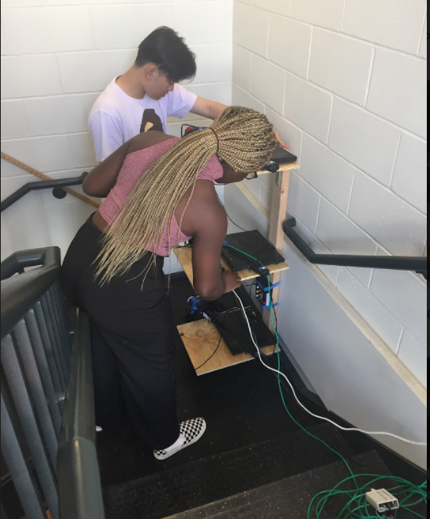
Questions?

Slide 18
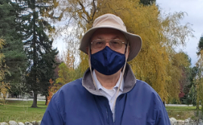
Contact
Nathan Unterman
nunterman@gmail.com
773 758-0464

